Slide 1
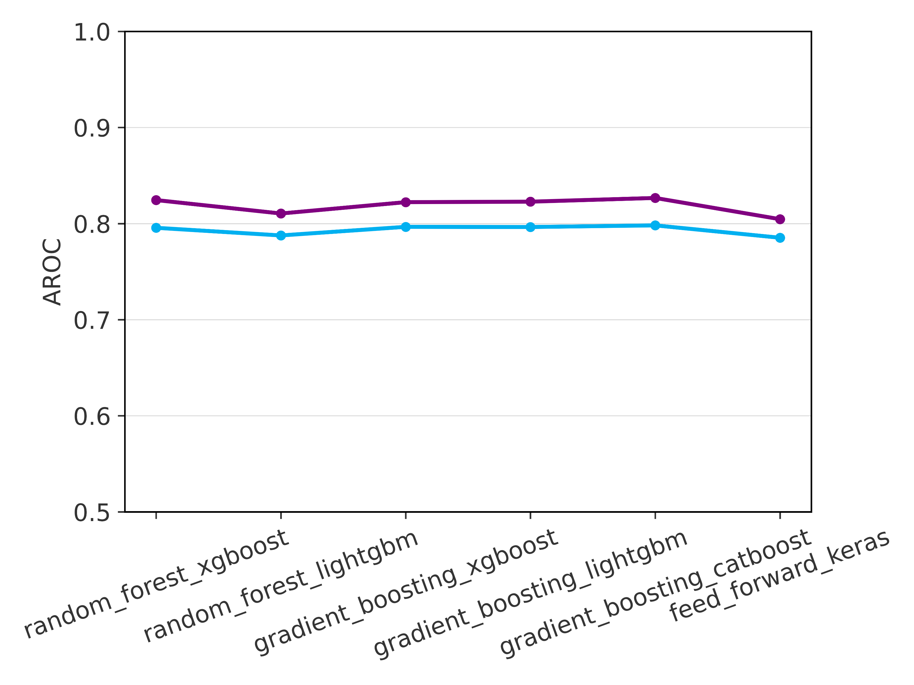
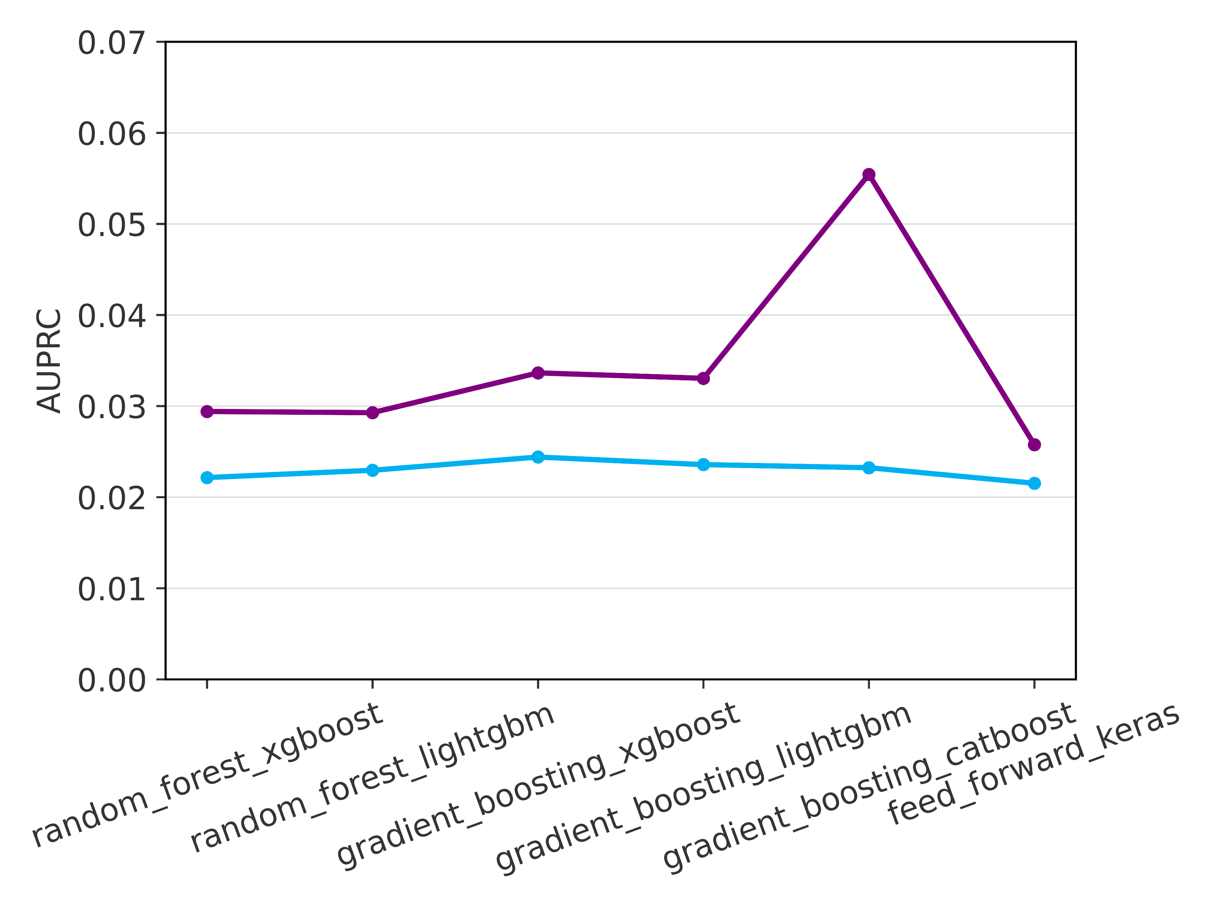
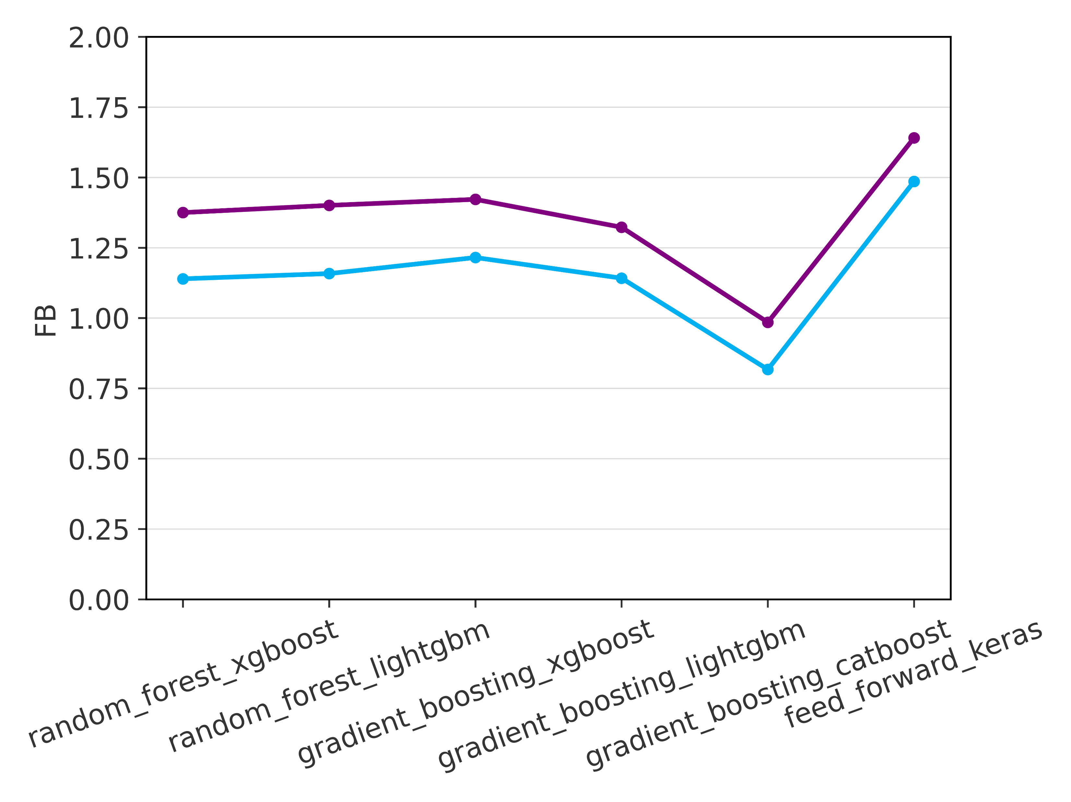
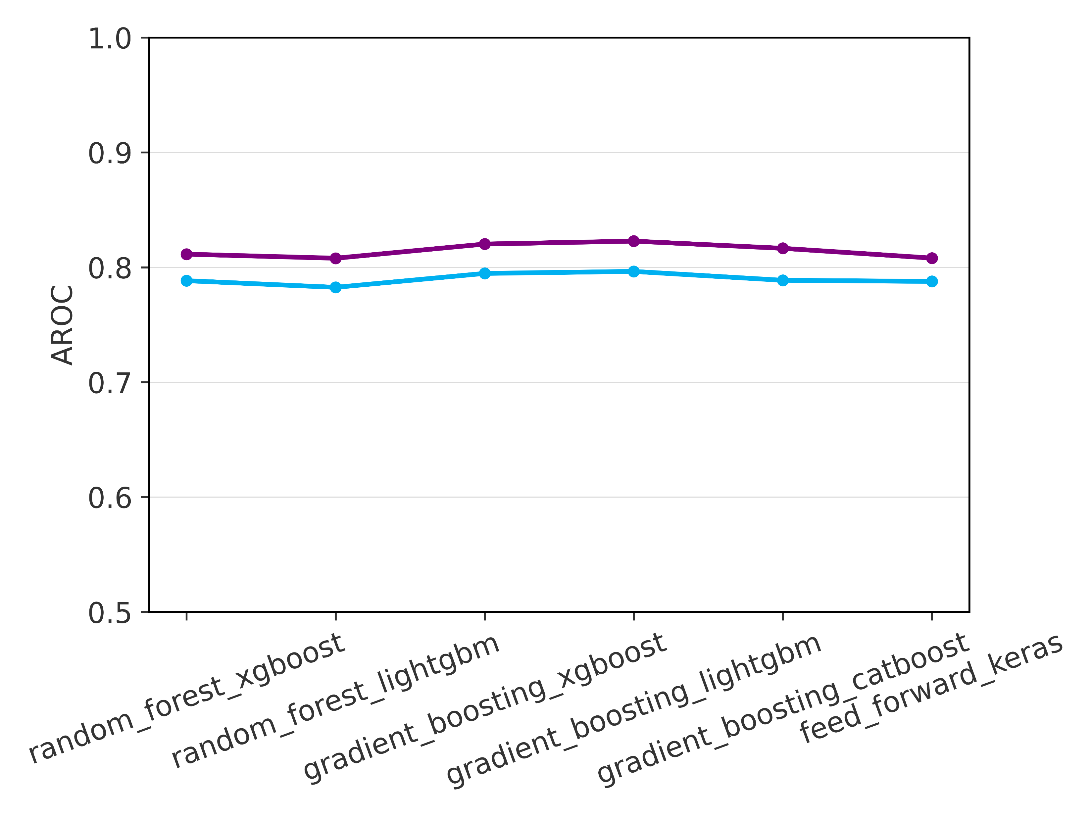
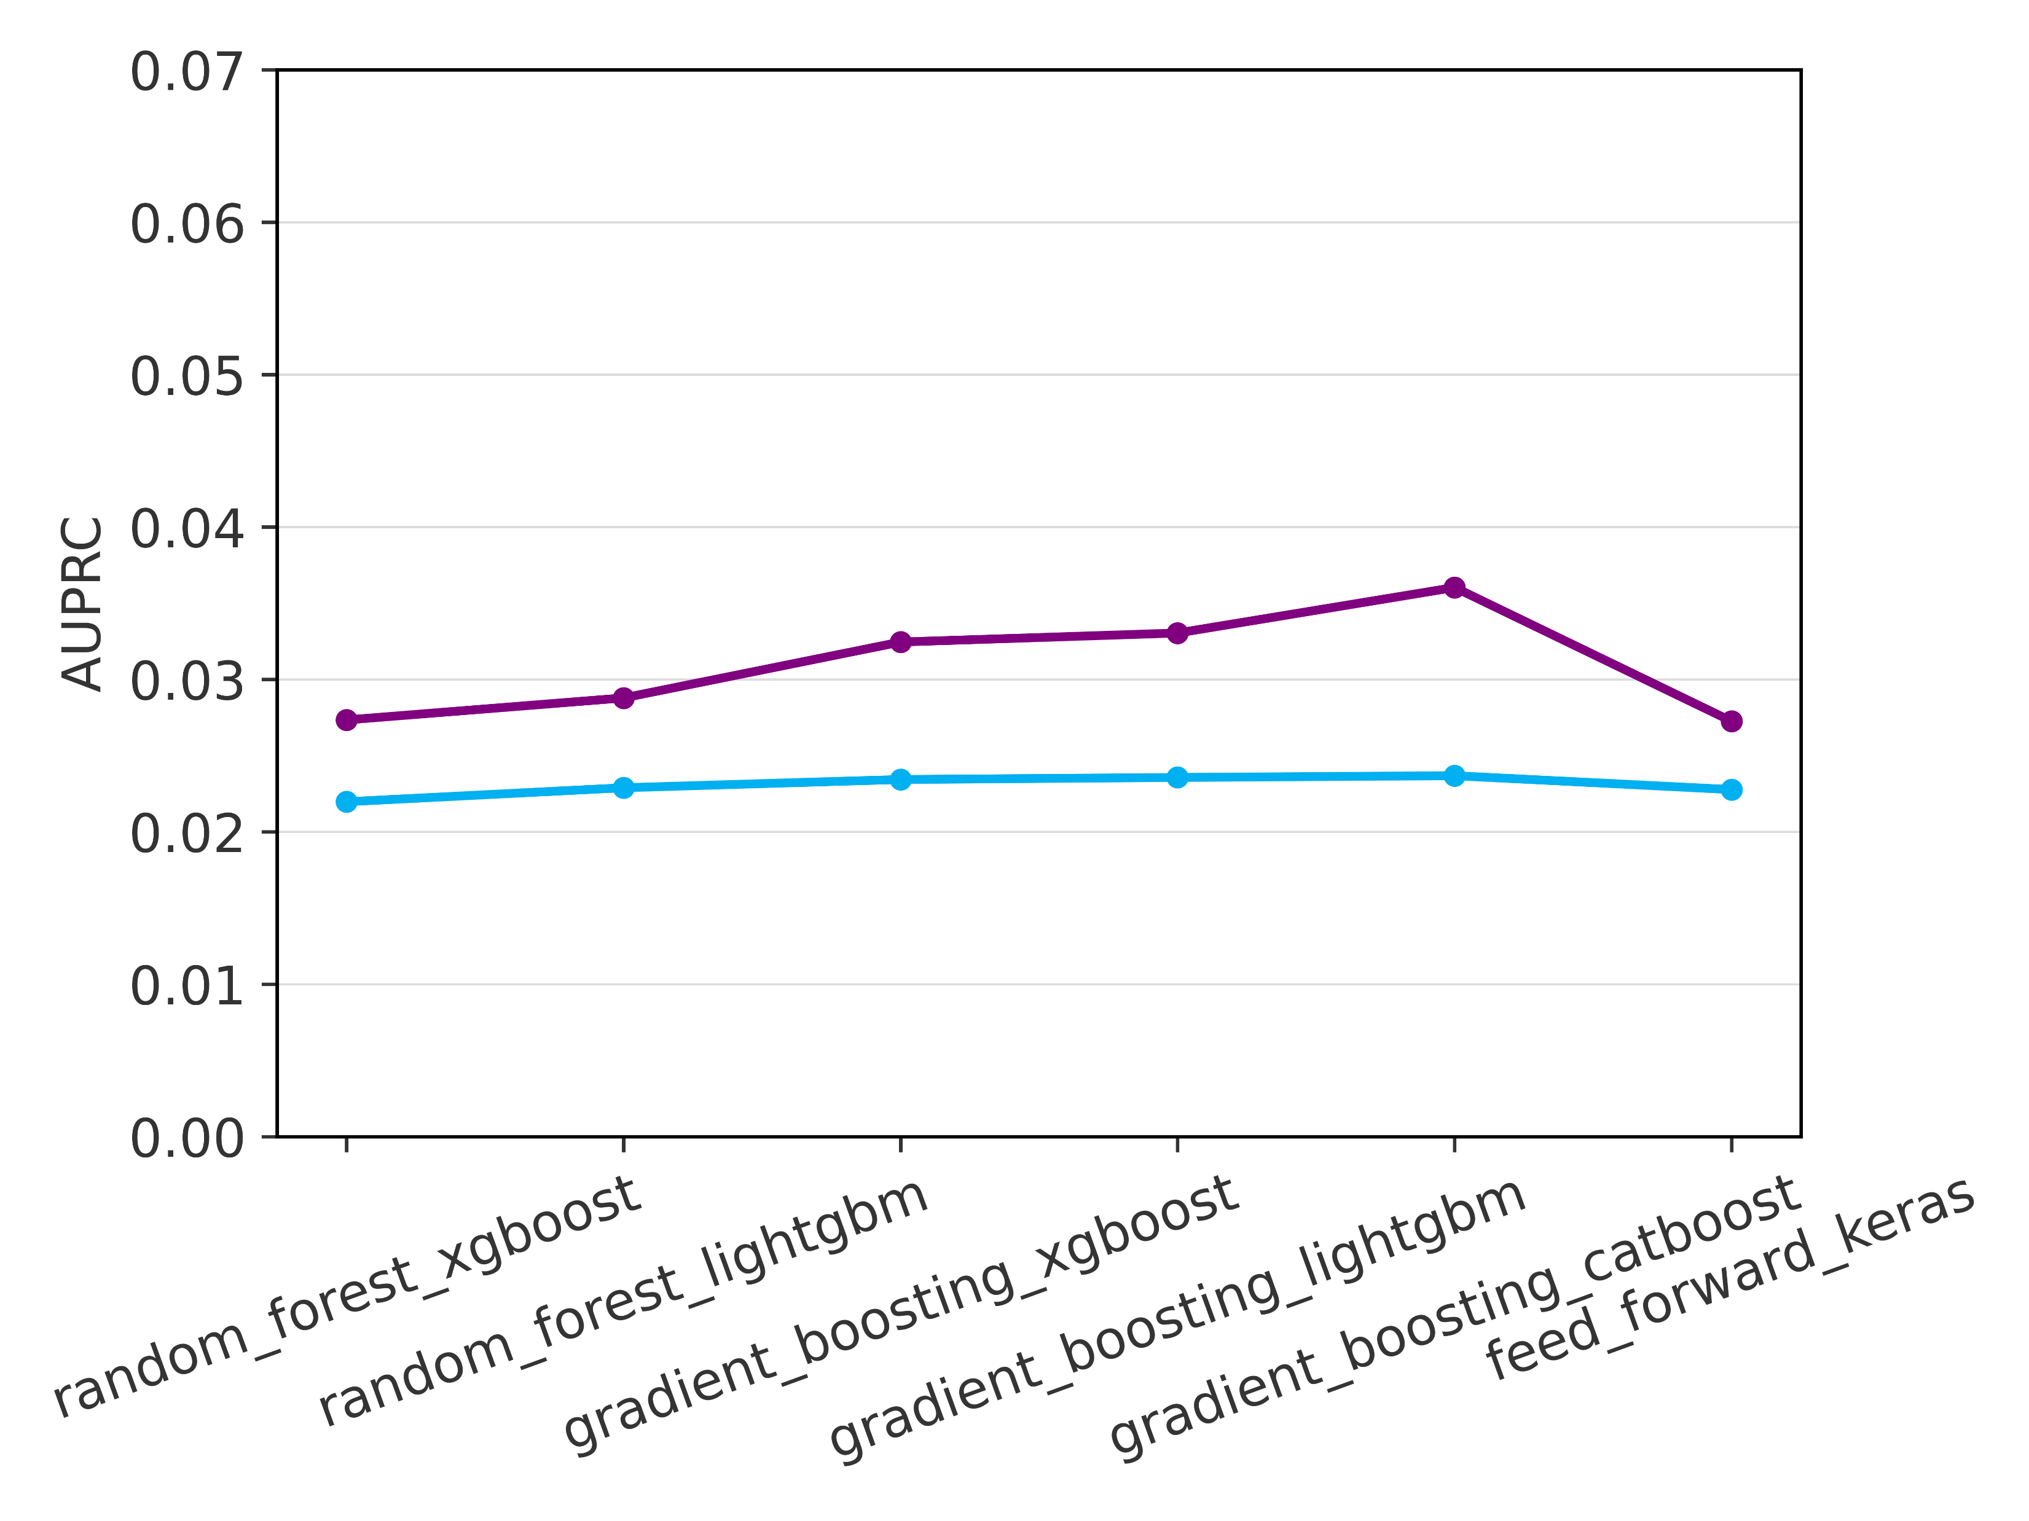
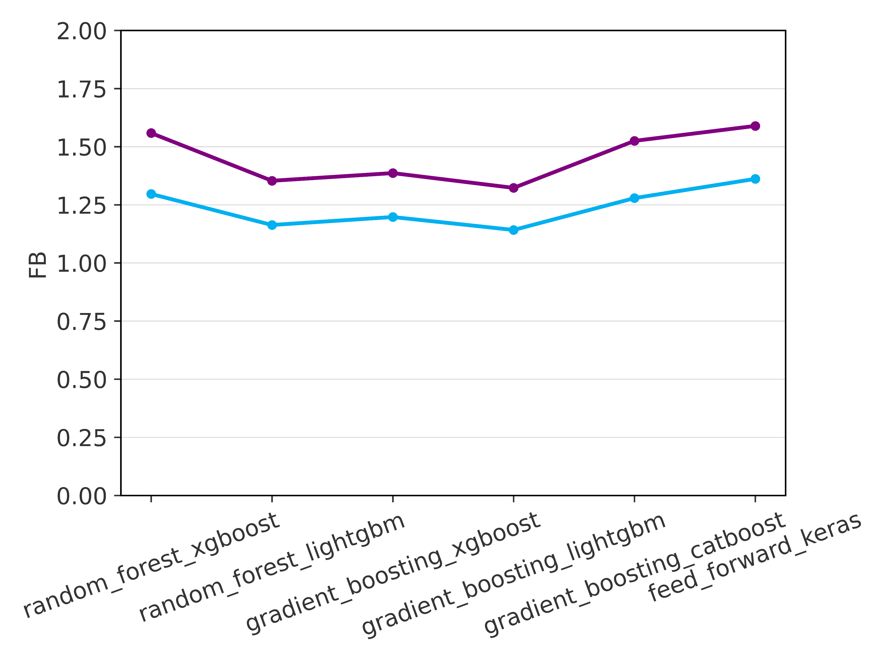
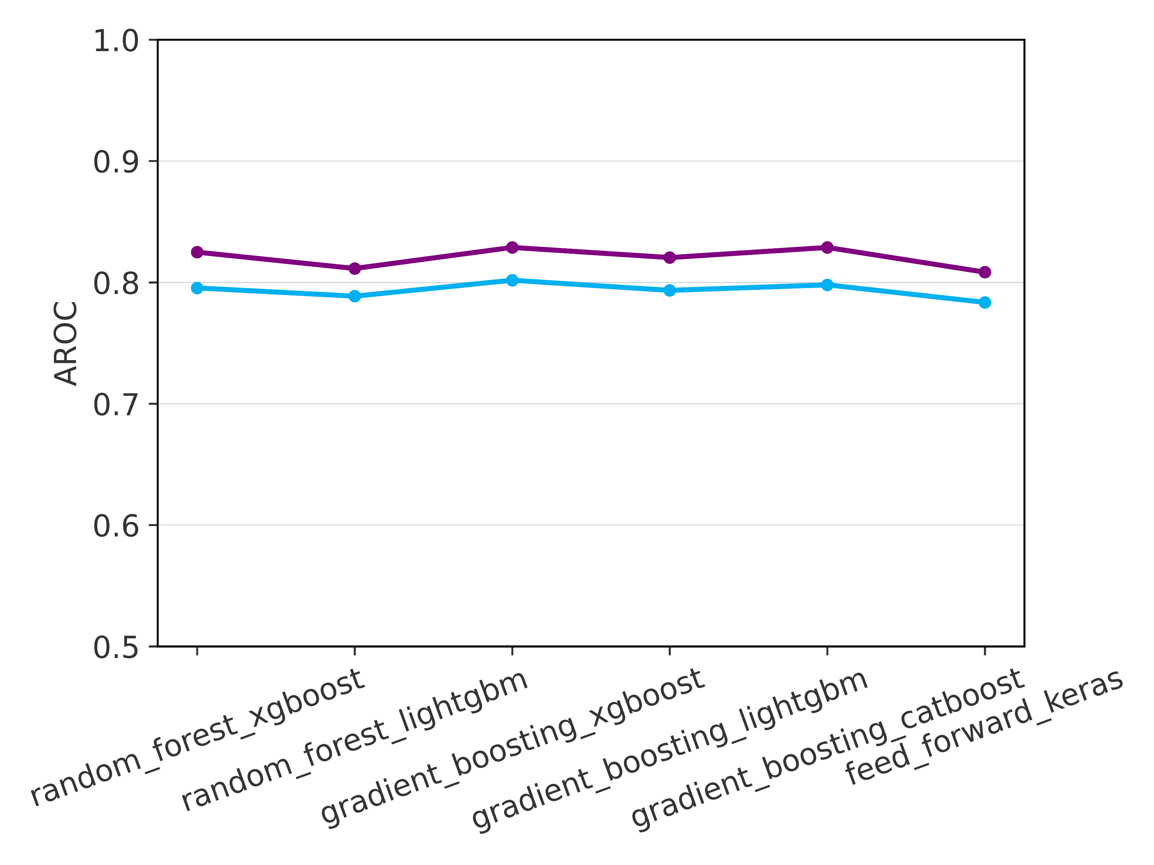
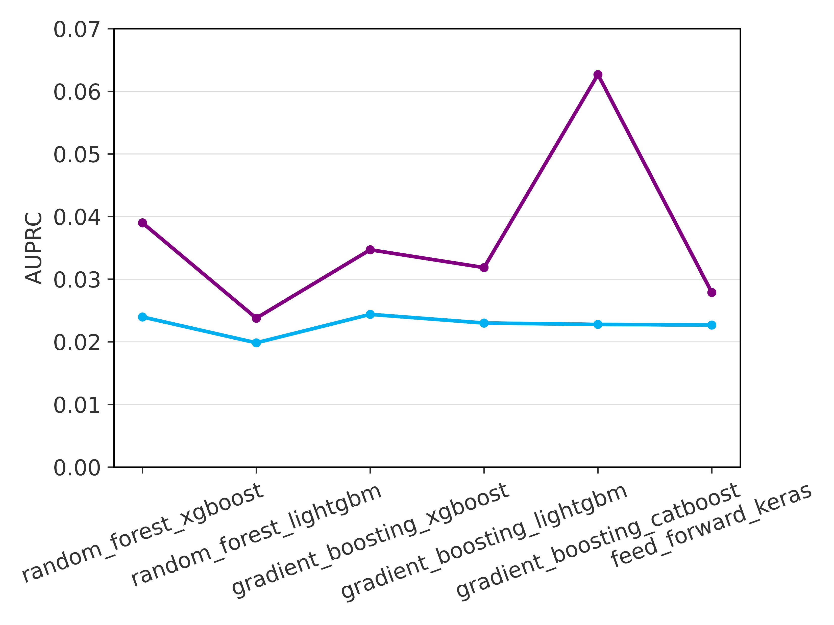
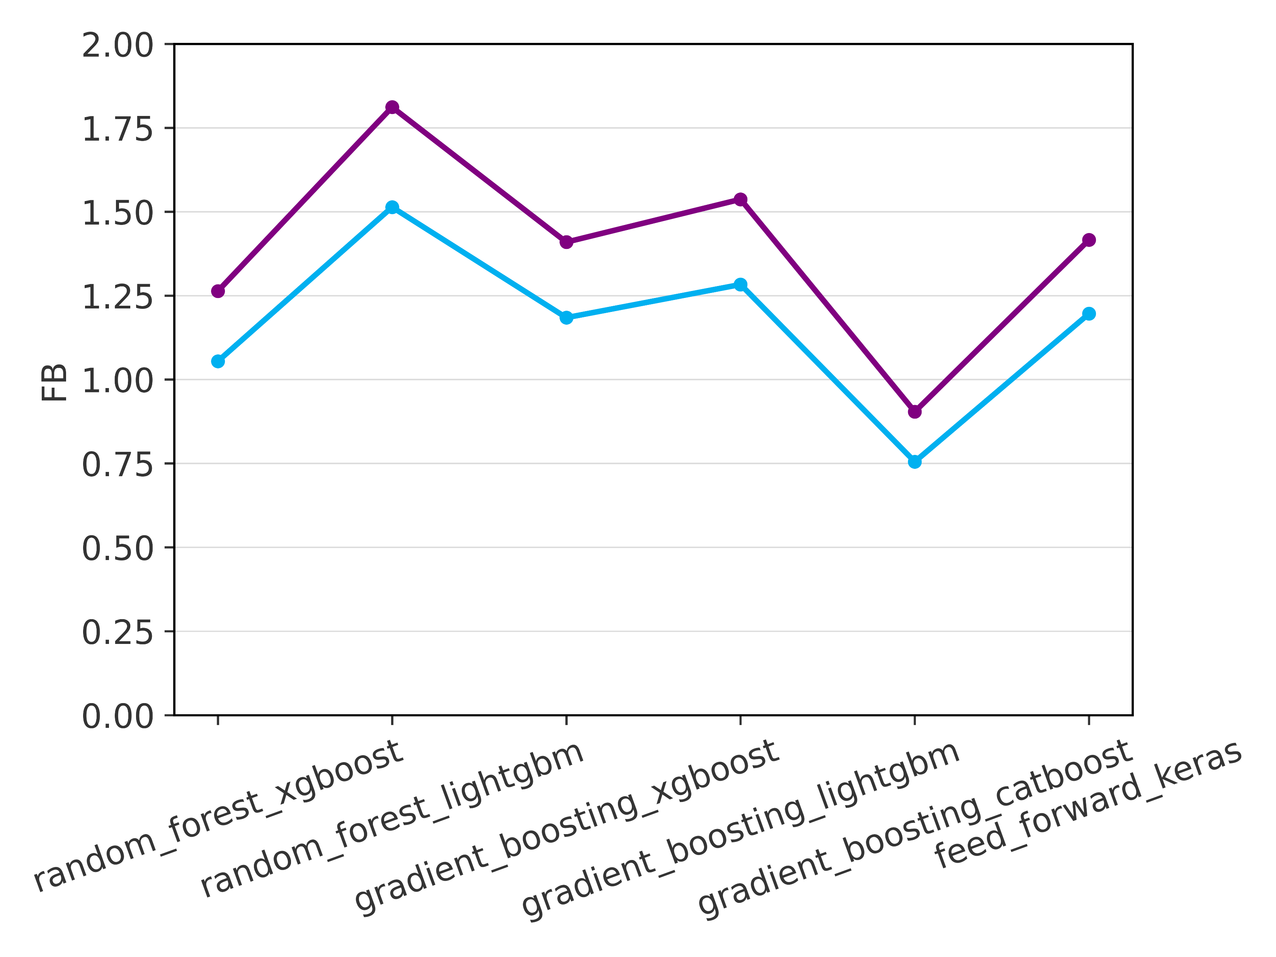
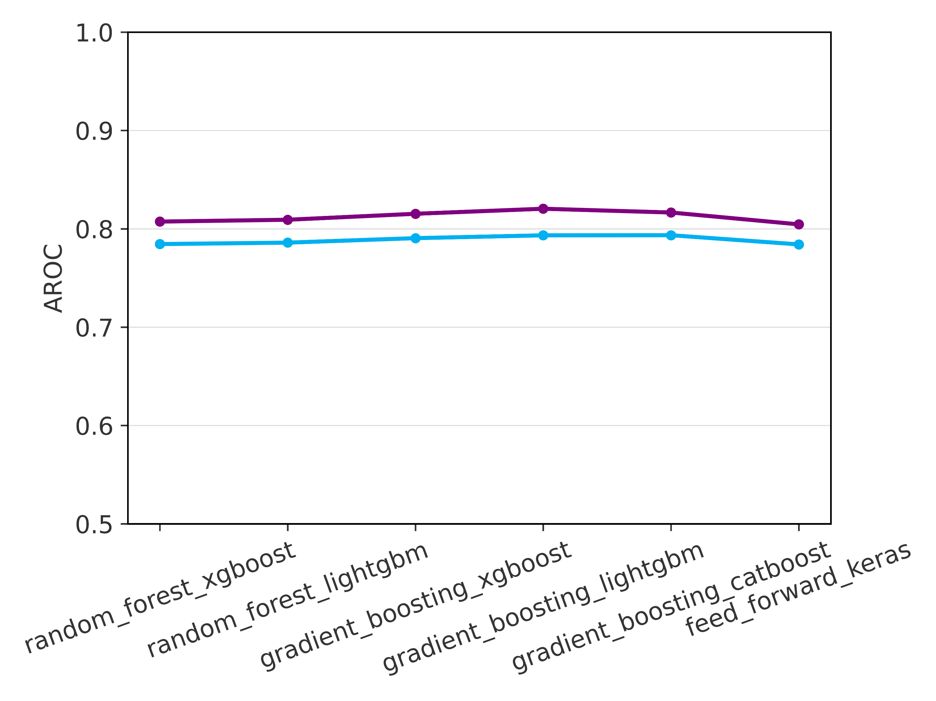
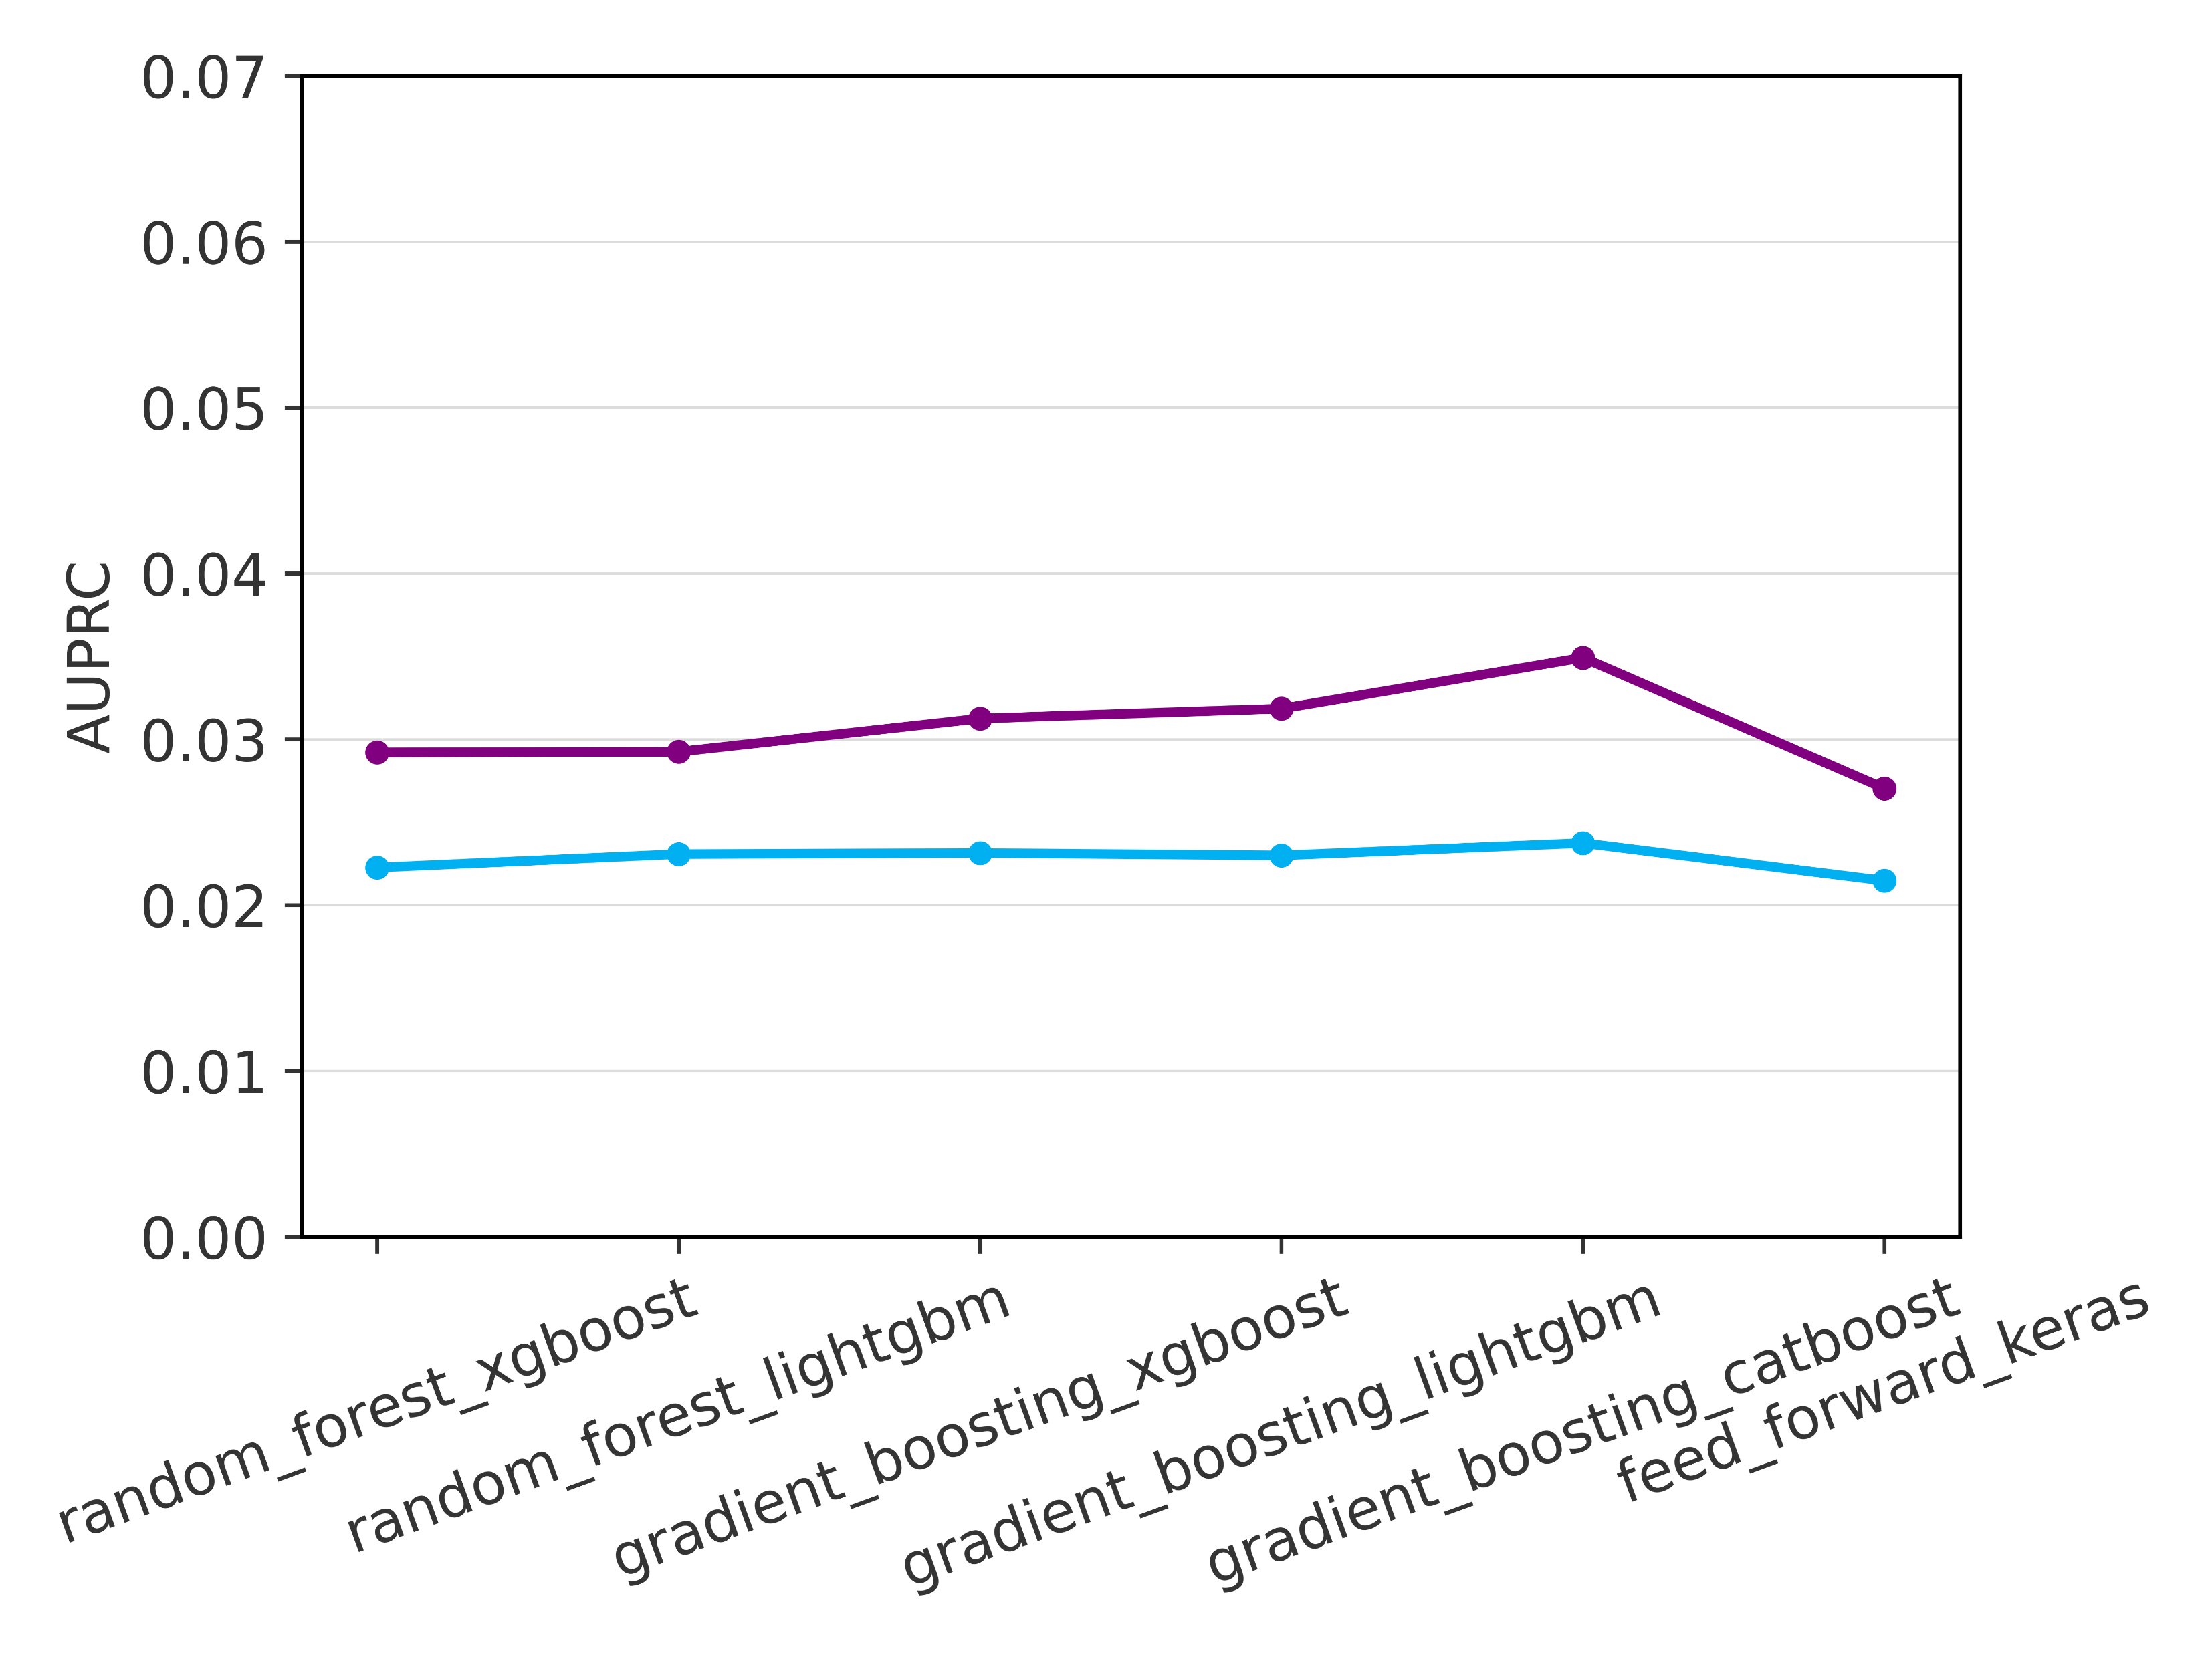
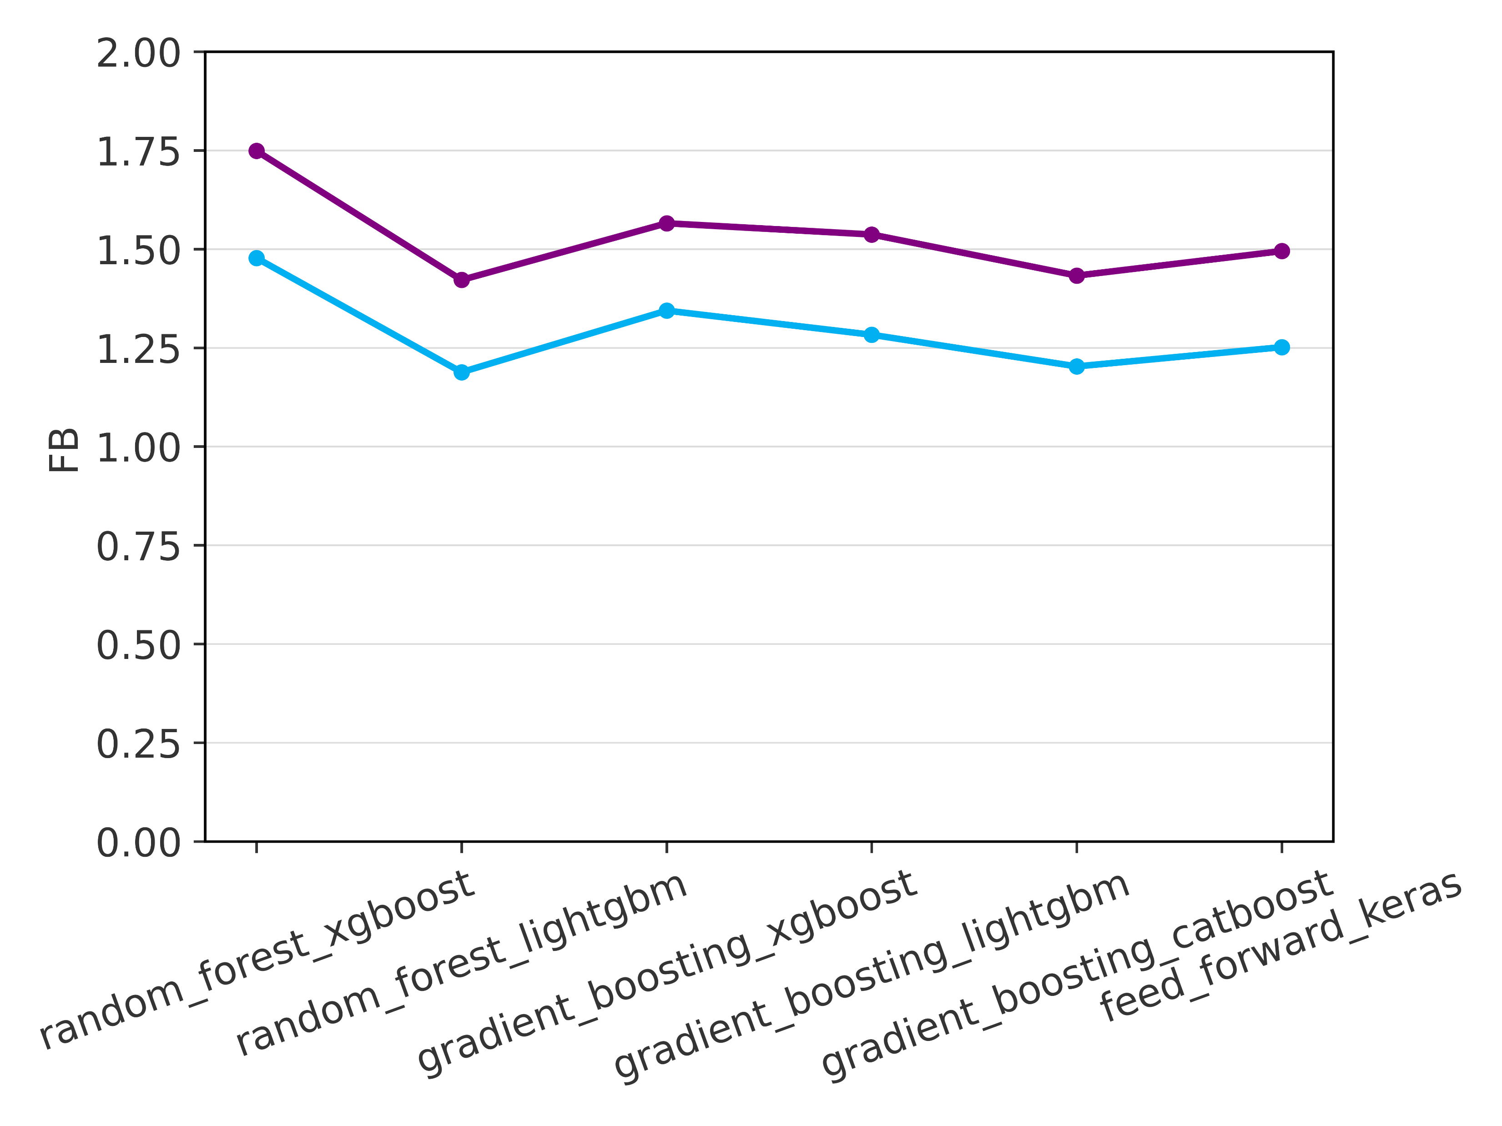
Verification results – Overall scores
Evaluated over the training and verification datasets
AUC-ROC
AUC-PR
FB
Loss Function - Balanced Data
1
0.07
2
0.9
0.06
1.75
0.05
1.5
0.8
0.04
1.25
Evaluation metric
AUC-ROC
0.03
1
0.7
0.02
0.75
0.6
0.5
a
0.01
e
0.25
i
0.5
0
0
1
0.07
2
0.9
0.06
1.75
0.05
1.5
0.8
0.04
1.25
Evaluation metric
AUC-PR
0.03
1
0.7
0.02
0.75
0.6
0.01
0.5
b
f
0.25
j
0.5
0
0
Loss Function - Imbalanced Data
1
0.07
2
0.9
0.06
1.75
0.05
1.5
0.8
0.04
1.25
Evaluation metric
AUC-ROC
0.03
1
0.7
0.02
0.75
0.6
0.01
0.5
c
g
0.25
k
0.5
0
0
Overprediction
1
0.07
2
0.9
0.06
1.75
0.05
1.5
Perfect bias
0.8
0.04
1.25
Evaluation metric
AUC-PR
0.03
1
0.7
No skill
0.02
No skill
0.75
Underprediction
0.6
0.01
0.5
l
d
h
0.25
RF - XGBoost
0.5
0
0
RF - LightGBM
GB - XGBoost
GB - LightGBM
GB - Catboost
Feed-Forward NN
RF - XGBoost
RF - LightGBM
GB - XGBoost
GB - LightGBM
GB - Catboost
Feed-Forward NN
RF - XGBoost
RF - LightGBM
GB - XGBoost
GB - LightGBM
GB - Catboost
Feed-Forward NN

