Slide 1
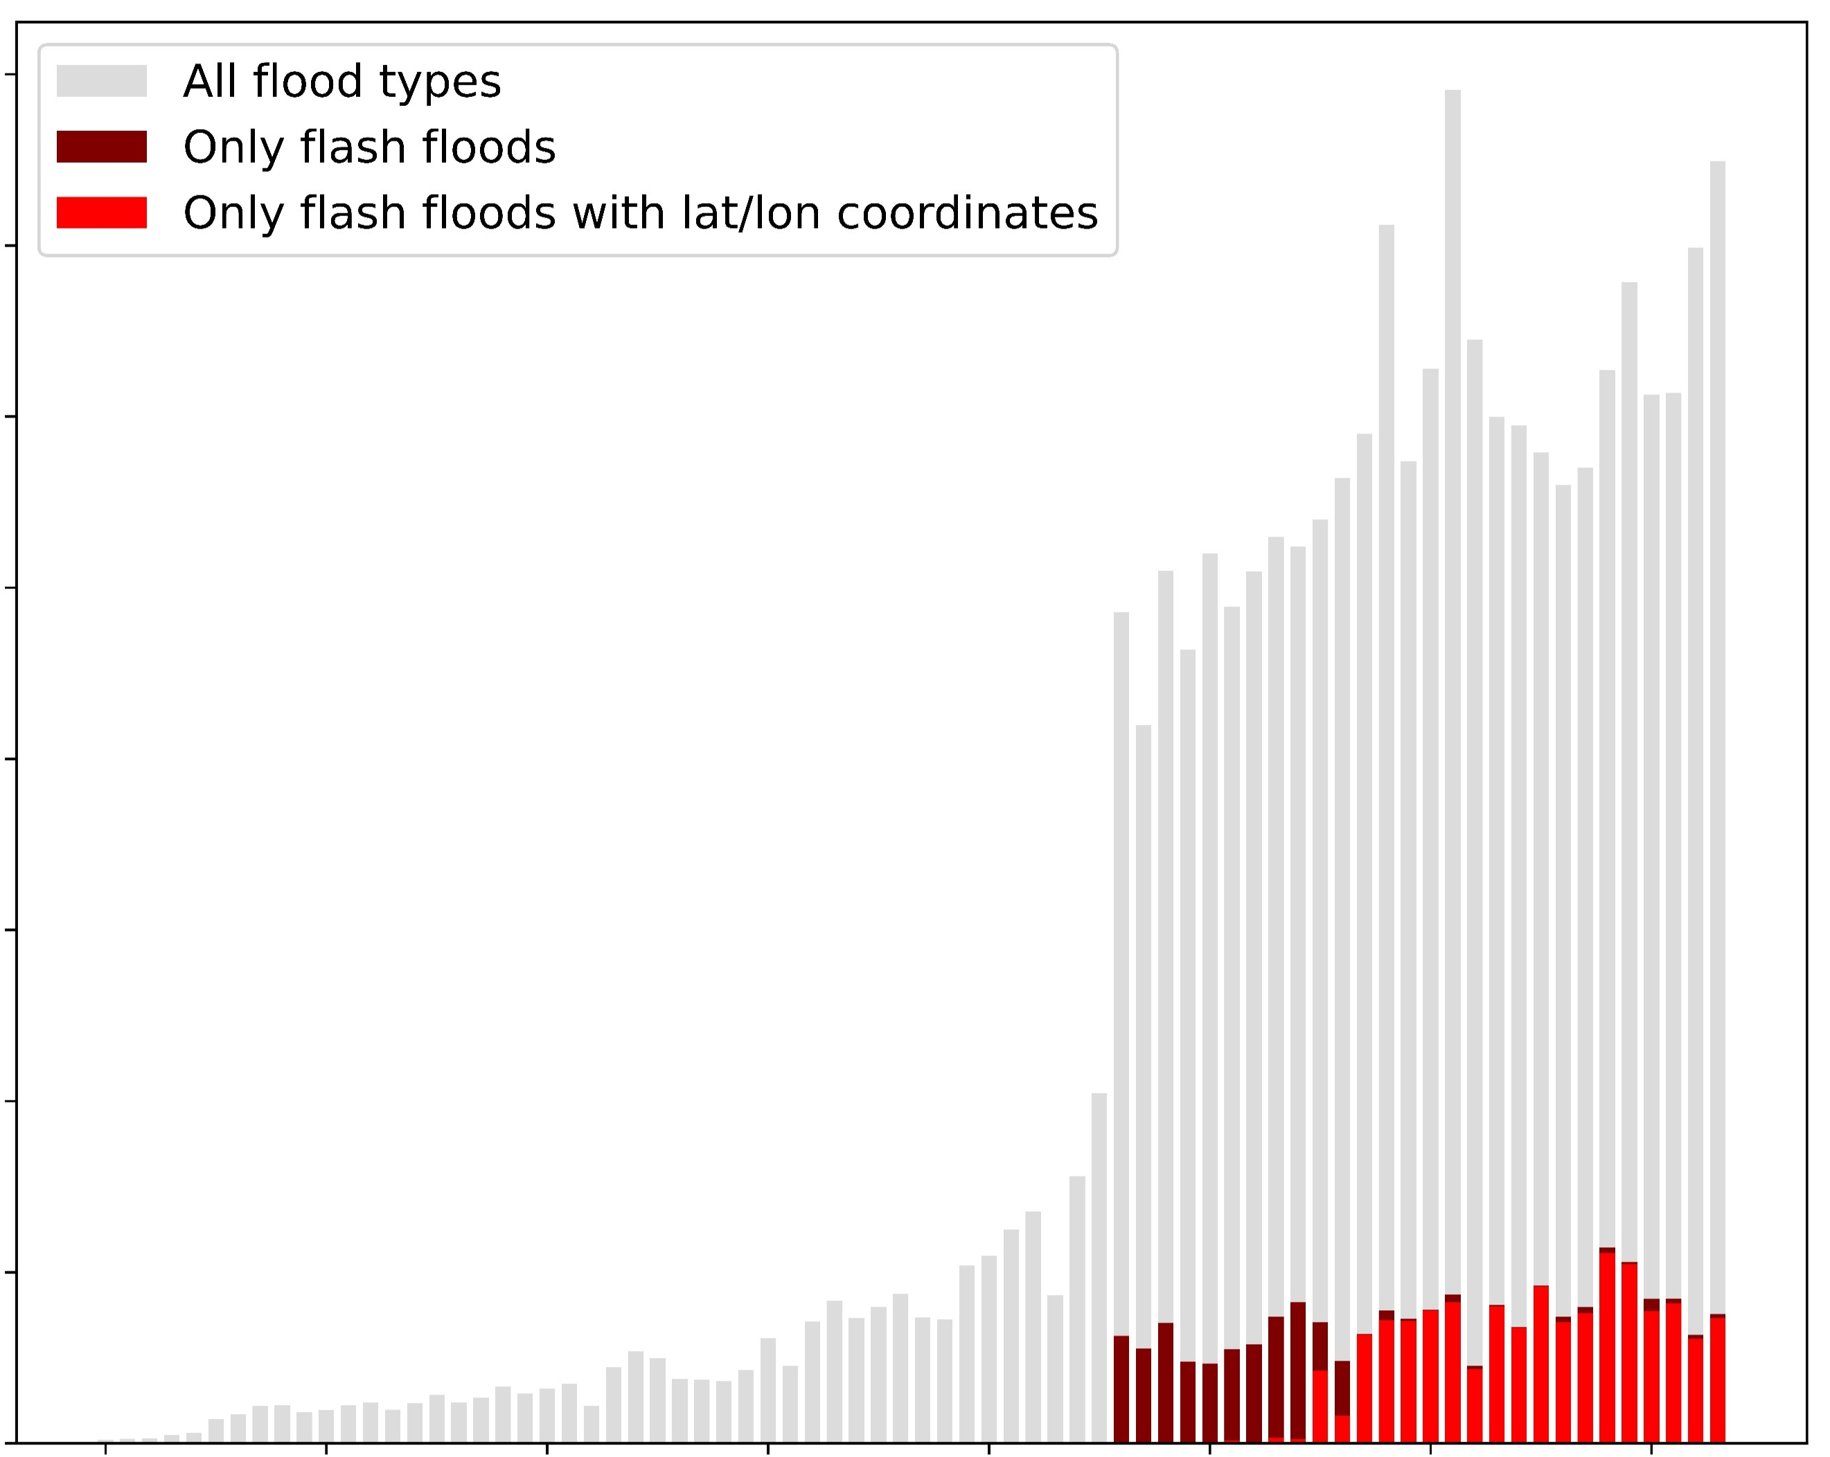
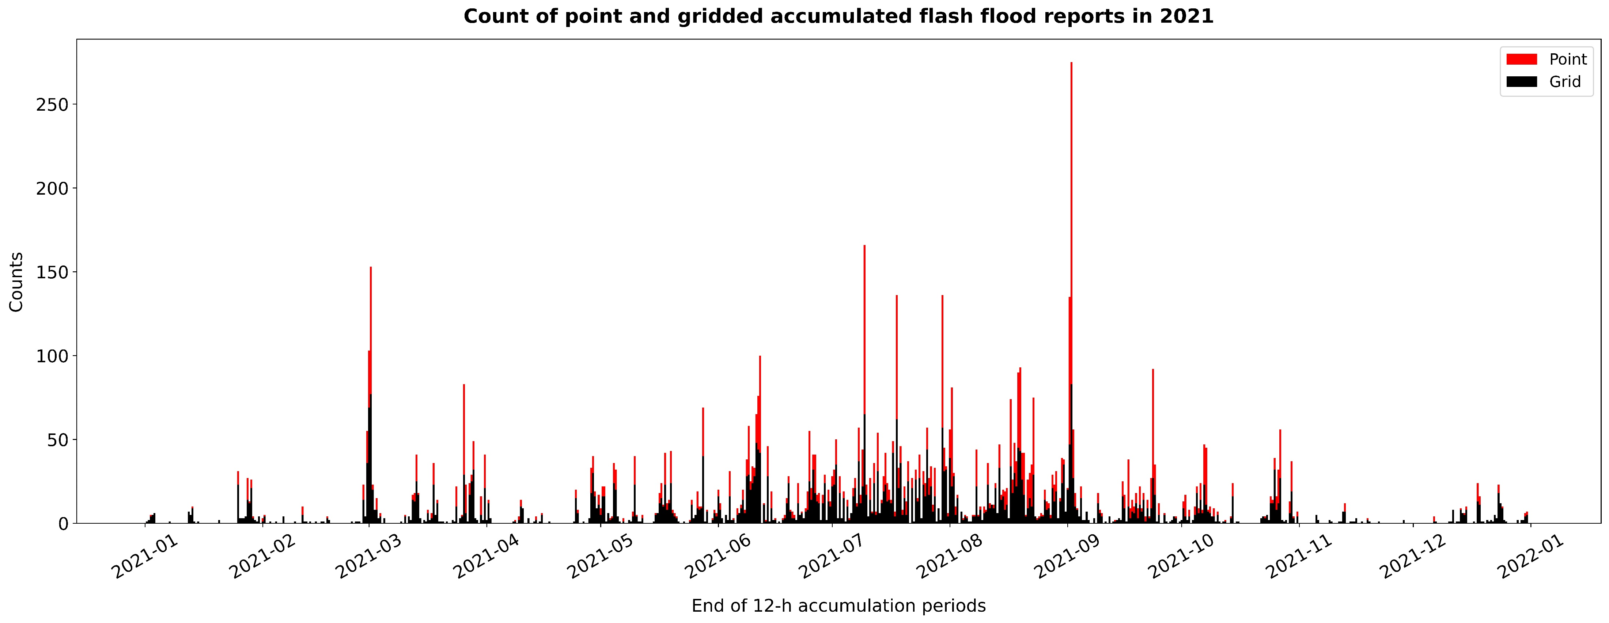
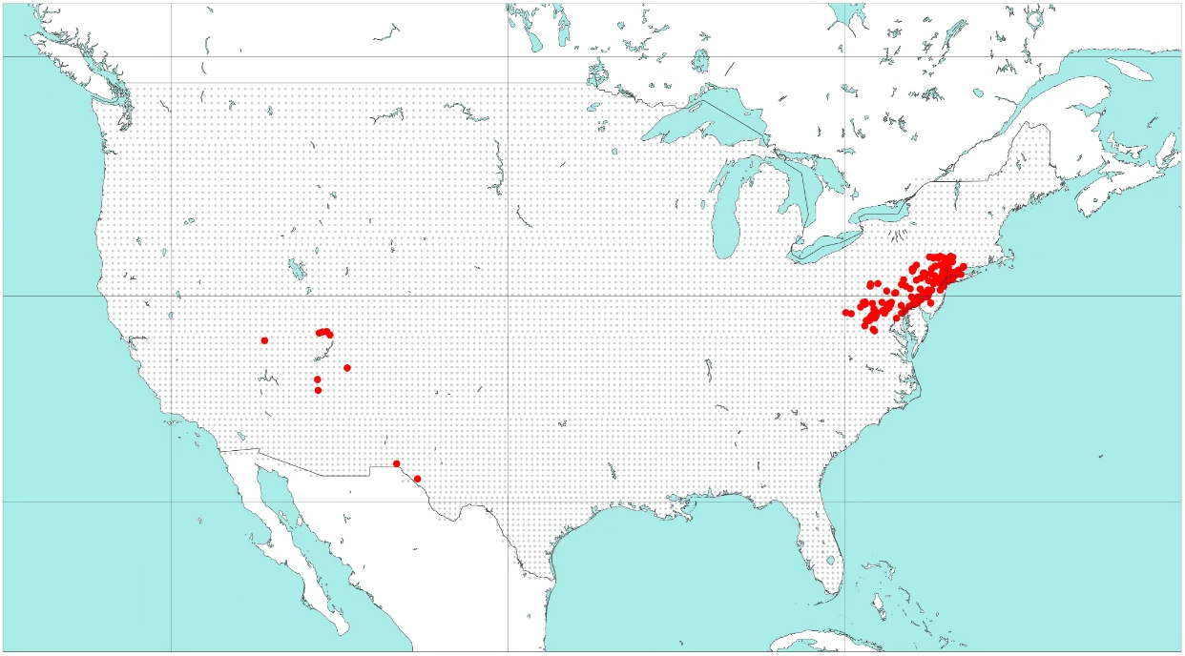
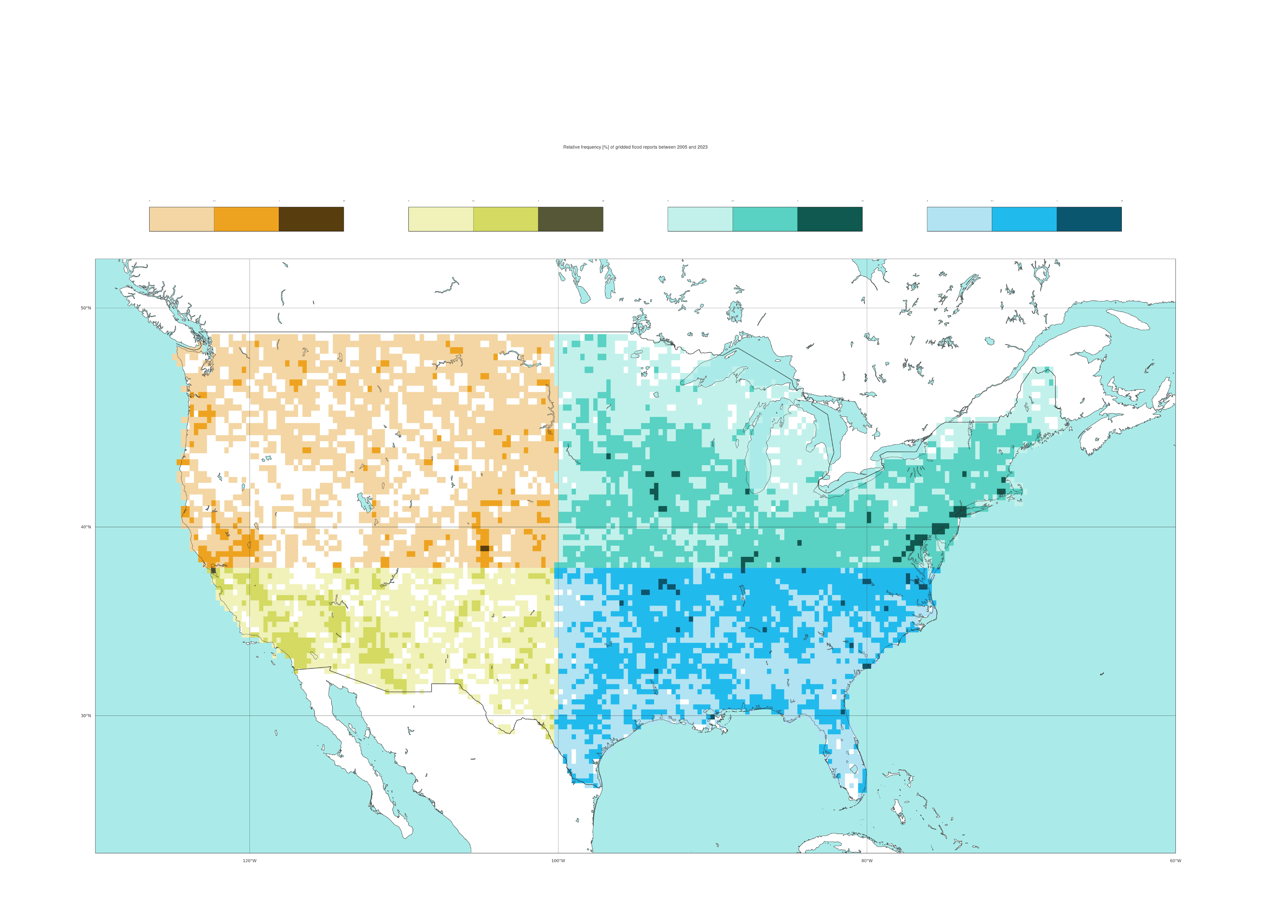
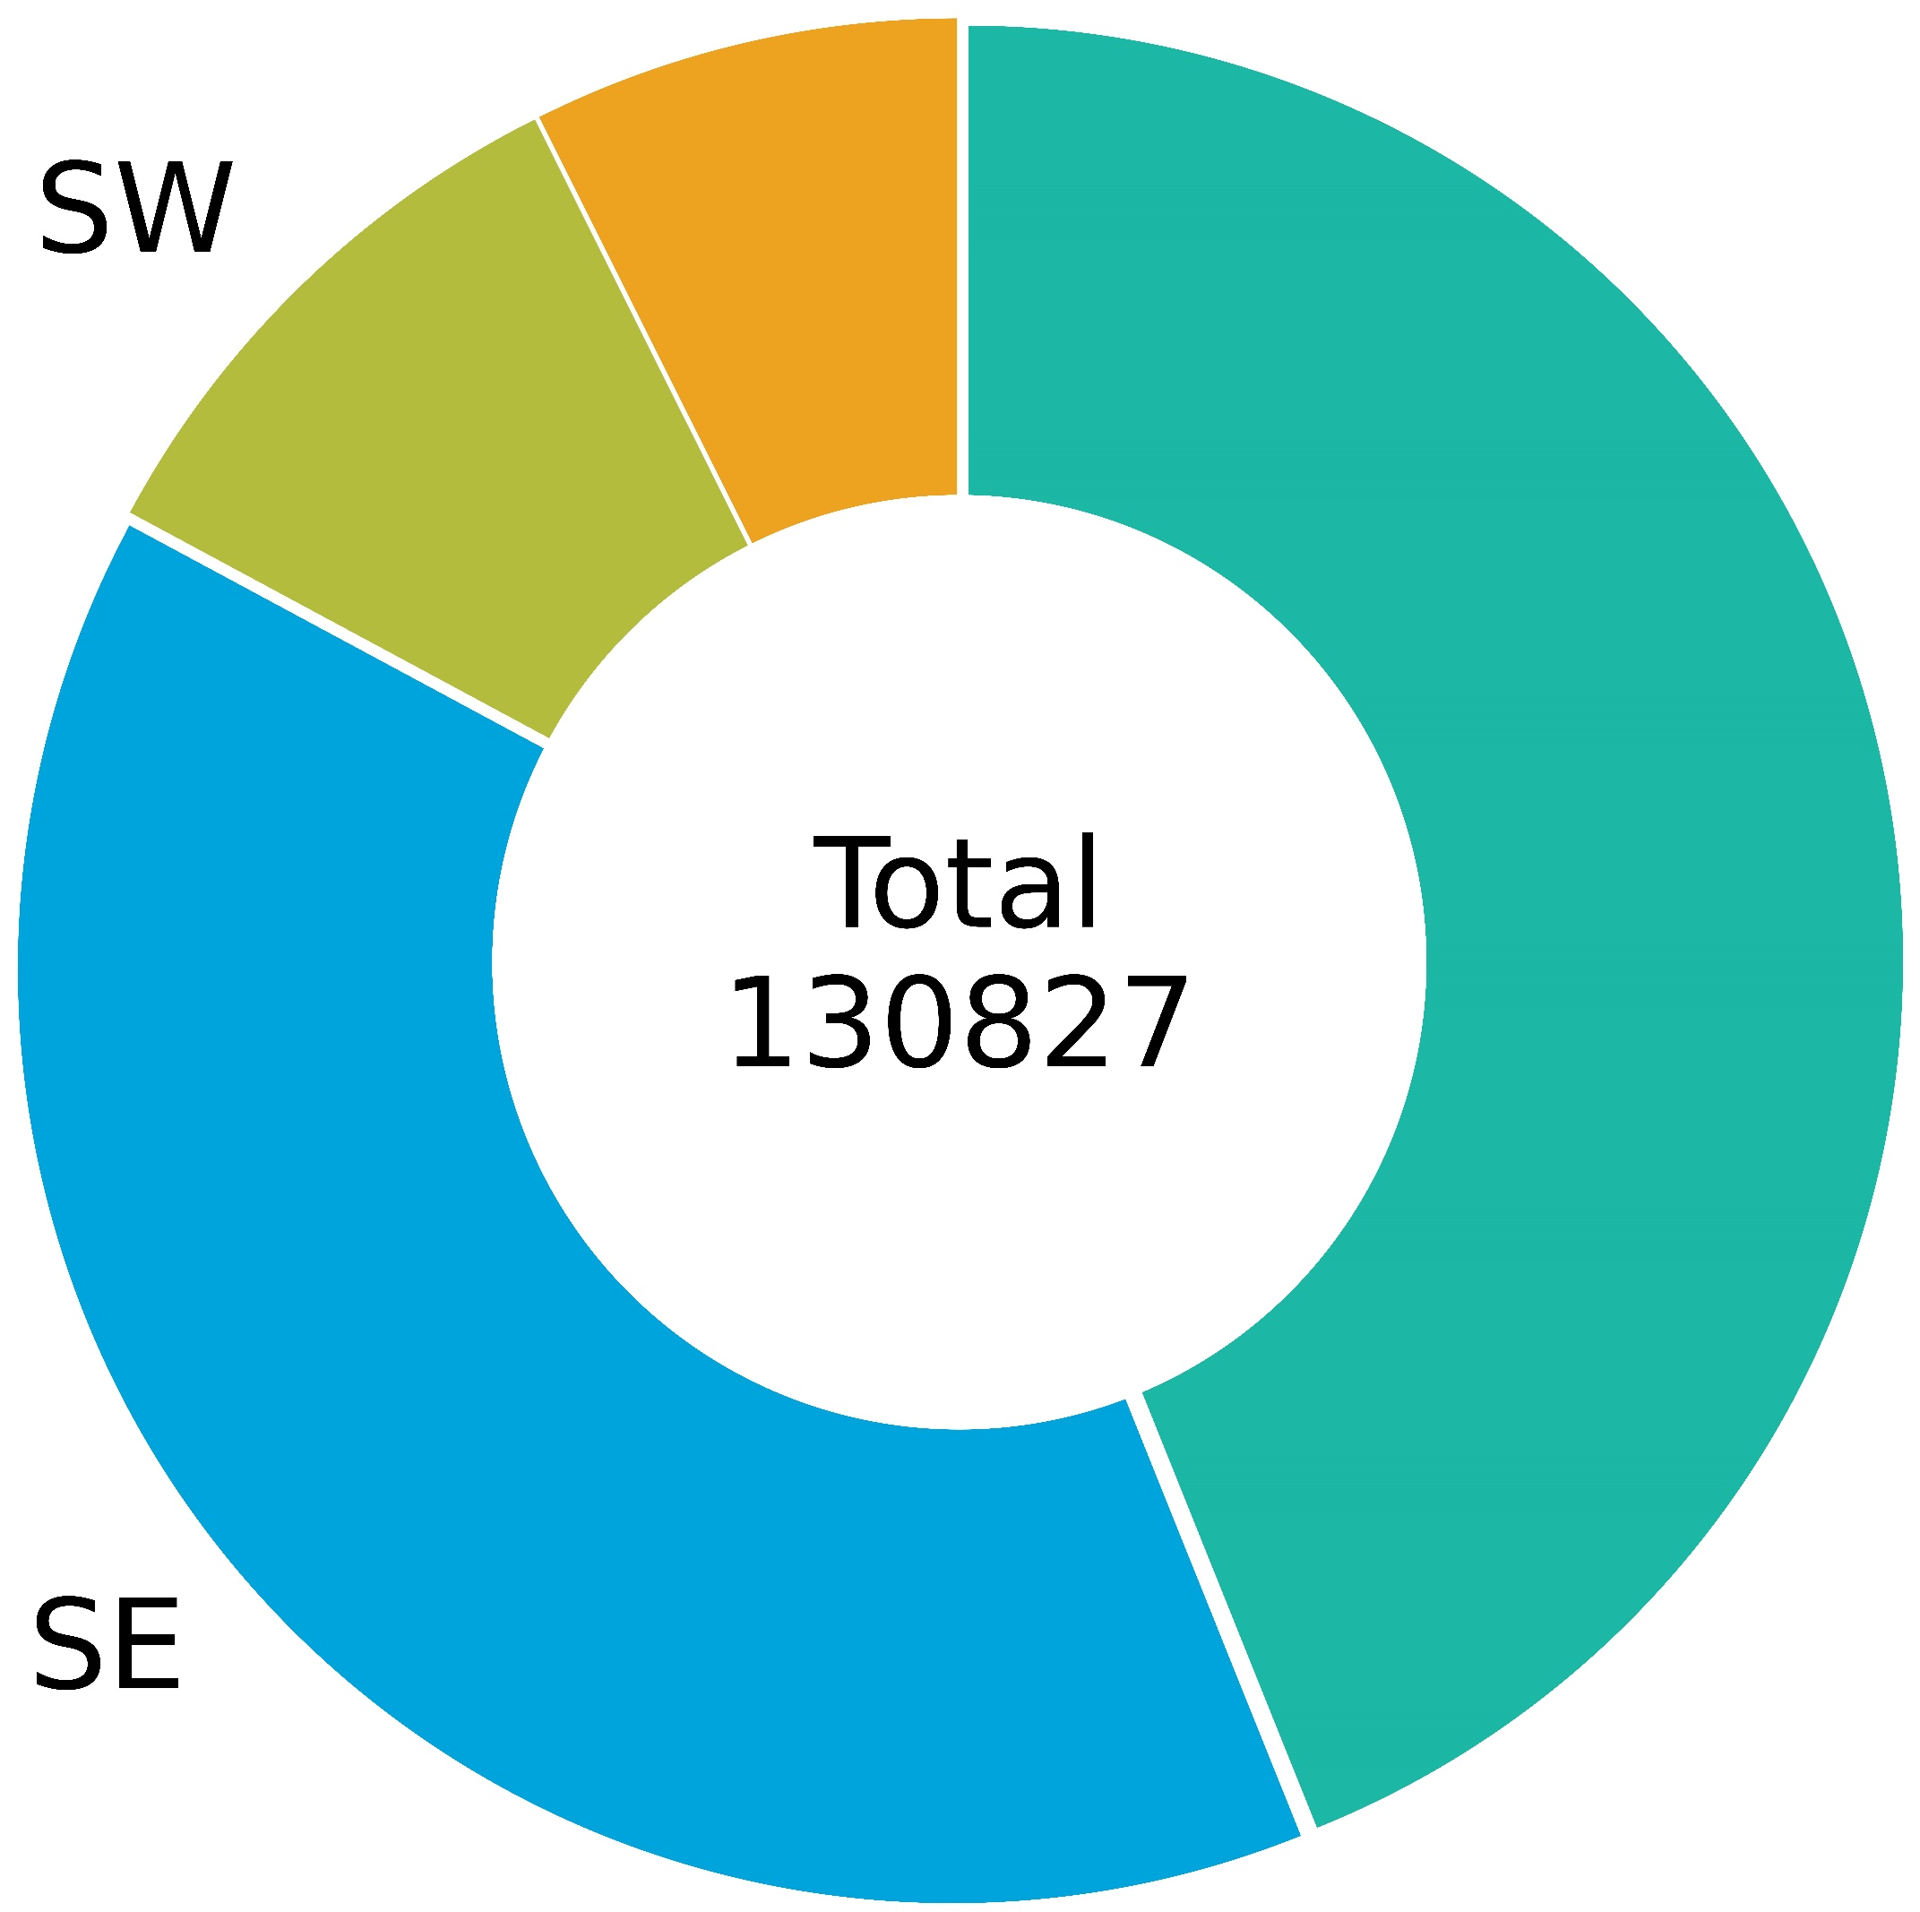
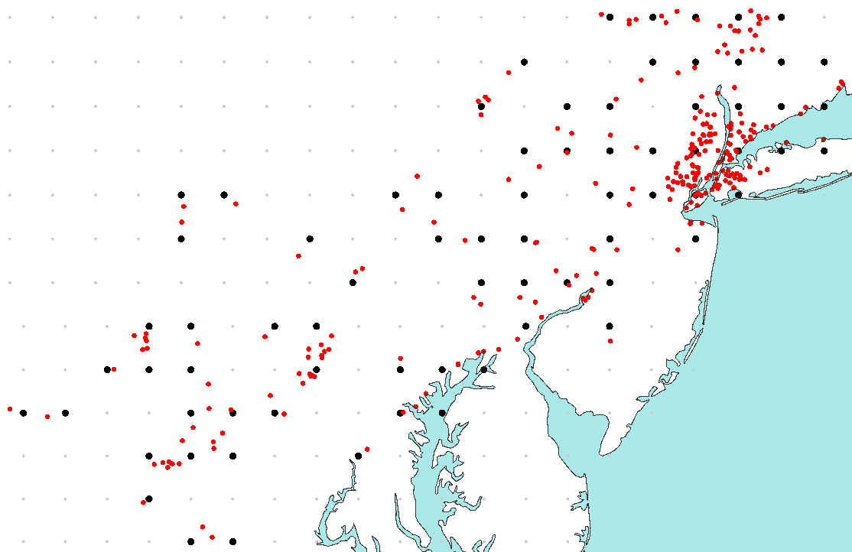
P1.1 - ANN’s target variable pre-processing
Timeseries of flood report counts in NOAA’s Severe Event Database per year, between 1950 to 2023
Distinction between all flood types and flash floods (with and without lat/lon coordinates)
Timeseries of flash flood report counts NOAA’s Severe Event Database in accumulated over 12-hourly periods ending at 00 and 12 UTC in 2021
Distinction between point and gridded flash flood reports
8
250
Point
7
All flood types
Gridded
12-hourly accumulation
period ending on
02-09-2021 at 00 UTC
6
Only flash floods
200
b
Only flash floods
with lat/lon coord.
2021
5
150
Counts
Counts * 10⁴
4
a
100
3
2
50
1
0
0
1950
1960
1970
1980
1990
2000
2010
2020
2021-01
2021-02
2021-03
2021-04
2021-05
2021-06
2021-07
2021-08
2021-09
2021-10
2021-11
2021-12
2022-01
Years
Days
Spatial distribution of the observed frequency of flash flood reports in NOAA’s Severe Storm Event Database, in each grid-box, between 2005 to 2023
Distinction between 4 geographical areas: South-West (SW), North-West (NW), North-East (NE), South-East (SE)
Spatial distribution of gridded, 12-hourly accumulated flash flood reports in NOAA’s Severe Event Database during the Ida storm
12-hourly accumulation period ending on 2021-09-02 at 00 UTC
%
%
%
%
50 °N
0
0.1
1
10
0
0.1
1
10
0
0.1
1
10
0
0.1
1
10
NW
SW
NE
SE
50 °N
40 °N
c
30 °N
40 °N
120 °W
100 °W
80 °W
9%
e
30 °N
11%
d
Total
130827
41%
120 °W
100 °W
80 °W
39%

