Slide 1

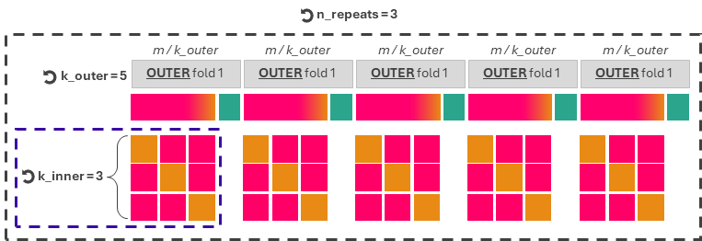

Workflow for repeated stratified k-fold cross validation
For hyperparameter tuning and assessment of model’s generalisation capabilities
(Imbalanced) Training dataset, m data points
RepeatedStratifiedKfold
To preserve class-balance in every outer and inner fold
Hyperparameter tuning with Optuna
n_trials = 50
80 %
20 %
Outer Training
Outer Test
INNER fold 1
INNER fold 2
INNER fold 3
Split 1
Inner Validation
Inner Training
Inner Training
Split 2
Inner Training
Inner Validation
Inner Training
Split 3
Inner Training
Inner Training
Inner Validation
Single Optuna trial
(candidate set of hyperparameters) =
Train each candidate set of hyperparameters over (k_inner - 1) splits and validate the set over 1 split
Score for single trial = average of k_inner scores
Optuna ranks the n_trials scores to provide the best hyper-parameter set, and train the model with it over the whole outer training dataset
Test the model over the outer test dataset (e.g. computing recall, f1, aroc, roc curves, and reliability diagrams).
Select the best set of hyperparameters out of the k_outer folds and train over the whole original dataset (m data points)
Model ready for forecast production

Slide 2

n_repeats = 3
m / k_outer
m / k_outer
m / k_outer
m / k_outer
m / k_outer
k_outer = 5
OUTER fold 1
OUTER fold 1
OUTER fold 1
OUTER fold 1
OUTER fold 1
k_inner = 3

