Slide 1
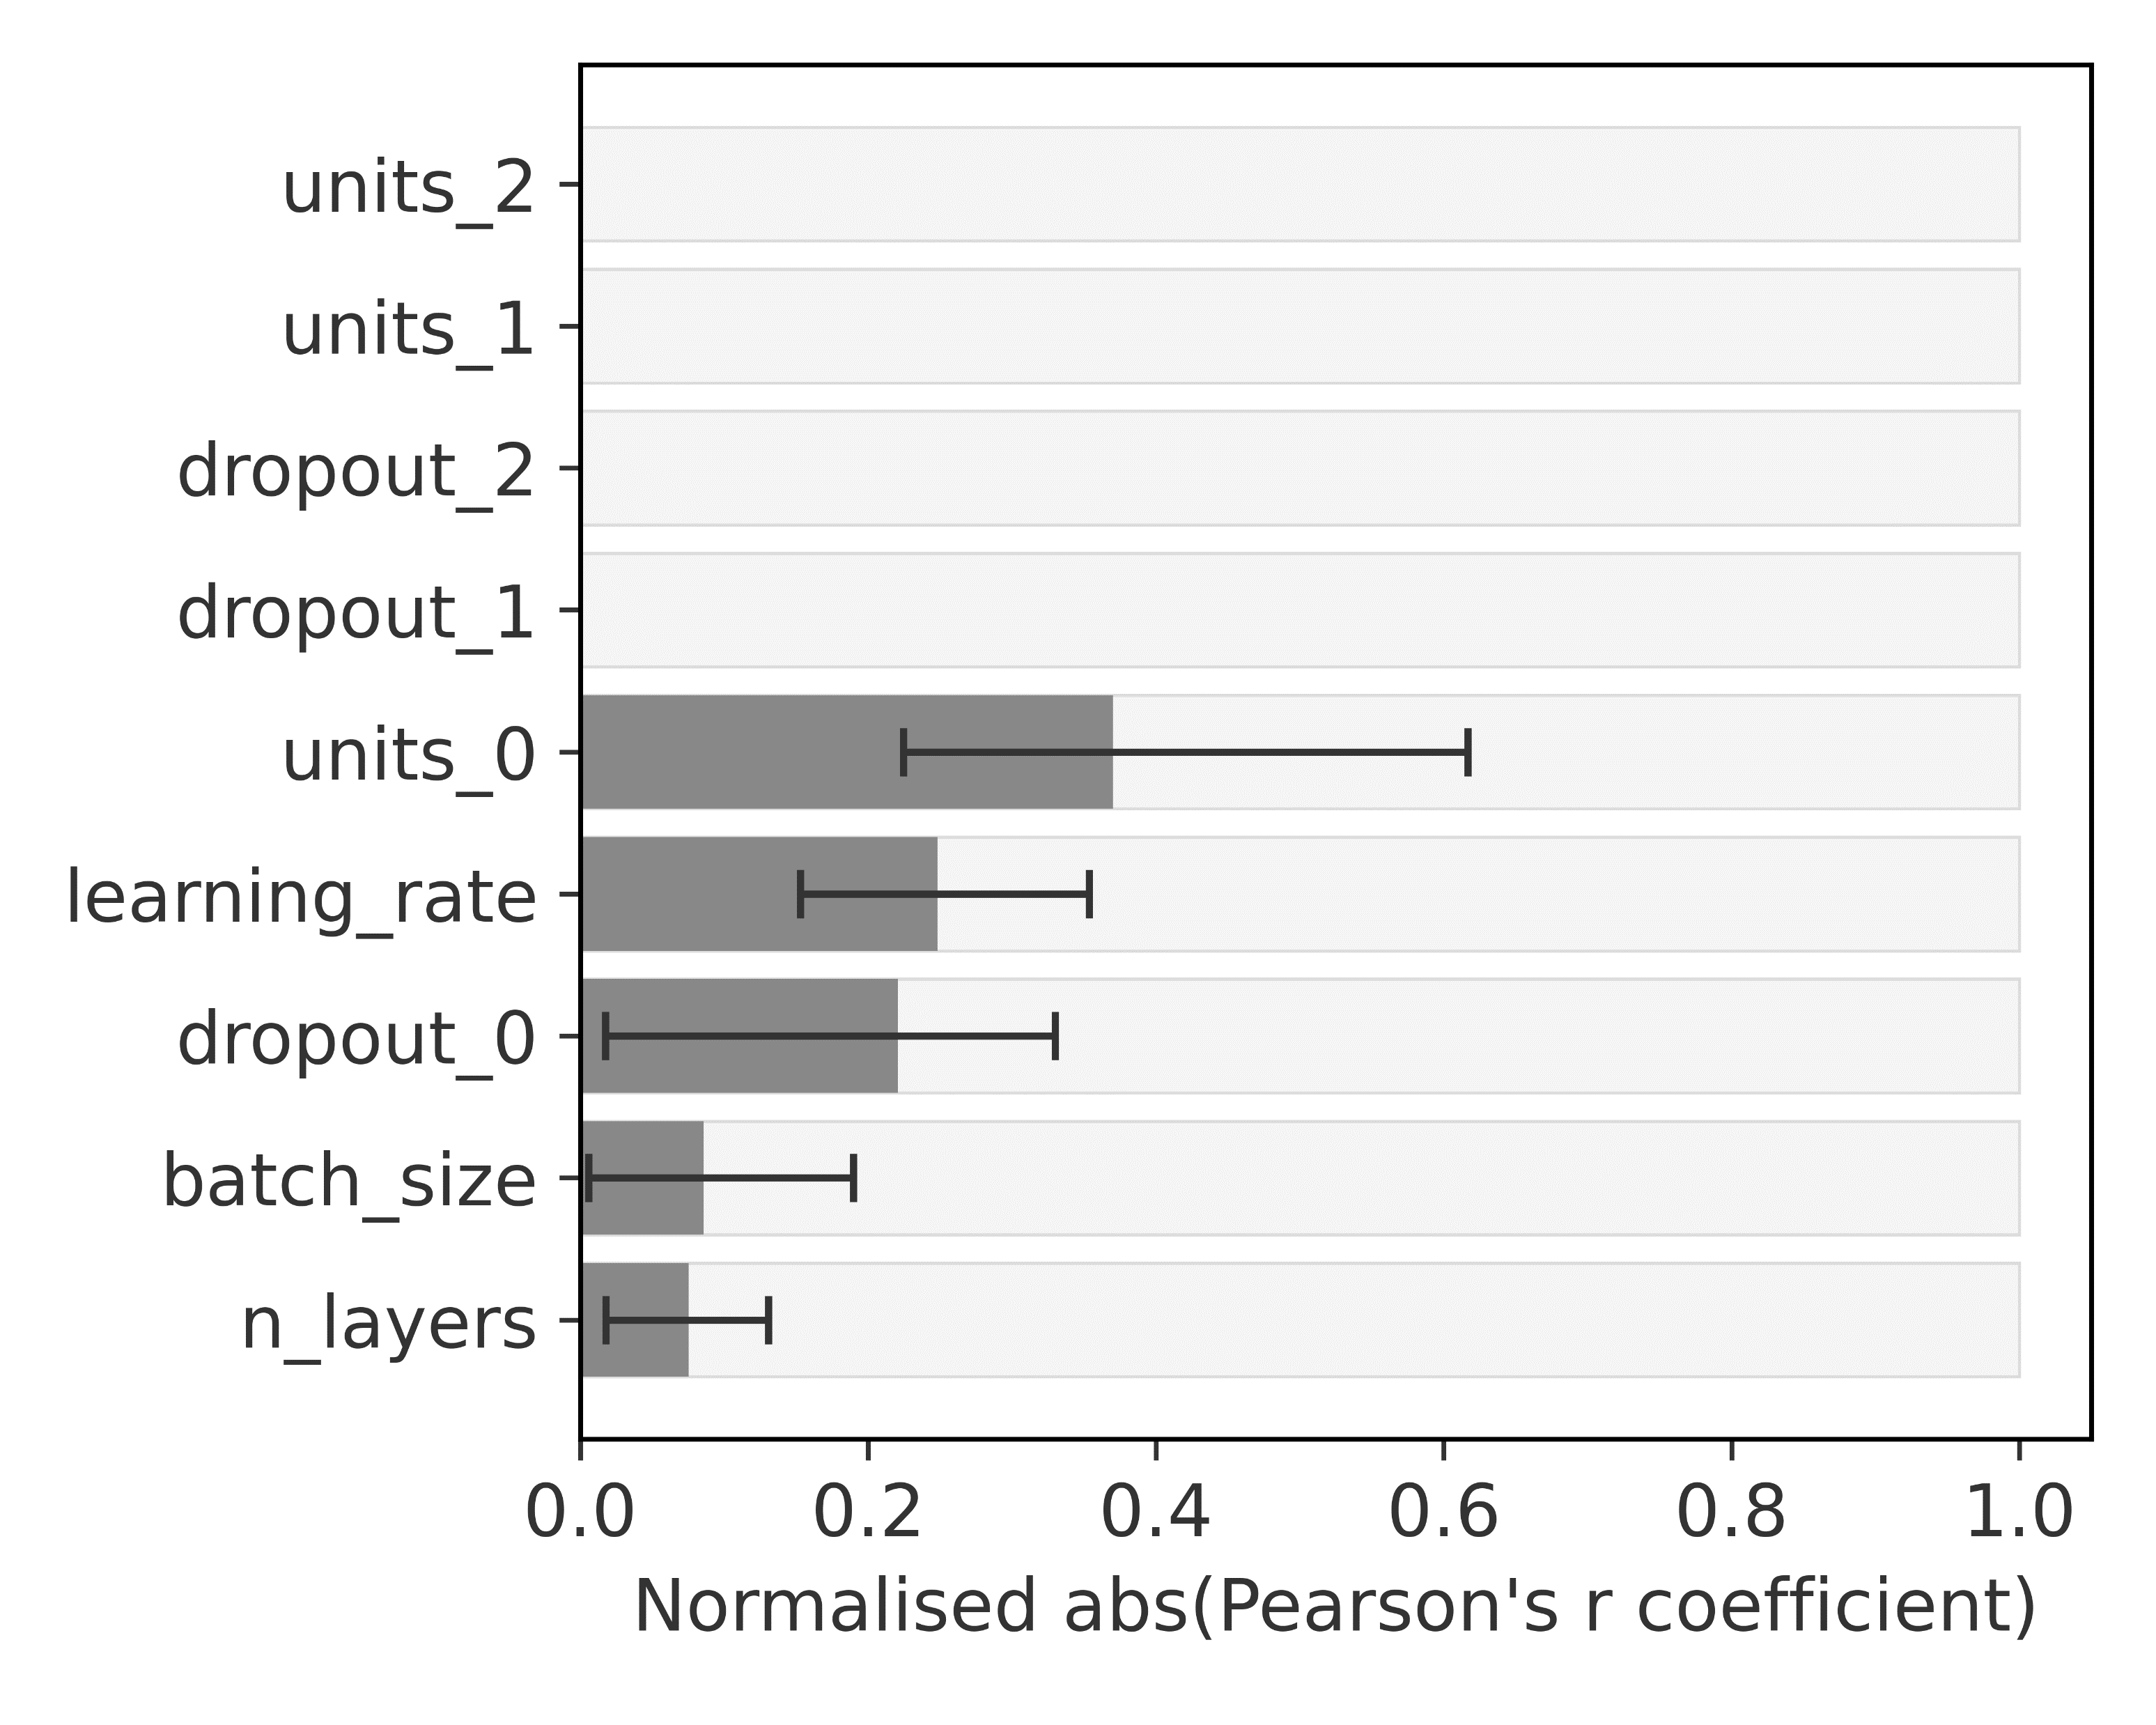
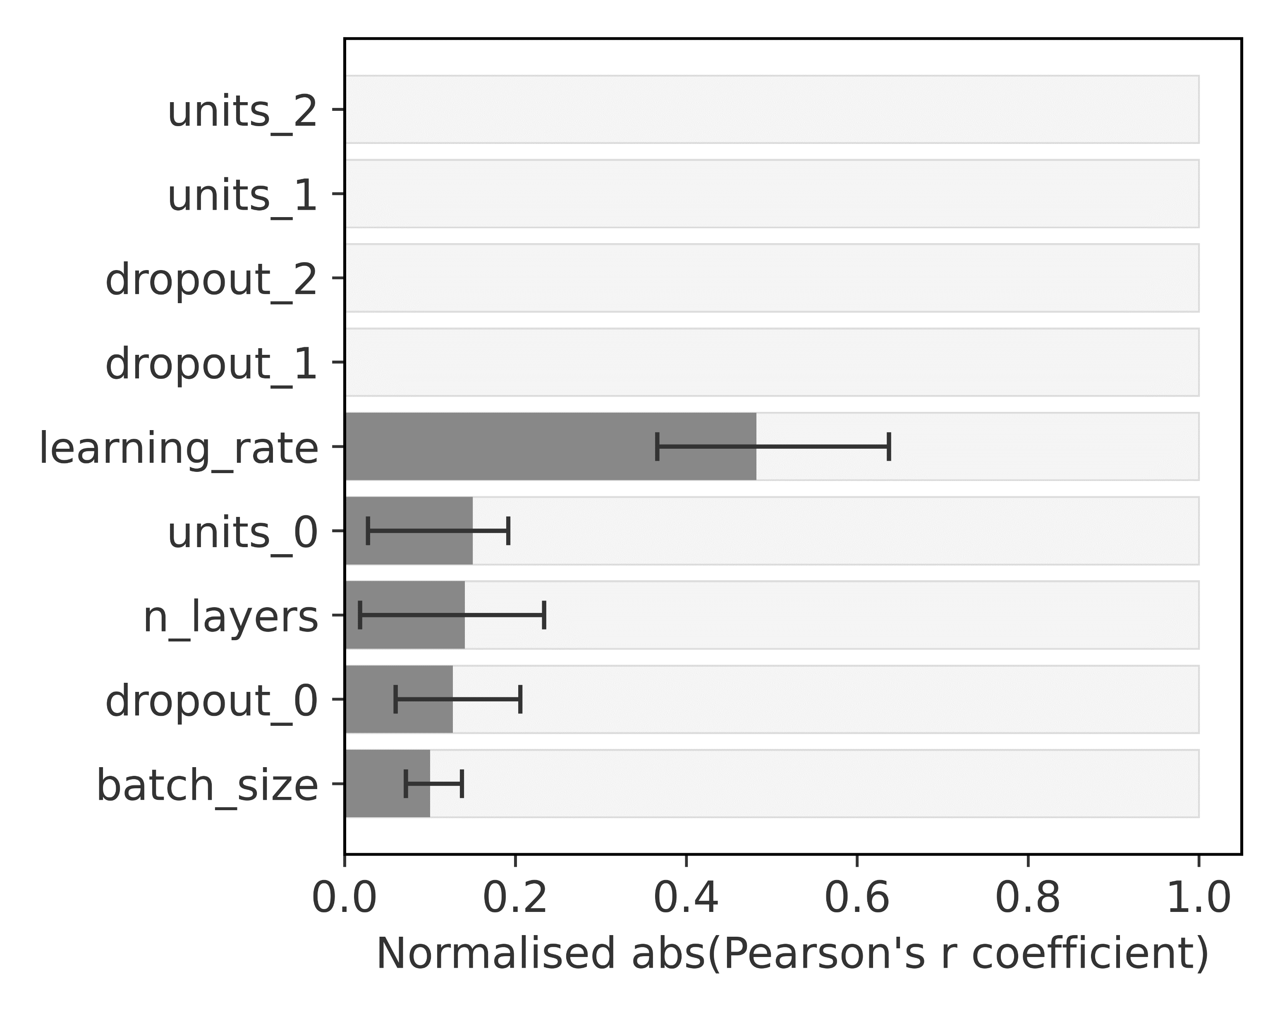
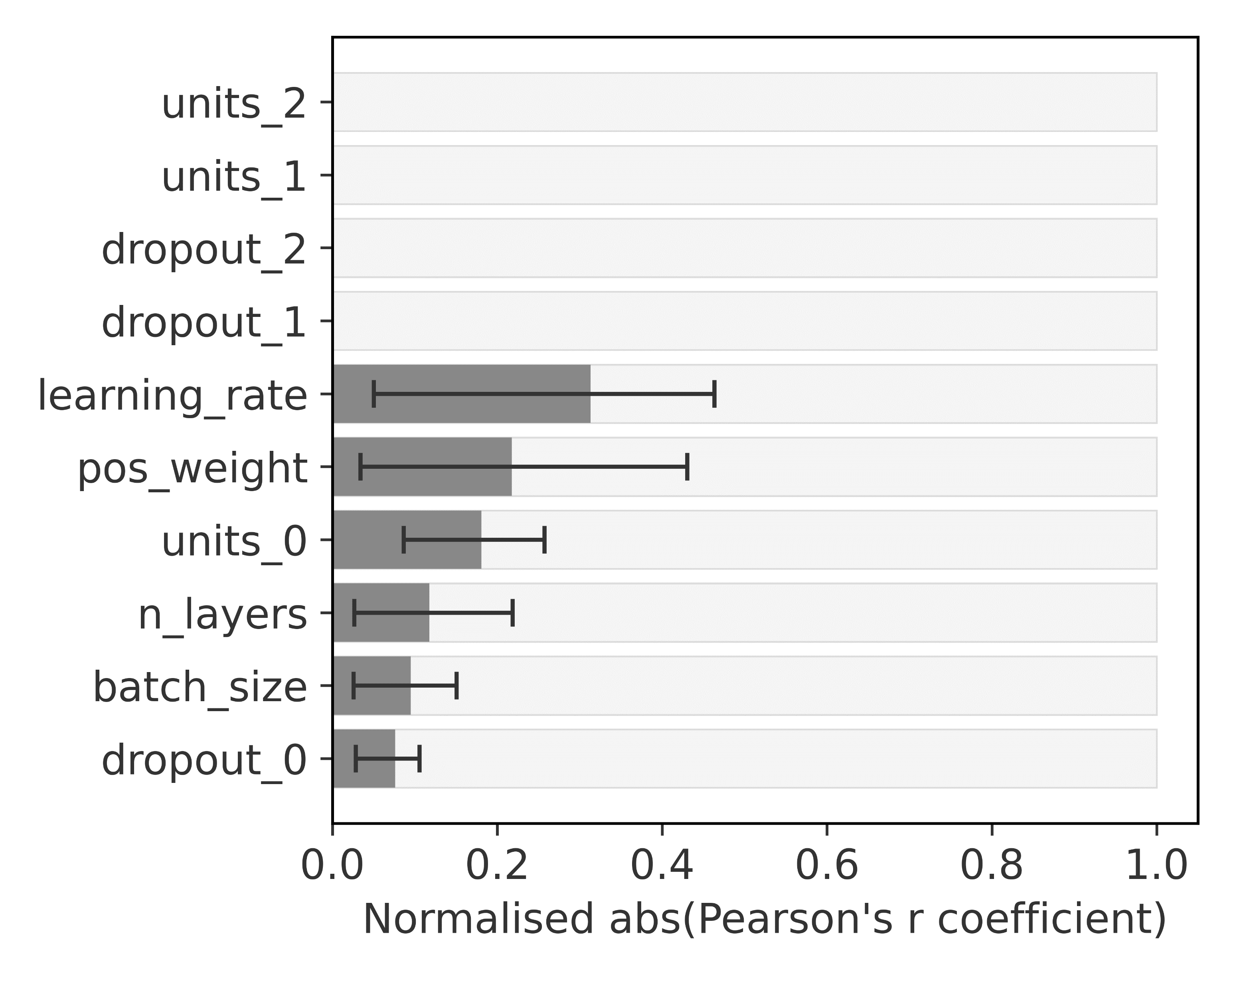
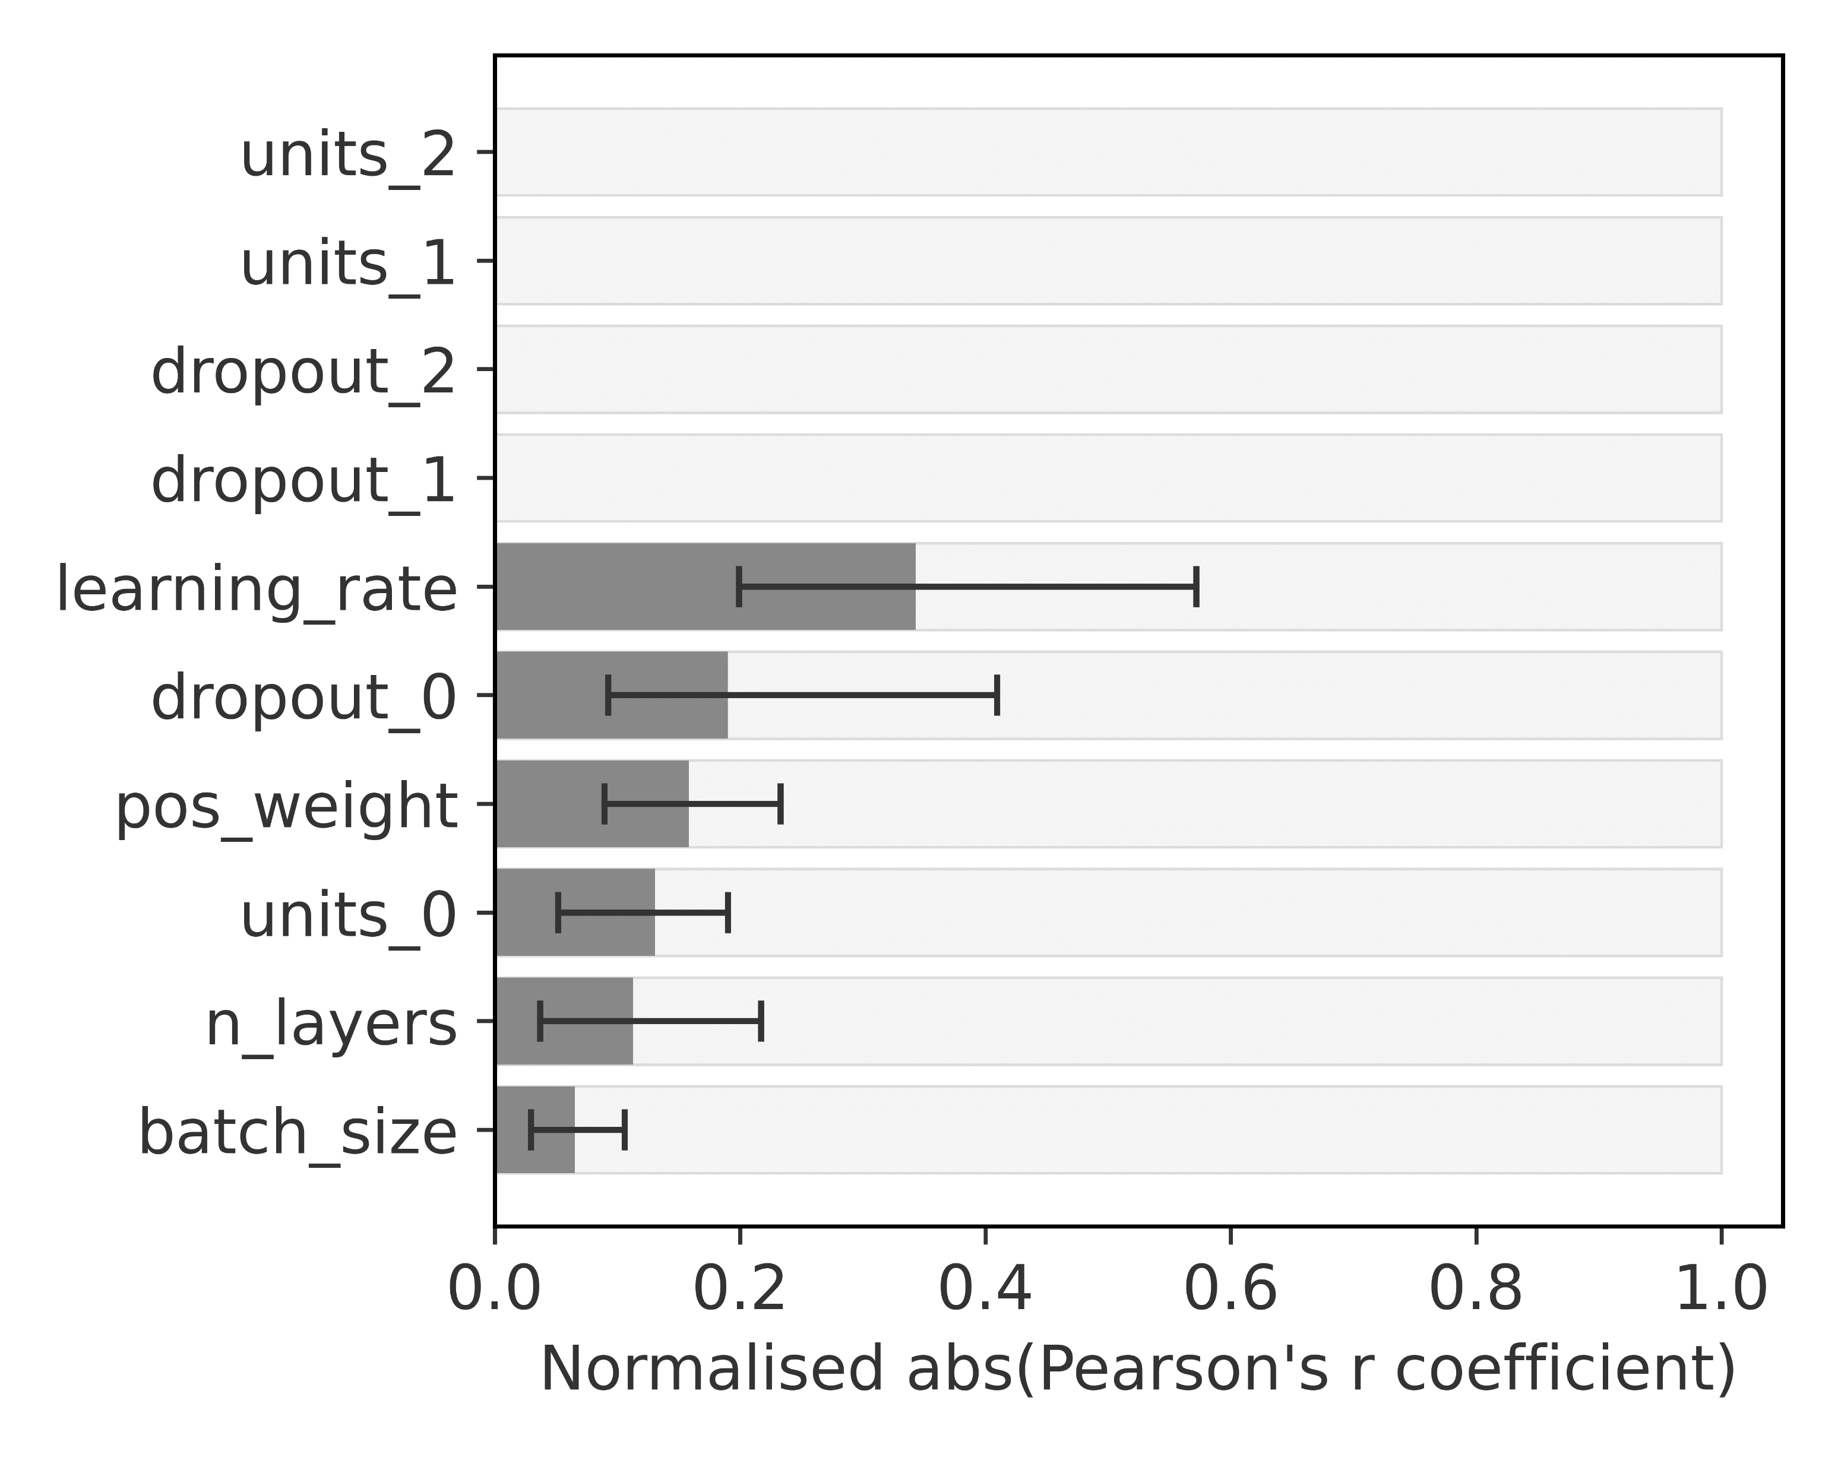
Optuna hyperparameter importance
Feed-Forward Neural Network
AUC-ROC
AUC-PR
Loss Function
Balanced Data
Loss Function
Imbalanced Data

