Slide 1
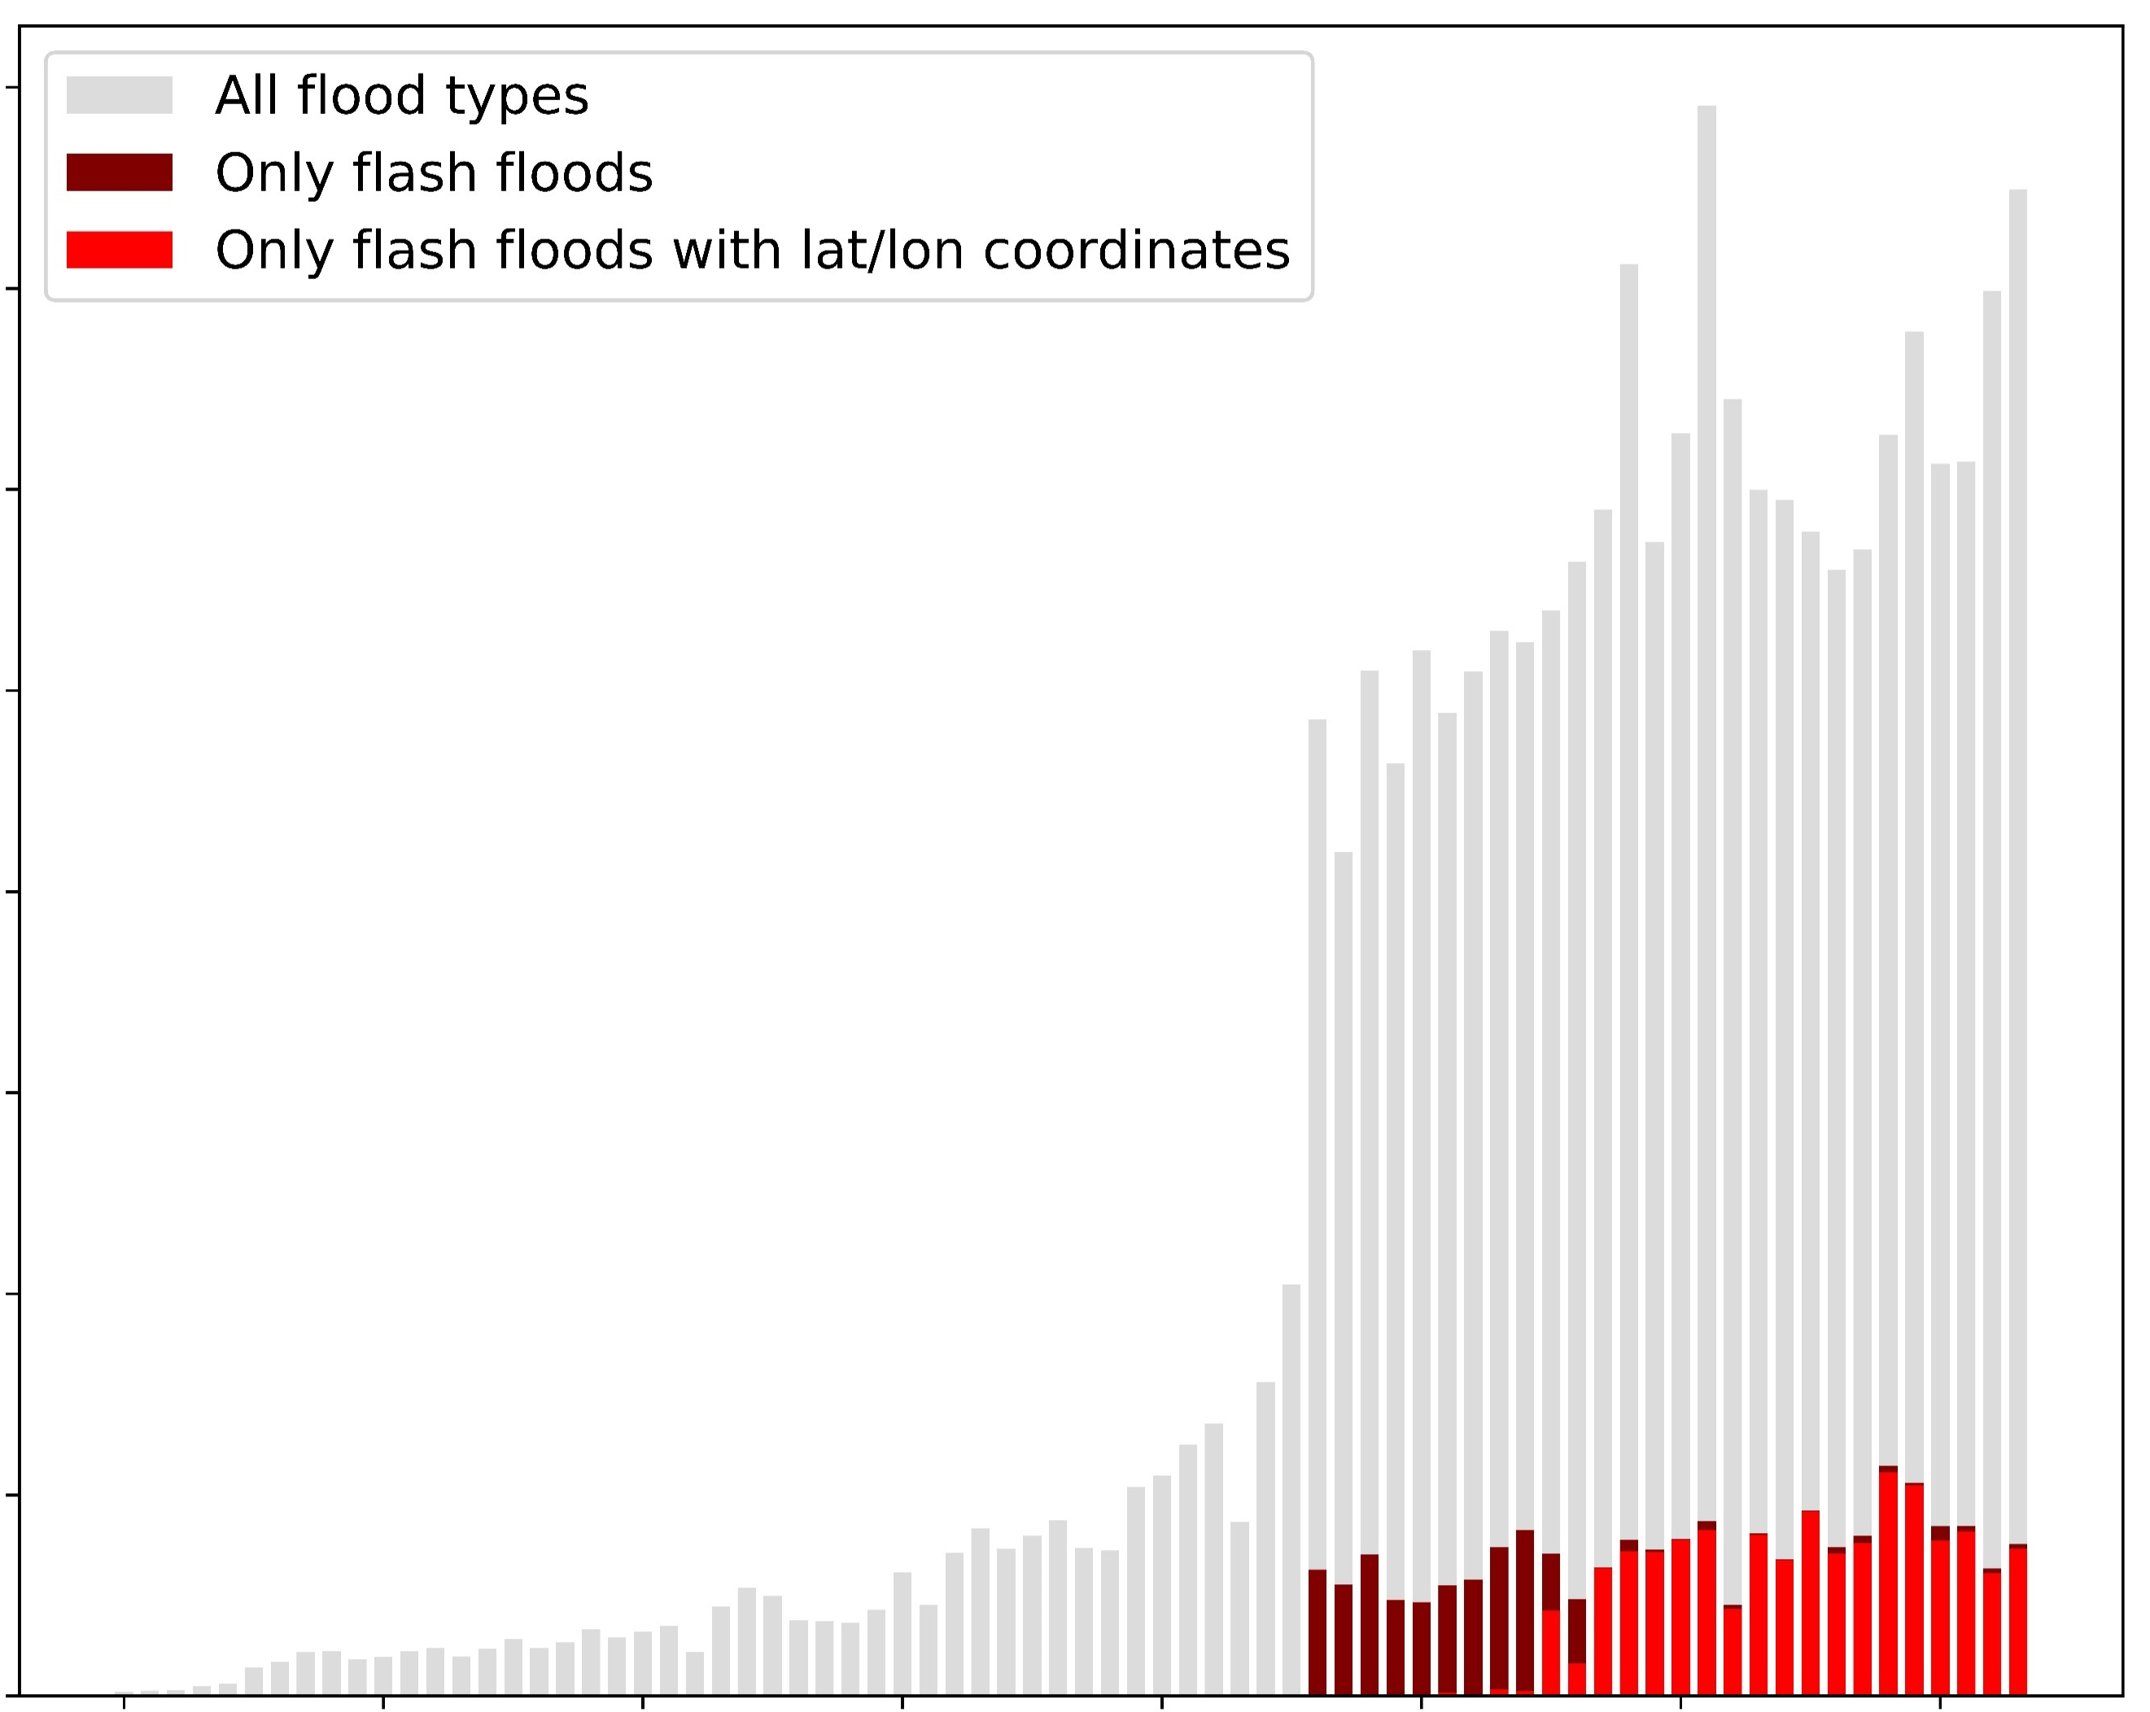
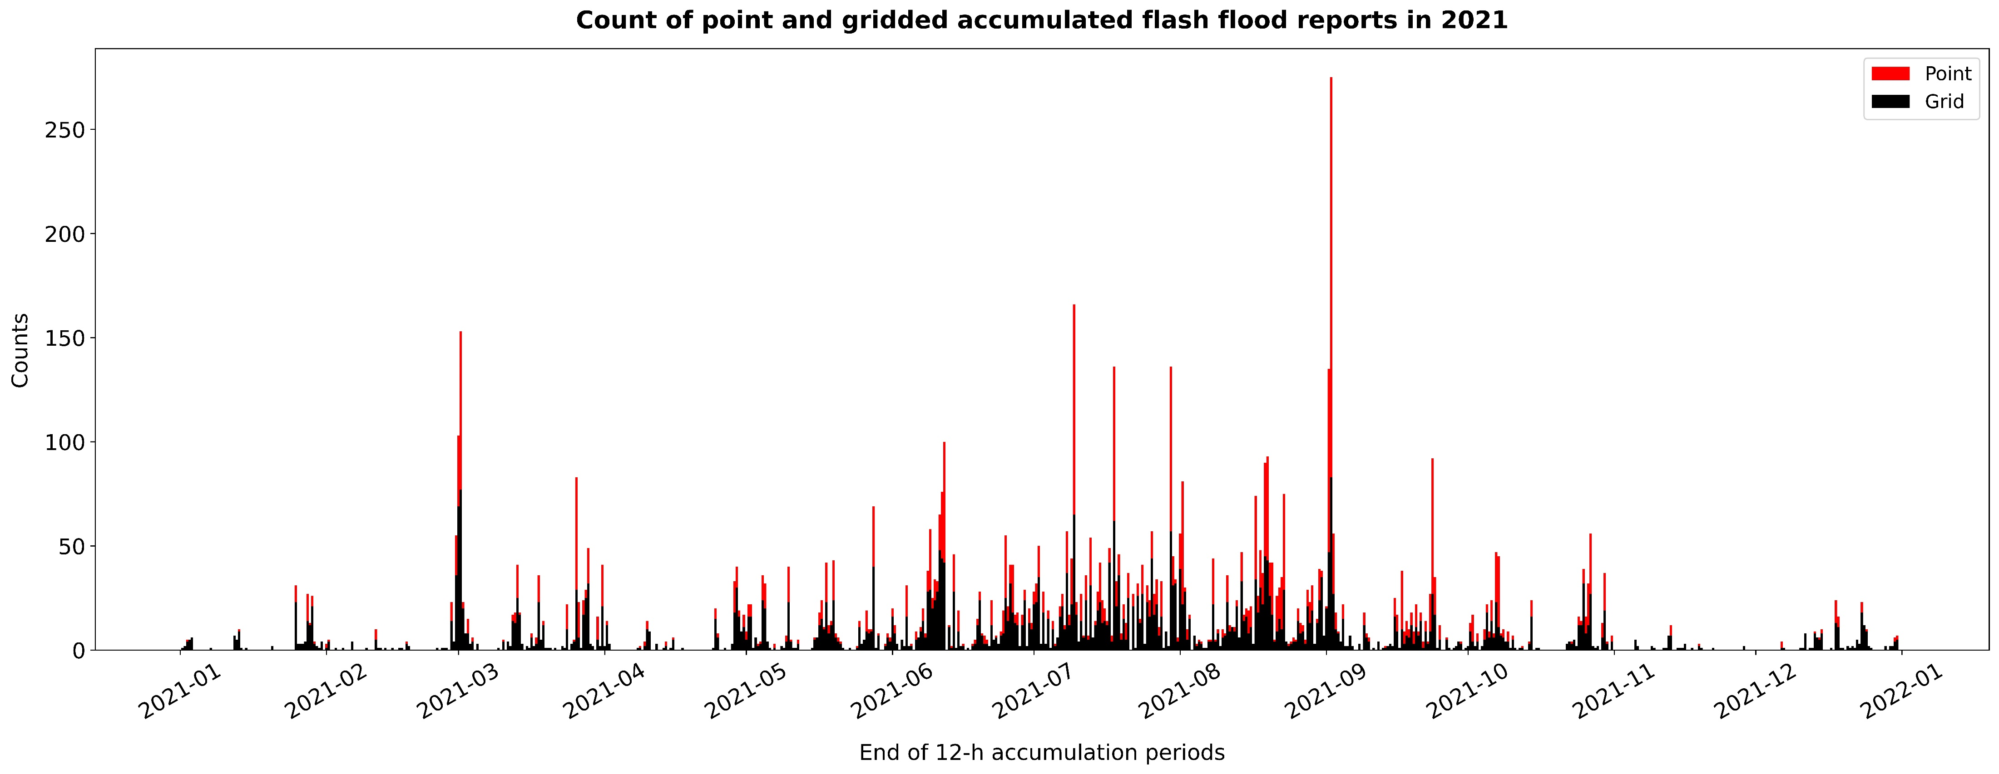
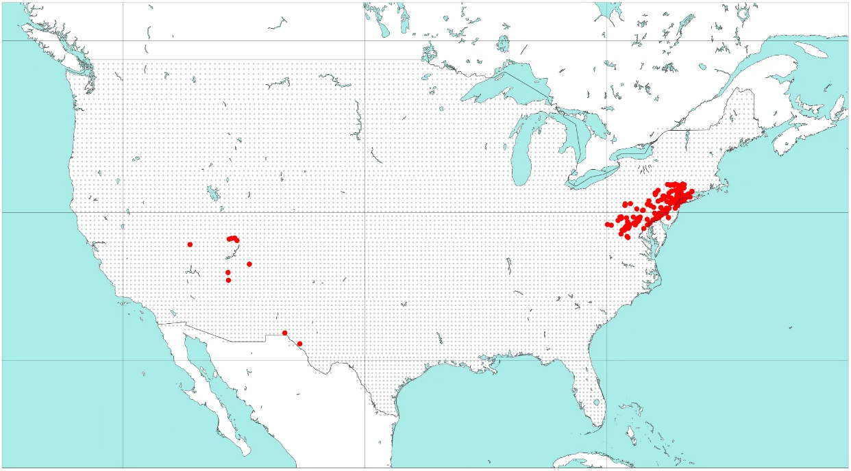
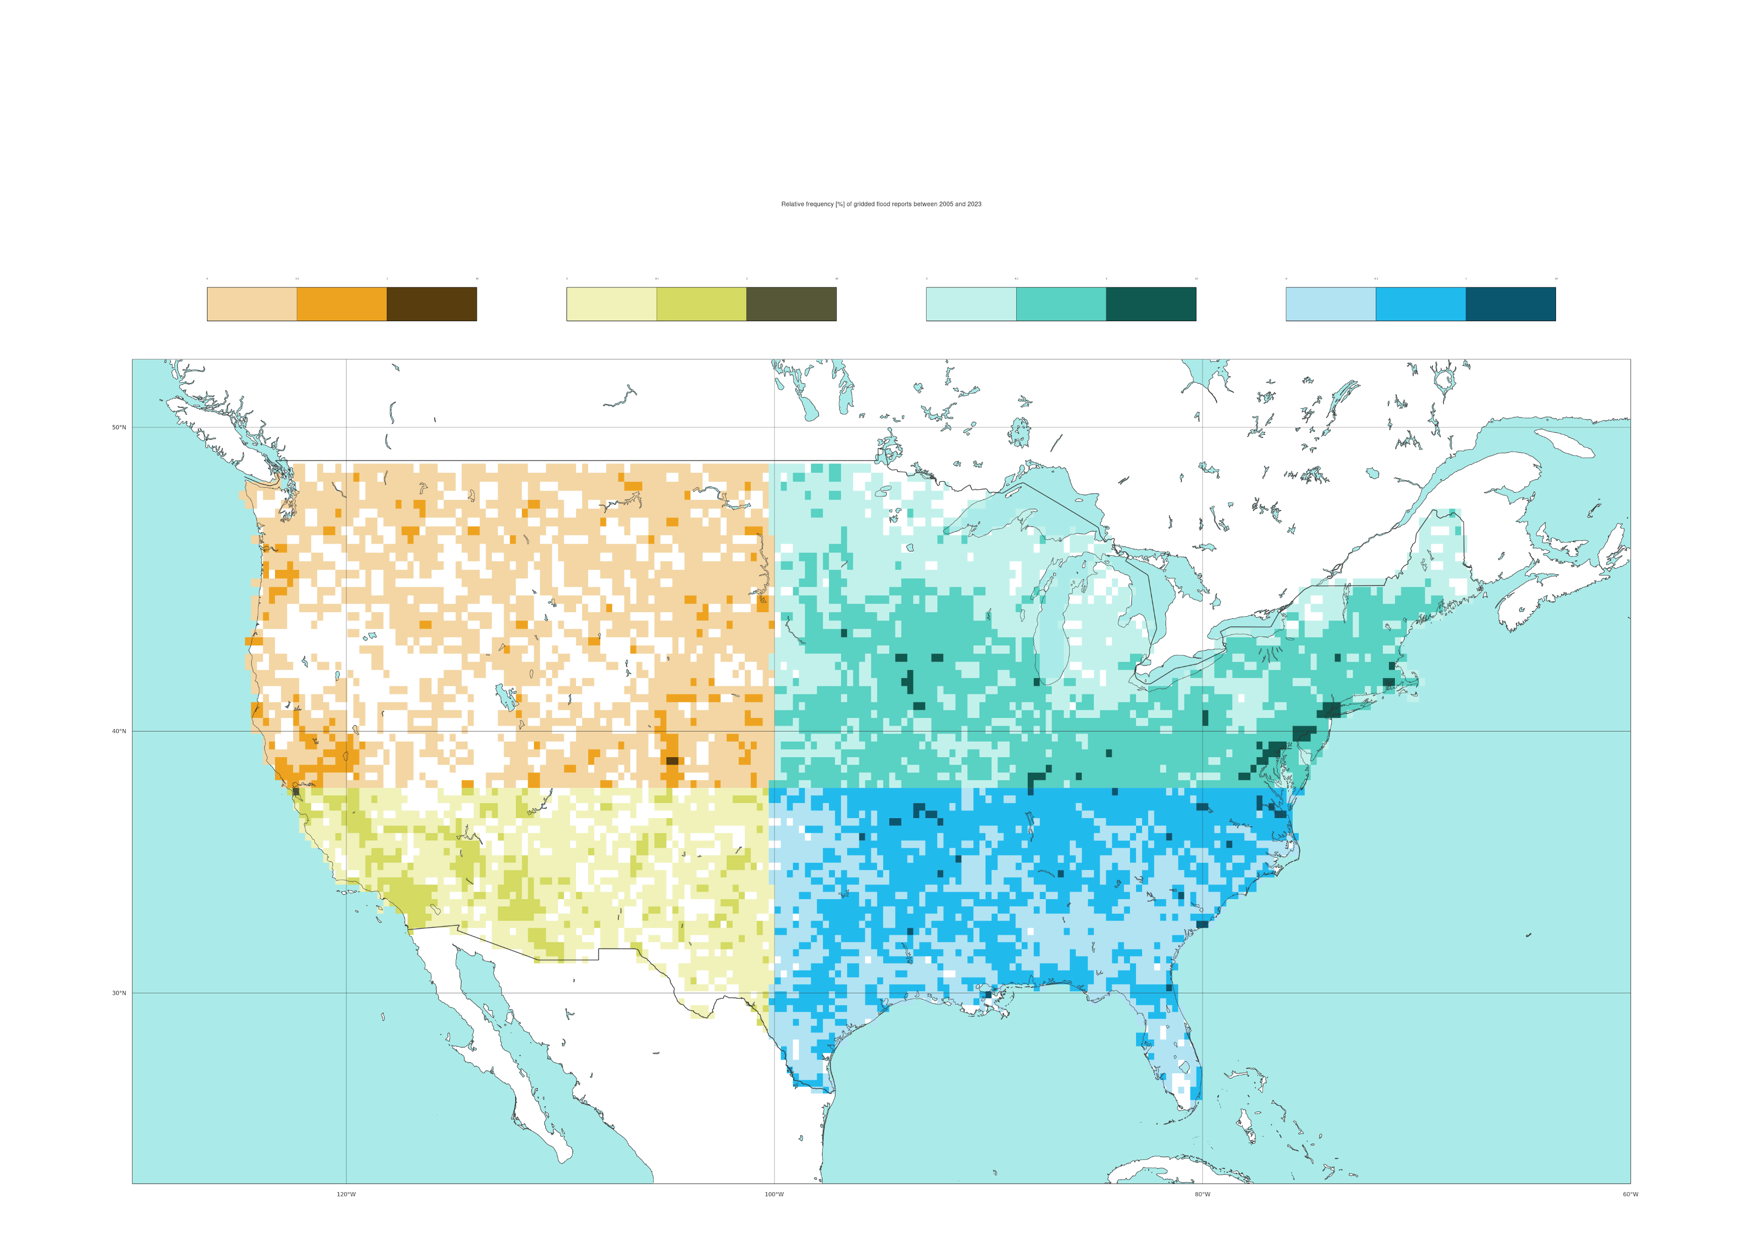
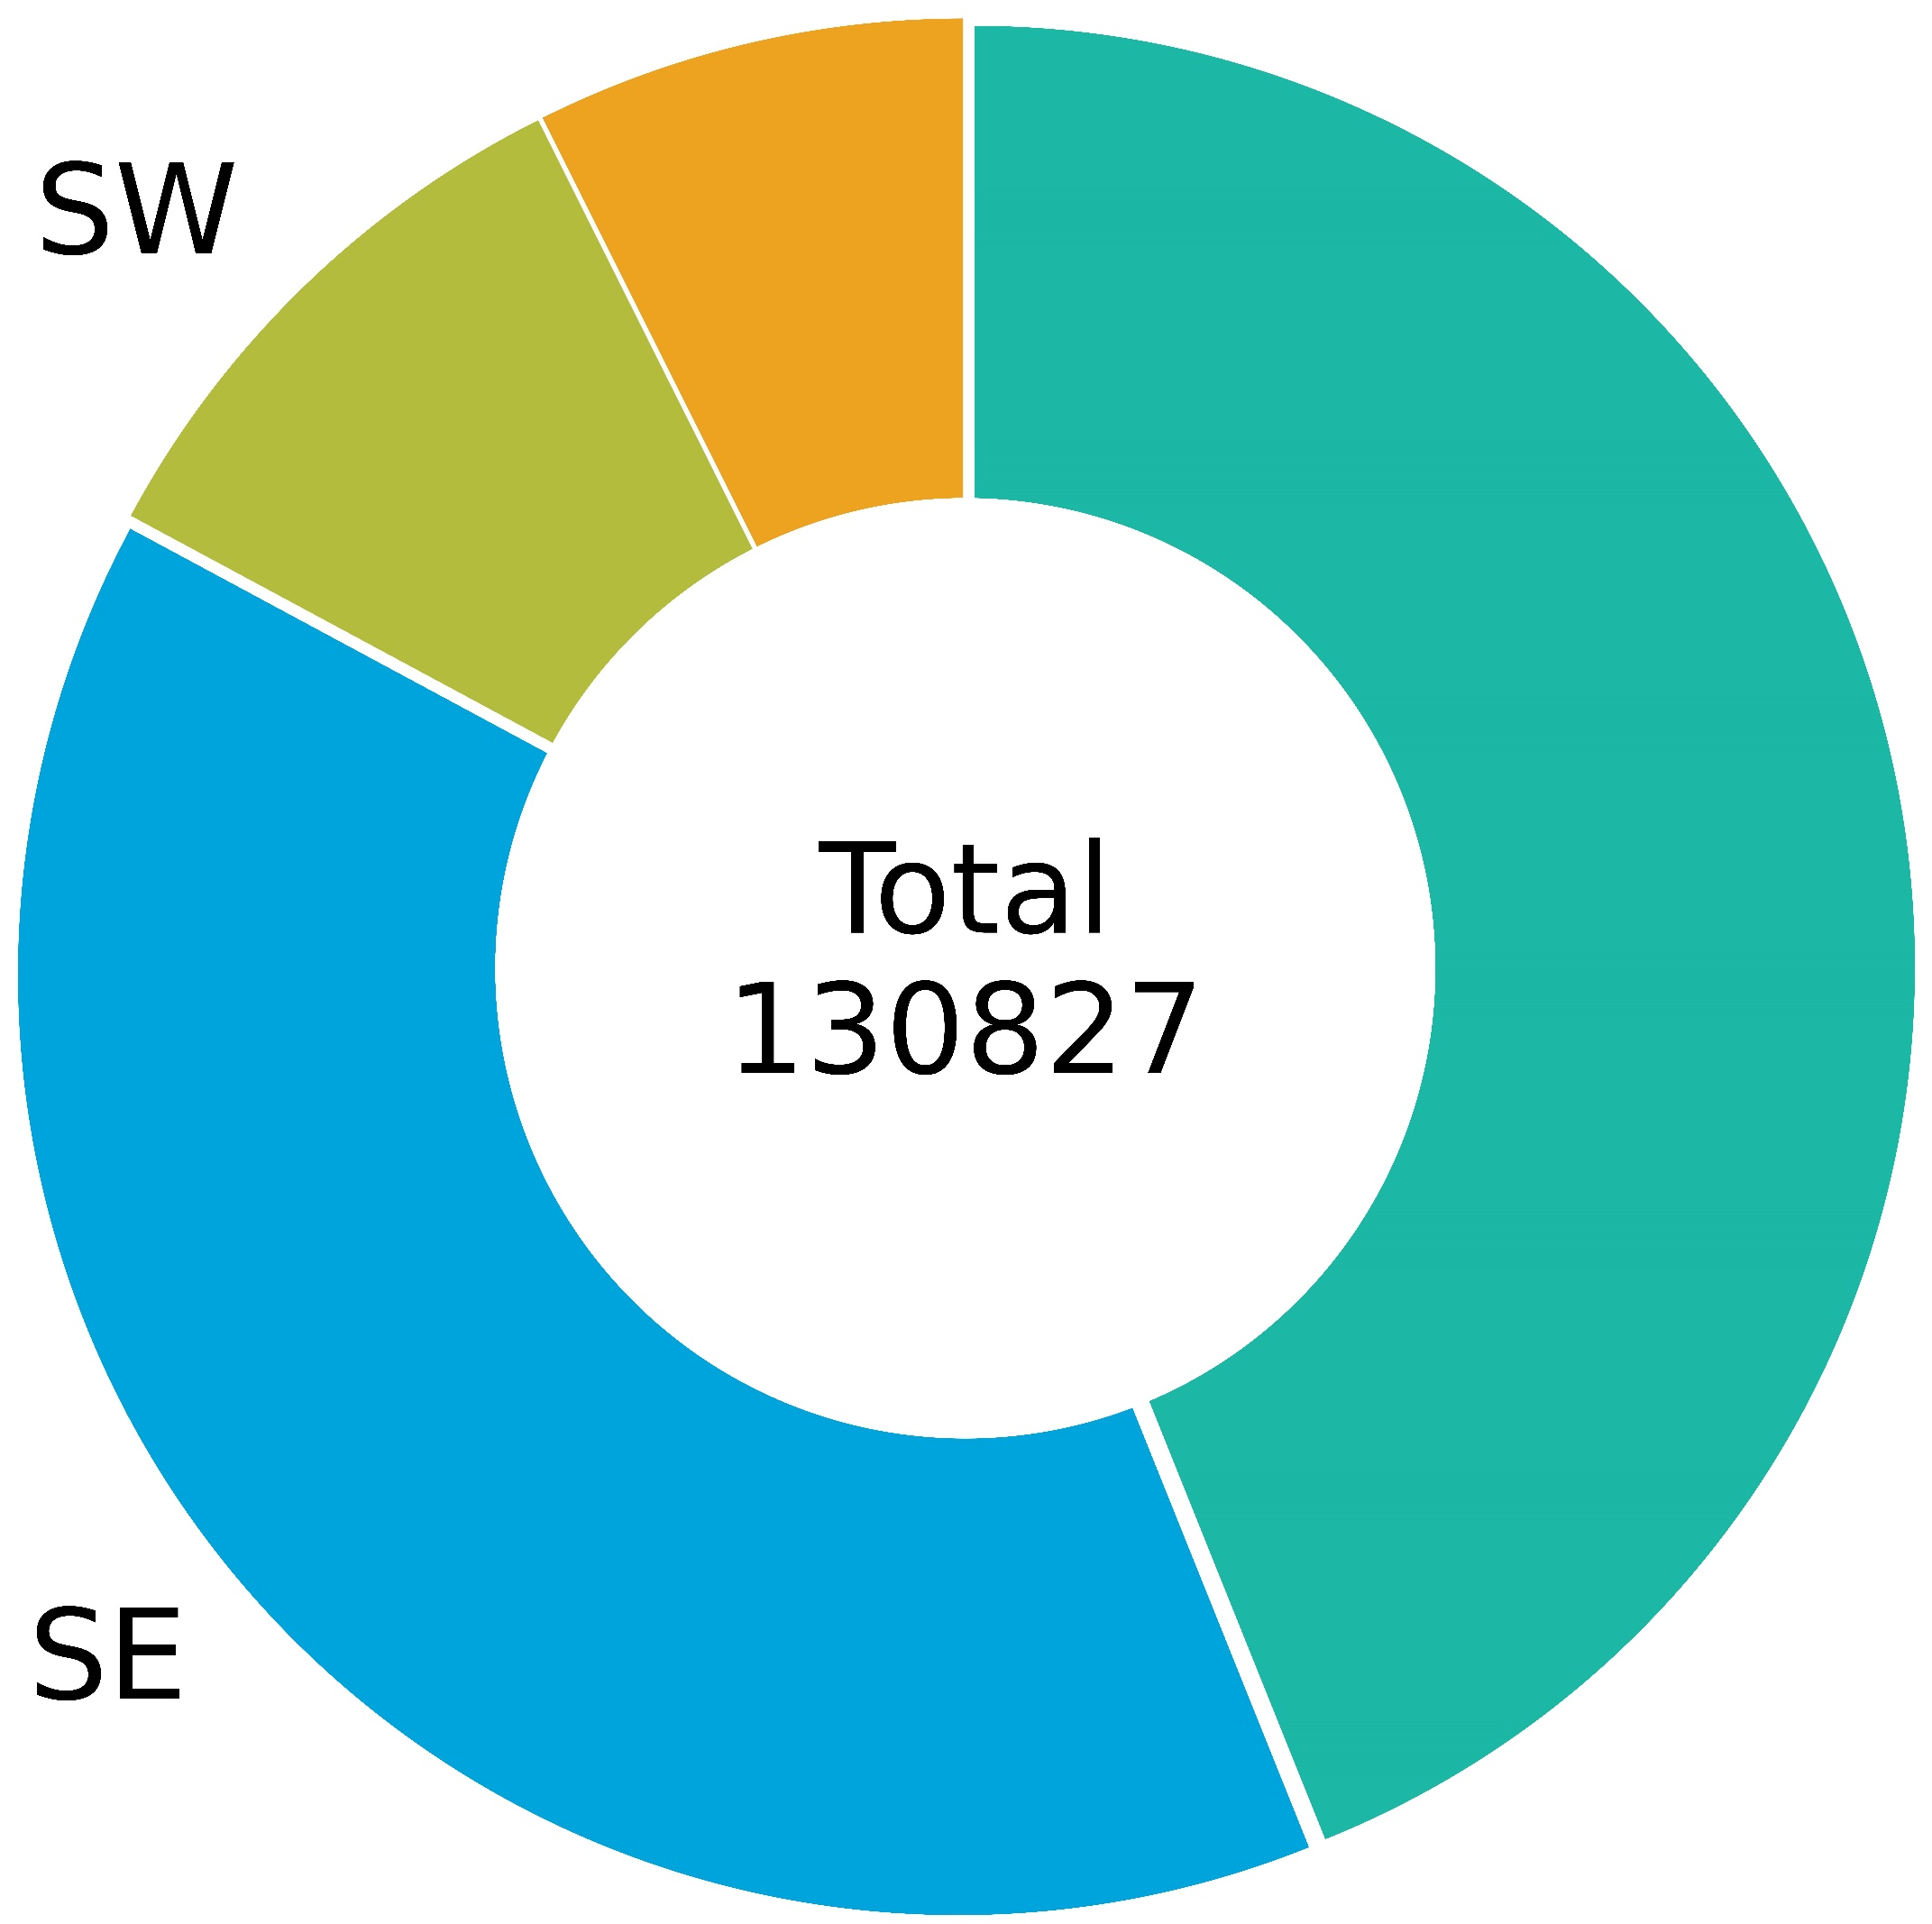
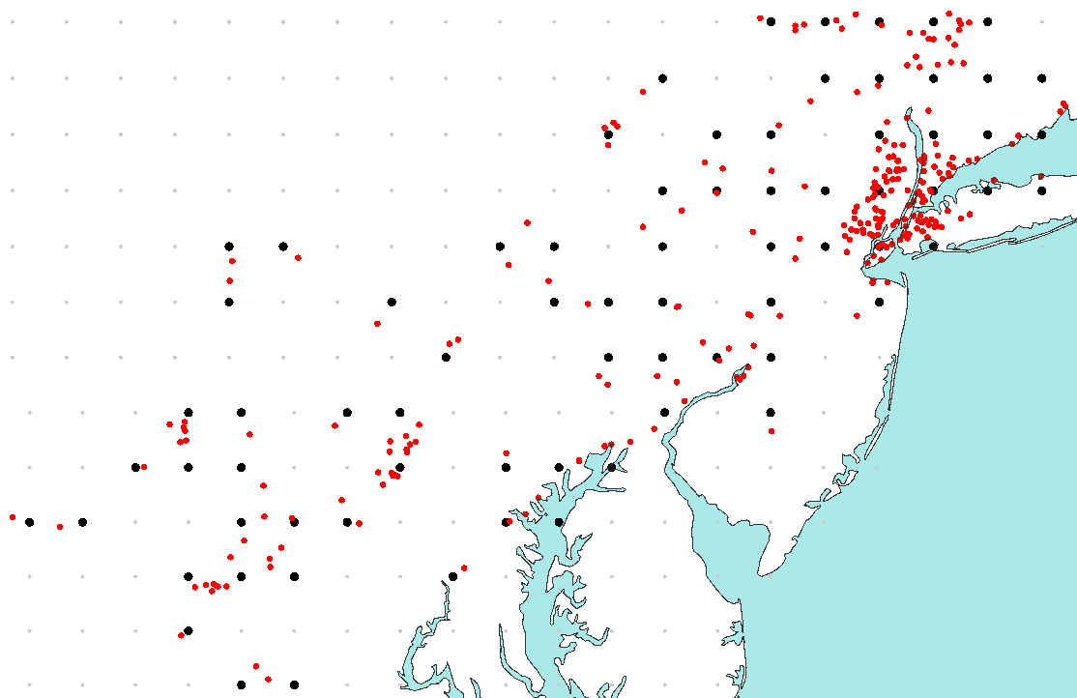
NOAA’s Storm Event Database
Reports for flash flood events
a) Timeseries of flood report counts in NOAA’s Severe Event Database per year, between 1950 to 2023
Distinction between all flood types and flash floods (with and without lat/lon coordinates)
b) Timeseries of flash flood report counts NOAA’s Severe Event Database in accumulated over 24-hourly accumulation periods ending at 00 UTC in 2021
Distinction between point and gridded flash flood reports
8
250
Point
7
All flood types
Gridded
12-hourly accumulation
period ending on
02-09-2021 at 00 UTC
6
Only flash floods
200
Only flash floods
with lat/lon coord.
2021
5
150
Counts
Counts * 10⁴
4
100
3
50
2
1
0
0
1950
1960
1970
1980
1990
2000
2010
2020
2021-01
2021-02
2021-03
2021-04
2021-05
2021-06
2021-07
2021-08
2021-09
2021-10
2021-11
2021-12
2022-01
Years
Days
d) Spatial distribution of the observed frequency of flash flood reports in NOAA’s Severe Storm Event Database, in each grid-box, between 2001 to 2024
Distinction between 4 geographical areas: South-West (SW), North-West (NW), North-East (NE), South-East (SE)
c) Spatial distribution of gridded, 24-hourly accumulated flash flood reports in NOAA’s Severe Event Database during the Ida storm
24-hourly accumulation period ending on 2021-09-02 at 00 UTC
%
%
%
%
50 °N
0
0.1
1
10
0
0.1
1
10
0
0.1
1
10
0
0.1
1
10
NW
SW
NE
SE
50 °N
40 °N
30 °N
40 °N
120 °W
100 °W
80 °W
9%
30 °N
11%
d
Total
130827
41%
120 °W
100 °W
80 °W
39%

