Slide 1
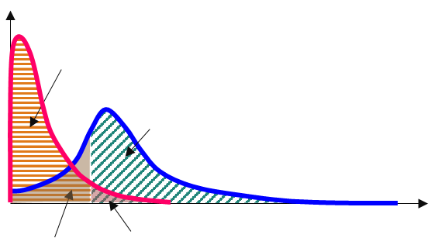
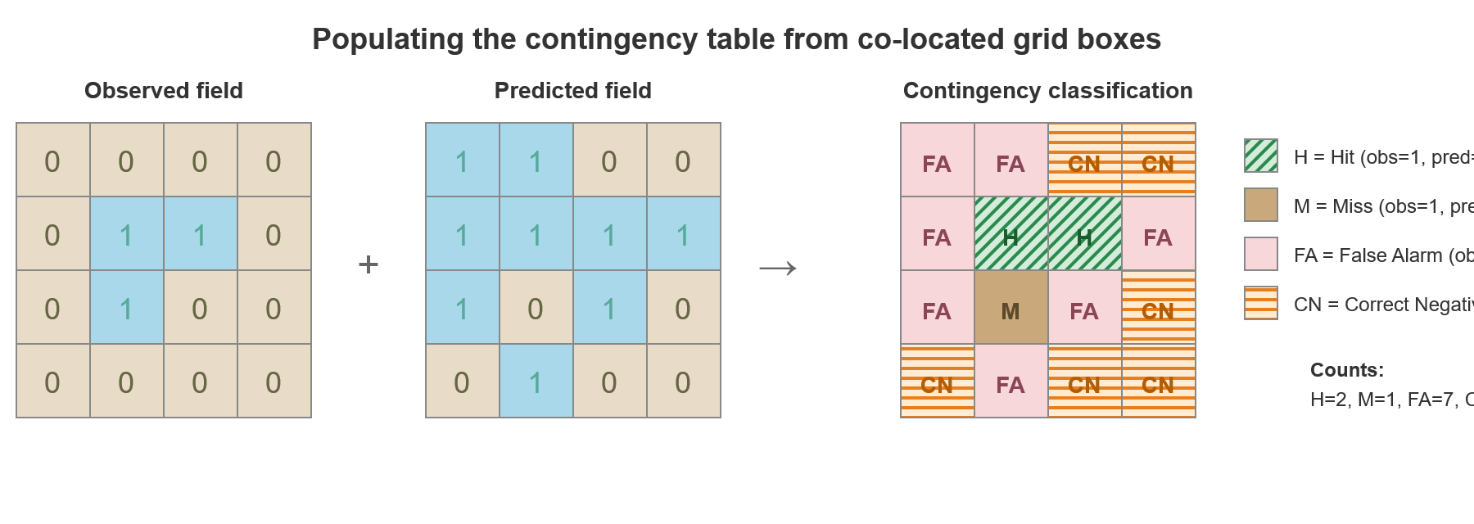
Contingency table for probabilistic forecasts
Basis to define objective verification scores
(a) Schematic of the contingency table for probabilistic forecasts
(b) 2x2 contingency table for a given probability threshold
Predicted
non-events
Predicted
yes-events
Predicted
yes-events
non-events
Density
(Moving) probability
threshold
yes-events
HITS (H)
The event was predicted and it was observed
MISSES (M)
The event was not predicted but it was observed
CN
Observed
Distribution of observed non-events
H
Distribution of observed yes-events
0
50
100 %
non-events
FALSE ALARMS (FA)
The event was predicted but it was not observed
CORRECT NEGATIVE (CN)
The event was not predicted and it was not observed
M
FA
Probabilities of exceeding the verifying rainfall threshold (defined as a percentile or return period)
(c) Practical construction of the 2x2 contingency table for each grid-box in the considered geographical domain
Observed binary field
Predicted binary field (for a probability of exceeding the verifying rainfall threshold)
Values of the 2x2 contingency table in each grid-box
overlapped with
=

