Slide 1
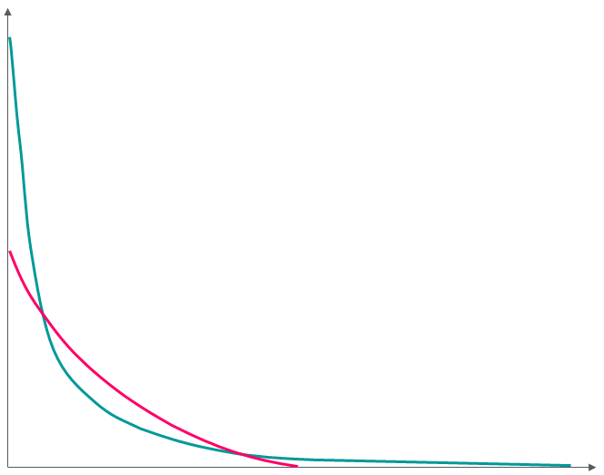
Definition of verifying rainfall thresholds
For point-scale and gridded rainfall estimates
(a)
RESOLUTION OF RAINFALL ESTIMATES
(b)
TYPES OF RAINFALL DISTRIBUTIONS BASED ON THE RAINFALL ESTIMATES’ SPATIAL RESOLUTION
Historical point-scale observations
(from rain gauges or rada-derived)
or
ERA5-ecPoint rainfall estimates
Xth percentile
(e.g., 99th)
Xth percentile
(e.g., 99th)
POINT-SCALE
Probability density
Range of rainfall values that might cause flash floods
or
Gridded blended or modelled rainfall estimates
GRIDDED
(Gridded)
verifying rainfall threshold
(Point)
verifying rainfall threshold
<
Rainfall (mm/24h)

