Slide 1
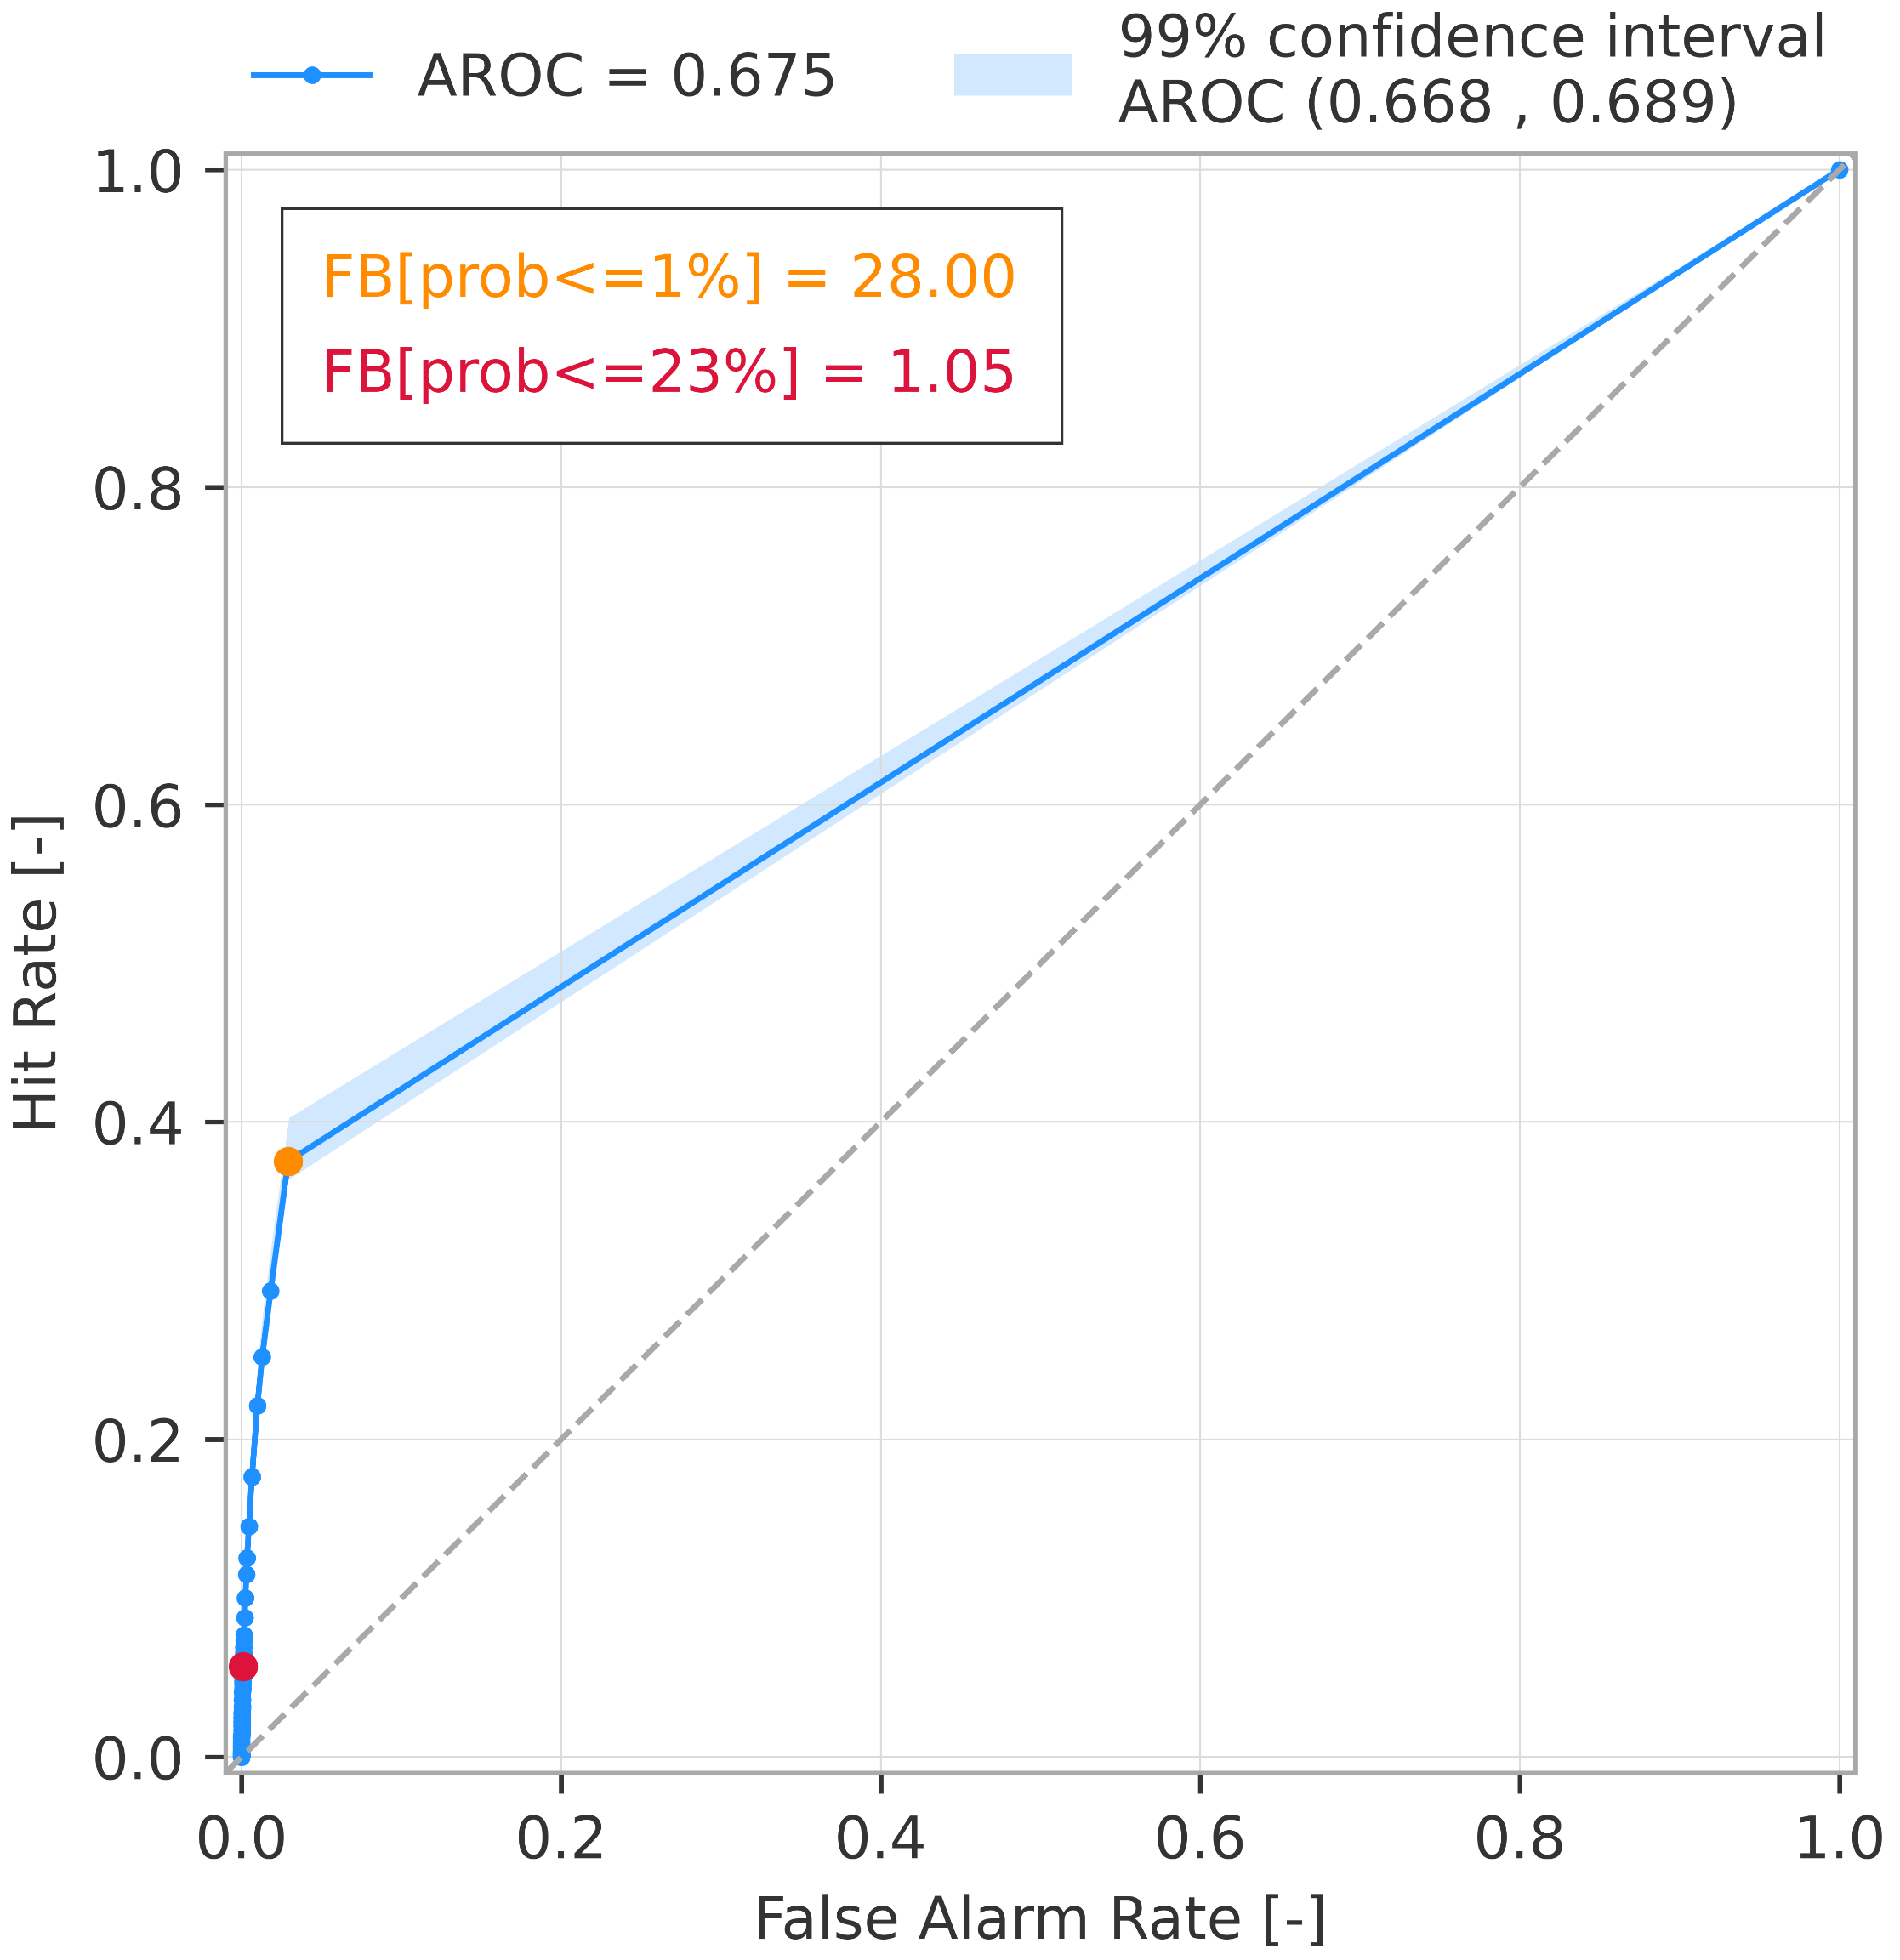
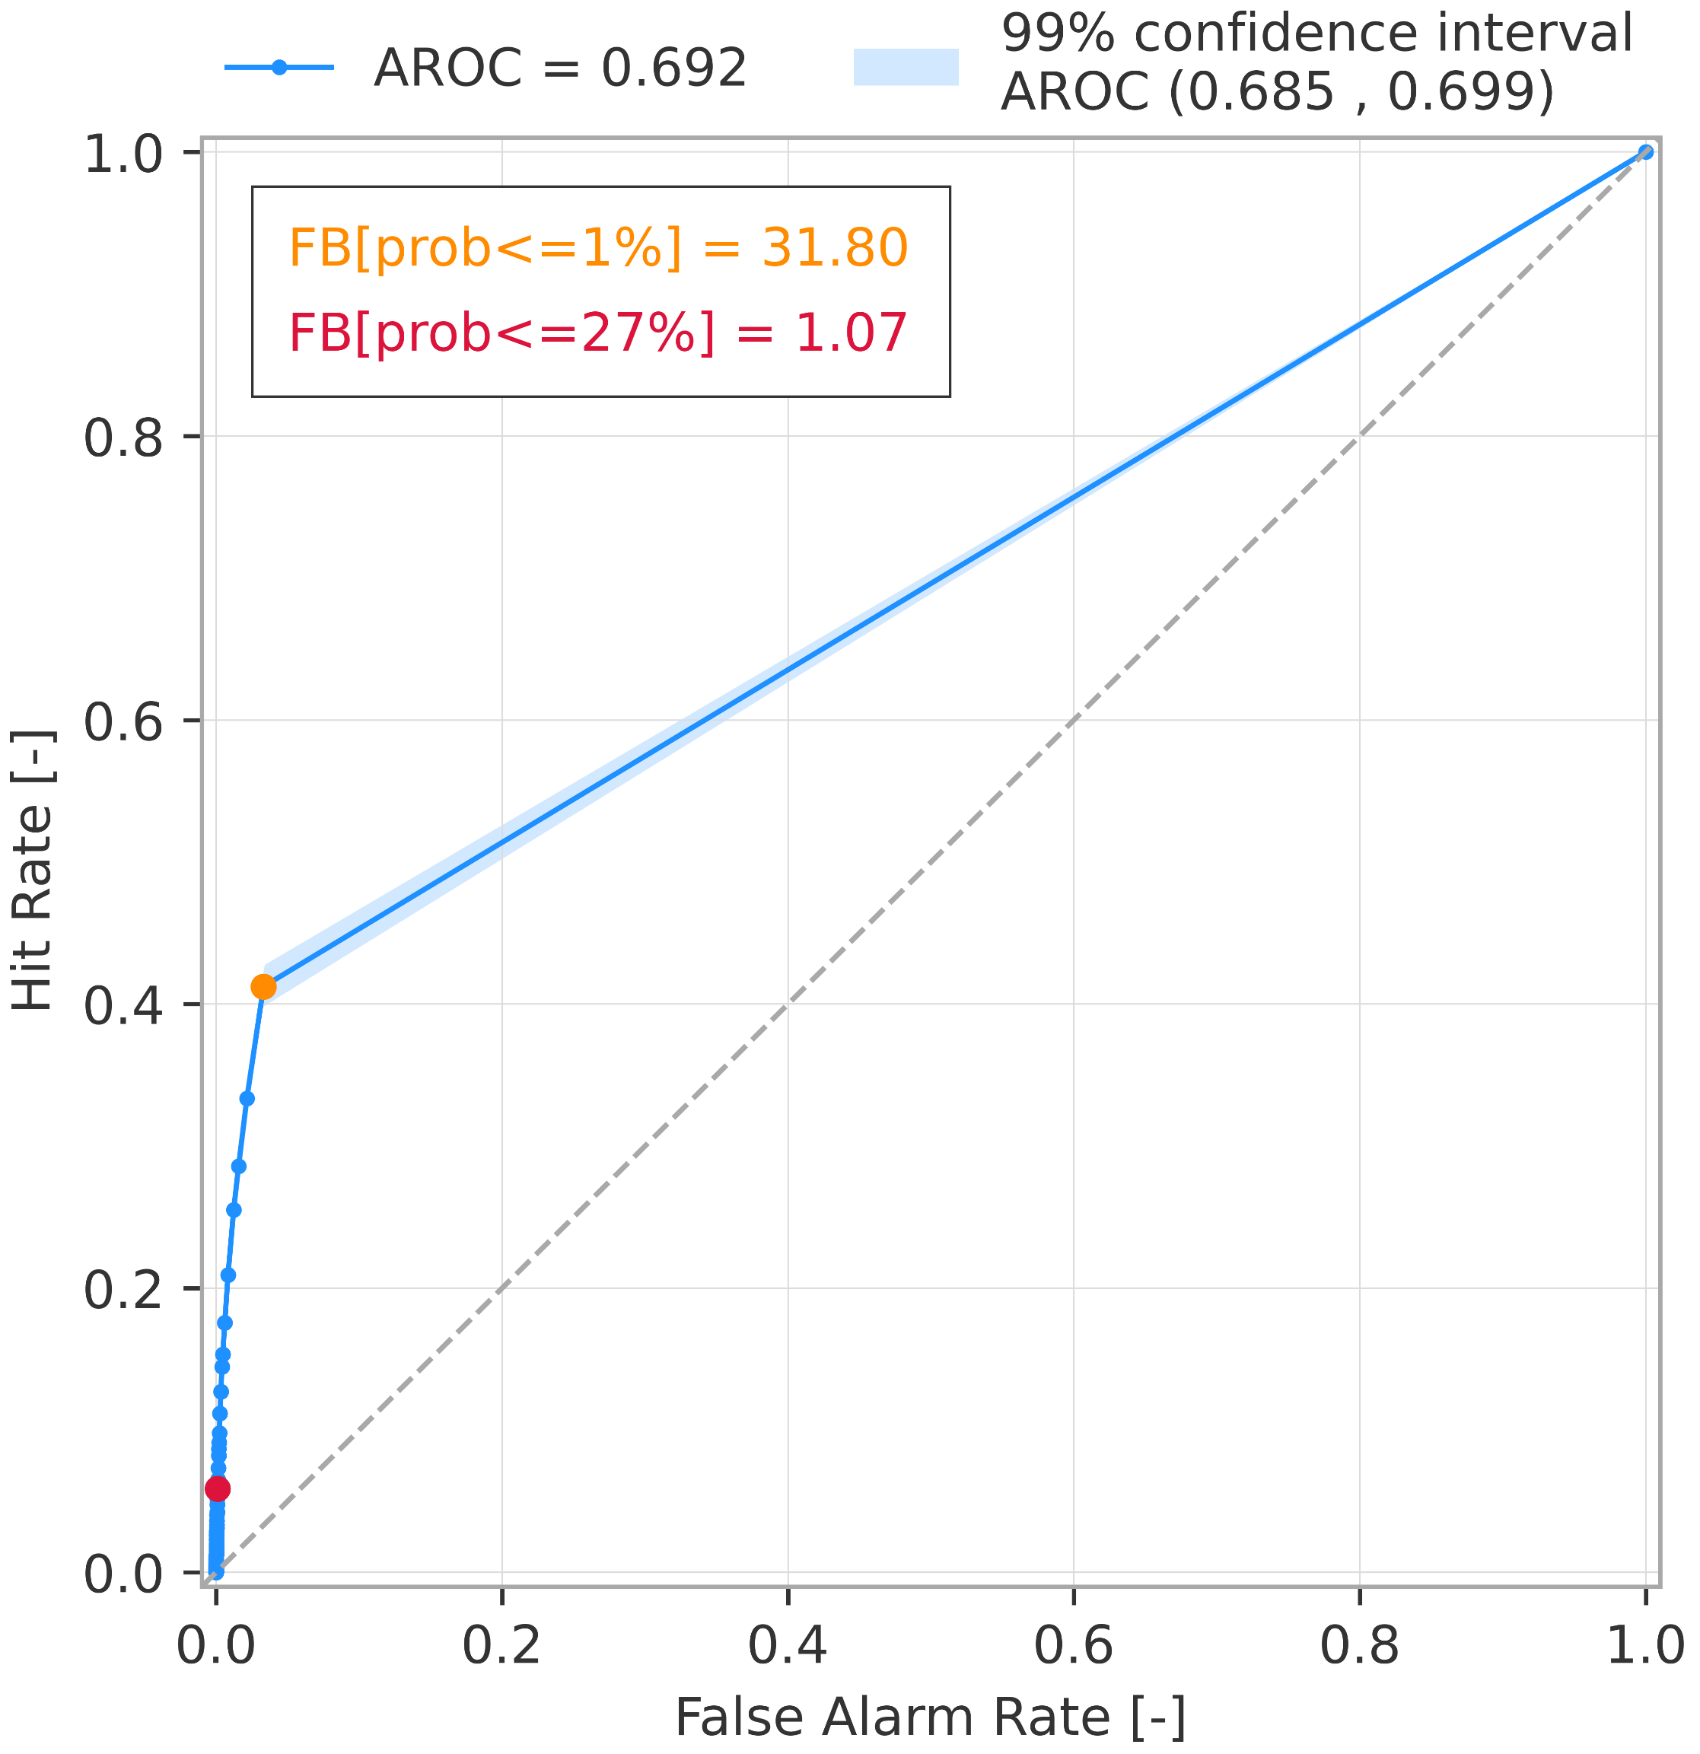
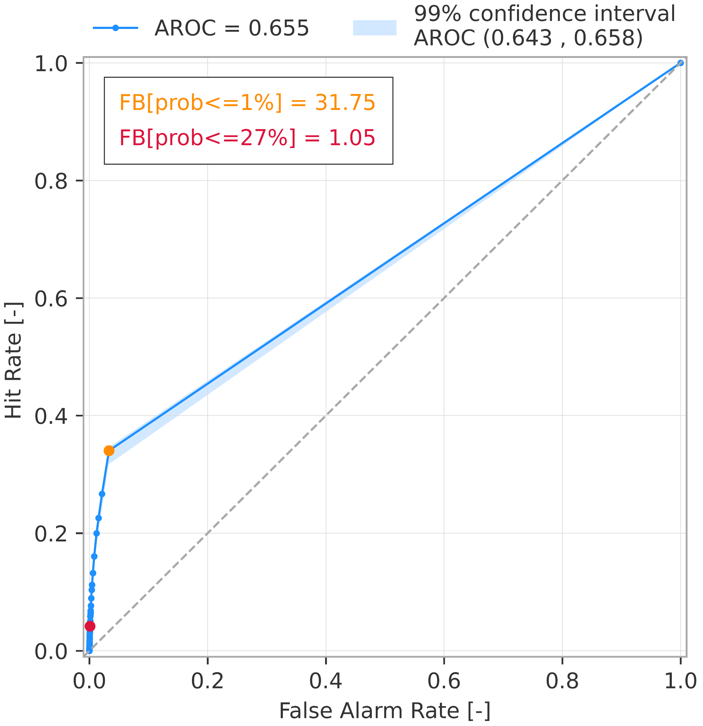
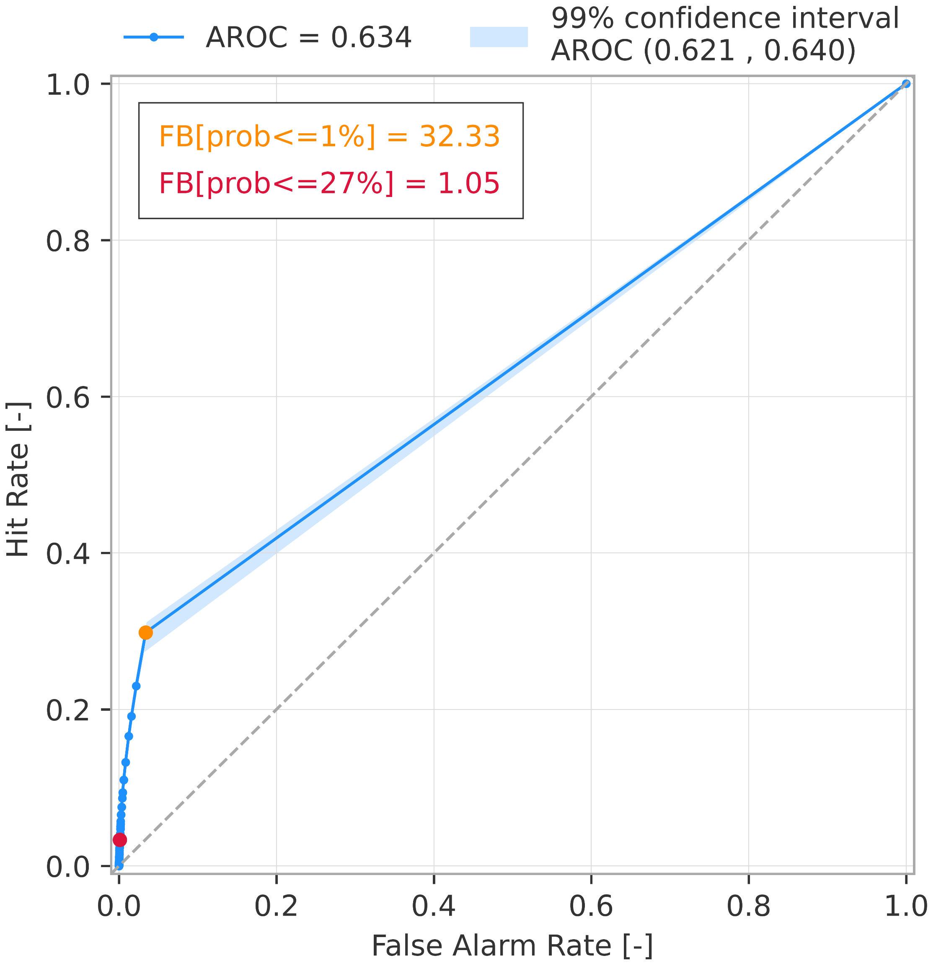
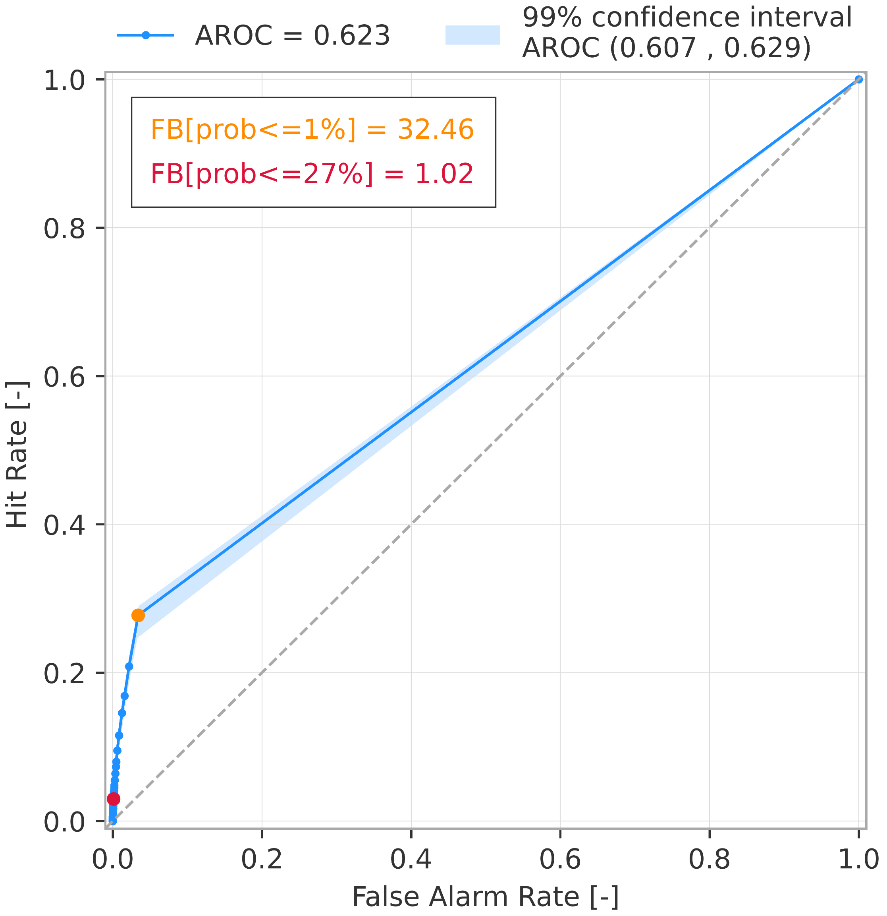
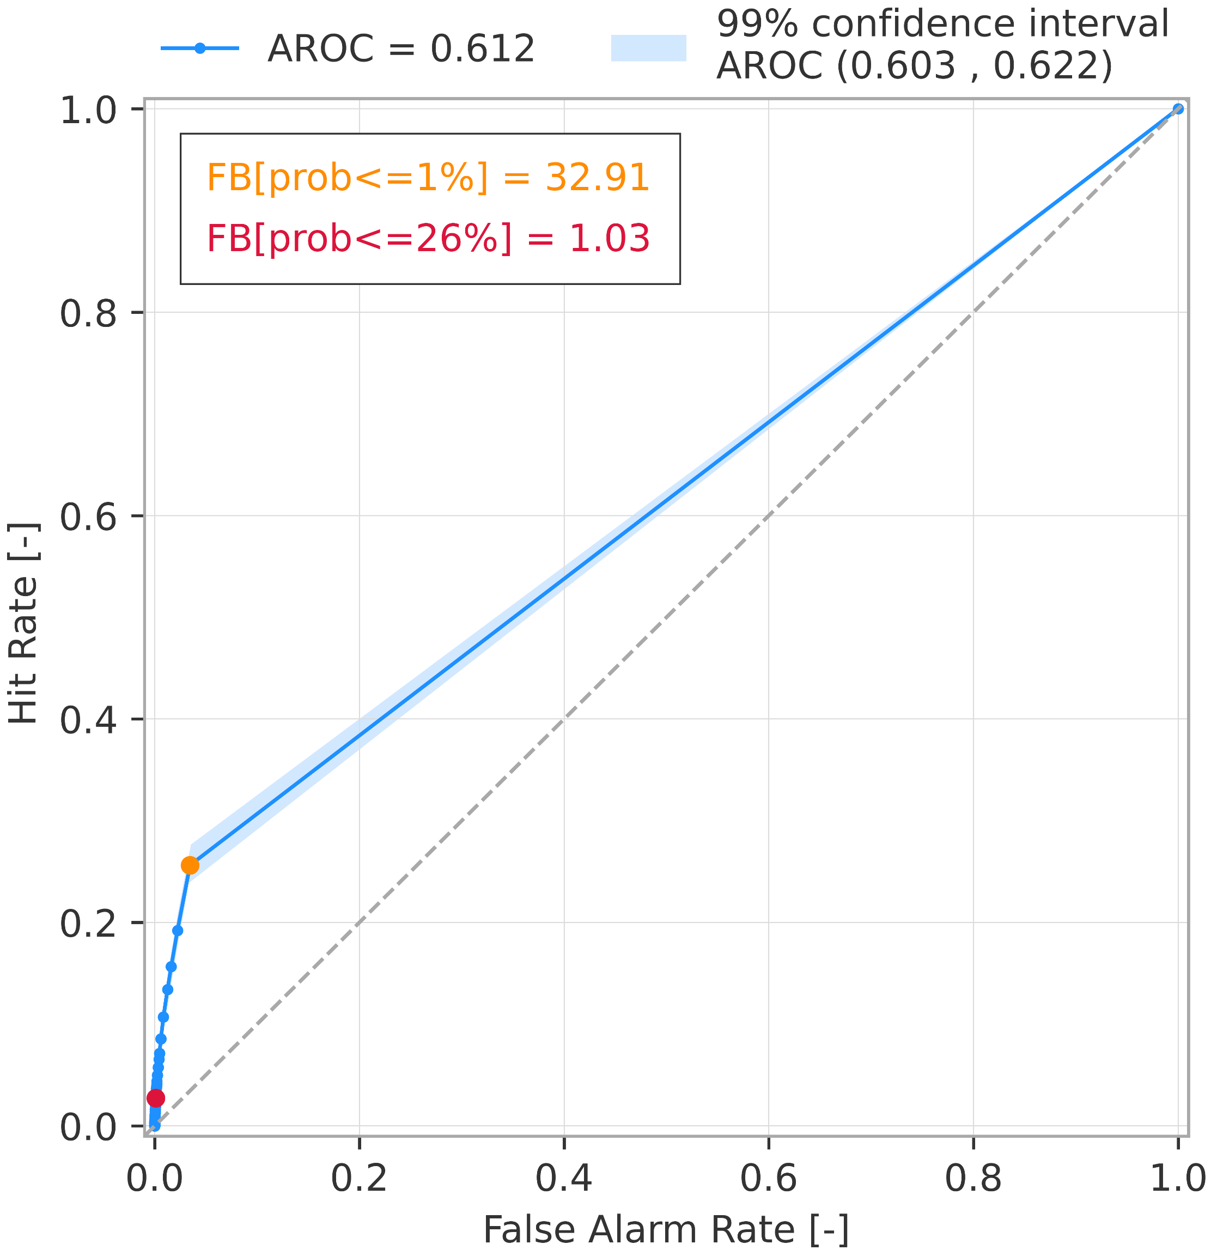
Rainfall-based forecasts of areas at risk of flash flood (ERA5-ecPoint)
Discrimination ability – ROC curves for tp >= 1-year return period
a) short-range forecast (reanalysis)
b) long-range forecast (t+0,t+24)
c) long-range forecast (t+24,t+48)
d) long-range forecast (t+48,t+72)
e) long-range forecast (t+72,t+96)
f) long-range forecast (t+96,t+120)

