Slide 1
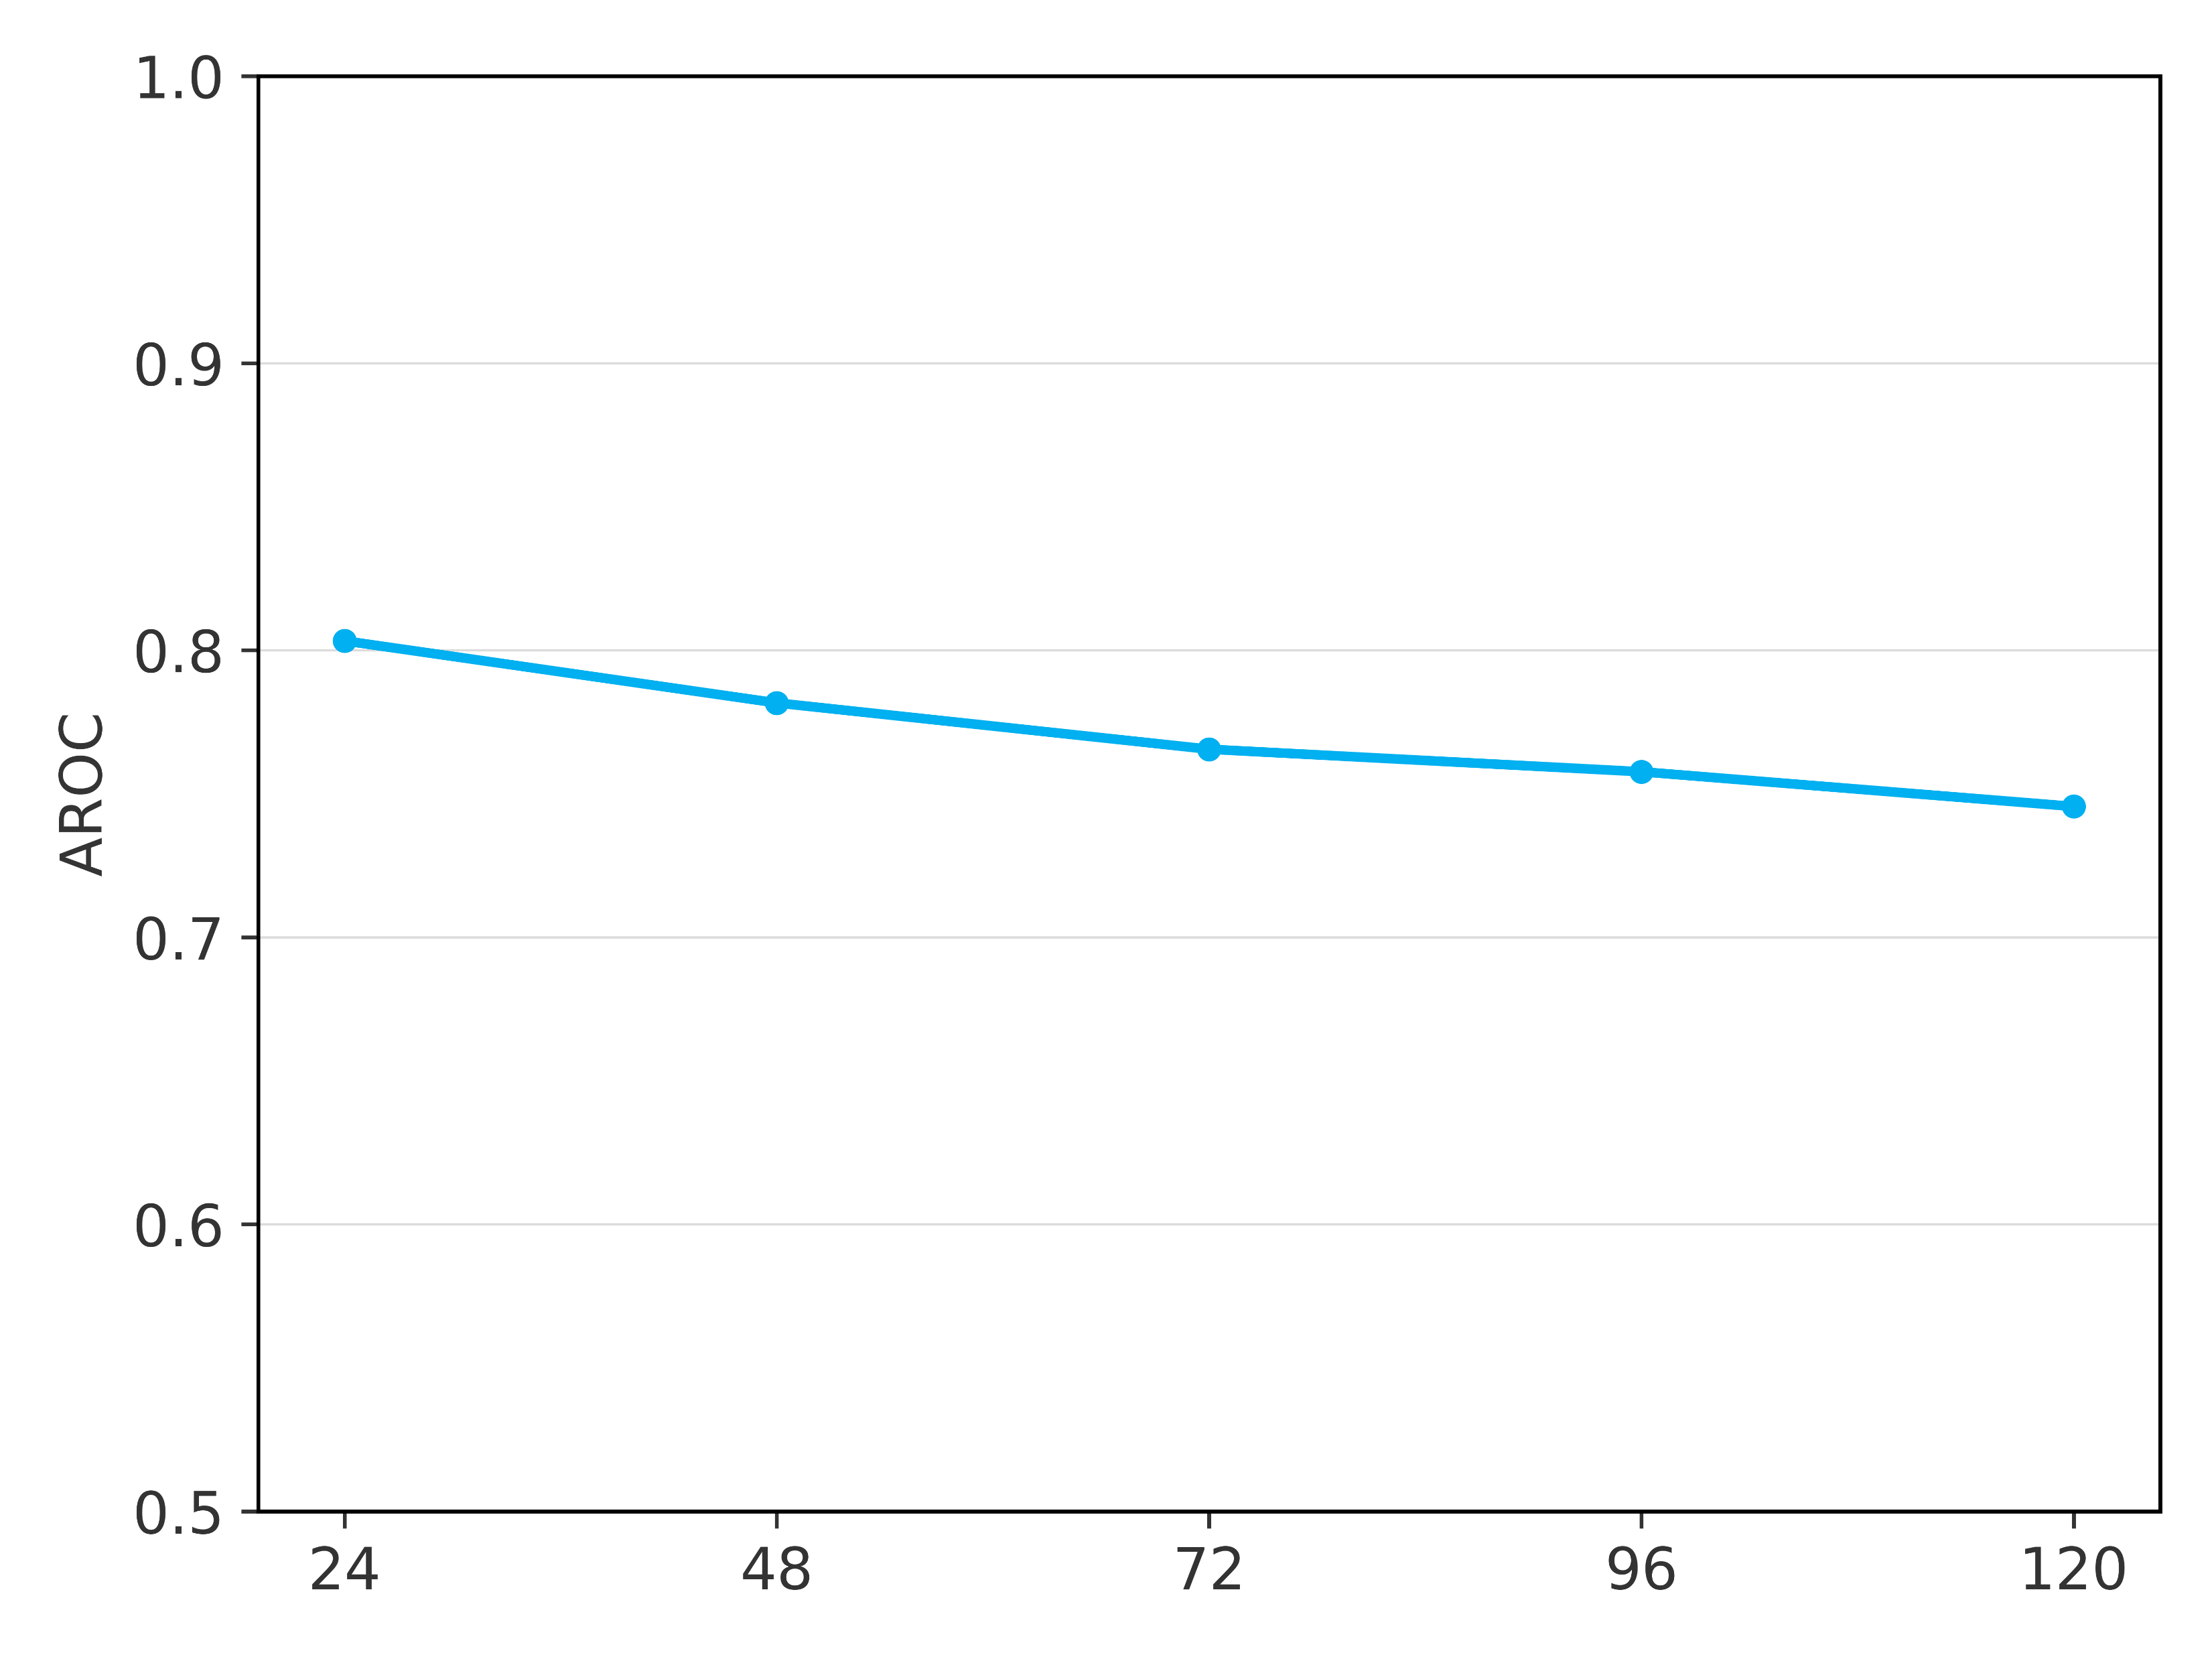
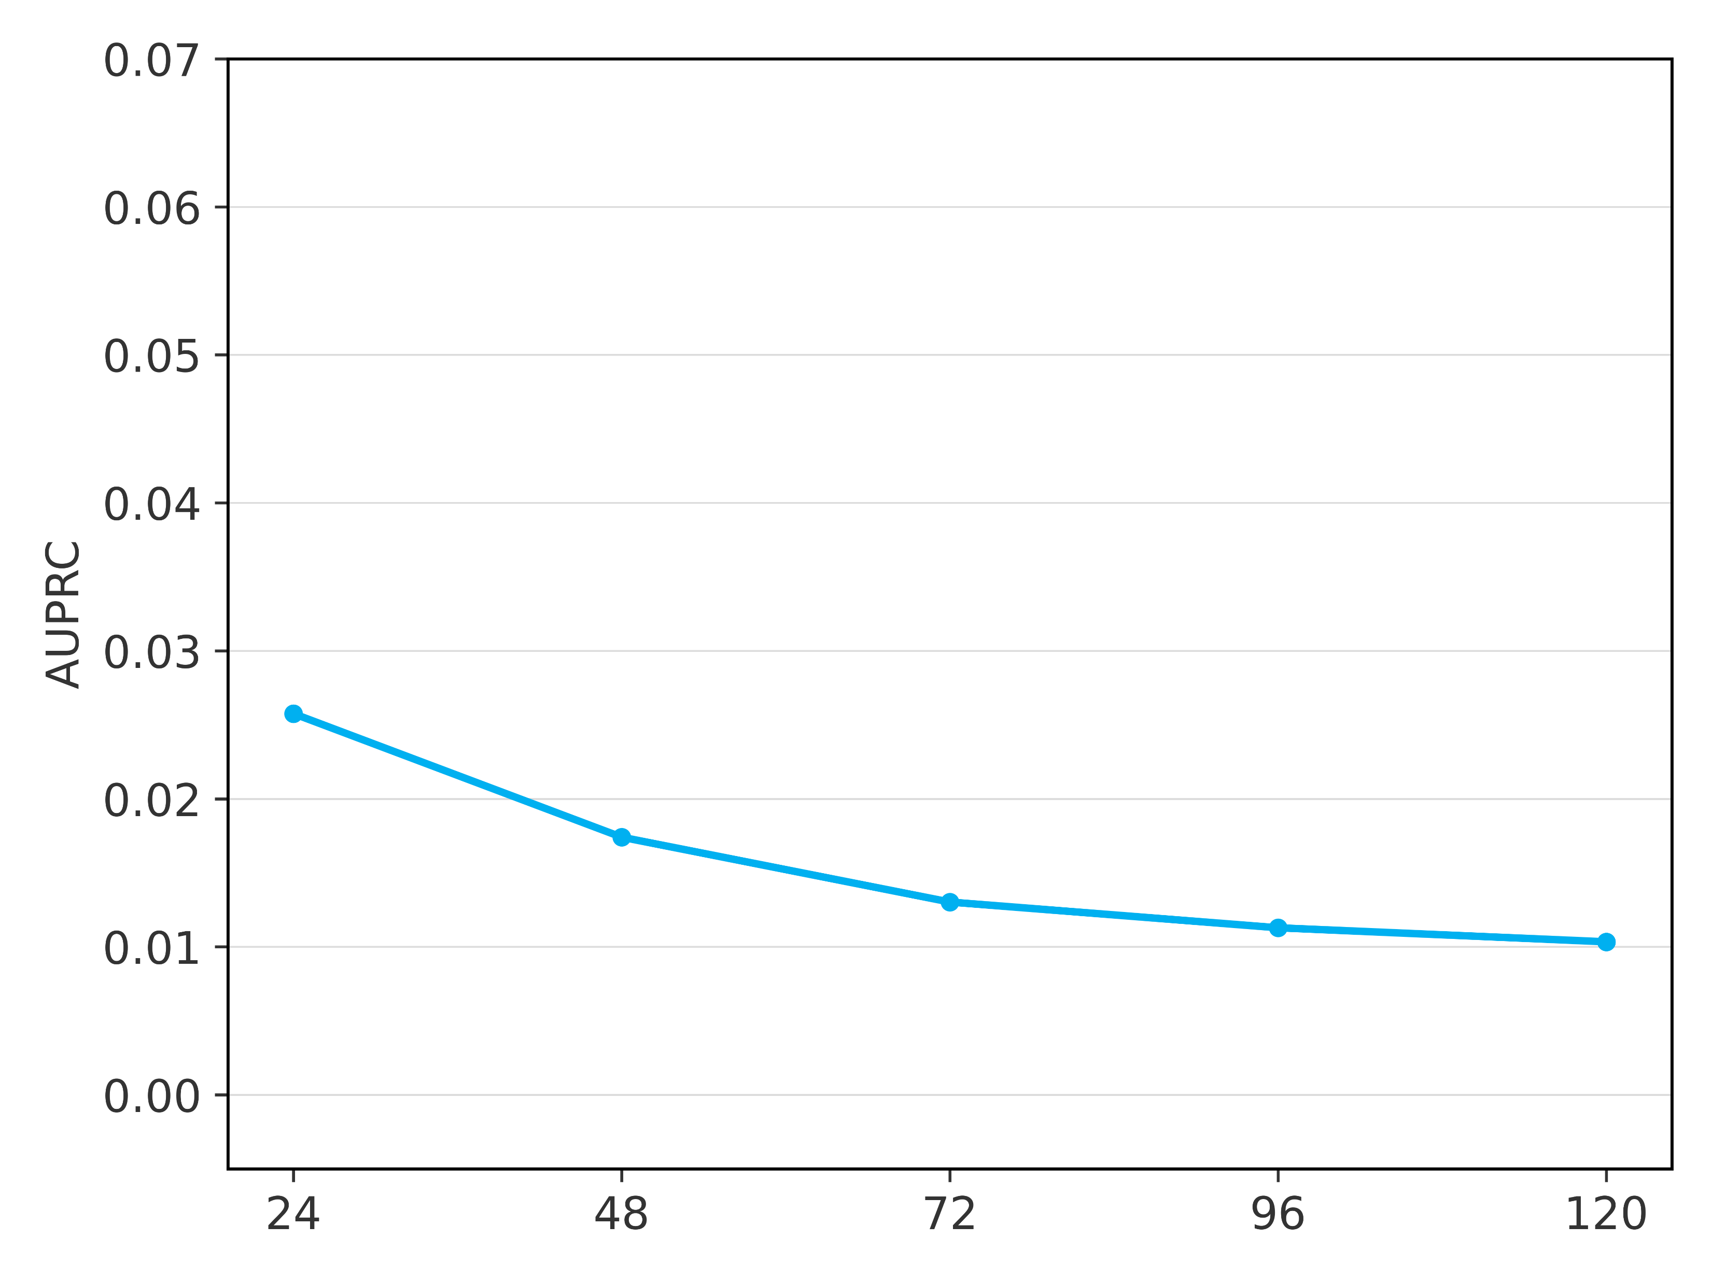
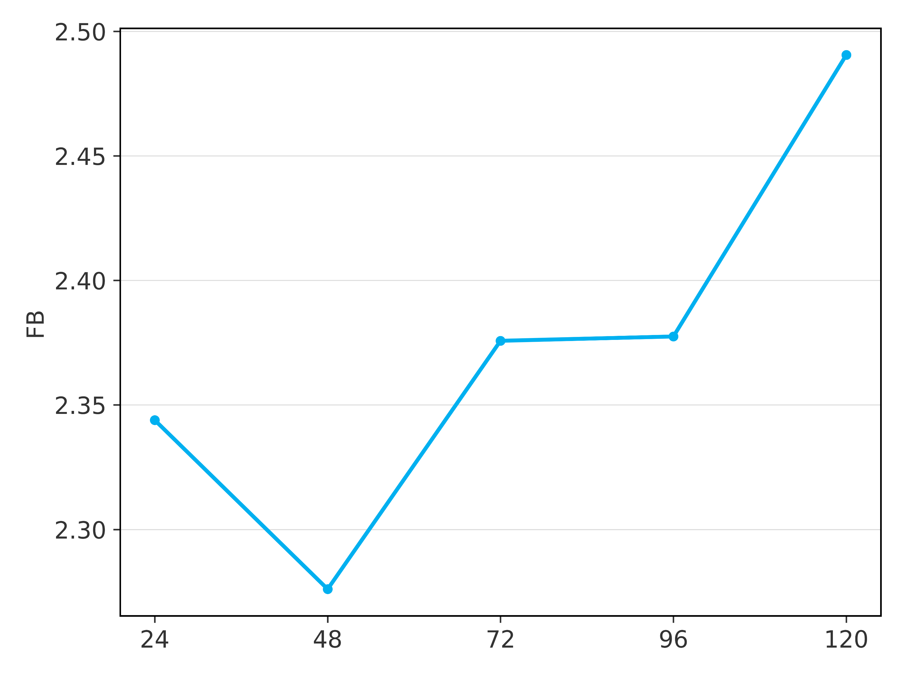
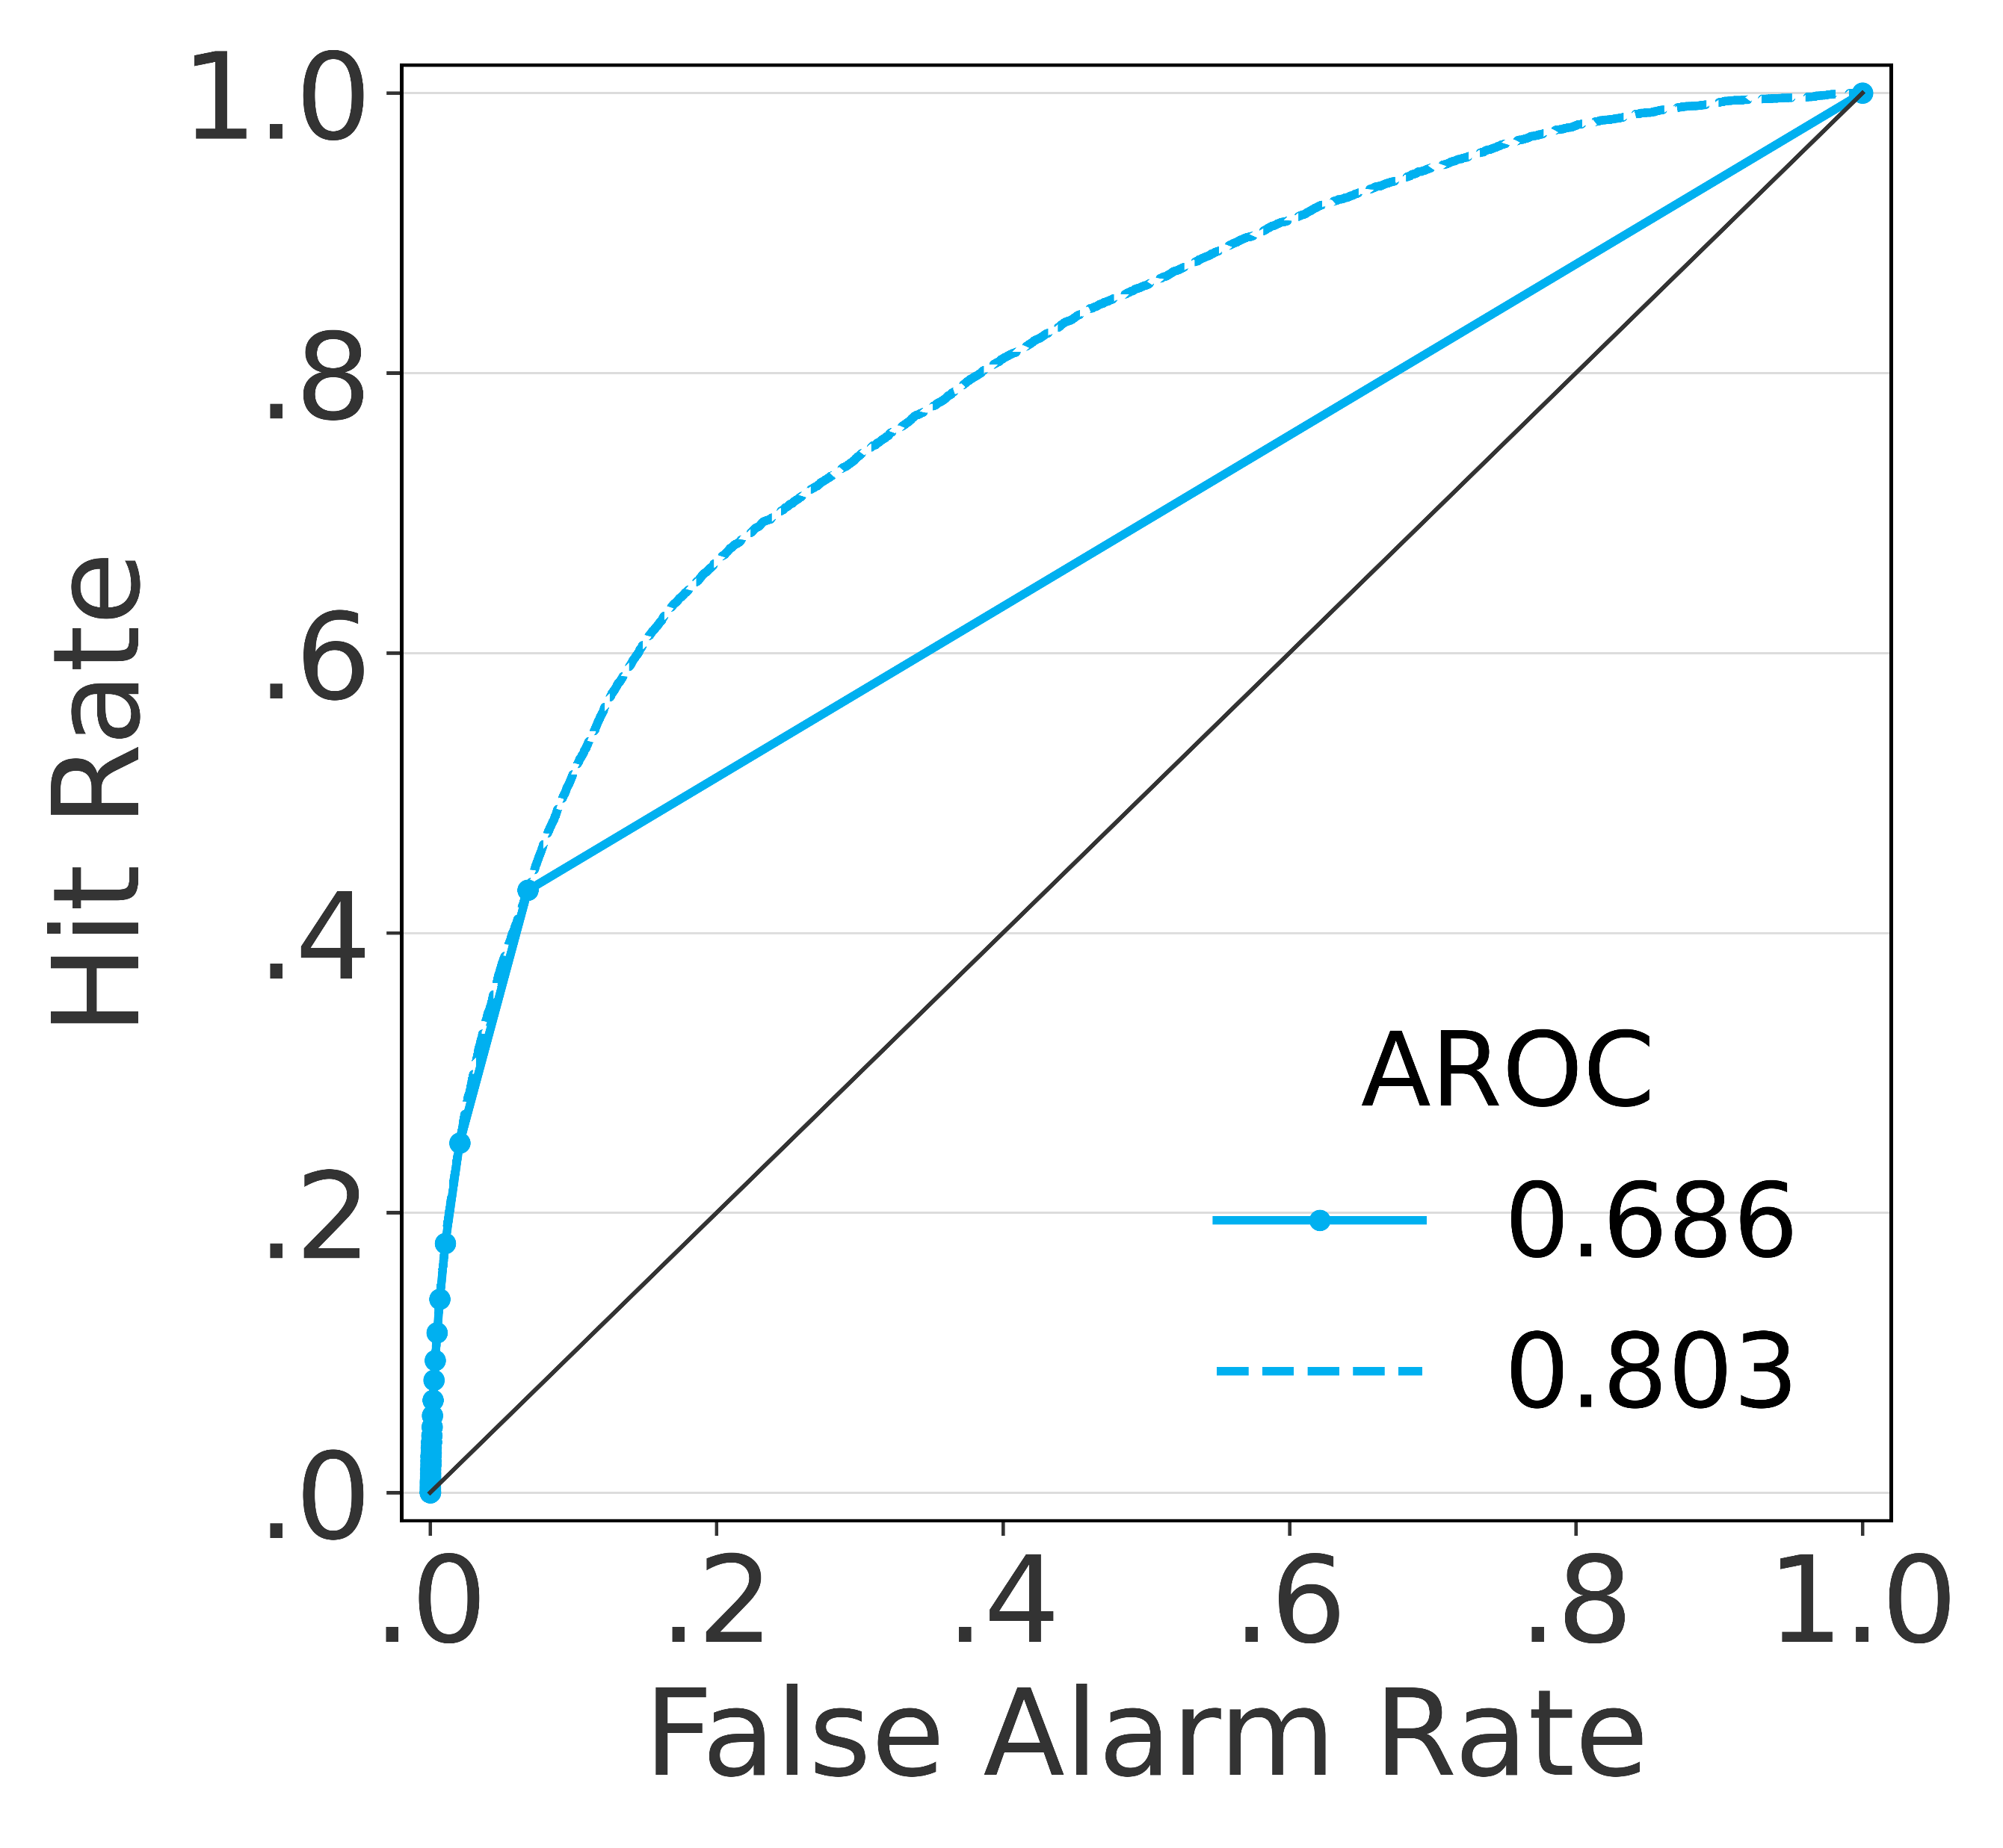

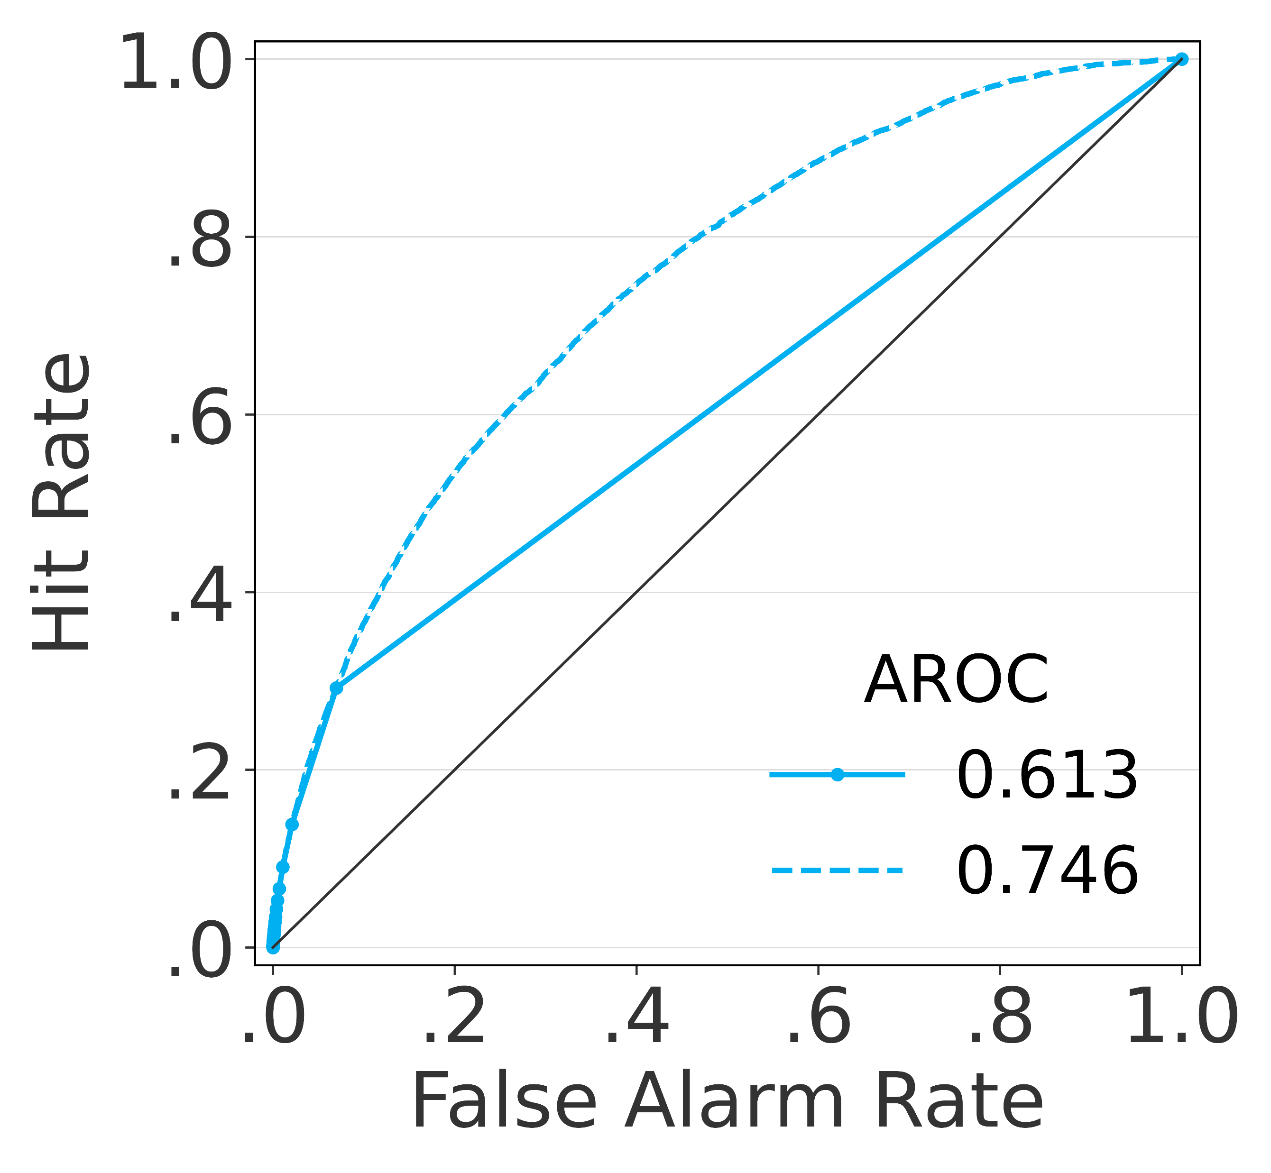
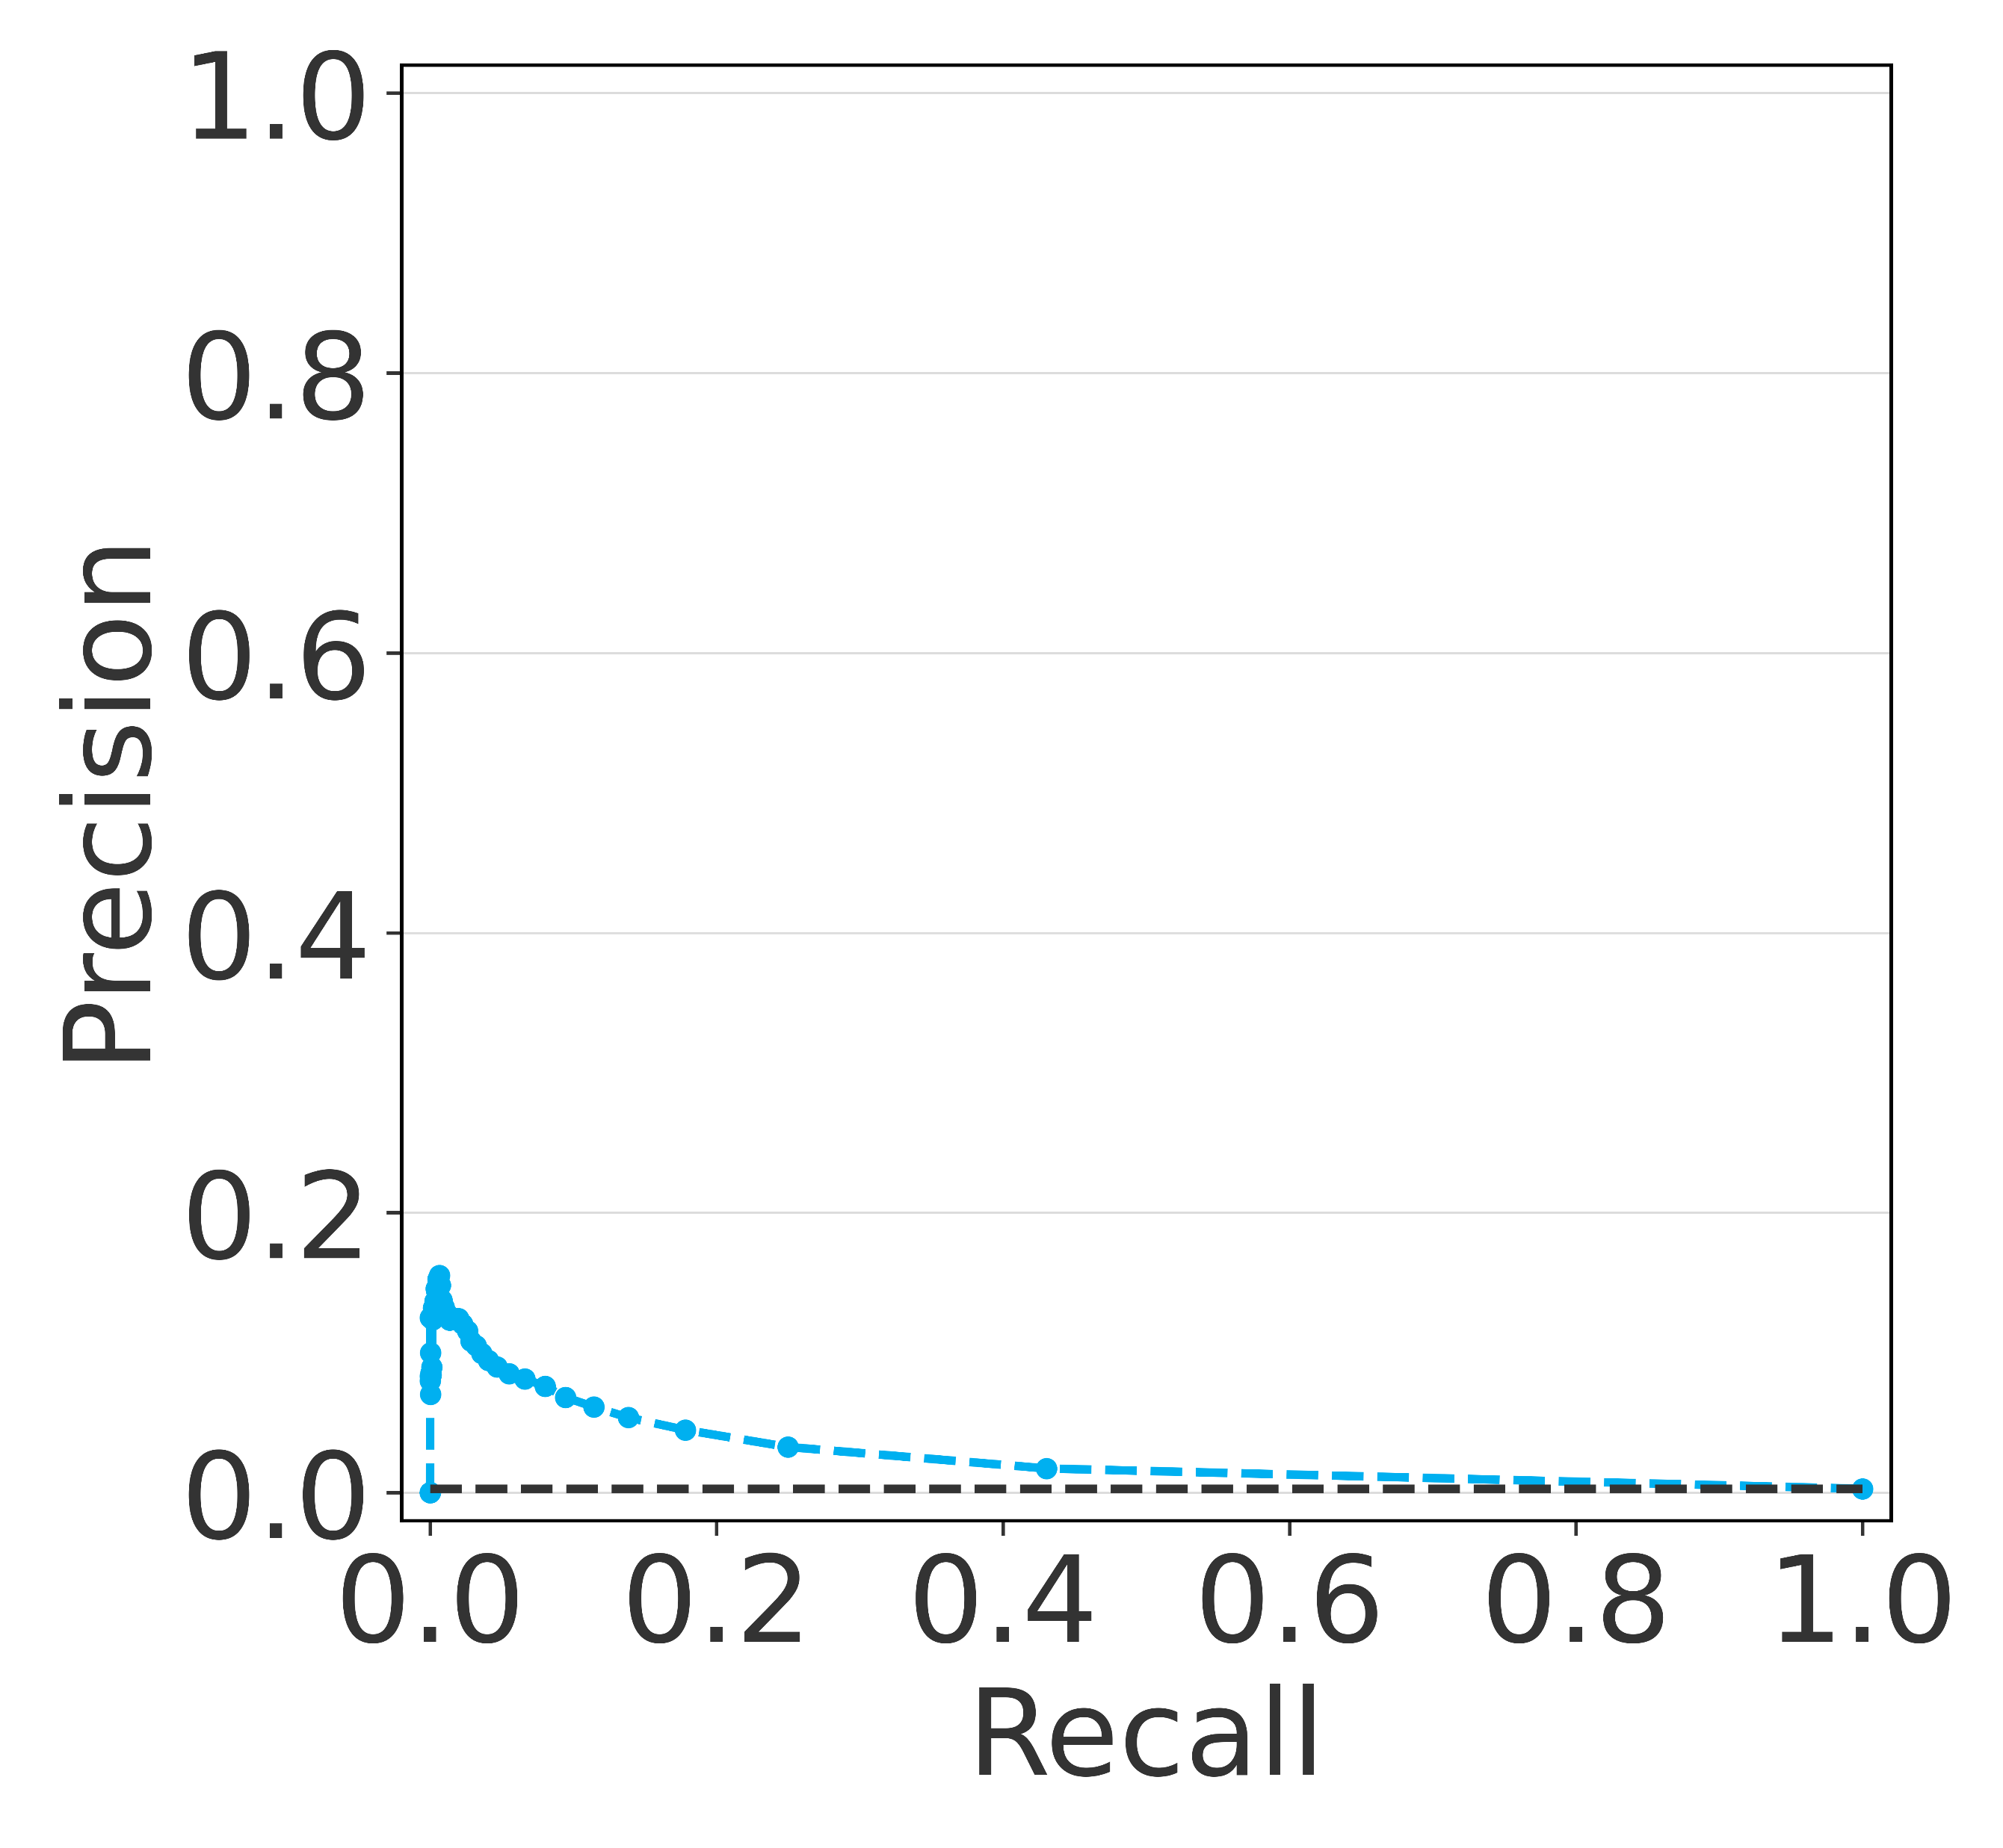
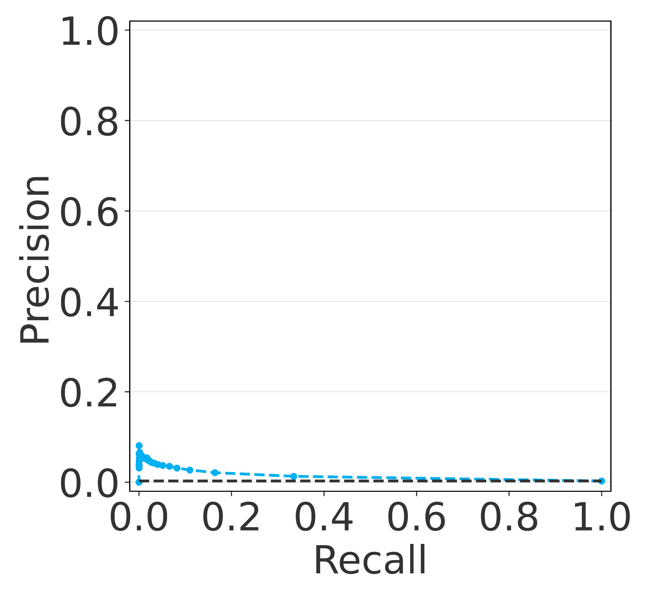
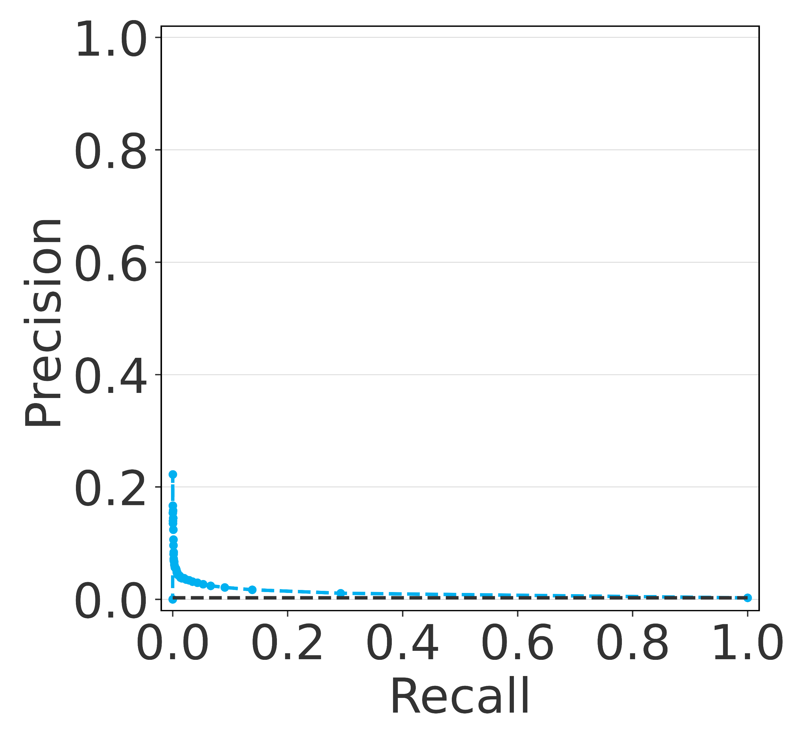
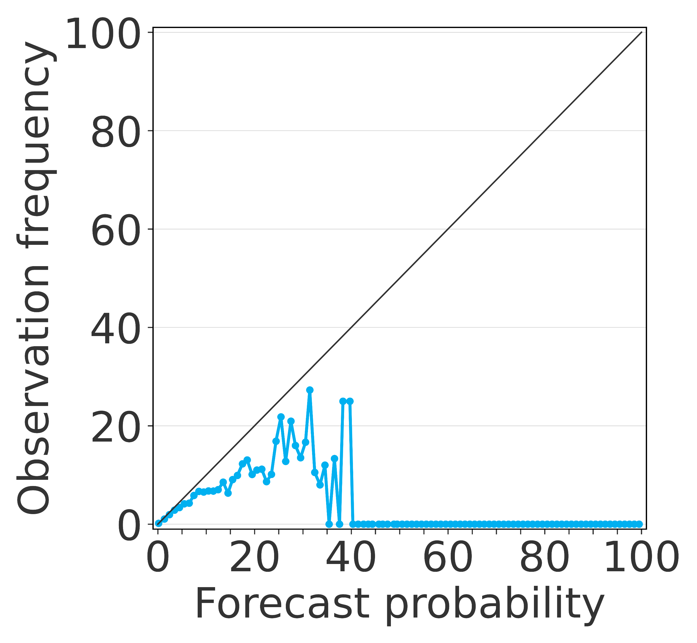
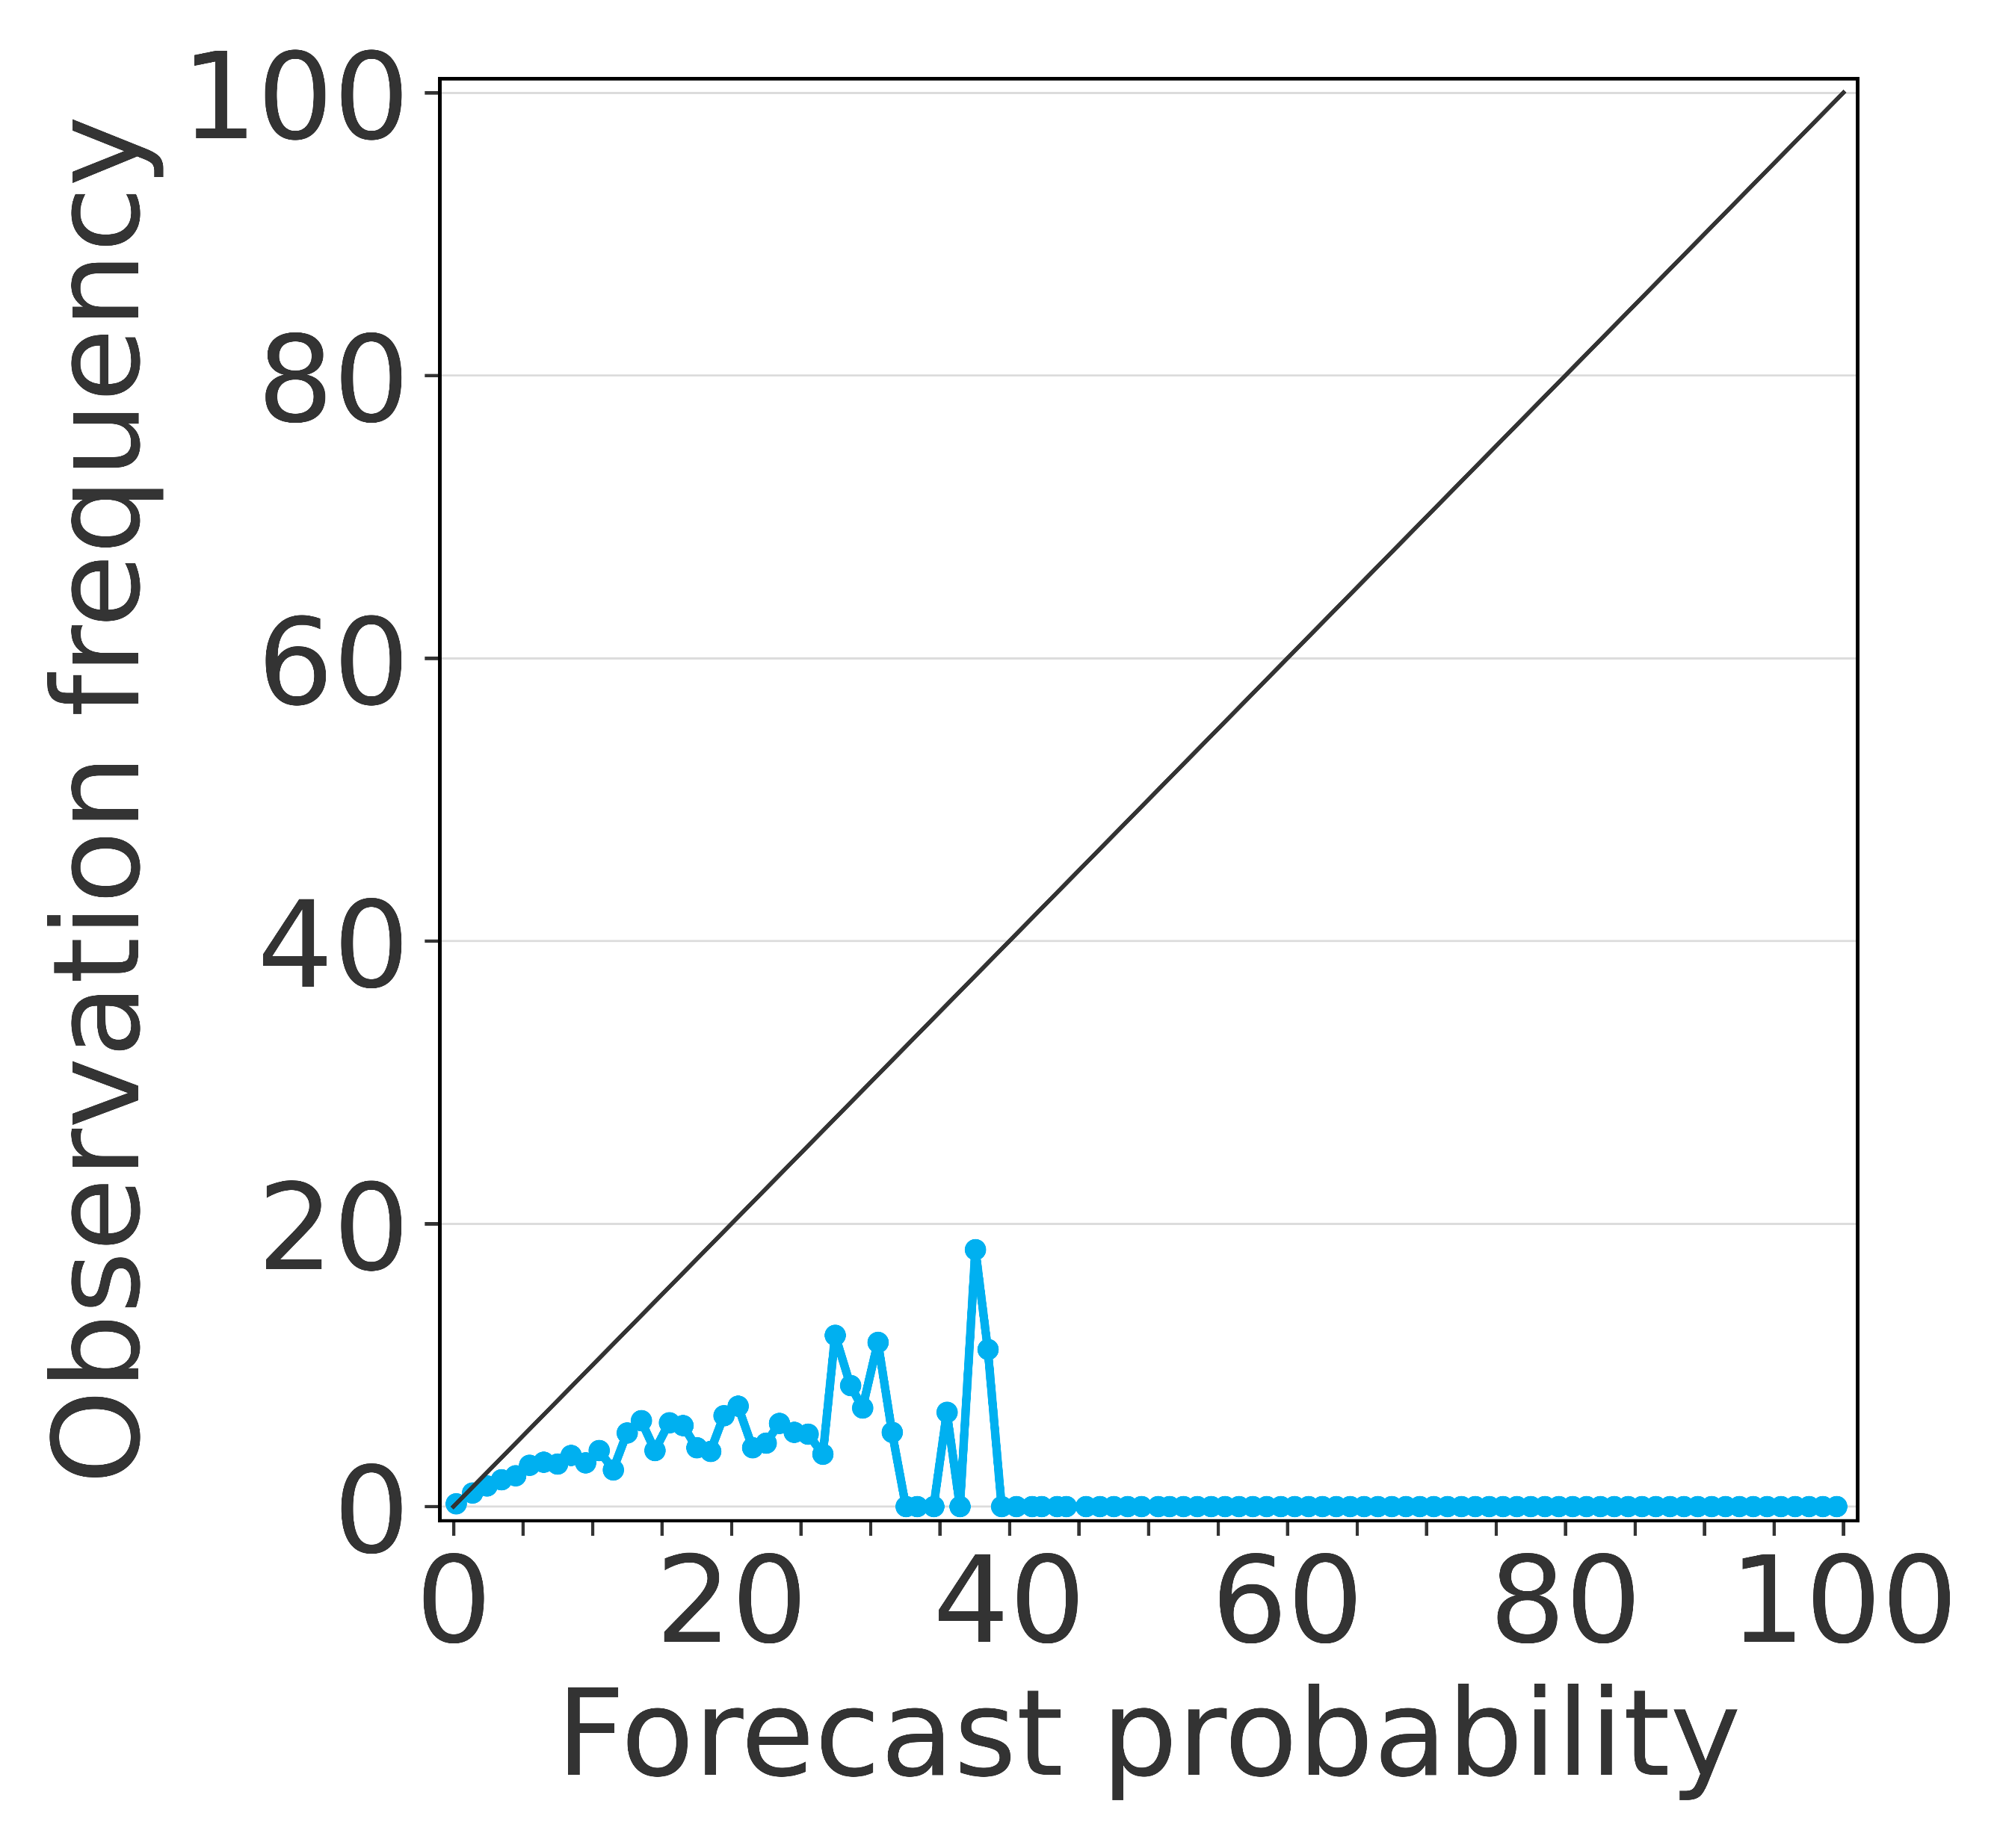
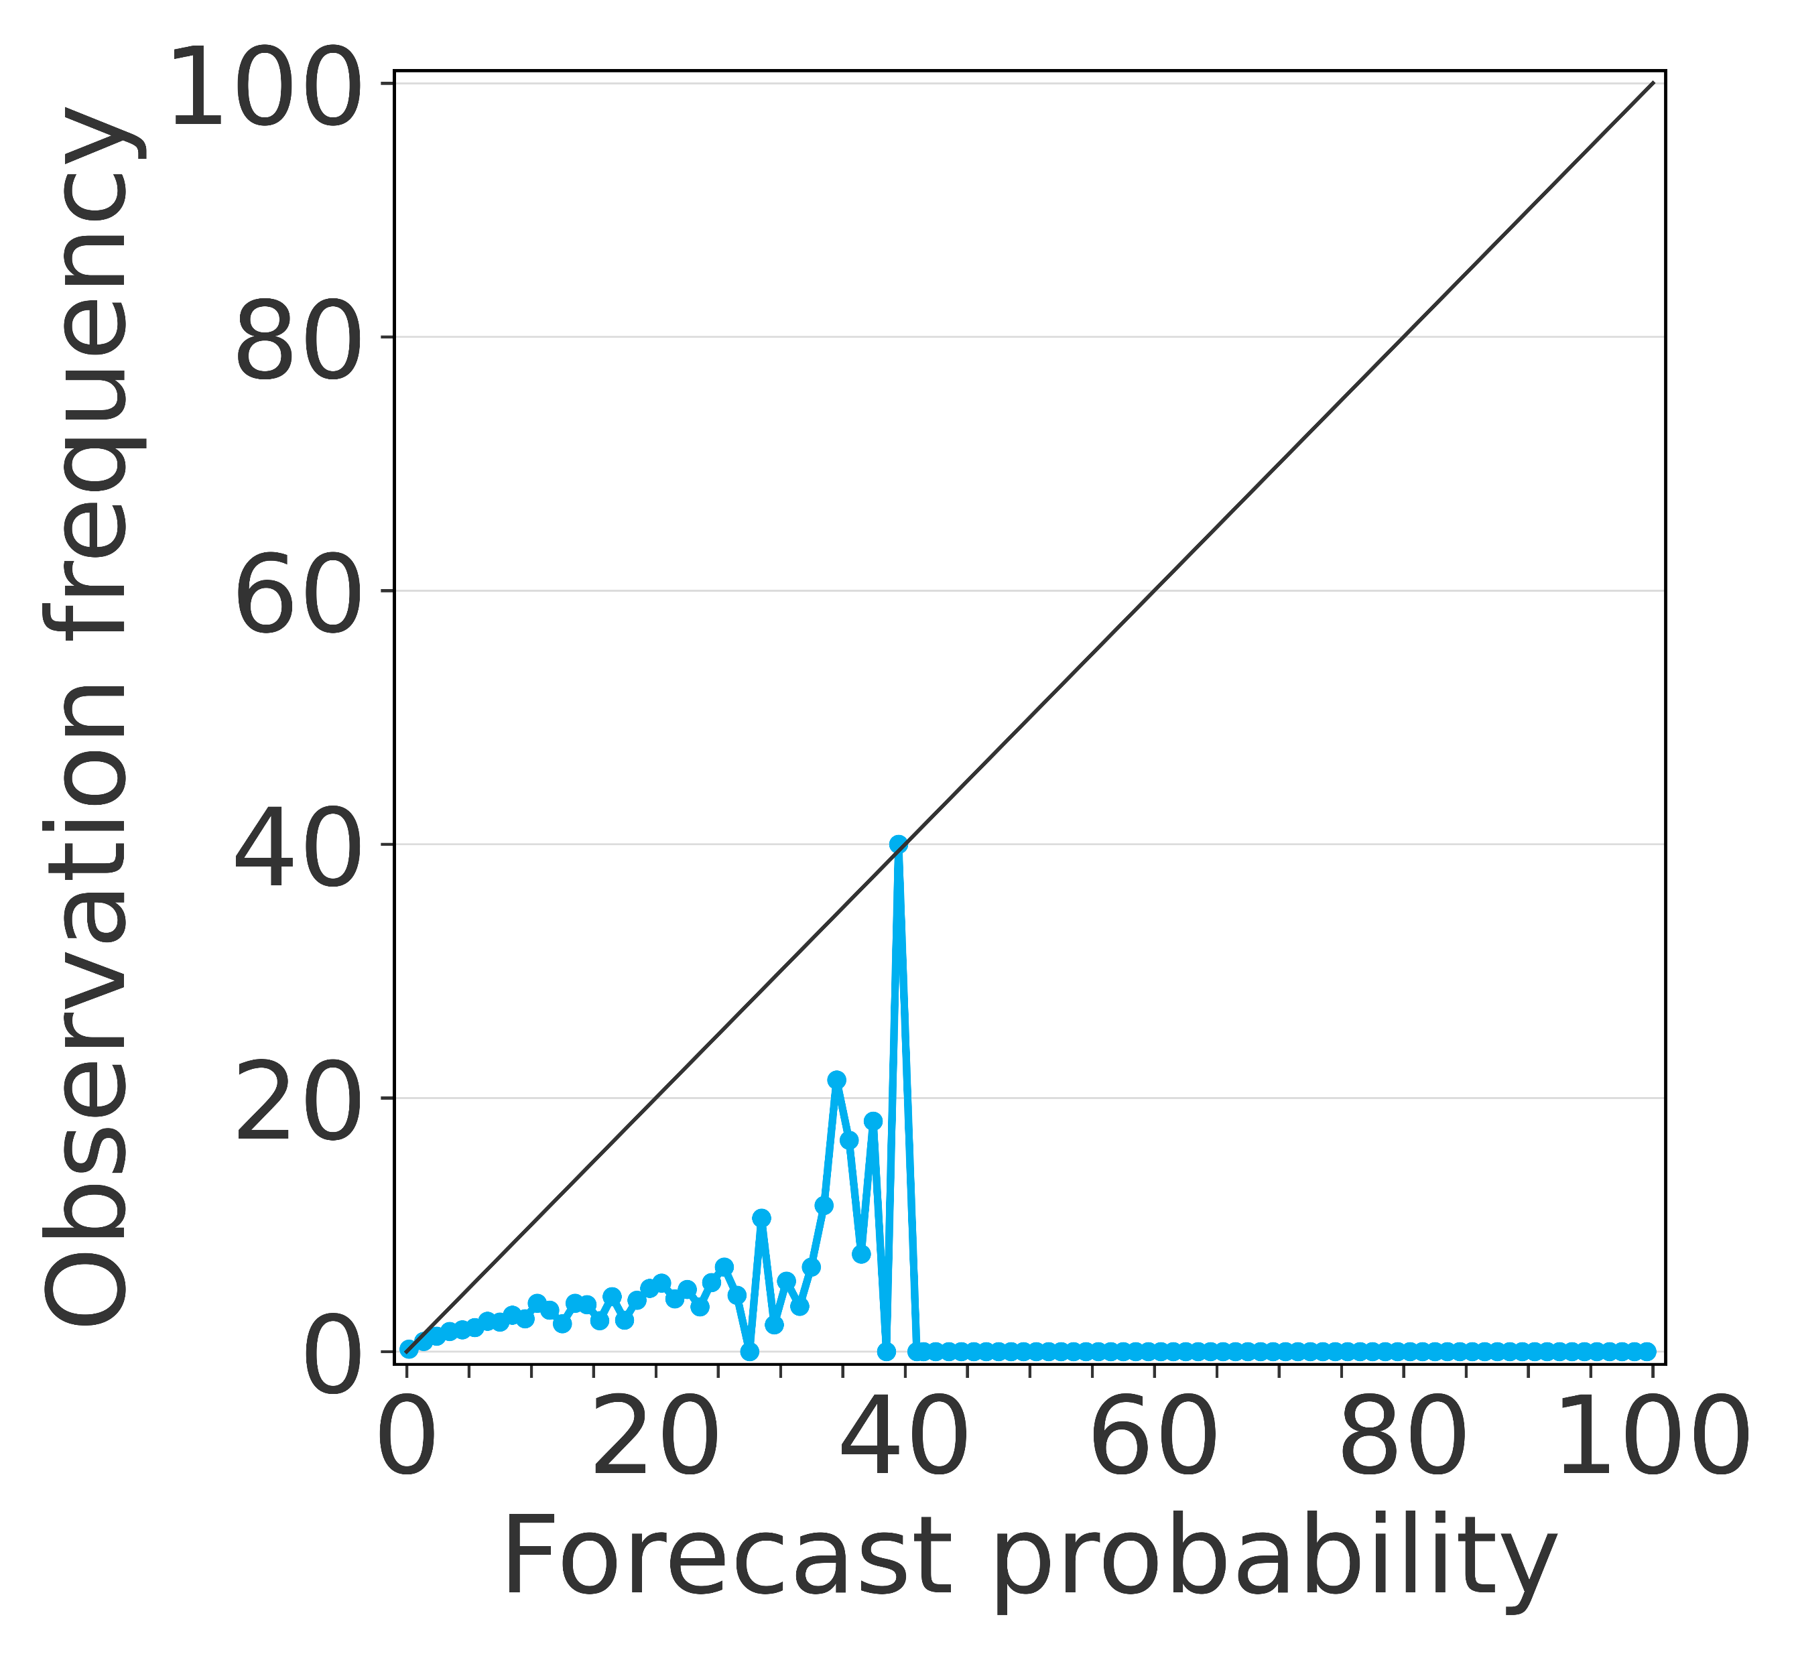
Overall scores
Verification results for medium-range forecasts
Evaluated over the verification dataset, for XGBoost (loss function for balanced data & AUC-ROC evaluation metric)
AUC-ROC
Breakdown scores
AUC-PR
FB
1
0.07
2.50
0.9
a
0.06
b
2.45
c
0.05
0.8
0.04
2.40
0.7
0.03
2.35
0.02
0.6
Lead time (hours)
0.01
Lead time (hours)
2.30
Lead time (hours)
0.5
0
24
48
72
96
120
24
48
72
96
120
24
48
72
96
120
Lead time
t+24
Lead time
t+72
Lead time
t+120
ROC Curves
d
e
f
Precision-Recall Curves
g
h
i
Reliability Diagrams
j
k
l

