Slide 1
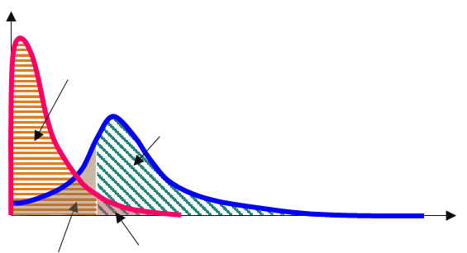
ROC and Precision-Recall Curves
Their computation from the contingency table and shape when evaluating data-driven models trained with balanced and imbalanced training datasets
a) Contingency table for probabilistic forecasts
Predicted
yes-events
non-events
Observed
yes-events
HITS (H)
The event was predicted and it was observed
MISSES (M)
The event was not predicted but it was observed
HIT RATE or RECALL [-]
Proportion of observed yes-events that were correctly predicted
HR = H / (H + M)
non-events
FALSE ALARMS (FA)
The event was predicted but it was not observed
CORRECT NEGATIVE (CN)
The event was not predicted and it was not observed
FALSE ALARM RATE [-]
Proportion of observed non-events that were incorrectly predicted as yes-events
FAR = FA / (FA + CN)
PRECISION [-]
Proportion of predicted yes-events that were observed
P = H / (H + FA)
Predicted
non-events
Predicted
yes-events
Density
Probability threshold
CN
Distribution of observed non-events
H
Distribution of observed yes-events
0
M
FA
50
100 %
Probabilities of exceeding the verifying threshold event
b) ROC curves: class-balanced discrimination ability (better for balanced datasets)
1
Perfect
1
None
1
Good
Imbalanced dataset
1
0.5
0.5
0.5
0.5
Hit Rate
Hit Rate
Hit Rate
Hit Rate
0
0
0
0
0
0.5
1
0
0.5
1
0
0.5
1
0
0.5
1
False Alarm Rate
False Alarm Rate
False Alarm Rate
False Alarm Rate
c) Precision-Recall curves: class-conditional discrimination ability (better for imbalanced datasets)
1
Perfect
1
None
1
Good
Imbalanced dataset
1
i-a
0.5
0.5
Precision
Precision
Precision
0.5
0.5
Precision
i-b
0
0
0
0
0
0.5
1
0
0.5
1
0
0.5
1
0
0.5
1
Recall
Recall
Recall
Recall

