Slide 1
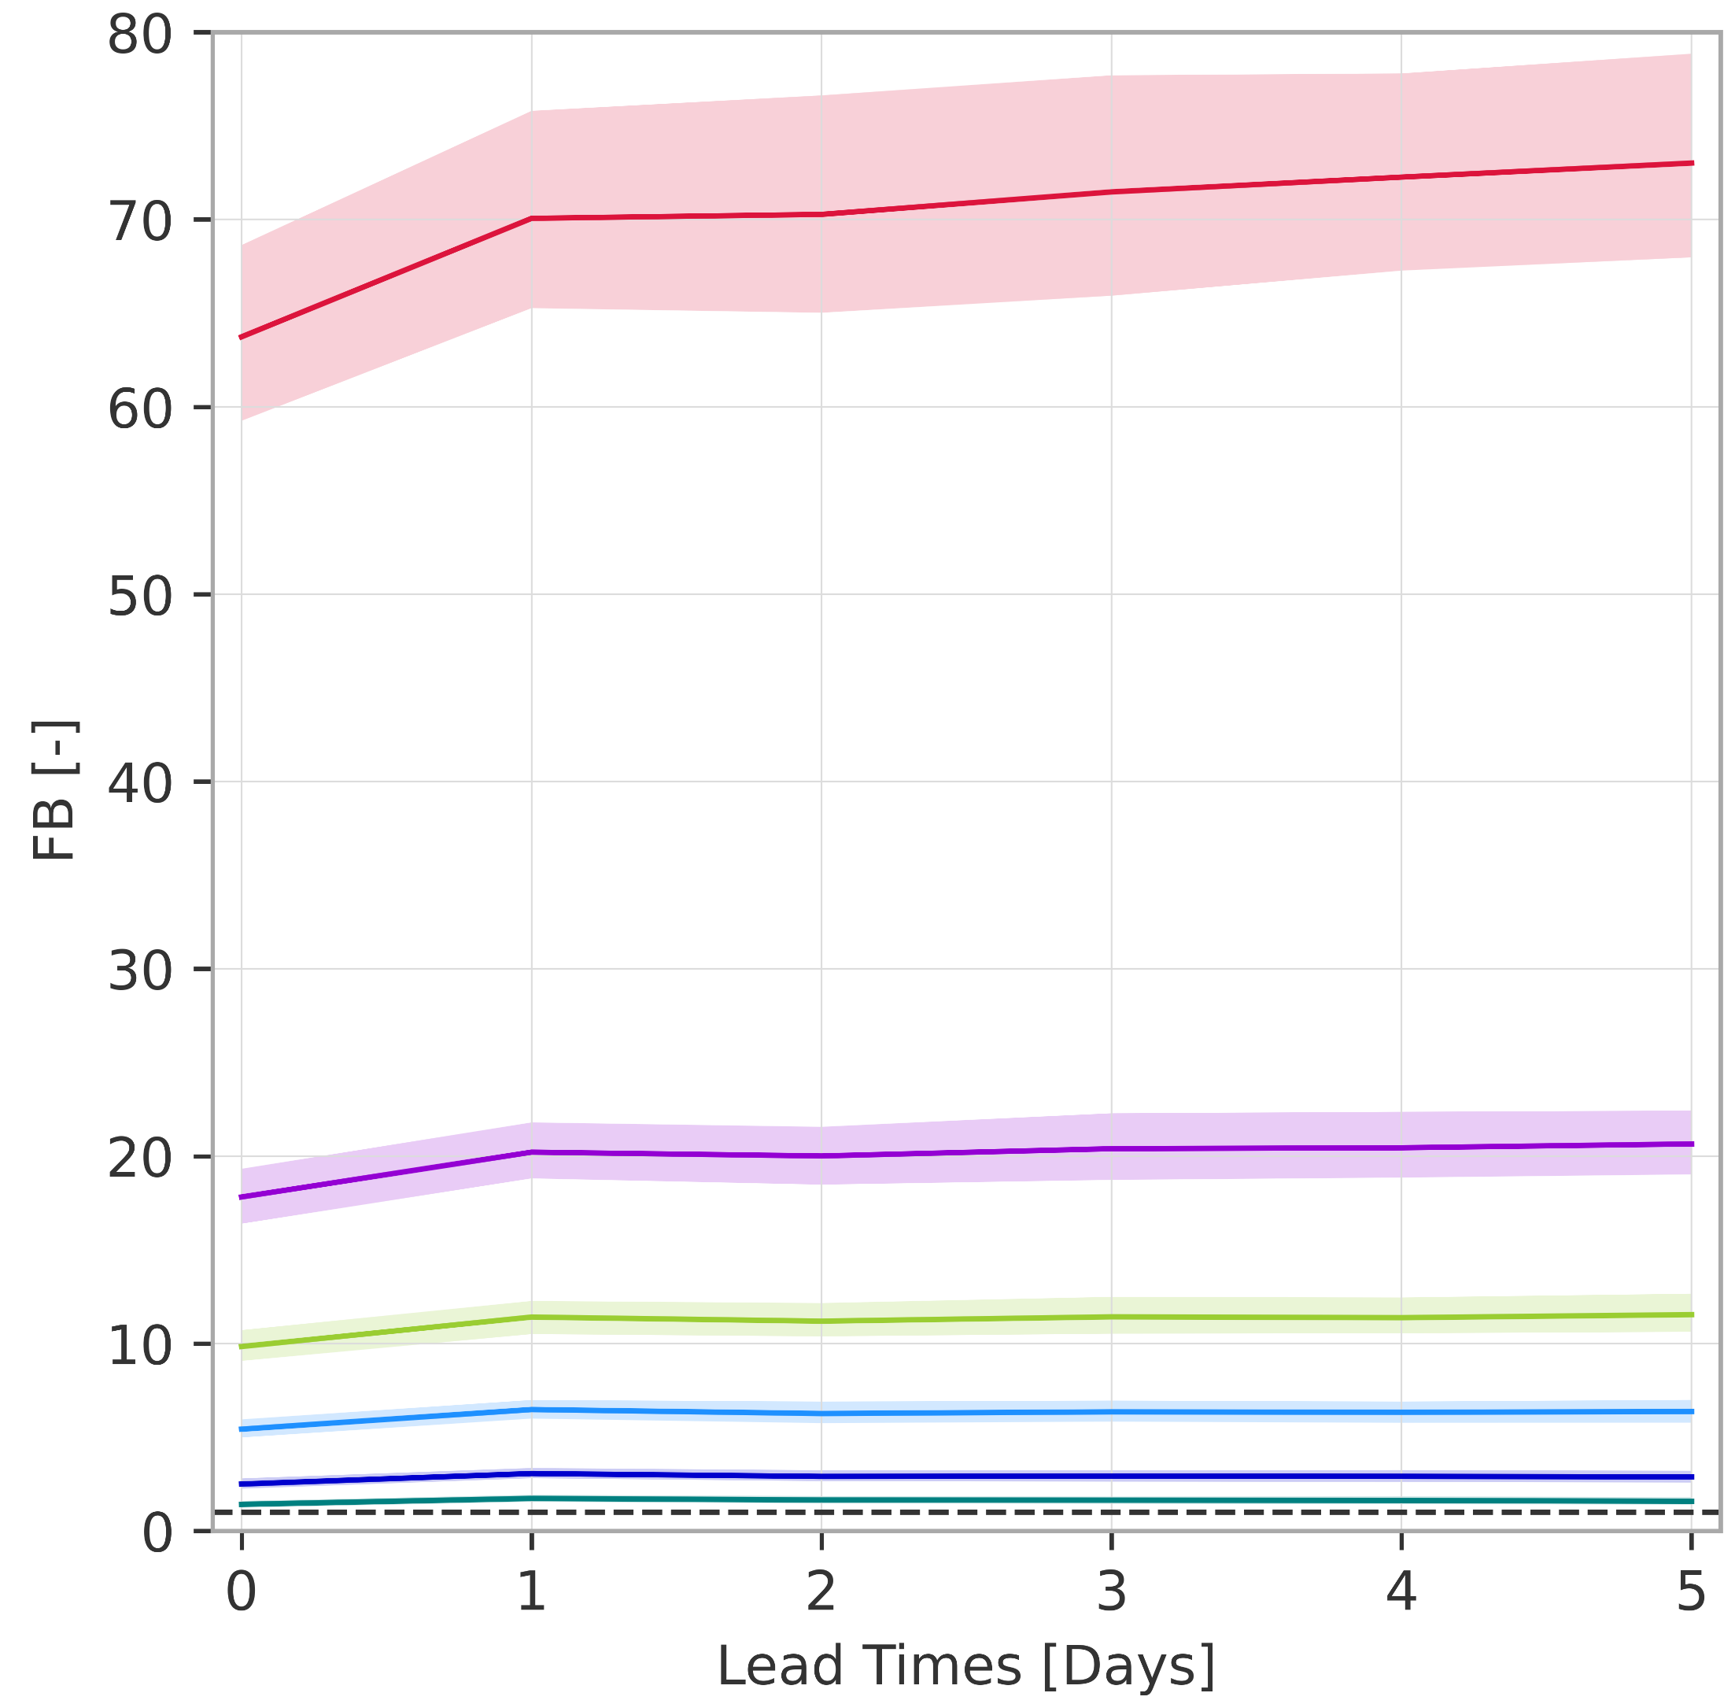
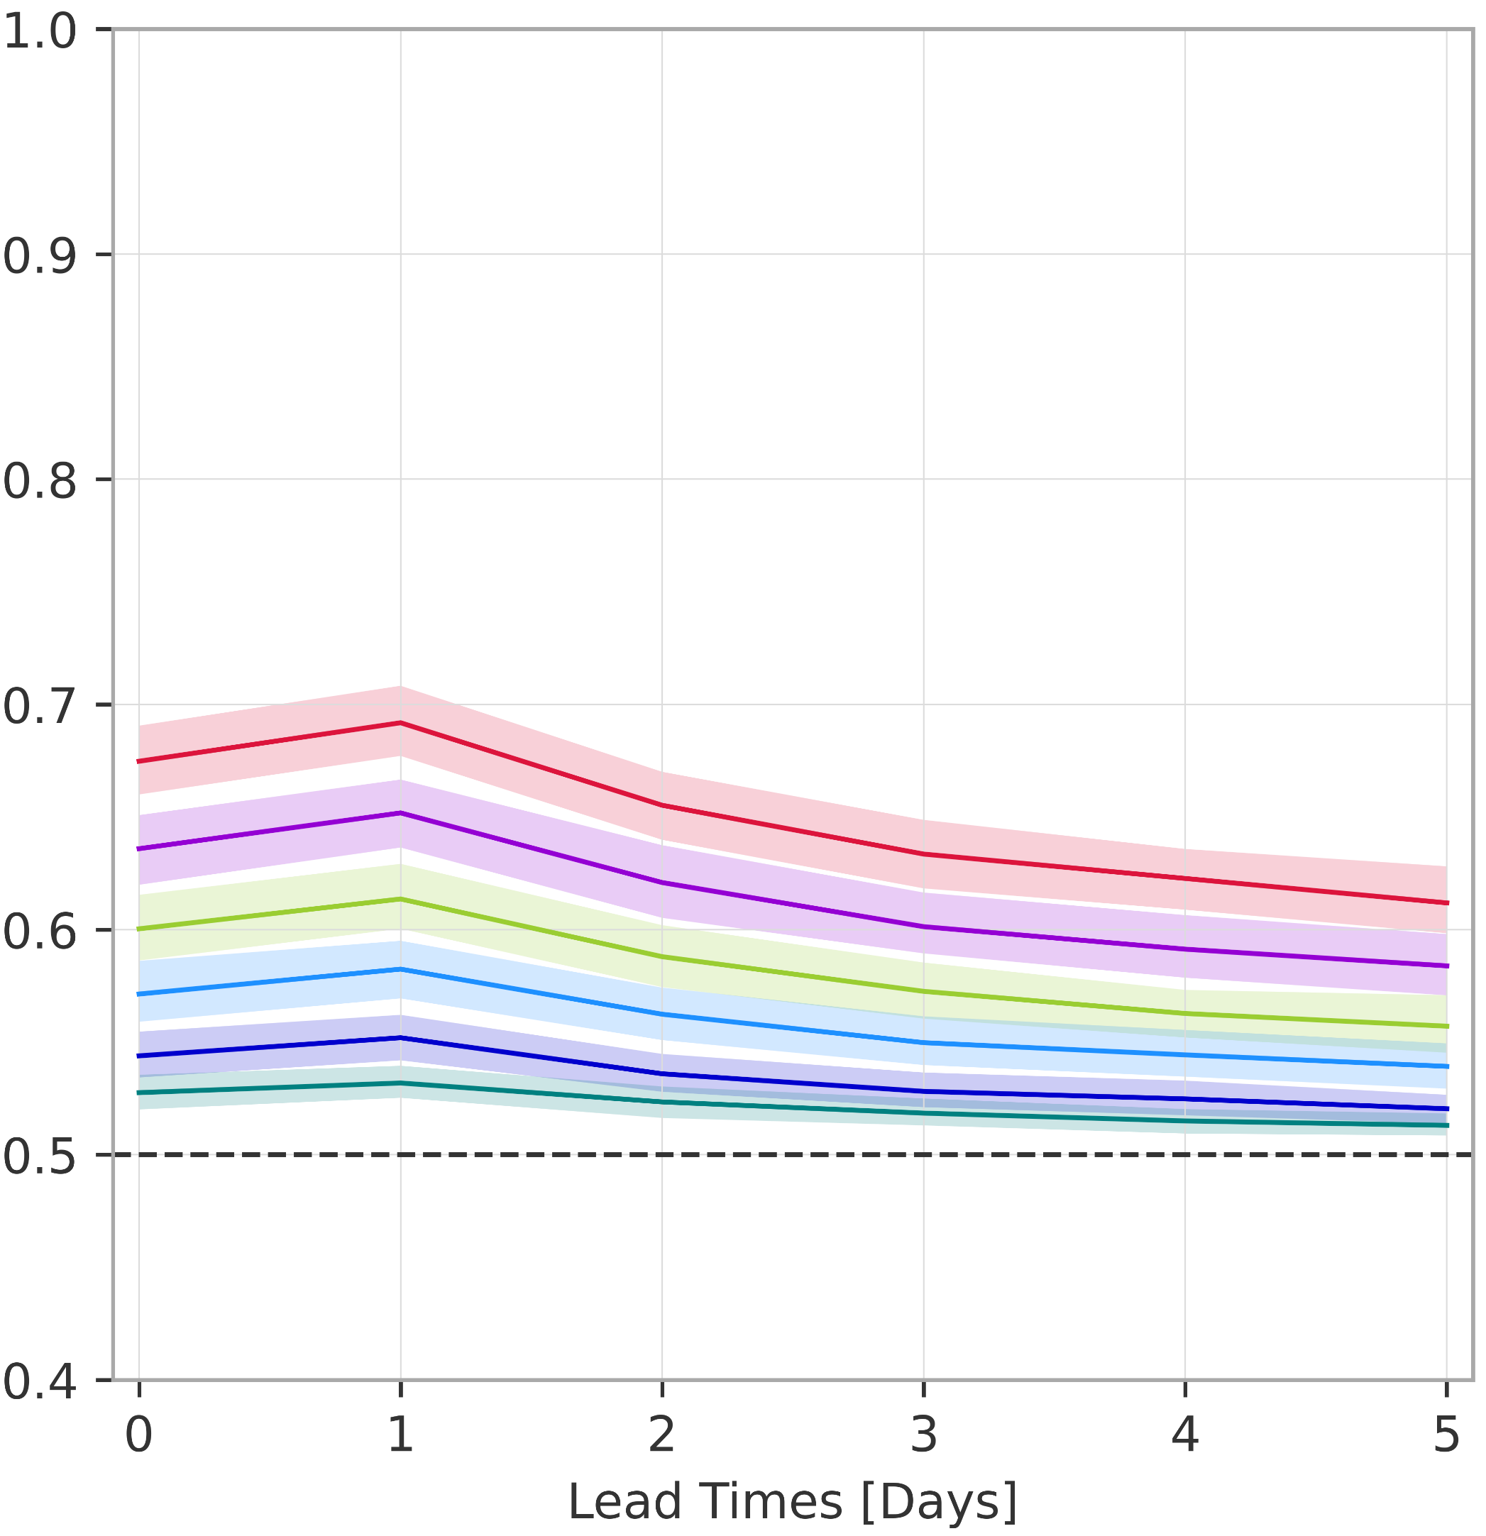
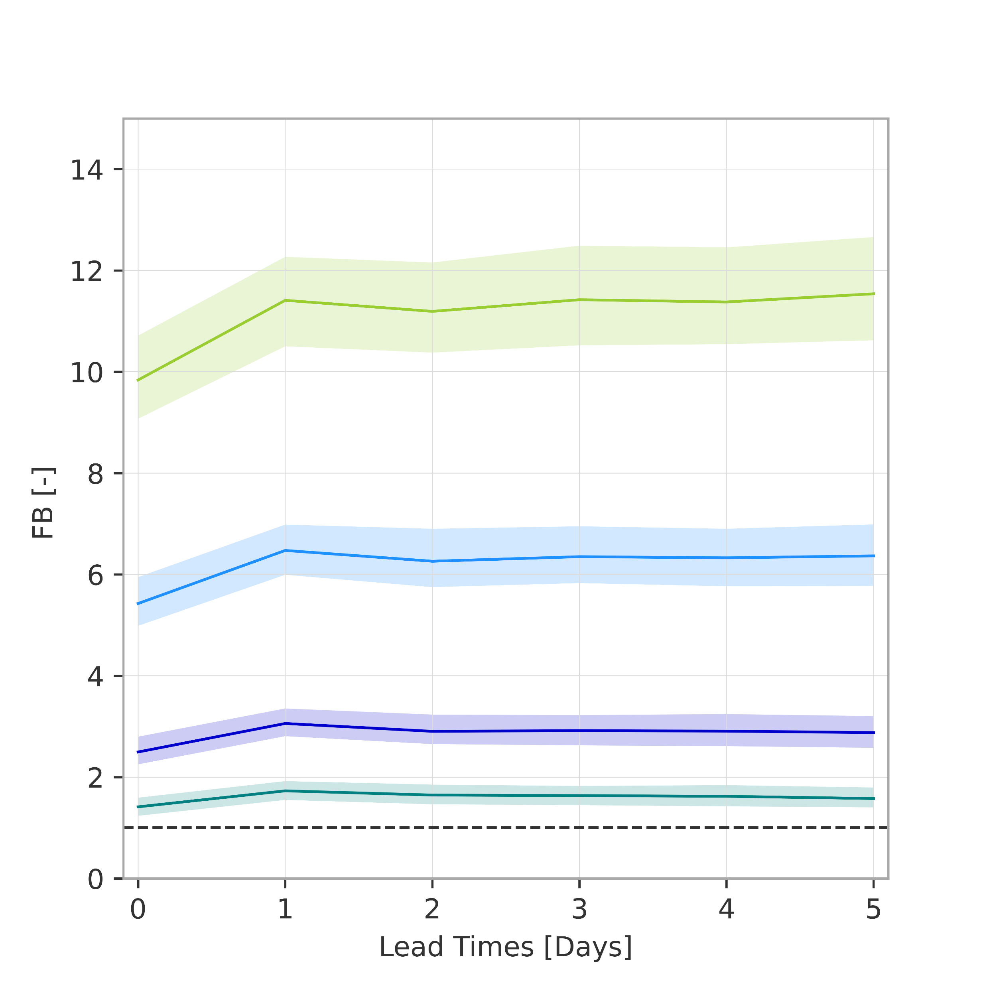
Overall verification scores (rainfall-based forecasts)
Frequency bias (FB) and Area under the ROC curve (AUC-ROC)
1-year return period (CI 99%)
20-year return period
.
.
5-year return period
50-year return period
.
.
10-year return period
100-year return period
.
a) Frequency bias
b) Area under the ROC curve
better
14
10
6
AUC-ROC [-]
FB = 1
(perfect bias)
2
0
1
2
3
4
5
better
AUC-ROC = 0.5 (no skill)
r
r

