Slide 1
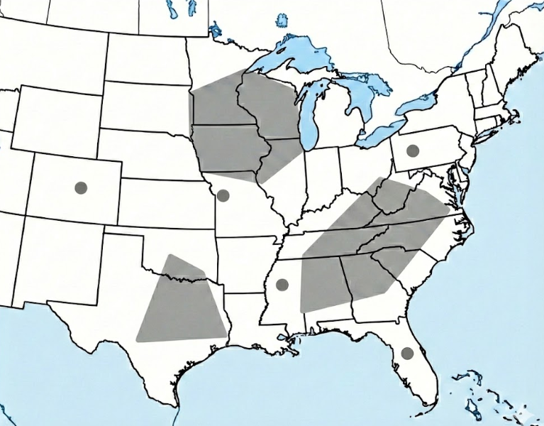

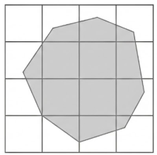
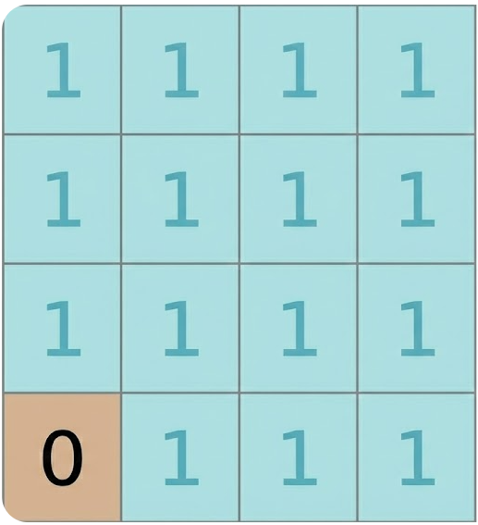

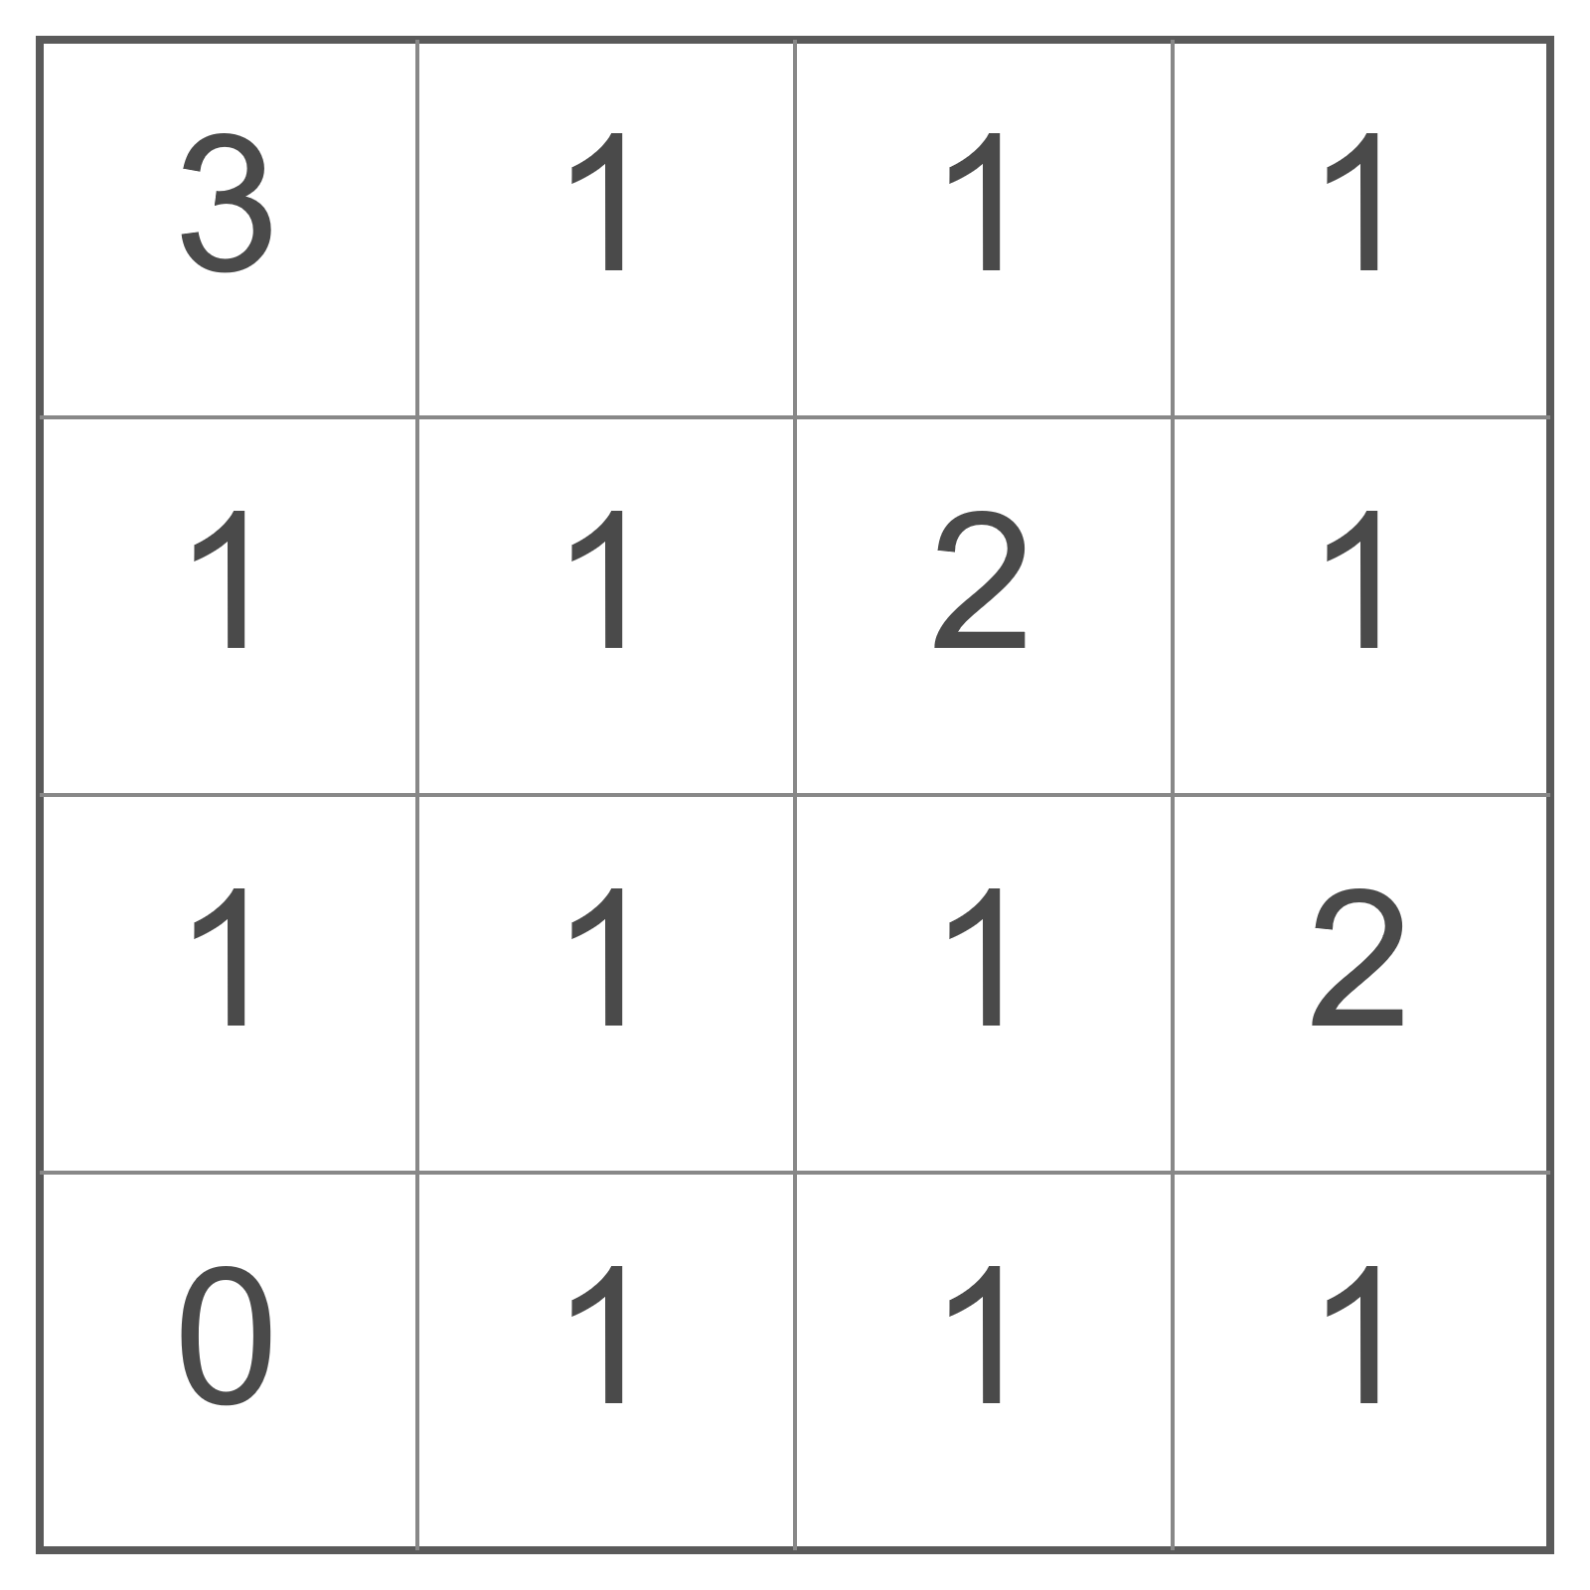
Observational gridded field
Defining model grid-boxes containing impact flash floods reports
(b)
CREATION OF THE GRIDDED OBSERVATIONAL FIELDS
Temporal grouping into 24-hourly (00 – 00 UTC) accumulation periods
(a)
INPUT DATA
NOAA’s Storm Event Database
Spatial mapping into
model grid (reduced Gaussian N320, 31 km)
(c) OBSERVATIONAL GRIDDED FIELD
1
Assign to grid-boxes with
at least one report; otherwise (binary field)
Point report
(Nearest grid-box)
Polygon report
(All grid-boxes within polygon)
0
Point/Polygon flash flood impact reports
Instantaneous timestamps
Count the number of reports in each grid-box

