Slide 1

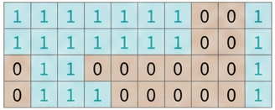
Rainfall-based predictions of areas at risk of flash floods
Defining yes- and non-events
99th percentile of ERA5-ecPoint
rainfall forecasts (mm/24h, point-scale within the grid-box)
NO
Is the forecast >= threshold
(i.e., rainfall return period - in years)
YES
Non-event
(no flash flood risk)
0
Yes-event
(flash flood risk)
1
Rainfall-based predictions of areas at risk of flash floods (binary field)

