Slide 1
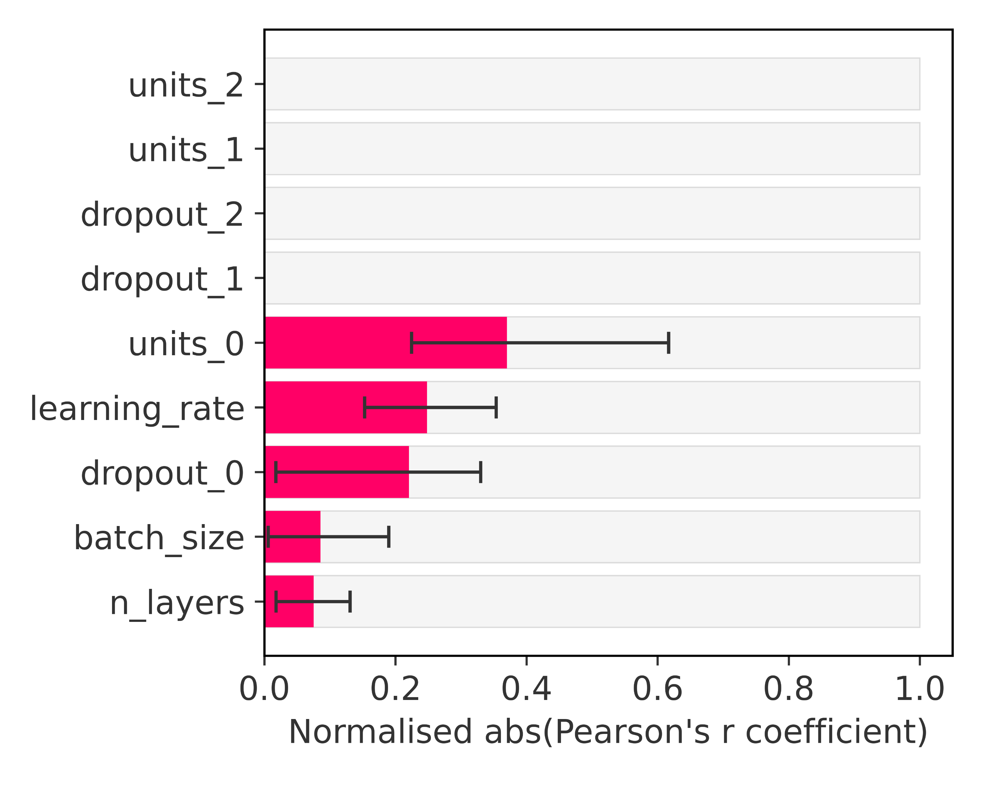
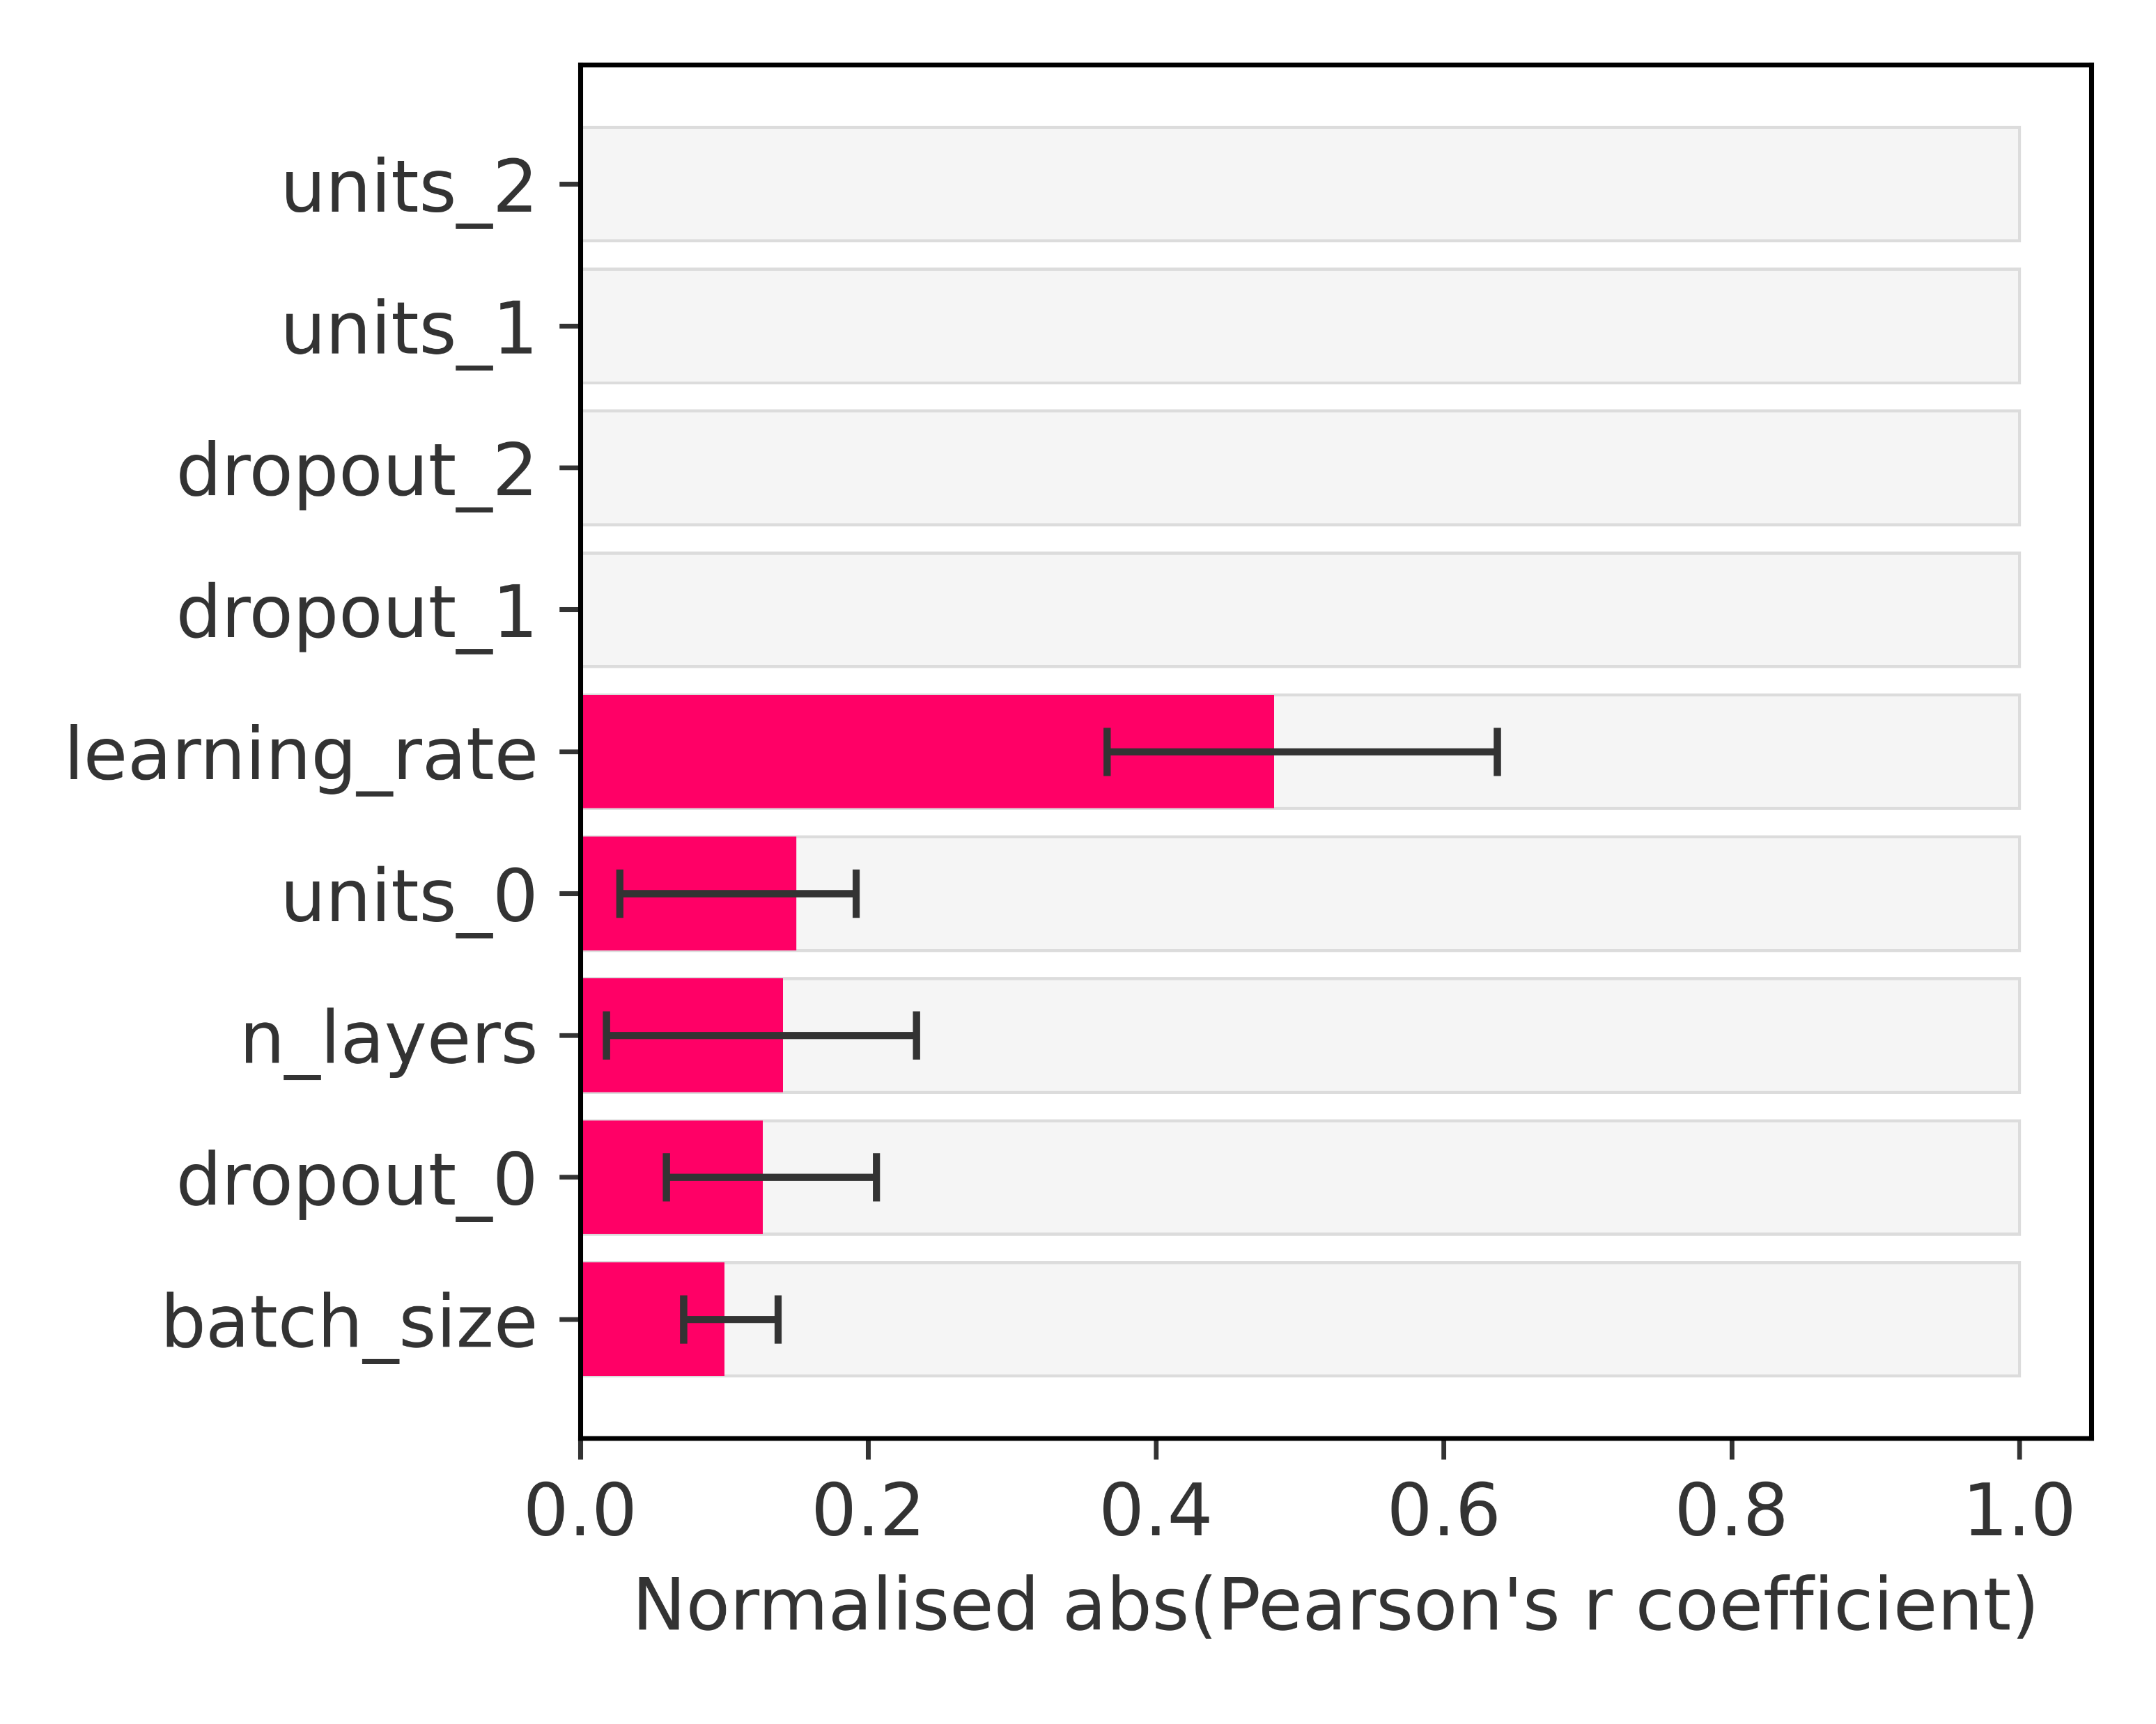
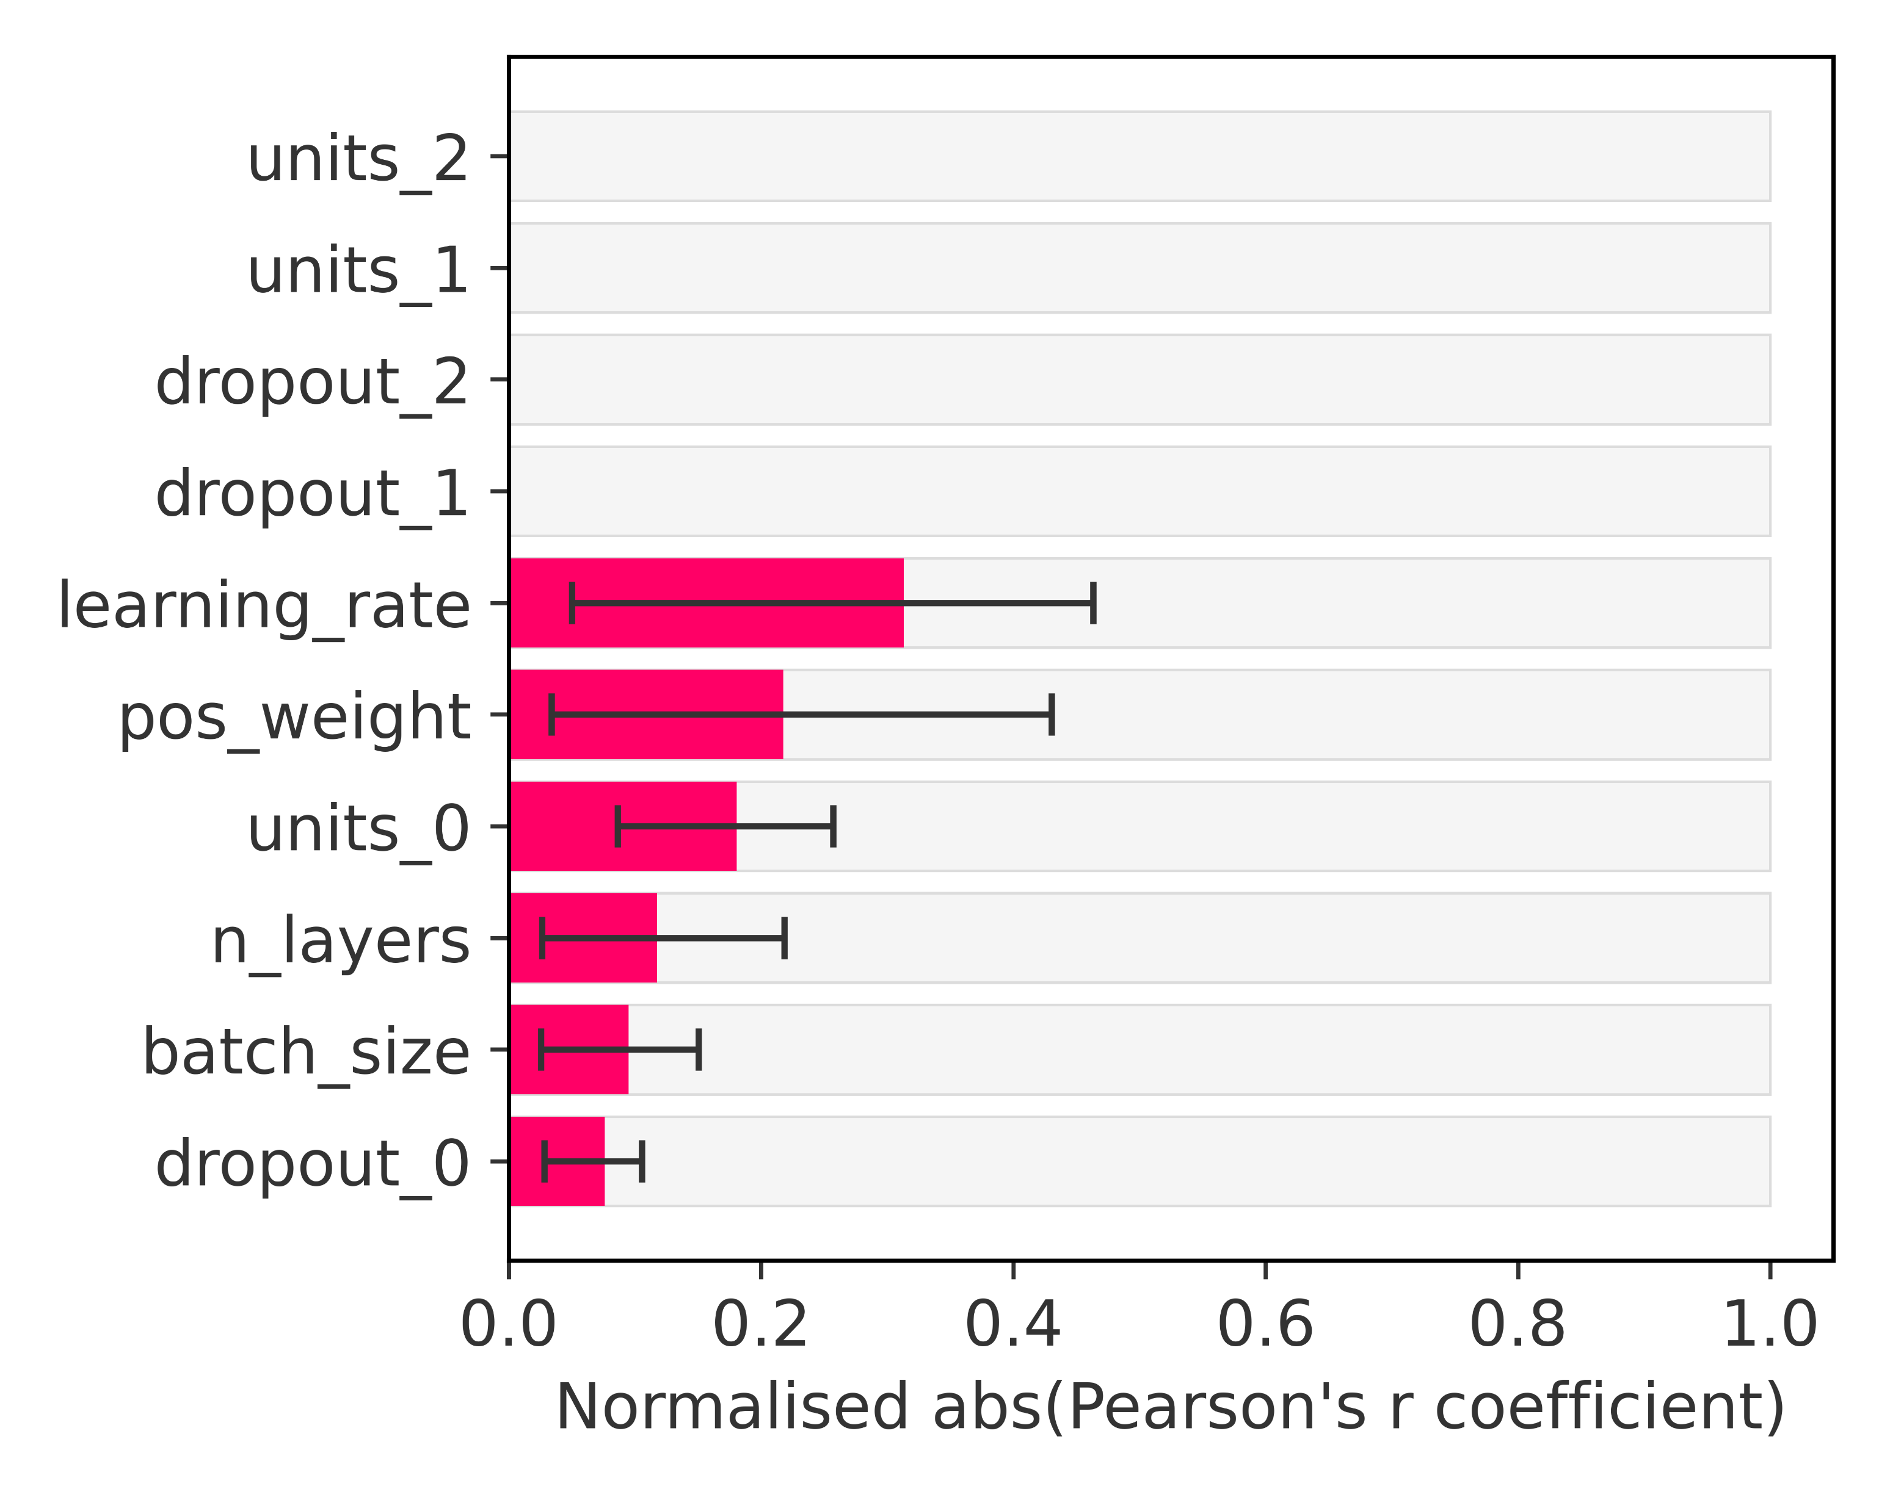
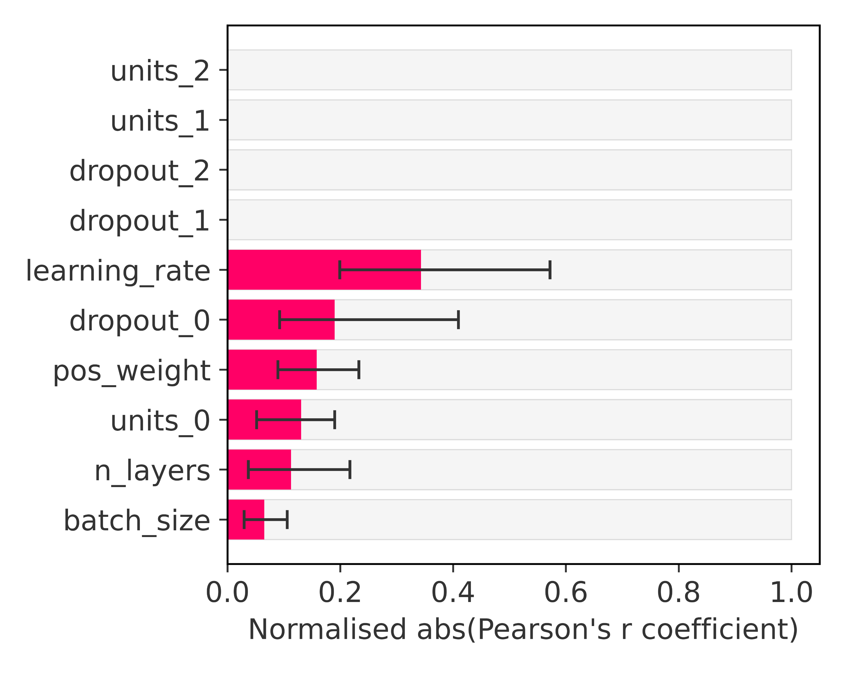
Optuna’s hyperparameter tuning – Hyperparameter importance
Evaluated over the inner training datasets for Feed-Forward Neural Network
min
mean
max
over Optuna’s trials
AUC-ROC
AUC-PR
Loss Function
Balanced Data
Loss Function
Imbalanced Data

