Slide 1
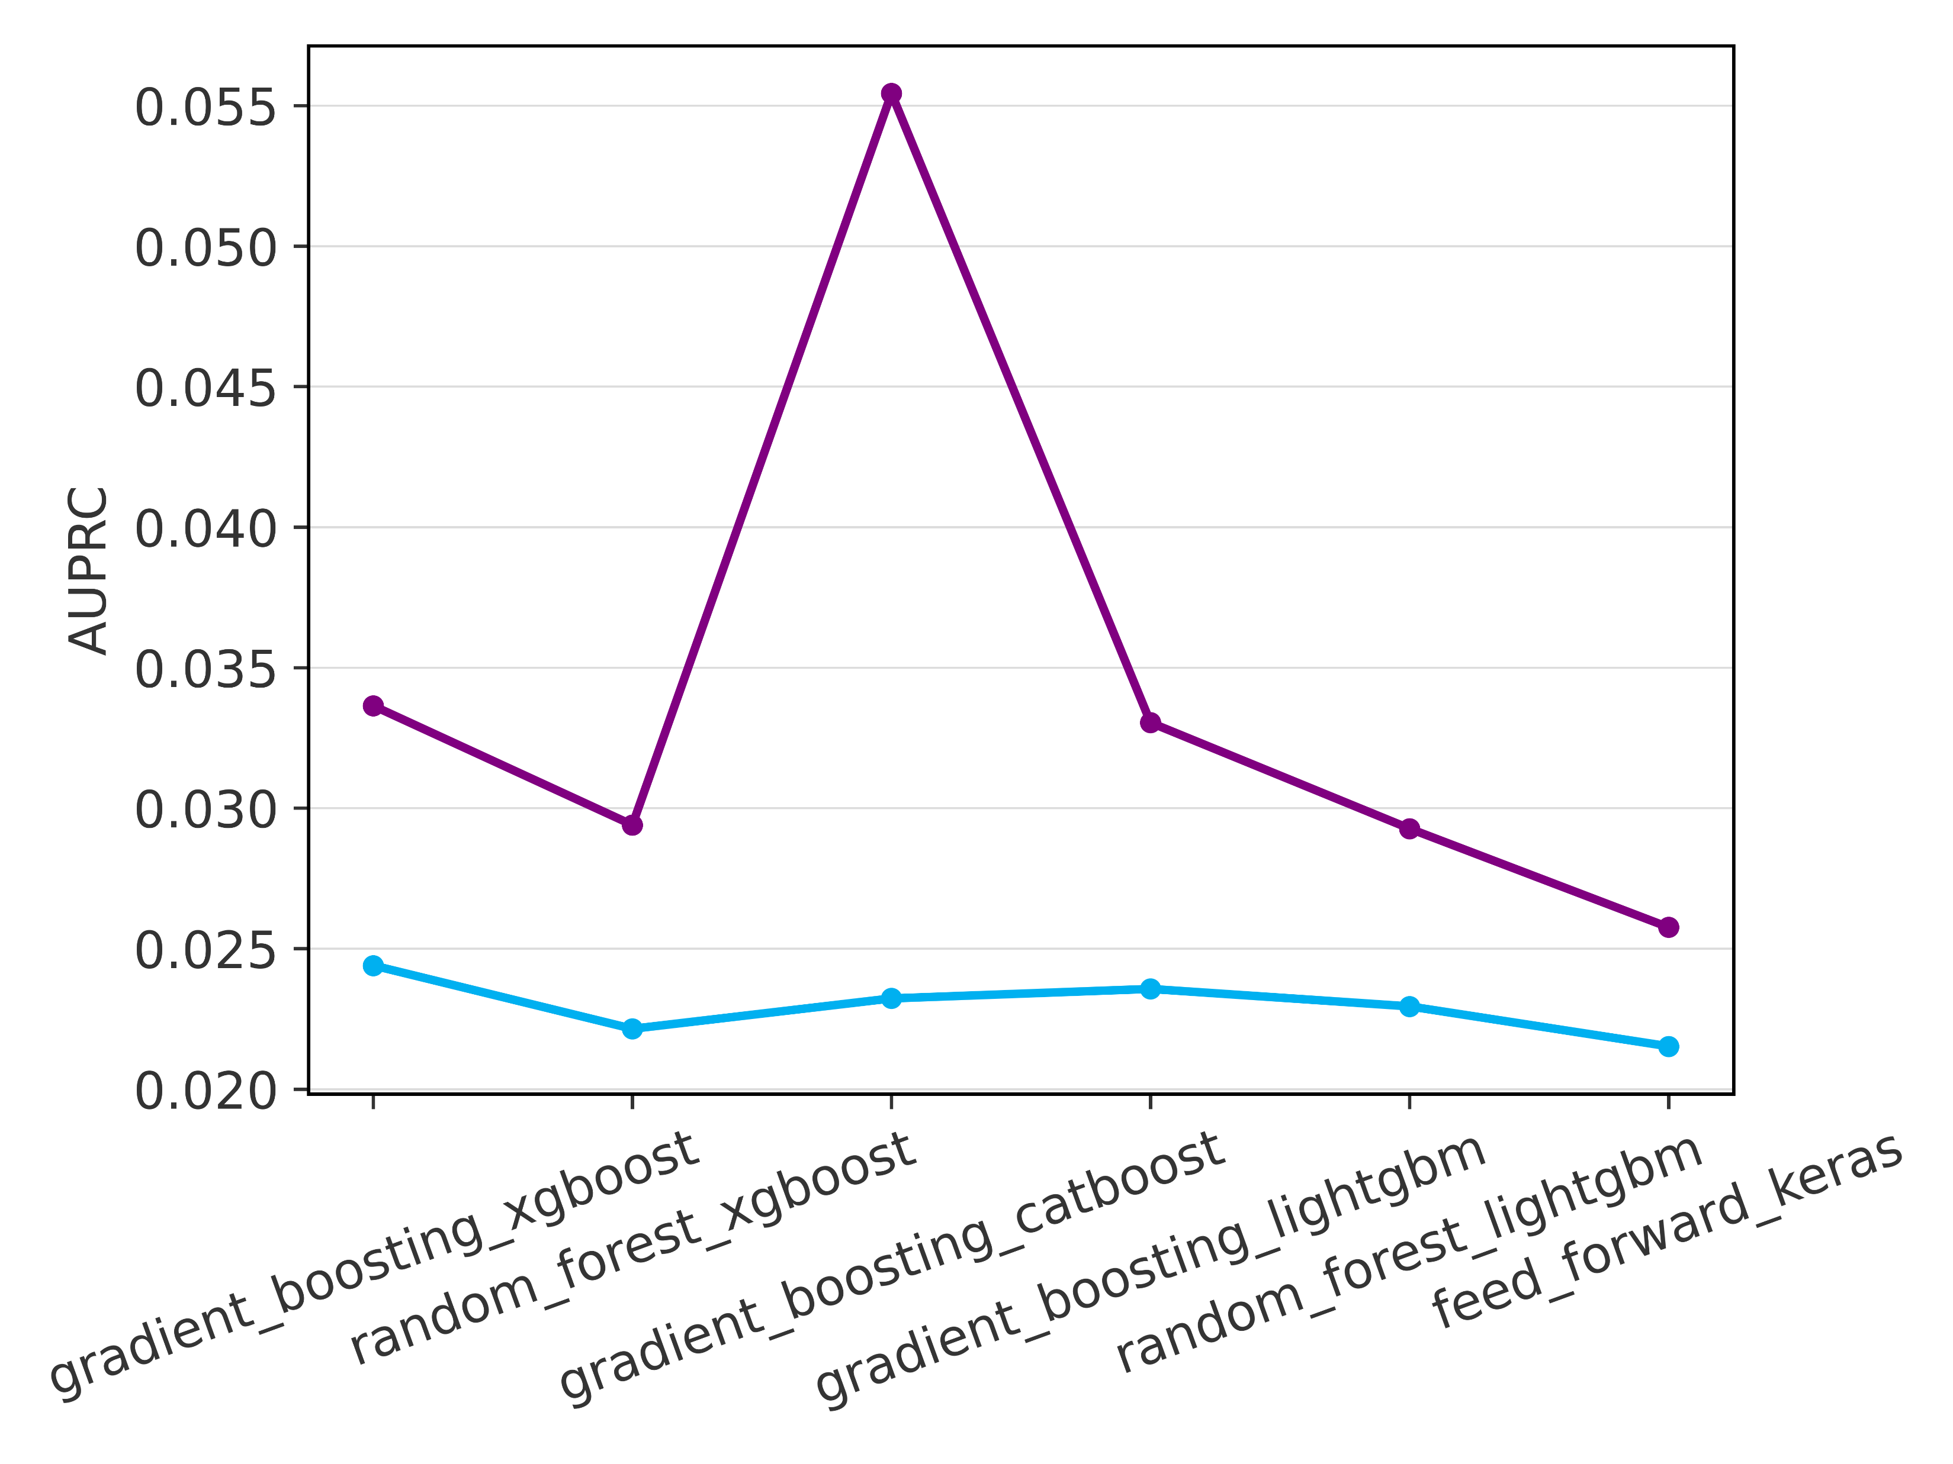
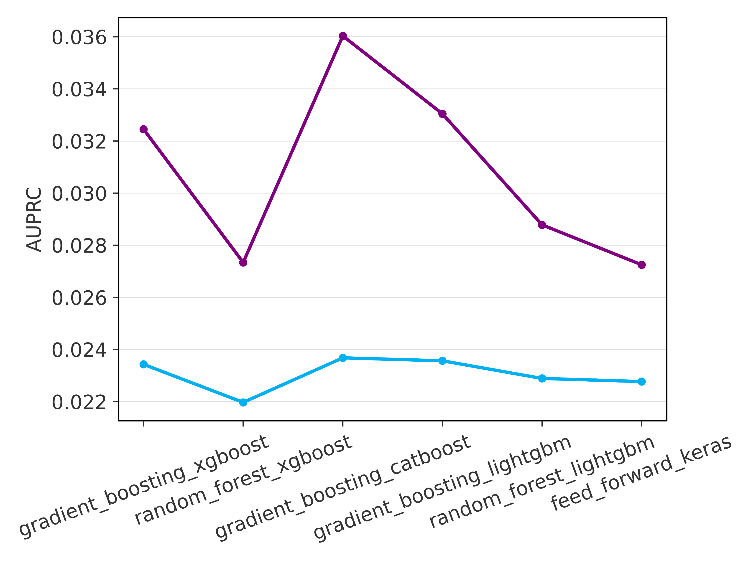
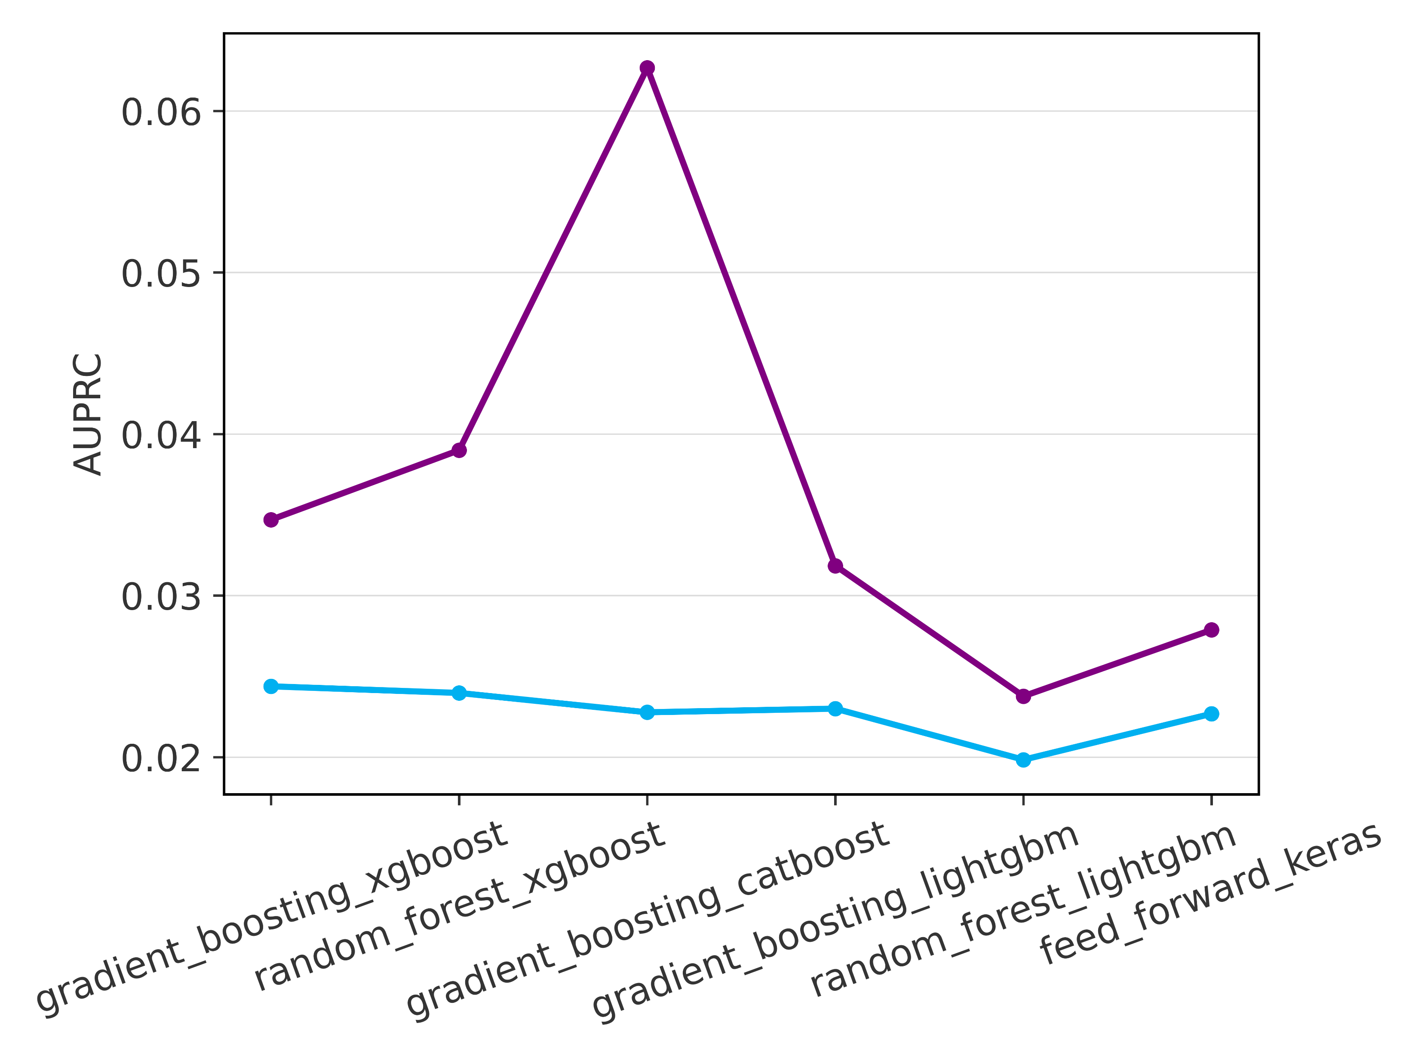
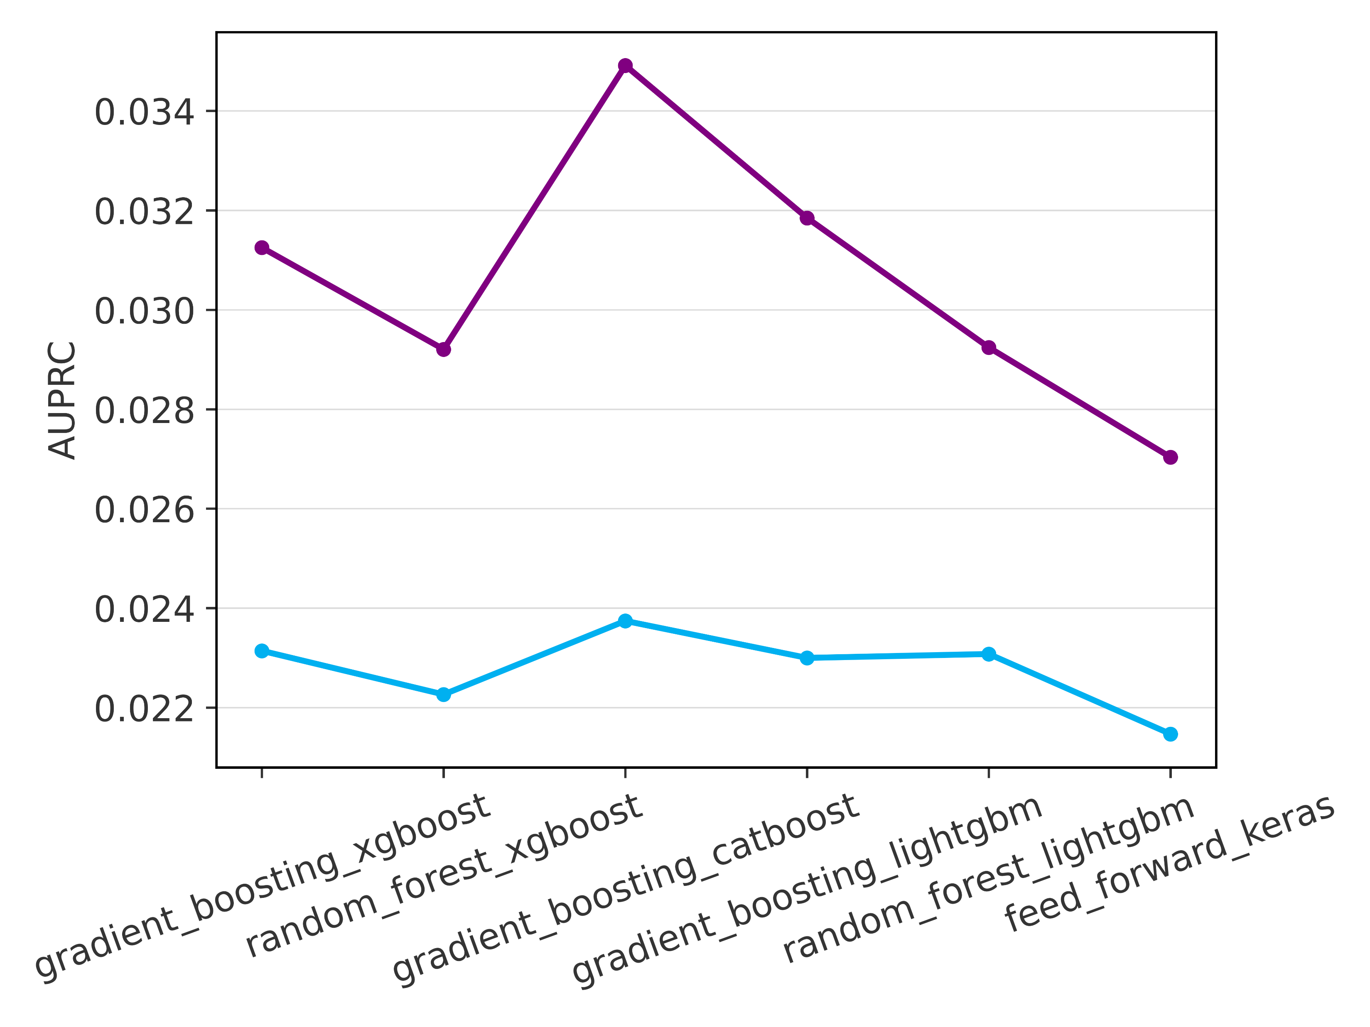
Verification results – AUC-ROC (overall score)
Evaluated over the training and verification datasets
Evaluation metric
AUC-ROC
Evaluation metric
AUC-PR
Loss Function
Balanced Data
AUC-ROC
AUC-ROC
Loss Function
Imbalanced Data
AUC-ROC
AUC-ROC
GB - XGBoost
RF - XGBoost
GB - Catboost
GB - LightGBM
RF - LightGBM
Feed-Forward NN
GB - XGBoost
RF - XGBoost
GB - Catboost
GB - LightGBM
RF - LightGBM
Feed-Forward NN

