Slide 1
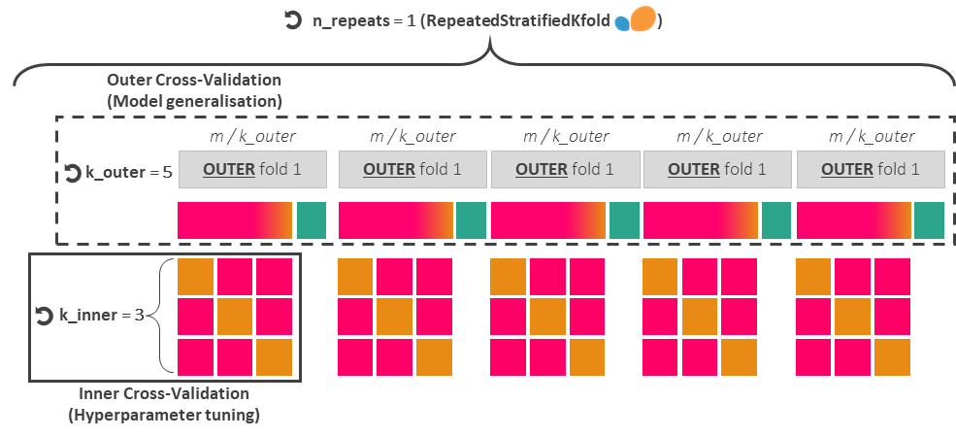

Repeated nested cross-validation
For hyperparameter tuning and model’s generalisation capabilities
Imbalanced training dataset (from 2001 to 2020)
m = 19.75M gridded data points, of which 53245 (0.27%) are yes-events
Hyperparameter tuning with Optuna ( n_trials = 20 )
80 %
20 %
Outer Training
Outer Test
INNER fold 1
INNER fold 2
INNER fold 3
Split 1
Inner Validation
Inner Training
Inner Training
Split 2
Inner Training
Inner Validation
Inner Training
Split 3
Inner Training
Inner Training
Inner Validation
Train each candidate hyperparameters set over (k_inner - 1) splits (maximising AUC-PR and AUC-ROC) and validate over 1 split
Score for single trial = average of k_inner scores
Optuna ranks the n_trials scores to provide the best-performing hyperparameter set
Test predictions (through AUC-PR and AUC-ROC) over the corresponding outer test dataset
Train the model using the best-performing hyperparameter set over the entire outer training dataset
Select best-performing fold, and
train it over the original training dataset
(model ready for operational deployment)
Imbalanced verification dataset (from 2021 to 2024)
n = 4.36M gridded data-points, of which 10742 (0.25%) are yes-events
Test predictions using the Precision-Recall curve and AUC-PR, the ROC curve and AUC-ROC, the reliability diagram and the frequency bias.

Slide 2

n_repeats = 1 (RepeatedStratifiedKfold )
Outer Cross-Validation
(Model generalisation)
m / k_outer
m / k_outer
m / k_outer
m / k_outer
m / k_outer
k_outer = 5
OUTER fold 1
OUTER fold 1
OUTER fold 1
OUTER fold 1
OUTER fold 1
k_inner = 3
Inner Cross-Validation
(Hyperparameter tuning)

Slide 3

Hyperparameter tuning with Optuna
n_trials = 20
80 %
Outer Training
INNER fold 1
INNER fold 2
INNER fold 3
Split 1
Inner Validation
Inner Training
Inner Training
Split 2
Inner Training
Inner Validation
Inner Training
Split 3
Inner Training
Inner Training
Inner Validation
Single Optuna trial (candidate set of hyperparameters) =
Train each candidate set of hyperparameters over (k_inner - 1) splits and validate the set over 1 split
Score for single trial = average of k_inner scores
Optuna ranks the n_trials scores to provide the best hyper-parameter set and trains the model with it over the whole outer training dataset.

