Slide 1

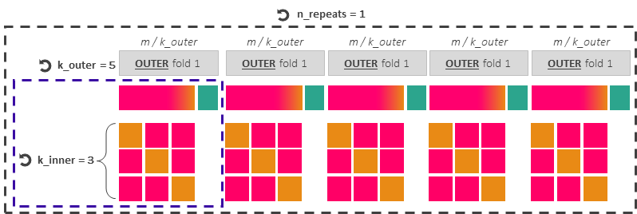

Workflow for training data-driven predictive models
Hyperparameter tuning and model’s generalisation capabilities when using imbalanced observational datasets for training
Imbalanced training dataset (from 2001 to 2020)
m = 19M data points, of which only 53245 (0.27%) are yes-events
RepeatedStratifiedKfold
To preserve in every outer and inner fold the training dataset’s original class ratio between yes- and non-events
Hyperparameter tuning with Optuna
n_trials = 20
80 %
20 %
Outer Training
Outer Test
INNER fold 1
INNER fold 2
INNER fold 3
Split 1
Inner Validation
Inner Training
Inner Training
Split 2
Inner Training
Inner Validation
Inner Training
Split 3
Inner Training
Inner Training
Inner Validation
Single Optuna trial (candidate set of hyperparameters) =
Train each candidate set of hyperparameters over (k_inner - 1) splits, maximising auprc and aroc, and validate the set over 1 split
Score for single trial = average of k_inner scores
Optuna ranks the n_trials scores to provide the best hyper-parameter set per outer fold, and trains the model with it over the whole outer training dataset.
Test predictions over the corresponding outer test dataset, computing precision-recall curves, auprc, roc curves, aroc, reliability diagrams, and frequency bias.
Select the overall best set of hyperparameters out of all k_outer folds:
-> Compute the mode for categorical hyperparameters
-> Compute the median for numerical hyperparameters
Train the best model over the original training dataset (m datapoints)
Model ready for forecast production

Slide 2

n_repeats = 1
m / k_outer
m / k_outer
m / k_outer
m / k_outer
m / k_outer
k_outer = 5
OUTER fold 1
OUTER fold 1
OUTER fold 1
OUTER fold 1
OUTER fold 1
k_inner = 3

Slide 3
Hyperparameter tuning with Optuna
n_trials = 20
80 %
Outer Training
INNER fold 1
INNER fold 2
INNER fold 3
Split 1
Inner Validation
Inner Training
Inner Training
Split 2
Inner Training
Inner Validation
Inner Training
Split 3
Inner Training
Inner Training
Inner Validation
Single Optuna trial (candidate set of hyperparameters) =
Train each candidate set of hyperparameters over (k_inner - 1) splits and validate the set over 1 split
Score for single trial = average of k_inner scores
Optuna ranks the n_trials scores to provide the best hyper-parameter set and trains the model with it over the whole outer training dataset.

