Slide 1
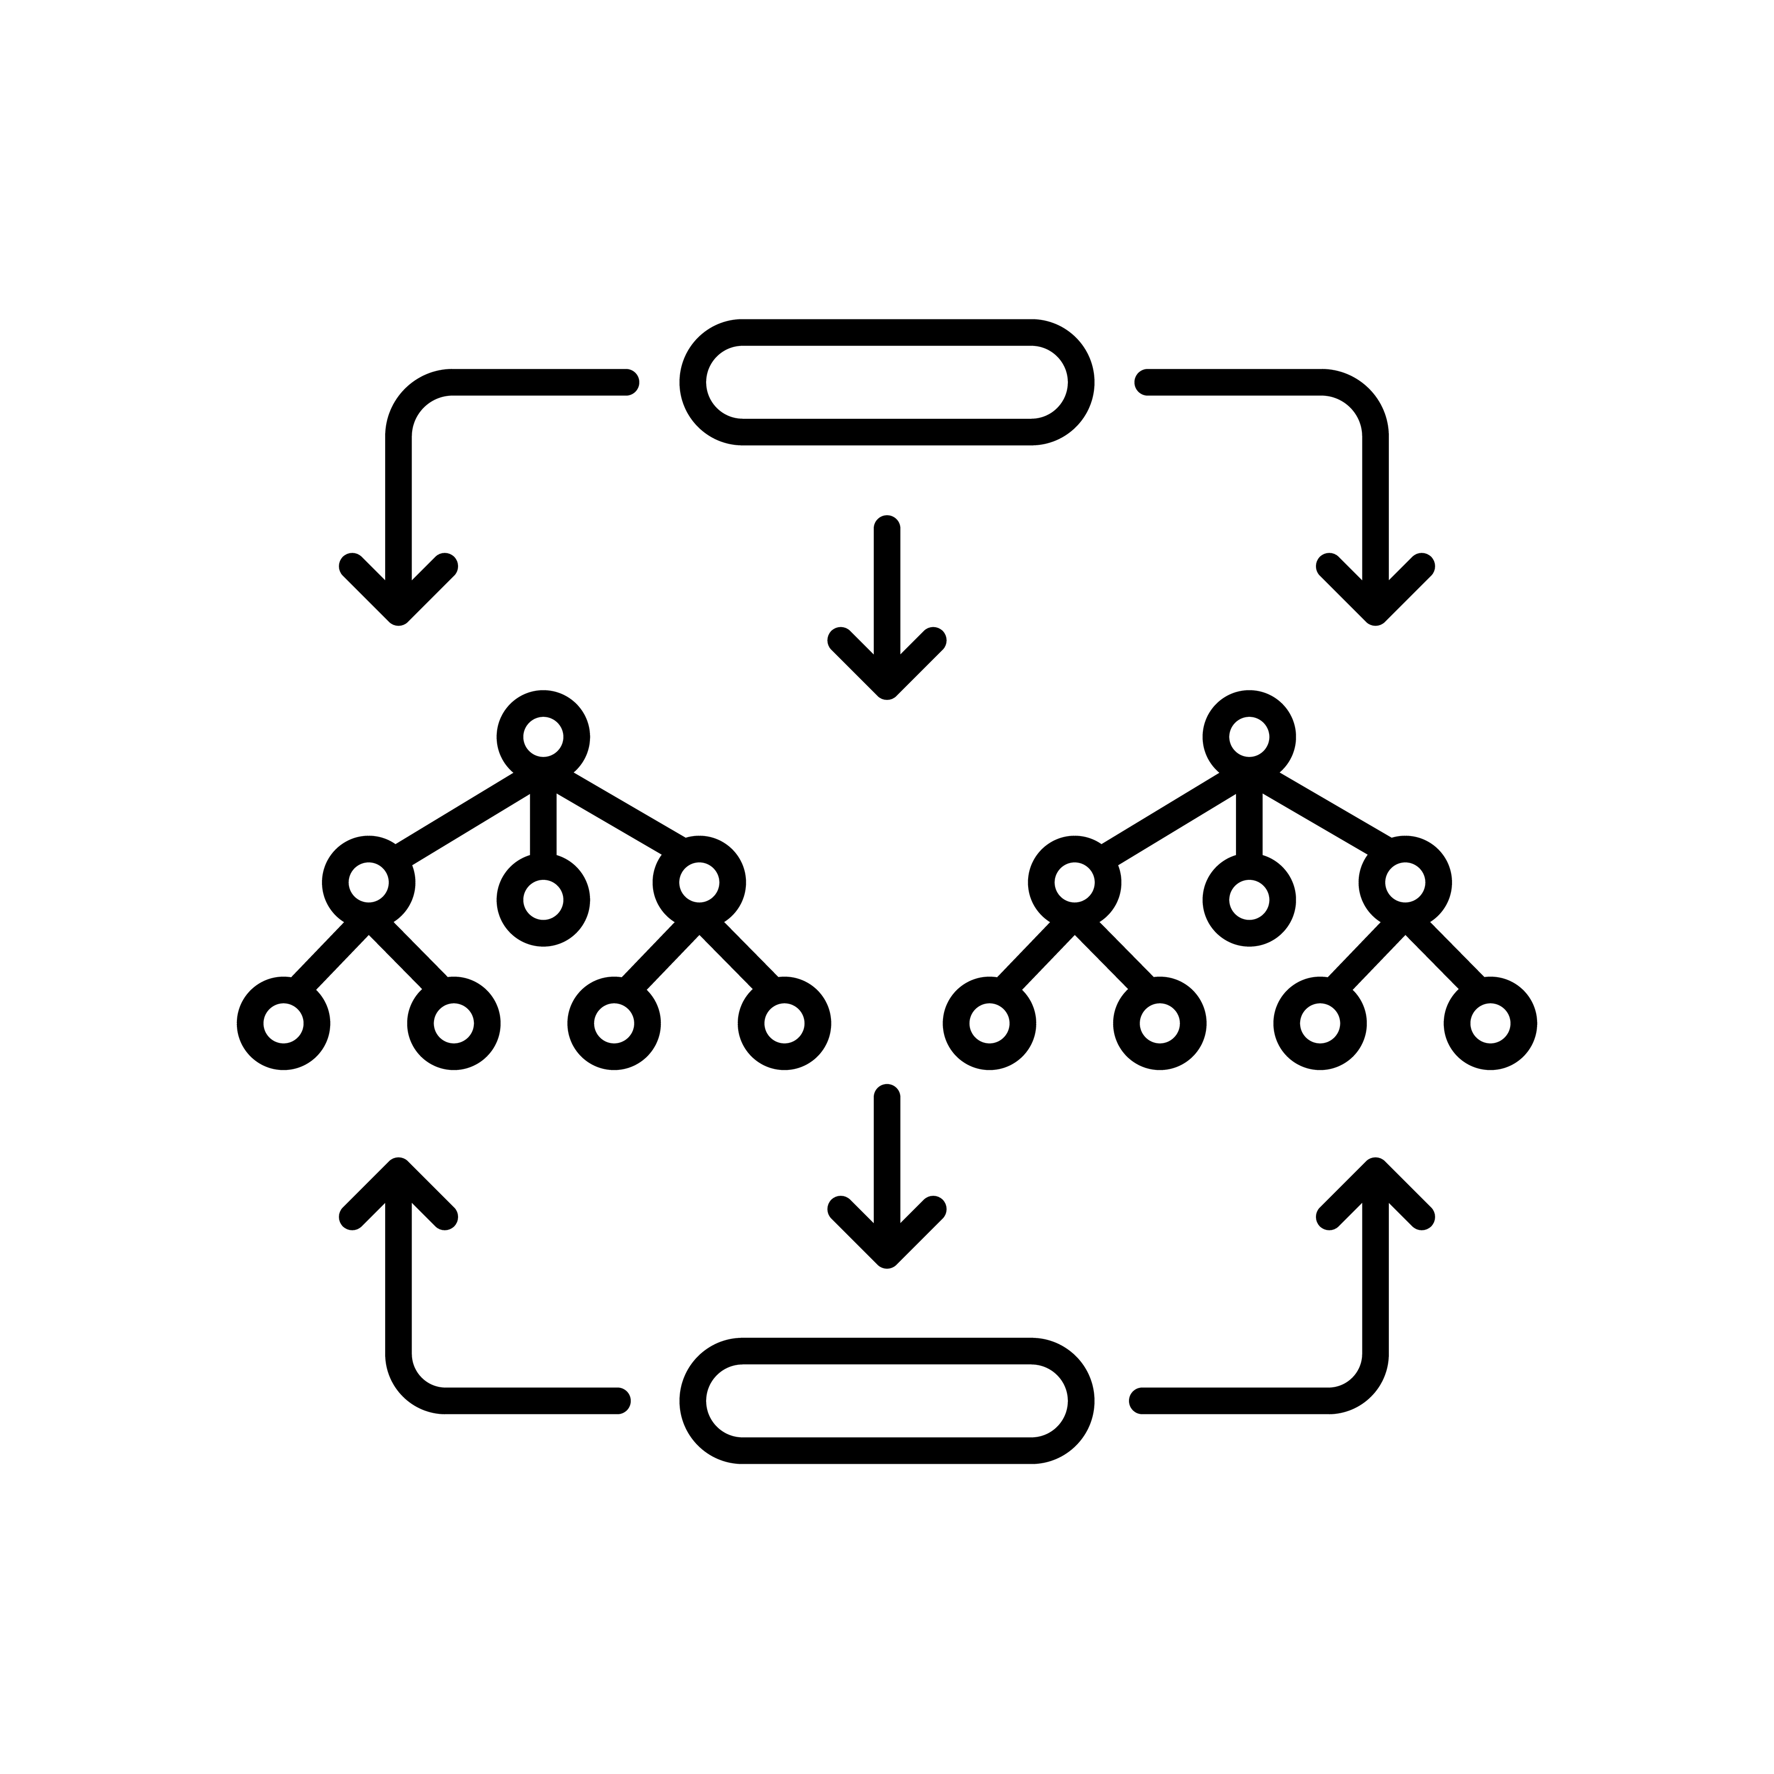
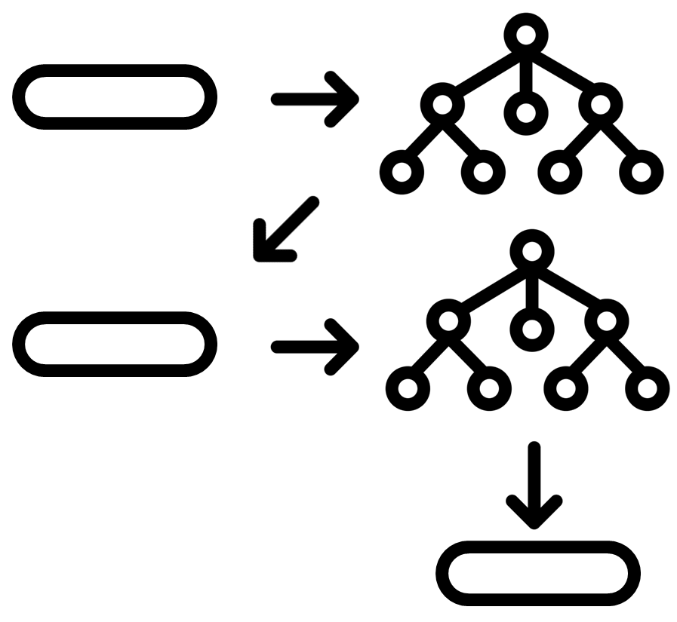
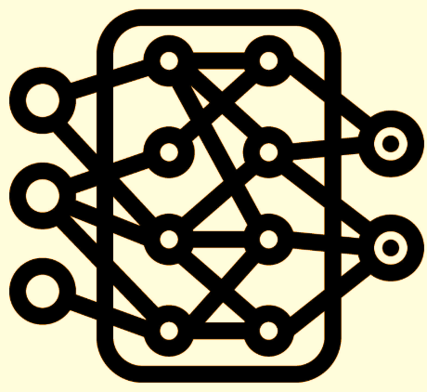
Ensemble data-driven model architectures
Overview
a) Family: Bagging
Algorithm: Random Forest
Implementation(s): XGBoost - RF | LightGBM - RF
b) Family: Boosting
Algorithm: Gradient Boosting
Implementation(s): XGBoost | LightGBM | CatBoost
c) Family: Neural networks
Algorithm: Feed-forward neural network
Implementation(s): Keras + TensorFlow

