Slide 1
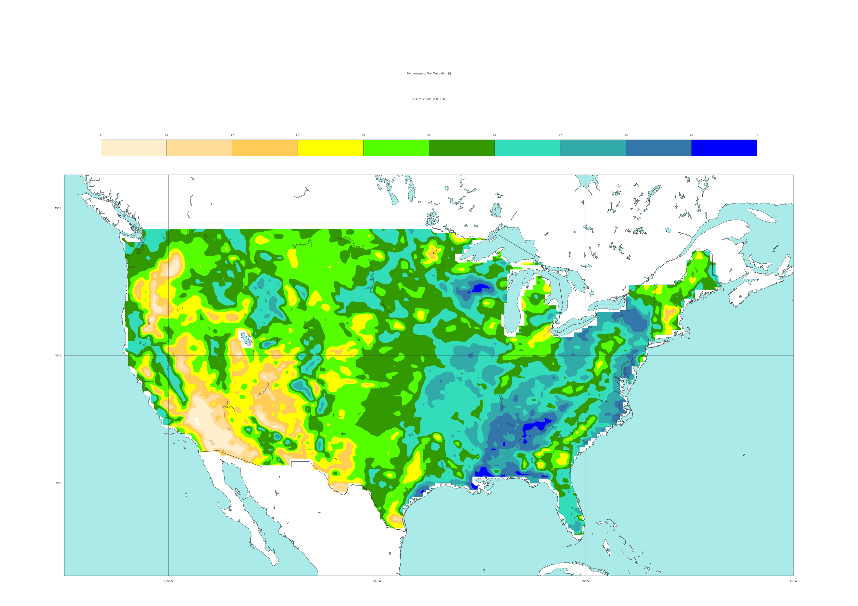

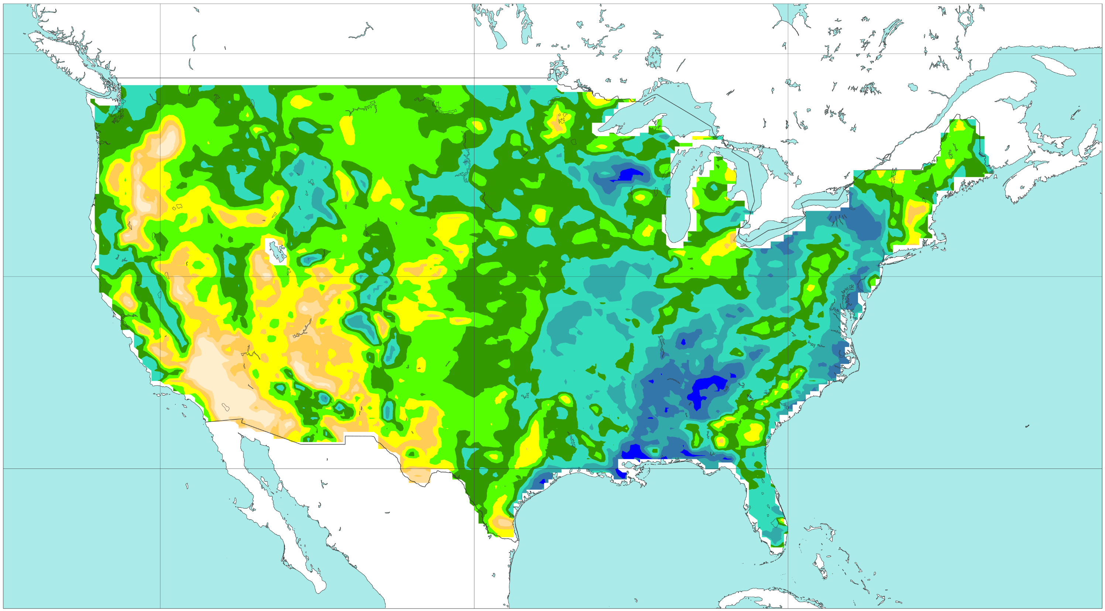




Percentage of soil maximum saturation (ERA5)
Dynamic Field (VT: 2021-09-01 at 00 UTC)
[%]
0
10
20
30
40
50
60
70
80
90
100
a) Reanalysis
b) FC: 2021-08-31 at 00 UTC (t+24) – Day 1
50 °N
40 °N
30 °N
c) FC: 2021-08-30 at 00 UTC (t+48) – Day 2
d) FC: 2021-08-29 at 00 UTC (t+72) – Day 3
50 °N
40 °N
30 °N
e) FC: 2021-08-28 at 00 UTC (t+96) – Day 4
f) FC: 2021-08-27 at 00 UTC (t+120) – Day 5
50 °N
40 °N
30 °N
120 °W
100 °W
80 °W
120 °W
100 °W
80 °W

