Slide 1
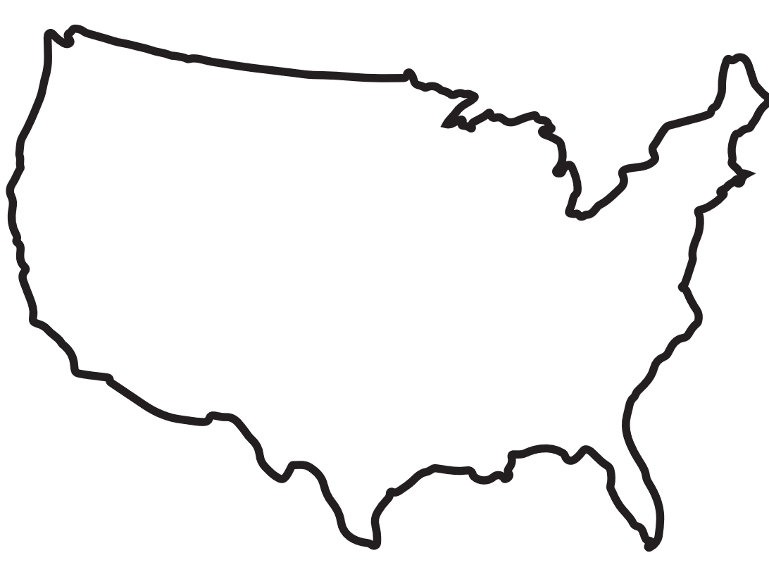

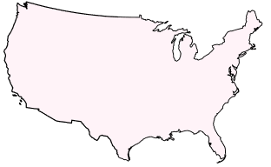










Sensitivity analysis
Training approaches
a) Approach 1: reduced-density training dataset - Training carried out over the full domain with randomly reduced number (lower density) of flash flood reports over the full domain
0%
% of flash flood reports used for training
100%
10%
50%
90%
b) Approach 2: sparsed-regional training dataset – Training carried out over the full domain with flash flood reports only over a part of the domain (i.e., during the training, the model still sees the full domain)
West
East
North
South
c) Approach 3: domain-restricted training dataset – Training carried out only over the part of the domain with flash flood reports (i.e., during the training, the model does not see the part of the domain with no reports)
West
East
North
South

