Slide 1
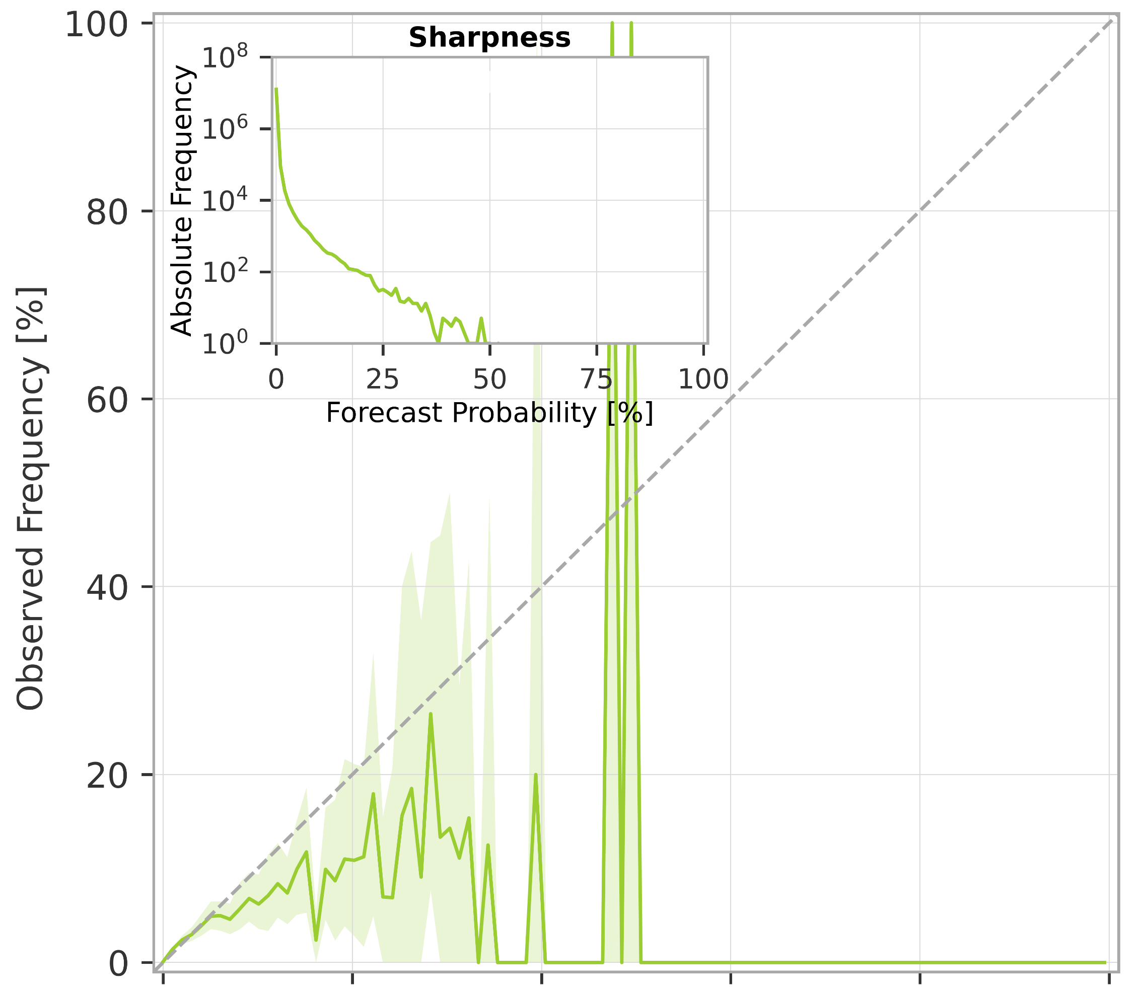
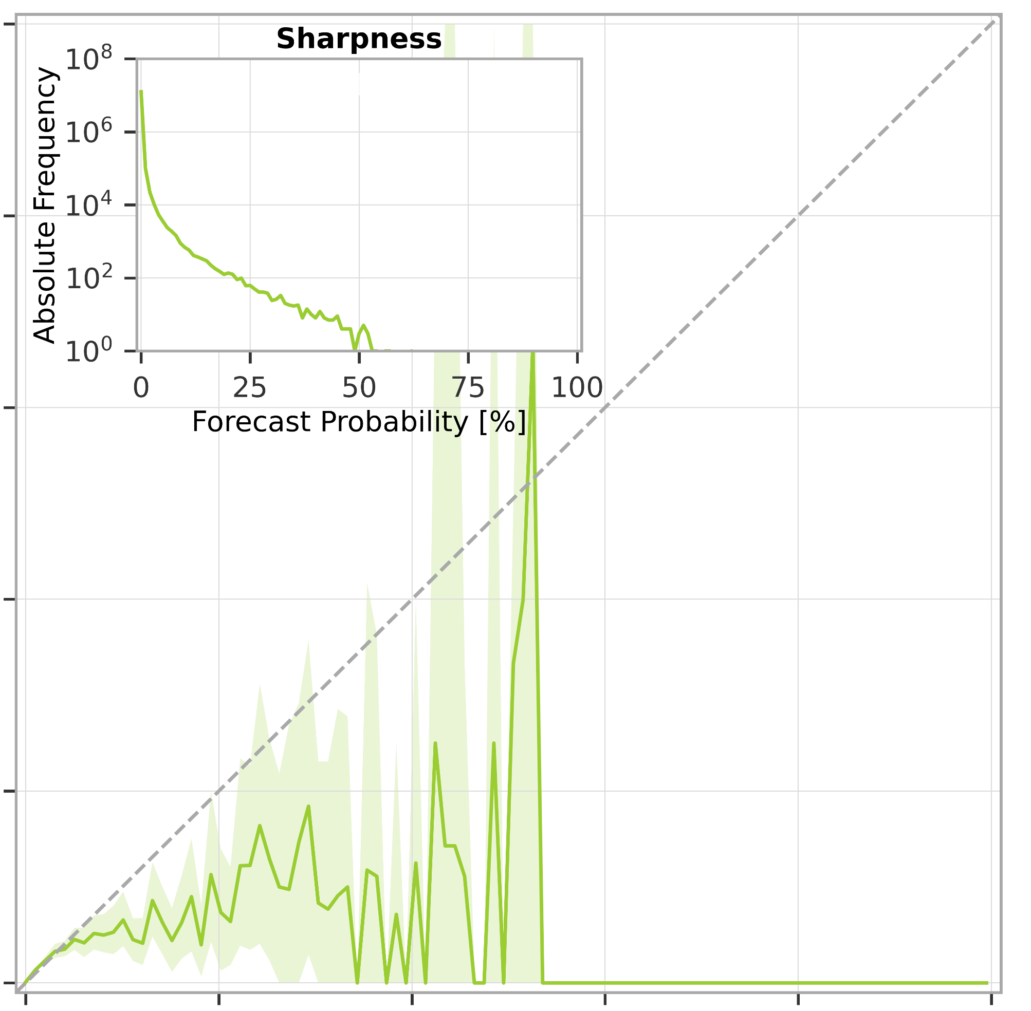
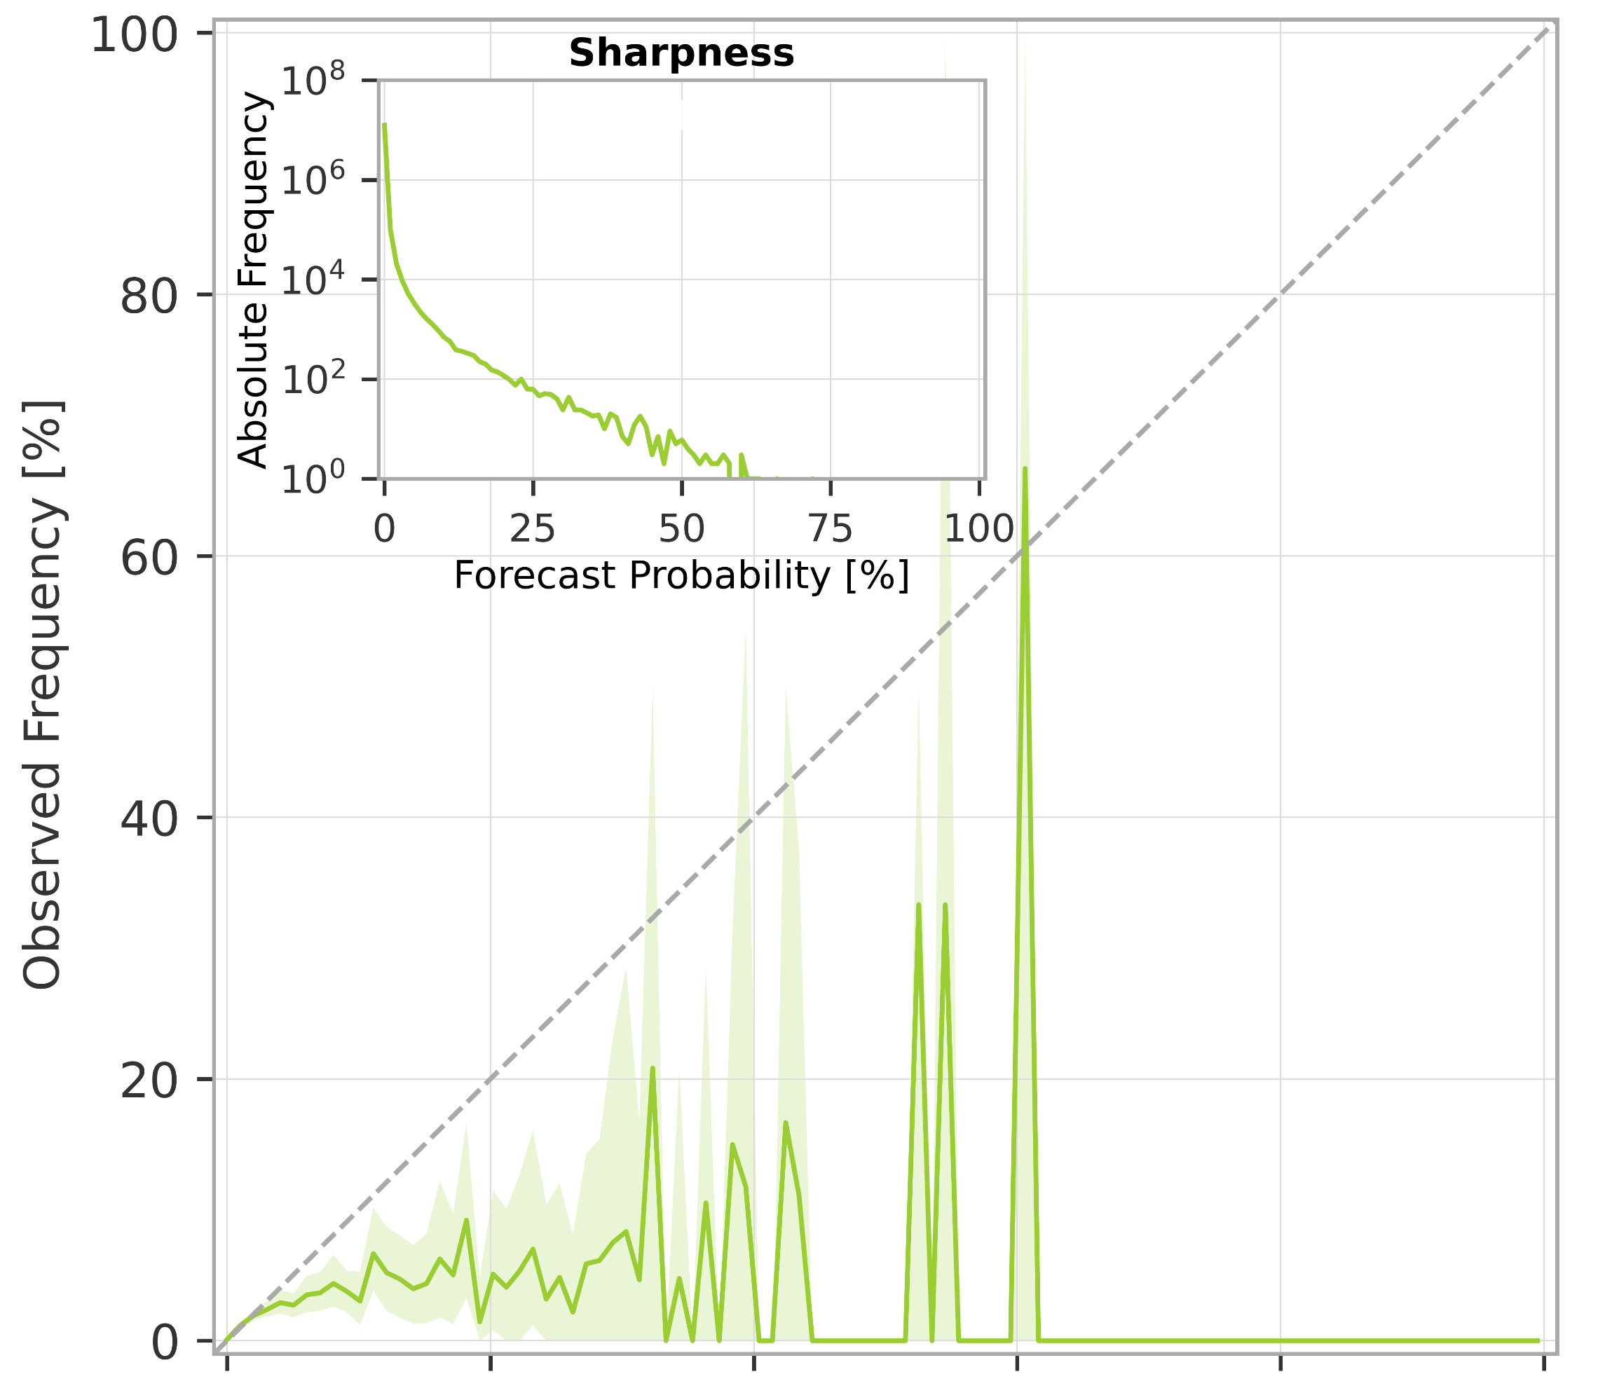
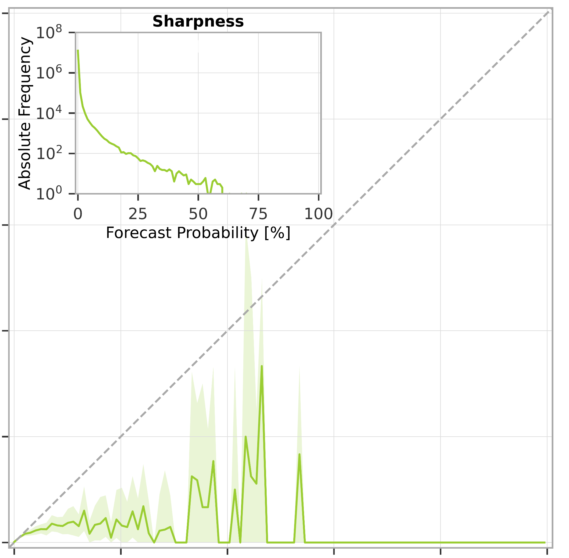
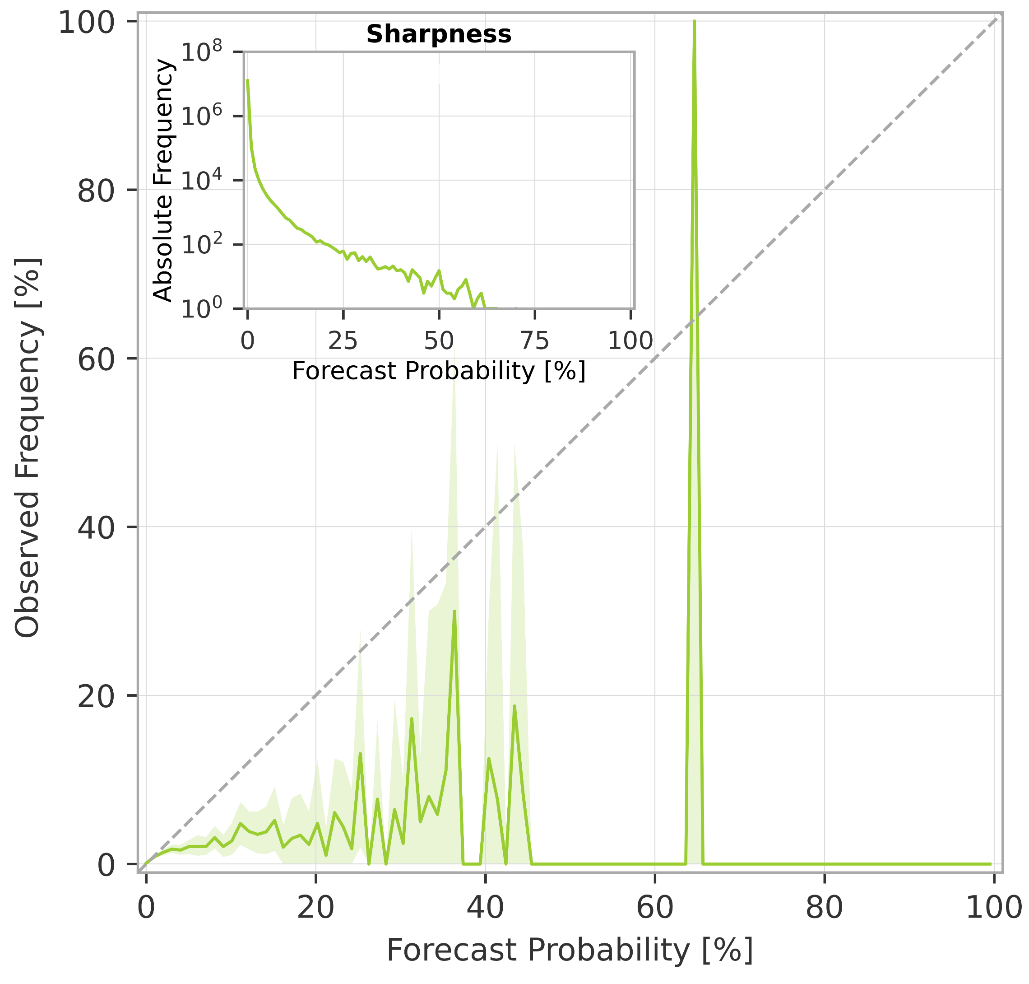
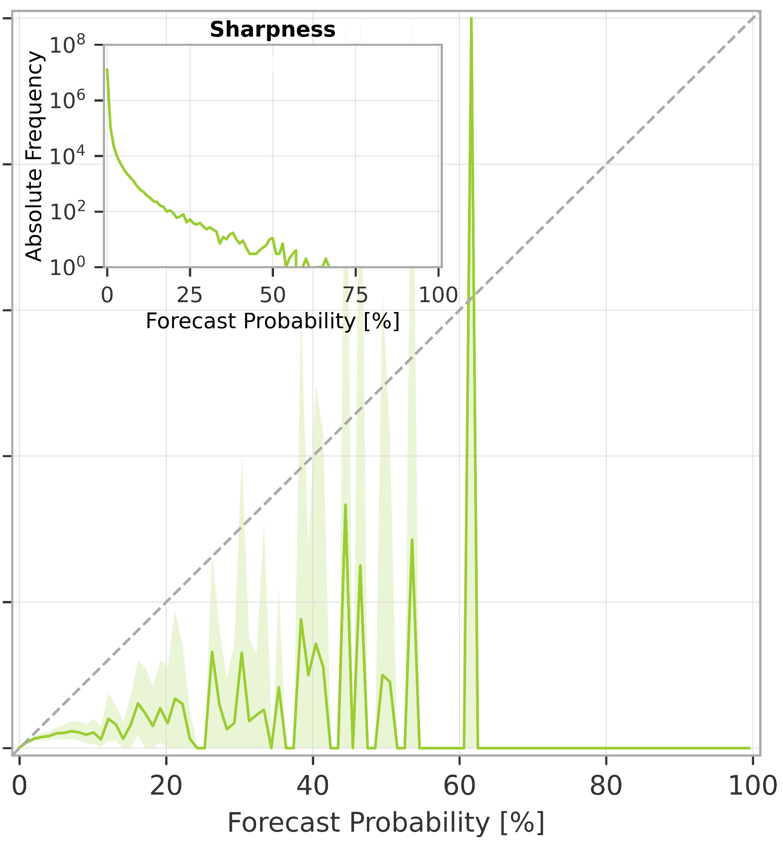
Breakdown verification scores (rainfall-based forecasts)
Reliability diagrams for rainfall events exceeding the 10-year return period
Reliability diagram
99% confidence interval
a) short-range forecast (reanalysis)
.
b) long-range forecast (t+0,t+24)
c) long-range forecast (t+24,t+48)
d) long-range forecast (t+48,t+72)
e) long-range forecast (t+72,t+96)
f) long-range forecast (t+96,t+120)

