Slide 1

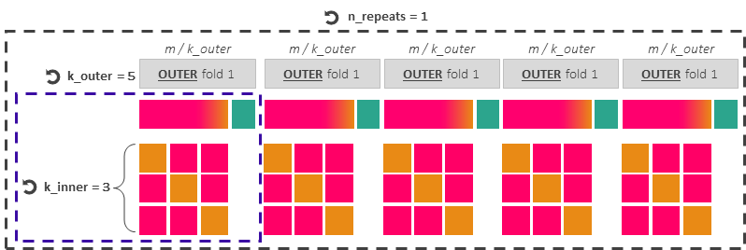

Repeated nested cross-validation
For hyperparameter tuning and model’s generalisation capabilities
Imbalanced training dataset (from 2001 to 2020)
m = 19.75M data points, of which 53245 (0.27%) are gridded yes-events
RepeatedStratifiedKfold
To preserve in every outer and inner fold the training dataset’s original class ratio between yes- and non-events
Hyperparameter tuning with Optuna
n_trials = 20
80 %
20 %
Outer Training
Outer Test
INNER fold 1
INNER fold 2
INNER fold 3
Split 1
Inner Validation
Inner Training
Inner Training
Split 2
Inner Training
Inner Validation
Inner Training
Split 3
Inner Training
Inner Training
Inner Validation
Single Optuna trial (candidate set of hyperparameters) =
Train each candidate set of hyperparameters over (k_inner - 1) splits, maximising AUC-PR and AUC-ROC, and validate the set over 1 split
Score for single trial = average of k_inner scores
Optuna ranks the n_trials scores to provide the best hyper-parameter set per outer fold and trains the model with it over the entire outer training dataset.
Test predictions (through AUC-PR and AUC-ROC) over the corresponding outer test dataset.
Select the best-performing fold, and train it over the original training dataset (m datapoints)
Model ready
for forecast production
Verification dataset (from 2021 to 2024)
n = 4.36M, of which 10742 (0.25%) are gridded yes-events
Test predictions using the Precision-Recall curve and AUC-PR, the ROC curve and AUC-ROC, the reliability diagram and the frequency bias.

Slide 2

n_repeats = 1
m / k_outer
m / k_outer
m / k_outer
m / k_outer
m / k_outer
k_outer = 5
OUTER fold 1
OUTER fold 1
OUTER fold 1
OUTER fold 1
OUTER fold 1
k_inner = 3

Slide 3
Hyperparameter tuning with Optuna
n_trials = 20
80 %
Outer Training
INNER fold 1
INNER fold 2
INNER fold 3
Split 1
Inner Validation
Inner Training
Inner Training
Split 2
Inner Training
Inner Validation
Inner Training
Split 3
Inner Training
Inner Training
Inner Validation
Single Optuna trial (candidate set of hyperparameters) =
Train each candidate set of hyperparameters over (k_inner - 1) splits and validate the set over 1 split
Score for single trial = average of k_inner scores
Optuna ranks the n_trials scores to provide the best hyper-parameter set and trains the model with it over the whole outer training dataset.

