Slide 1

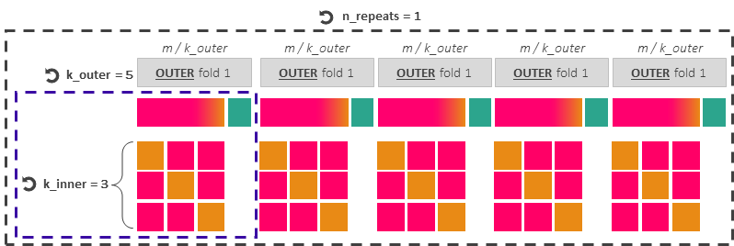

Workflow for training data-driven predictive models
Hyperparameter tuning and model’s generalisation capabilities when using imbalanced observational datasets for training
Imbalanced training dataset (from 2001 to 2020)
m = 19.75M data points, of which 53245 (0.27%) are gridded yes-events
RepeatedStratifiedKfold
To preserve in every outer and inner fold the training dataset’s original class ratio between yes- and non-events
Hyperparameter tuning with Optuna
n_trials = 20
80 %
20 %
Outer Training
Outer Test
INNER fold 1
INNER fold 2
INNER fold 3
Split 1
Inner Validation
Inner Training
Inner Training
Split 2
Inner Training
Inner Validation
Inner Training
Split 3
Inner Training
Inner Training
Inner Validation
Single Optuna trial (candidate set of hyperparameters) =
Train each candidate set of hyperparameters over (k_inner - 1) splits, maximising AUC-PR and AUC-ROC, and validate the set over 1 split
Score for single trial = average of k_inner scores
Optuna ranks the n_trials scores to provide the best hyper-parameter set per outer fold, and trains the model with it over the entire outer training dataset.
Test predictions over the corresponding outer test dataset, computing Precision-Recall curves, AUC-PR, ROC curves, AUC-ROC, reliability diagrams, and frequency bias.
Select the model corresponding to the fold with the best set of hyperparameters over the outer test datasets, and train it over the original training dataset (m datapoints)
Model ready for forecast production
Verification dataset (from 2021 to 2024)
n = 4.36M, of which 10742 (0.25%) are gridded yes-events

Slide 2

n_repeats = 1
m / k_outer
m / k_outer
m / k_outer
m / k_outer
m / k_outer
k_outer = 5
OUTER fold 1
OUTER fold 1
OUTER fold 1
OUTER fold 1
OUTER fold 1
k_inner = 3

Slide 3
Hyperparameter tuning with Optuna
n_trials = 20
80 %
Outer Training
INNER fold 1
INNER fold 2
INNER fold 3
Split 1
Inner Validation
Inner Training
Inner Training
Split 2
Inner Training
Inner Validation
Inner Training
Split 3
Inner Training
Inner Training
Inner Validation
Single Optuna trial (candidate set of hyperparameters) =
Train each candidate set of hyperparameters over (k_inner - 1) splits and validate the set over 1 split
Score for single trial = average of k_inner scores
Optuna ranks the n_trials scores to provide the best hyper-parameter set and trains the model with it over the whole outer training dataset.

