Slide 1


SCHOOL OF ELECTRICAL ENGINEERING AND COMPUTER SCIENCES
Lack of Financial Literacy in Low Income Groups
Applications of Information and Communication Technology

Slide 2

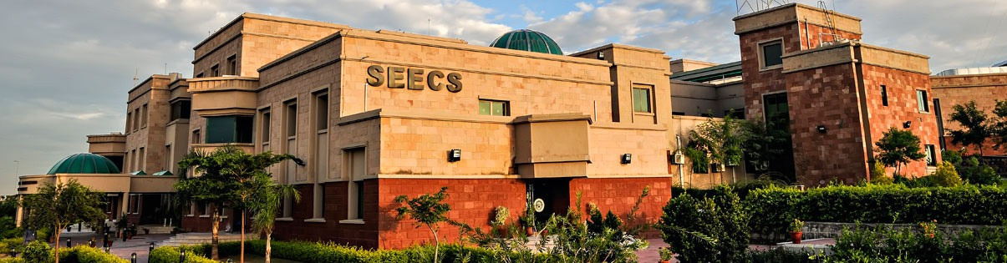

Group# 12
Group Members
Fatima Sajjad
503676
Ayesha Kamran
514562

Slide 3



Contents
Introduction
4
Problems Faced due to Lack of Financial Literacy in Low Income Groups
5

Slide 4



Lack of financial literacy refers to the insufficient understanding of financial concepts and skills necessary to make financial decisions. such as budgeting, saving and investing money, and understanding financial products and services. It is most prominent in low income groups due to lack of awareness.
Introduction
4

Slide 5
Causes of Lack of Financial Literacy:
Lack of practical financial education
Lack of resources to provide basic financial knowledge
Lack of awareness regarding the problem
Repercussions if Problem Remains Unsolved:
Poor credit
Bankruptcy
Foreclosure of property

Slide 6
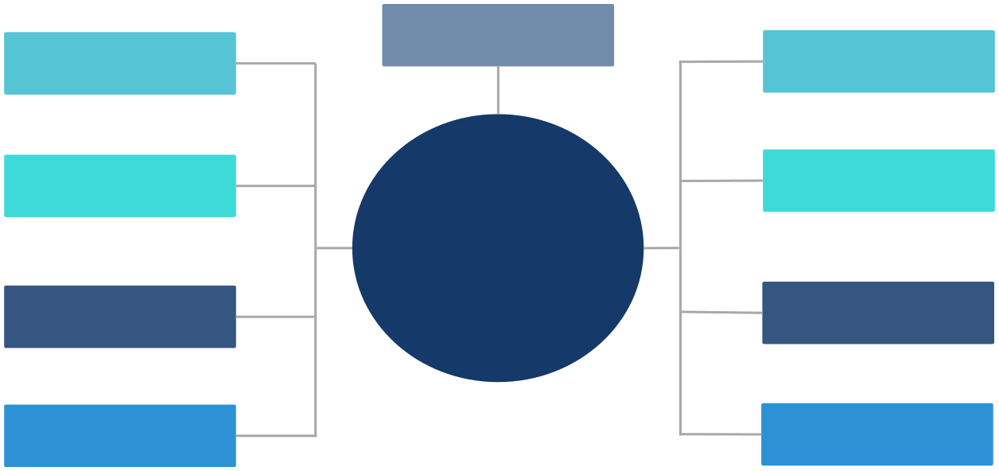
Lack of Financial Products Awareness
Lack ofBudgeting skills
Understanding of Credit/ Debit Cards
Debt Management
PROBLEMS FACED DUE TO LACK OF FINANCIAL LITERACY
Lack of Knowledge Regarding Inflation ans Taxes
High Interest Debts
Investment Scams
Lack of Financial Education Resources In Workplaces
5

Slide 7


Any
Questions?

