Slide 1

Exploring the role of intelligence in project manager leadership
MSc Project Management
University of the West of Scotland

Slide 2
Introduction
RQ1: How does cognitive intelligence affect project managers' judgment, and its impact on leadership effectiveness?
RQ2: How may emotional intelligence be used to improve conyhj6flict resolution within project teams?
RQ3: What relationship exists between emotional intelligence and project managers' capacity for conflict resolution?
Research Aim
This is an exploration of the intricate interplay between emotional and cognitive intelligence in the realm of project manager leadership. Project manager's responsibilities today include thorough project planning, skillful implementation of meticulously crafted plans, skillful management of the diverse and frequently complex web of project stakeholders, and ultimately, ensuring the successful delivery of the intended beneficial changes (Merrow, 2022). This transformation emphasizes the fluidity of the project manager's position, which has evolved beyond simple project execution to play a key role in fostering change, cultivating connections, and guaranteeing project success in the broadest sense (Qin & Green, 2022).
The aim of this study is to explore how emotional and cognitive intelligence influence project manager leadership traits and behaviors.
Research Objectives
Research Questions
Determine the impact of cognitive intelligence in decision making ability of project managers.
Explore the link between conflict-resolution abilities and emotional intelligence in project teams.
To identify the strategies for leveraging intelligence-based training's impact on leadership development.
RQ1: How does cognitive intelligence affect project managers' judgment, and its impact on leadership effectiveness?
RQ2: How may emotional intelligence be used to improve conflict resolution within project teams?
RQ3: What relationship exists between emotional intelligence and project managers' capacity for conflict resolution?

Slide 3
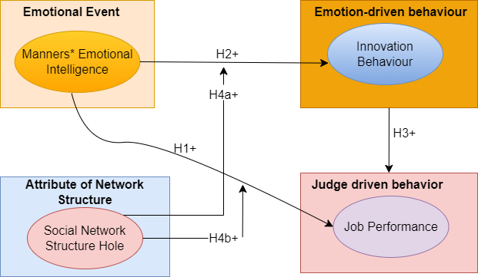

Methodology
Hypothesis
First hypothesis: Employee job performance exhibits a positive correlation with managers' emotional intelligence. Second hypothesis: There exists a positive relationship between manager Emotional Intelligence (EI) and the manifestation of innovative behavior within project teams. Third hypothesis: The innovative behavior of employees shows a positive correlation with their job performance, significantly enhancing their effectiveness in project execution. Fourth (a) hypothesis: The existence of a structural hole within a social network structure can positively moderate the correlation between managers' EI and employees' innovative behavior. Fourth (b) hypothesis: The presence of a structural hole within a social network structure can positively moderate the relationship between manager EI and employee job performance.
Figure 1: Describes the theoretical foundation for our secondary research project

Slide 4
Methodology
Research philosophy
Research approach
Emphasis on Secondary Research
Rooted in Systematic Literature review (SLR)
Focus on synthesis of existing literature
Theoretical Framework Development
Synthesizing insights from scholarly and professional Data
Research Methadology
Search Keywords
Inductive
Employed secondary data collection methods
Stressed comprehensive literature review
Employed secondary data collection methods
Stressed comprehensive literature review

Slide 5
Methodology
Data Sources
Research Analysis
Search Keywords
IEEE Xplore
ScienceDirect
Scopus
Springer
Elsevier
Emotional Intelligence
Cognitive Intelligence
Project Management
Decision Making
Thematic analysis used to identify patterns in selected studies
Themes identified:
Emotional Intelligence and its impact
Cognitive Intelligence and Decision Making

Slide 6
Methodology
Inclusion and Exclusion Criteria Overview
Inclusion Criteria | Exclusion Criteria
English language studies. | Non- English language studies.
Peer review studies including: conference proceedings, journals and book proceedings. | Studies are not related to the research topic.
Published books available in amazon library. | Duplicate Studies.
Studies that focus on Web 4.0 paradigm. | Technical reports and thesis.
Studies published since 2009. | Magazines, news and blogs.

Slide 7
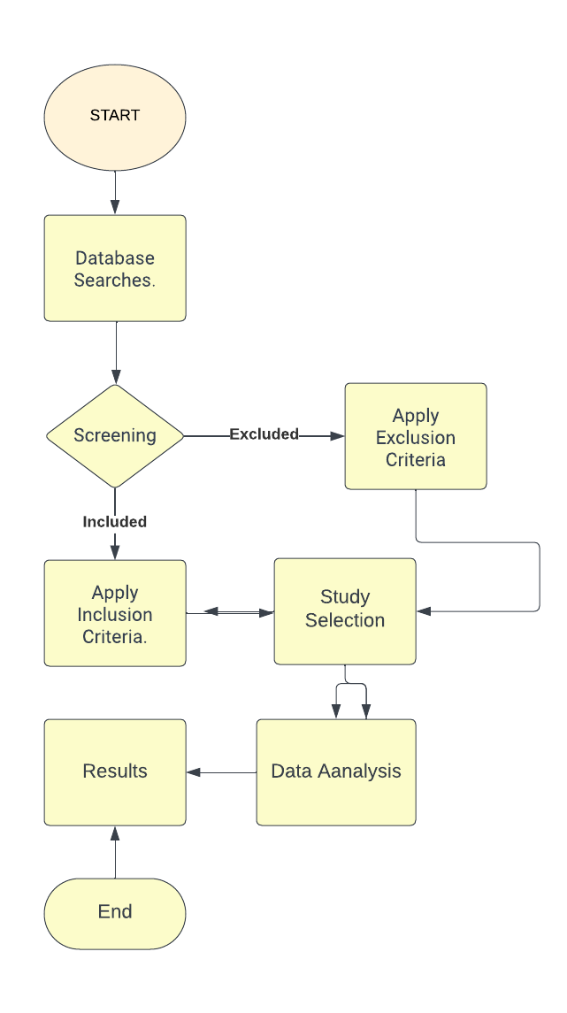
Methodology
Flowchart showing the steps involved in a systematic literature review

Slide 8
Methodology
Table 2.2: Themes Identified in Data Analysis (SUN, J., 2019)
Table 2.2: Themes Identified in Data Analysis (SUN, J., 2019)
Theme | Number of Studies | Description
Emotional Intelligence | 20 | - Impact on decision-making and conflict resolution
 |  | - Relationship with project manager leadership
Cognitive Intelligence | 18 | - Influence on strategic decision-making
 |  | - Connection to effective team collaboration

Slide 9
Results and Discussions
 | Perceive Emotions | Understand Emotions | Manage Emotions | Decision-Making Effectiveness
Perceive Emotions | 1.00 | 0.76 | 0.54 | 0.68
Understand Emotions | 0.76 | 1.00 | 0.62 | 0.74
Manage Emotions | 0.54 | 0.68 | 1.00 | 0.58
Table 3.2.1.1: Correlation Matrix of Emotional Intelligence Components and Decision-Making Effectiveness

Slide 10
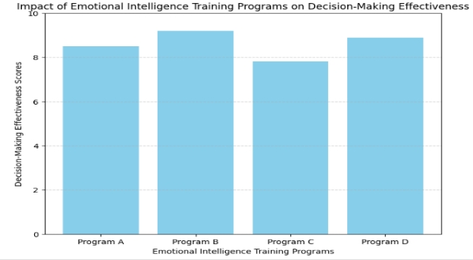
Results and Discussions
 | Perceive Emotions | Understand Emotions | Manage Emotions | Decision-Making Effectiveness
Perceive Emotions | 1.00 | 0.76 | 0.54 | 0.68
Understand Emotions | 0.76 | 1.00 | 0.62 | 0.74
Manage Emotions | 0.54 | 0.68 | 1.00 | 0.58
Figure 3.2.2.1: Impact of Emotional Intelligence Training Programs on Decision-Making Effectiveness (Bar-On, 2017)

Slide 11
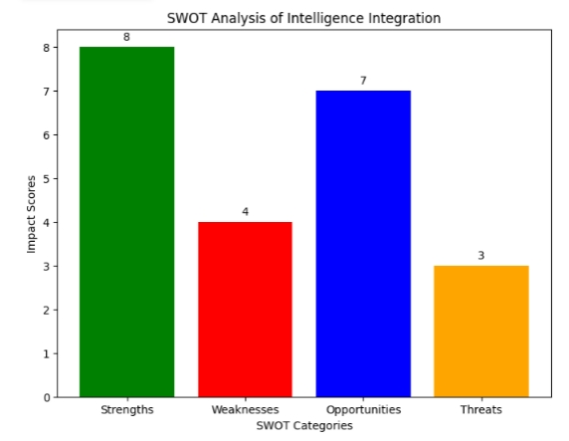
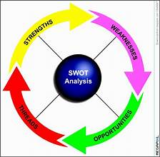
Results and Discussions
Figure: SWOT Intelligence Integration (Bar-On, 2017)
Figure 3.2.3.1: Emotional Intelligence Integration Framework (Bar-On, 2017)

Slide 12
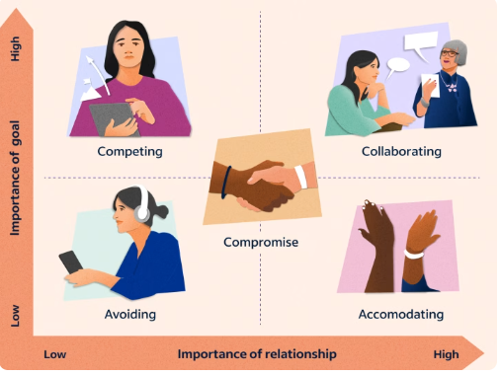
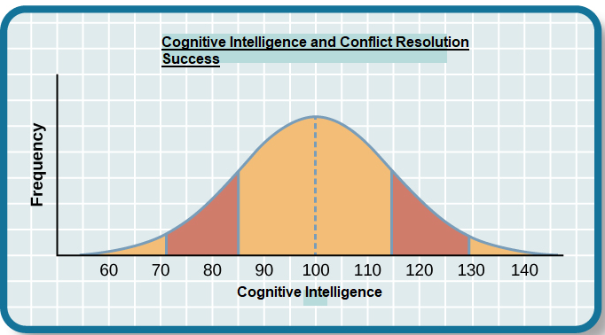
Results and Discussions
Conflict resolution Techniques
Figure: Conflict Resolution Techniques (Kenneth) Thomas-(Ralph) Kilmann model
Figure: Success of Cognitive Intelligence and Conflict Resolution from Introduction to Psychology.

Slide 13
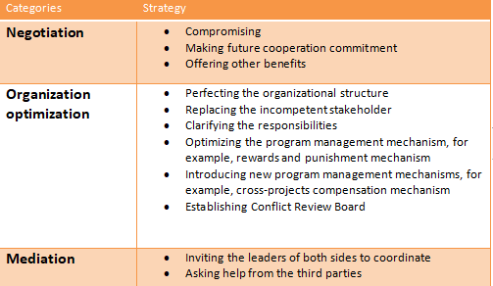
Strategies for Improving Cognitive Intelligence in Conflict Situations
Figure 3.3.2.2: The Principles and Strategies for Conflict Resolution, Nanan Wang 2022

Slide 14
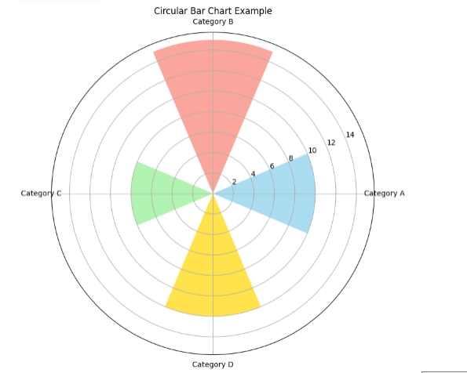
Cognitive Intelligence Development Cycle
This visual representation serves as a valuable aid, offering an insightful portrayal of the iterative nature of cognitive intelligence enhancement (Demetriou, A., 2023). The depicted cycle unfolds as follows:
Identification of Cognitive Challenges: The cycle commences with the identification of cognitive challenges encountered in conflict situations.
Application of Cognitive Strategies: Subsequently, project managers apply cognitive strategies, utilizing problem-solving techniques and analytical approaches to address the identified challenges.
Experiential Learning: The experiential learning phase follows, wherein the outcomes of applied cognitive strategies contribute to a reservoir of experiential knowledge.
Feedback and Reflection: Project managers engage in a feedback and reflection process, incorporating insights gained from applied cognitive strategies and learning experiences.
Iterative Refinement: The final stage involves the iterative refinement of cognitive intelligence based on feedback, fostering an ongoing cycle of improvement.
Figure 3.3.2.2: Cognitive Intelligence Development Cycle

Slide 15
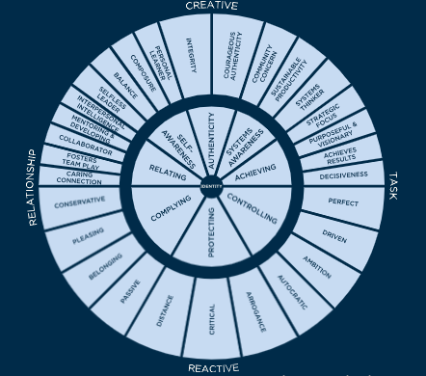
The Value of Emotional Intelligence for Project Managers Leadership
Characteristics of Successful Leadership
Assertiveness
Optimism
Independence
Strong impulse control
Problem-solving and decision-making skills
Confidence
Strong interpersonal skills
Flexibility
Figure3.4.3: Leadership Circle Profile Kate Everett, Forbes Coaches Counsil, 2019

Slide 16
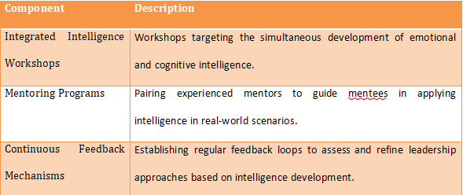
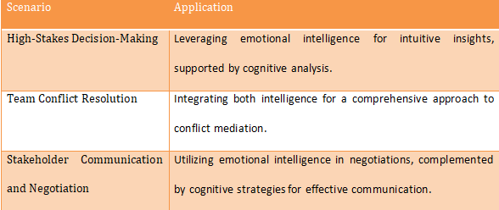
Practical Insights for Project Manager Leadership
Table 3.5.1.: Scenarios for Integrating Emotional and Cognitive Intelligence
Table 3.5.2: Key Components of Leadership Development Programs (Treglown, L. and Furnham, A., 2023)

Slide 17
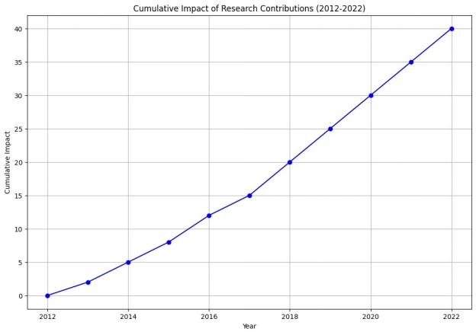
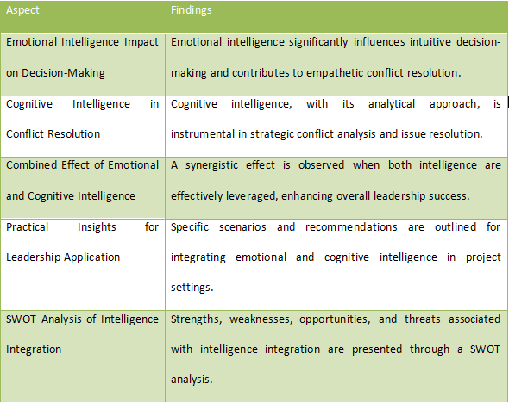
Conclusion
Key Findings
Figure 4.2.1: Cumulative Impact of Research Contributions (2012-2022)

Slide 18
Conclusion
Cumulative Impact of the research contributions (2012-2022)
Table 4.1: Summary of Key Findings

Slide 19
Conclusion
How objectives are met?
Objective 1: Determine the impact of cognitive intelligence in decision making ability of project managers.
Objective 2: Explore the link between conflict-resolution abilities and emotional intelligence in project teams managers.
Objective 3: To identify the strategies for leveraging intelligence-based training's impact on leadership development.
Identified the Role of cognitive intelligence in decision-making.
Investigated the relationship between cognitive intelligence and decision-making among project managers.
Explored how cognitive intelligence impacts judgment and decision-making within project management.
Conducted a systematic review of literature investigating emotional intelligence and conflict resolution.
Explored studies underscoring the link between emotional intelligence and conflict resolution in project teams.
Investigated the role of emotional intelligence in enhancing conflict resolution within project management.
Focused on intelligence-based training in leadership development.
Investigated methodologies employed in leveraging intelligence-based training for leadership.
Extracted practical recommendations for project managers.

Slide 20
Limitations
Dependency on existing literature may introduce biases.
The complex interrelation of emotional and cognitive intelligence poses challenges in isolating precise effects.

Slide 21
Recommendations
Recommendation Area | Action Steps
Emotional Intelligence Development | Conduct integrated intelligence workshops encompassing self-awareness, empathy, and interpersonal communication. Implement mentoring programs for personalized guidance. Establish continuous feedback mechanisms for ongoing improvement.
Cognitive Intelligence Enhancement | Provide training programs focusing on analytical problem-solving, data-driven decision-making, and conflict resolution strategies. Equip project managers with skills to analyze complex situations and formulate effective solutions.
Combined Intelligence Application | Encourage simultaneous application of emotional and cognitive intelligences in high-stakes decisions-making, conflict resolution, and stakeholder communication. Empower project managers to leverage both intelligences for a more holistic leadership approach.
Table 5.1: Actionable Recommendations for Leadership Development

Slide 22

References
Alegbeleye, I. and Kaufman, E., 2020. Relationship Between Middle Managers' Transformational Leadership and Effective Followership Behaviors in Organizations. Journal of Leadership Studies, 13(4), pp.6-19.
BMG Research, 2015. Factors in Project Success. Prepared for: The Association for Project Management (APM). Birmingham: APM.
Grisales, R. and Lopez, N., 2011. The Link between Project Management Leadership and Project Success. MBA. BLEKINGE TEKNISKA HOGSKOLA.
Hobday, M., 2000. The project-based organisation: an ideal form for managing complex products and systems?. Research Policy, 29(7-8), pp.871-893.
Keegan, A. and Den Hartog, D., 2004. Transformational leadership in a project-based environment: a comparative study of the leadership styles of project managers and line managers. International Journal of Project Management, 22(8), pp.609-617.
Keegan, A. and Den Hartog, D., 2018. Doing it for themselves? P erformance appraisal in project‐based organisations, the role of employees, and challenges to theory. Human Resource Management Journal, 29(2), pp.217-237.
Pemsel, S. and Wiewiora, A., 2013. Project management office a knowledge broker in project-based organisations. International Journal of Project Management, 31(1), pp.31-42.
ScottishPower (2021) ScottishPower Renewables. [online] Available: https://www.scottishpowerrenewables.com/pages/about_us.aspx [Accessed 12th August 2021]
Tyssen, A., Wald, A. and Spieth, P., 2014. The challenge of transactional and transformational leadership in projects. International Journal of Project Management, 32(3), pp.365-375.

