Slide 1
7074HUM Coursework
Dr Sarah Turner

Slide 2

Coursework
Tips and suggested structure
Referencing and avoiding plagiarism
Understanding the Learning Outcomes

Slide 3
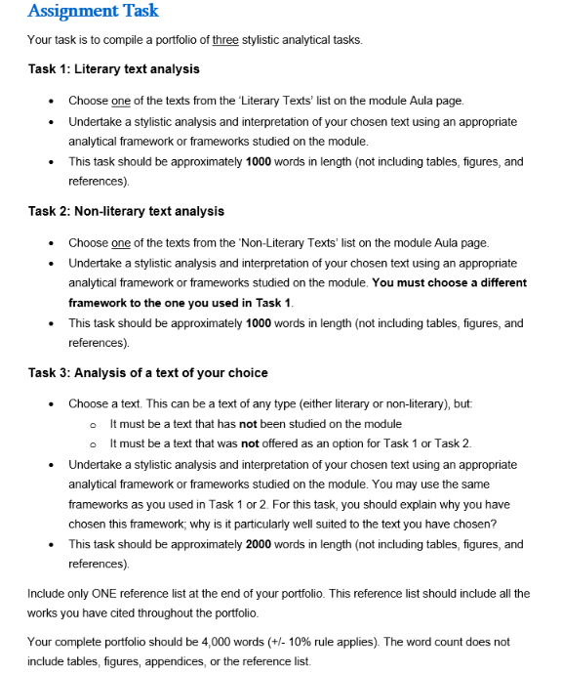
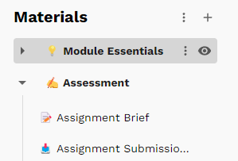

Slide 4
FAQs
Can we only use one framework for each of the two shorter analyses (Task 1 and Task 2)?
Focus on one, but if you want to bring in elements of others, you can.
How many frameworks can we use for Task 3?
Up to you! Remember, you only have 2000 words.
In the past, students have tended to use 2-3 frameworks for this task.

Slide 5
Suggested structure
‘Stylistics is...concerned with relating linguistic facts (linguistic description) to meaning (interpretation) in as explicit way as possible’ (Short, 1996, p. 5).
For each task:
Introduction: What text have you chosen? What framework(s) are you using to analyse it? For Task 3, you will also need to explain why you have chosen these frameworks.
Analysis and Interpretation: Present the results of your analysis in a clear and appropriate way; you may like to use tables or an appendix, but note that these do not count towards the word count. How do the results of your analysis help to inform and justify particular interpretations? (You may like to have a separate 'Interpretation' section, instead of merging the two.)
Conclusion: A short paragraph ‘wrapping up’: what are the ‘key points’ of your analysis and interpretation?

Slide 6

Using your reading
The majority of your citations will probably be in the Introduction sections:
Introducing the frameworks
Defining the concepts
Potentially, when justifying your choice of framework(s)
However, you may wish to also use further reading to deepen your interpretation section.
Use the readings from the appropriate week of the module as a starting point
Google Scholar and the Language and Literature Journal (available via Locate) may also prove useful if you want to go further – but ensure that you use the recommended readings, too.

Slide 7
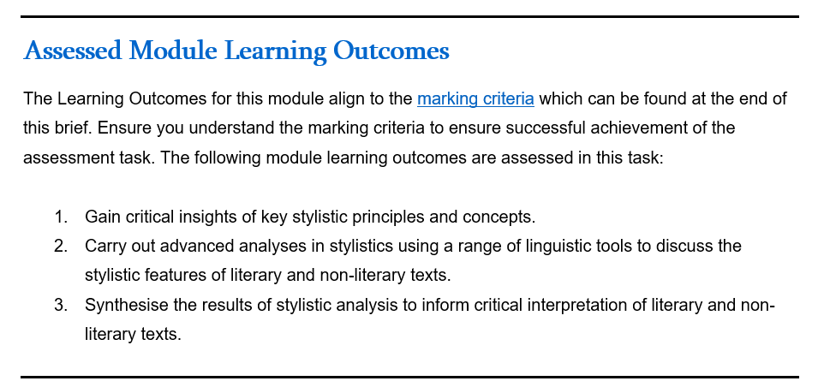
LO1: Do you understand what stylistics is, and what it’s for? Do you understand the different frameworks we’ve encountered, and when they might be useful to use?
LO2: Can you use the frameworks to undertake an accurate analysis of a text?
LO3: Can you use the results of your analyses to offer an evidence-based interpretation of a text?

Slide 8
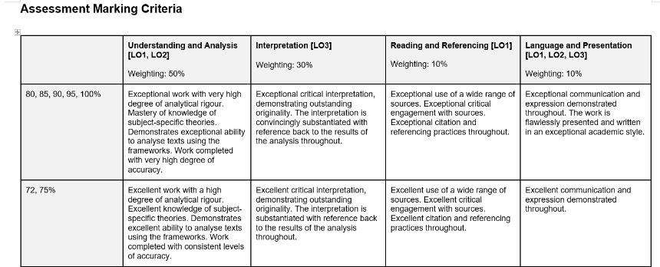
Understanding and Analysis (50 marks) Does the work demonstrate an understanding of the concepts covered on the module? Is the analysis thorough, accurate, and systematic?
Interpretation (30 marks) Are plausible interpretations of findings offered? Are interpretations clearly linked back to findings, explaining how the findings substantiate the interpretations?
Reading and references (10 marks) Is there evidence of a range of reading, including the recommended texts? Are sources correctly cited? Are the references correctly compiled? Are all cited sources referenced and vice versa? Is the APA style used correctly and consistently?
Language, Structure and Presentation (10 marks) Is the work logically organized? Is it possible/easy to follow the ideas and arguments within and across sections? Are any abbreviations carefully introduced? Is there appropriate use of signposting to link the sections together and guide the reader? Is the spelling and grammar standard/accurate? Is the style/register appropriate for this sort of academic work? Is punctuation used appropriately and accurately?

Slide 9
Referencing and avoiding plagiarism
Remember, you must include a citation in the text whenever you use words or ideas from a published source, and a reference list at the end giving the details of the texts you’ve used. Direct quotes must be in quotation marks.
We use APA style to reference.
Refer to https://libguides.coventry.ac.uk/apa/home
Consider booking a place on a library workshop on APA: https://libcal.coventry.ac.uk/calendar/libraryworkshops
If you are not confident in your ability to avoid plagiarism, consider booking a place on the Academic Integrity: A Practical Introduction workshop:
https://libcal.coventry.ac.uk/calendar/caw

Slide 10
Next Steps
Begin work on your portfolio now, even if it's just to think about which frameworks and texts you might like to choose out of what we've done so far.
Please don’t hesitate to email me with any questions, or to book an appointment.

