Slide 1
INTRODUCTION
Allow me to introduce myself. My name is Fatima Zahra. I am from Karachi itself. I recently completed my intermediate in Engineering faculty. I was free from study so I joined classes of CIT course in banoqabil and its going on. I am an introvert girl but it doesn’t mean I don’t have confidence. Still I am trying to be a better version of me.

Slide 2
PERSIONALITY TRAIT
Empathetic
Adventurous
Attentive
Adaptable
Perseverant

Slide 3
HOBBIES AND INTEREST
Discover new talents: Try new activities to find what you enjoy.
Develop skills: Improve existing skills or learn new ones.
Reduce stress: Engage in activities that calm your mind.
Art: Drawing, sculpting.
Reading: Fiction, non-fiction and genres.
Learning new languages: Explore cultures.
Travel: Explore new places.
Photography: Capture moments.

Slide 4
ACADEMIC
I had completed my matric (science faculty) in 2022.
I completed my intermediate (engineering) in 2024.
I have done language course recently and got certificate.
I am doing CIT (certificate information technology) and its going on.

Slide 5
Skills learn from CIT
Ms Office (word, excel and power point)
Using Github for project uploading and sharing.
Visual studio code
Improved presentation skills.
Python (Basic)

Slide 6
FAVOURITE TOPIC
Ladies and gentlemen, today I want to talk about something that drives us all ”Motivation”. It’s the spark that ignites our passions, fuels our dreams, and pushes us to achieve greatness. When we are motivated, we are more focused, more productive and more resilient. Sometime we feel lowkey down and we just need someone’s motivation. Because of this, we feel strong, confident and more focused. We need to learn from failures. If you don’t have anyone, be your own therapist and motivate yourself because you are capable enough.

Slide 7
HERE ARE SOME TIPS FOR YOU:
Trust your abilities: You have unique strength and talents.
Set goals: Identify what you want to achieve.
Face challenges: Don’t let fear hold you back.
Learn from failures: Use setbacks as opportunities for growth.
Find your why: Identify your purpose and passion.
Celebrate progress: Acknowledge your achievement .

Slide 8
CONCLUSION:
Motivational is a powerful tool that can help us achieve our dreams. It’s what drives us, what inspires us, and what pushes us to be our best selves. Let’s harness the power of motivation and unlock our full potential.

Slide 9
STRENGTH AND WEAKNESS
STRENGTH
Communication skill
Empathy
Teamwork
Confident
Leadership skill
Reliable
WEAKNESS
Blindly trust
Self-doubt
Anxious
Amicable
Overthinking

Slide 10

FUTURE GOAL
I would likely want to lead a major company. I want to become CEO, director, or manager and I will chose the path which I have interest. I don’t know about my future but I have a wish that I will earn lot of money and build a pet house for animals where they will be treated. I will take the responsibility of taking care and the better treatment. I love being around of cats and Allen Beck(researcher) who studied the human-animal bond and said its benefit for human health.

Slide 11
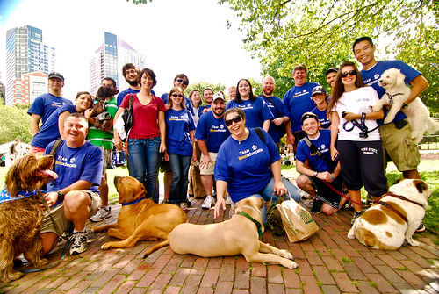
INSPIRATION
Today we celebrate the unsung heroes who rescue animals from streets. These individuals embody compassion, kindness and empathy. They see the value in every life, no matter how small or vulnerable. Rescuing animals from streets is not just about saving lives, its about changing lives. Its about giving a second chance to those who need it most. Every rescue story is a testament to the human spirit’s capacity for kindness and generosity. These heroes inspires us to be better versions of ourselves. They show us that even small actions can have a significant impact. By sharing their stories, we can motivate a difference in their communities.

Slide 12
Every life matters, and every action counts. Lets keep making a difference, one rescue at a time.

