Slide 1
CSC103-Programming Fundamentals
Selections-Switch
Lecture-9
Instructors
Mr. Rizwan Rashid

Slide 2
Lecture Outline
Switch Statement
Logical Operators
Conditional Expressions

Slide 3

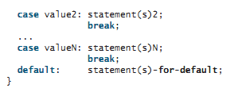
switch Statements

Slide 4
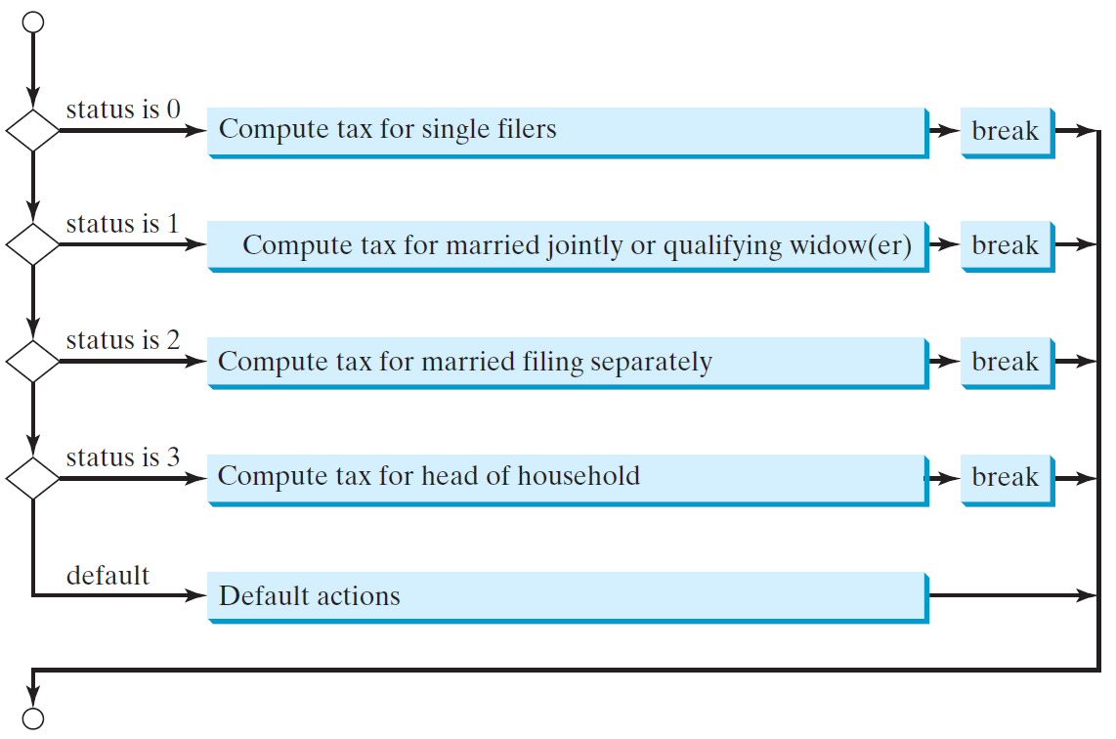
switch Statement Flow Chart

Slide 5
Switch- Example
int number=20;
//Switch expression
switch(number){
//Case statements
case 10: System.out.println("10");
break;
case 20: System.out.println("20");
break;
case 30: System.out.println("30");
break;
//Default case statement
default:System.out.println("Not in 10, 20 or 30");
}

Slide 6
switch Statement Rules
The switch-expression must yield a value of char, byte, short, or int type and must always be enclosed in parentheses.
switch (switch-expression) {
case value1: statement(s)1;
break;
case value2: statement(s)2;
break;
…
case valueN: statement(s)N;
break;
default: statement(s)-for-default;
}
The value1, ..., and valueN must have the same data type as the value of the switch-expression.
The resulting statements in the case statement are executed when the value in the case statement matches the value of the switch-expression.
Note that value1, ..., and valueN are constant expressions, meaning that they cannot contain variables in the expression, such as 1 + x.

Slide 7
switch Statement Rules
The keyword break is optional, but it should be used at the end of each case in order to terminate the remainder of the switch statement. If the break statement is not present, the next case statement will be executed.
switch (switch-expression) {
case value1: statement(s)1;
break;
case value2: statement(s)2;
break;
…
case valueN: statement(s)N;
break;
default: statement(s)-for-default;
}
The default case, which is optional, can be used to perform actions when none of the specified cases matches the switch-expression.
When the value in a case statement matches the value of the switch-expression, the statements starting from this case are executed until either a break statement or the end of the switch statement is reached.

Slide 8
Trace switch statement
Suppose day is 2:
switch (day) {
case 1:
case 2:
case 3:
case 4:
case 5: System.out.println("Weekday"); break;
case 0:
case 6: System.out.println("Weekend");
}

Slide 9
Trace switch statement
Match case 2
switch (day) {
case 1:
case 2:
case 3:
case 4:
case 5: System.out.println("Weekday"); break;
case 0:
case 6: System.out.println("Weekend");
}

Slide 10
Trace switch statement
Fall through case 3
switch (day) {
case 1:
case 2:
case 3:
case 4:
case 5: System.out.println("Weekday"); break;
case 0:
case 6: System.out.println("Weekend");
}

Slide 11
Trace switch statement
Fall through case 4
switch (day) {
case 1:
case 2:
case 3:
case 4:
case 5: System.out.println("Weekday"); break;
case 0:
case 6: System.out.println("Weekend");
}

Slide 12
Trace switch statement
Fall through case 5
switch (day) {
case 1:
case 2:
case 3:
case 4:
case 5: System.out.println("Weekday"); break;
case 0:
case 6: System.out.println("Weekend");
}

Slide 13
Trace switch statement
Encounter break
switch (day) {
case 1:
case 2:
case 3:
case 4:
case 5: System.out.println("Weekday"); break;
case 0:
case 6: System.out.println("Weekend");
}

Slide 14
Trace switch statement
Exit the statement
switch (day) {
case 1:
case 2:
case 3:
case 4:
case 5: System.out.println("Weekday"); break;
case 0:
case 6: System.out.println("Weekend");
}

Slide 15
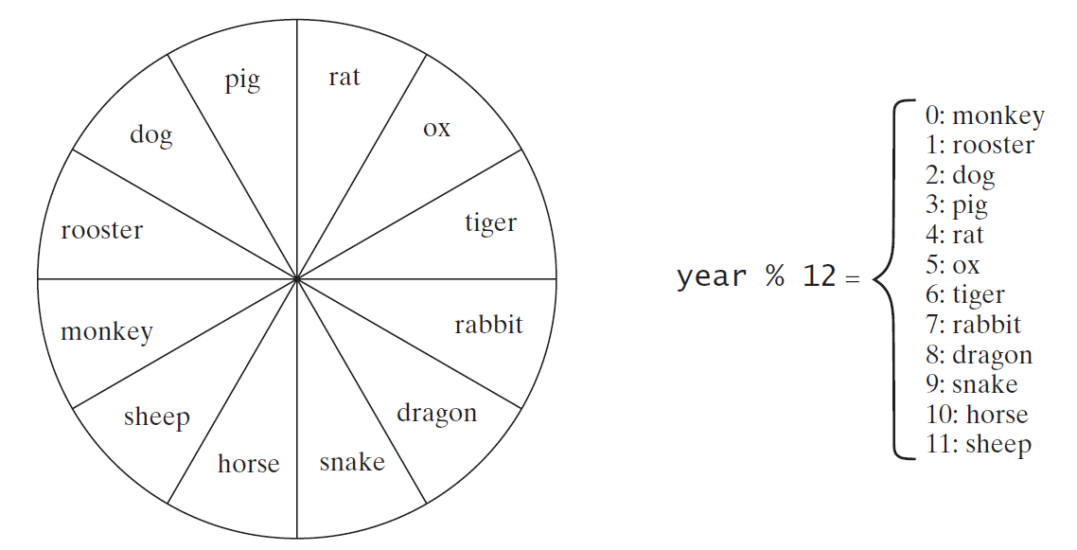
Problem: Chinese Zodiac
Write a program that prompts the user to enter a year and displays the animal for the year.

Slide 16
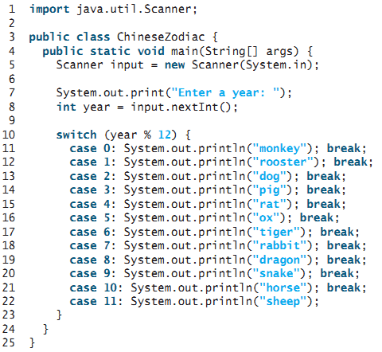



Slide 17
Logical Operators
The logical operators !, &&, ||, and ^ can be used to create a compound Boolean expression
Logical operators, also known as Boolean operators
Operator | Name | Description
! | not | logical negation
&& | and | logical conjunction
|| | or | logical disjunction
^ | exclusive or | logical exclusion

Slide 18
Truth Table for Operator !
p | !p | Example (assume age = 24, weight = 140)
true | false | !(age > 18) is false, because (age > 18) is true.
false | true | !(weight == 150) is true, because (weight == 150) is false.

Slide 19
Truth Table for Operator &&
p₁ | p₂ | p₁ && p₂ | Example (assume age = 24, weight = 140)
false | false | false | (age <= 18) && (weight < 140) is false, because (age > 18) and (weight <= 140) are both false.
false | true | false
true | false | false | (age > 18) && (weight > 140) is false, because (weight > 140) is false.
true | true | true | (age > 18) && (weight >= 140) is true, because both (age > 18) and (weight >= 140) are true.

Slide 20
Truth Table for Operator ||
p₁ | p₂ | p₁ || p₂ | Example (assume age = 24, weight = 140)
false | false | false
false | true | true | (age > 34) || (weight <= 140) is true, because (age > 34) is false, but (weight <= 140) is true.
true | false | true | (age > 14) || (weight >= 150) is false, because (age > 14) is true.
true | true | true

Slide 21
Truth Table for Operator ^
p₁ | p₂ | p₁ ^ p₂ | Example (assume age = 24, weight = 140)
false | false | false | (age > 34) ^ (weight > 140) is true, because (age > 34) is false and (weight > 140) is false.
false | true | true | (age > 34) ^ (weight >= 140) is true, because (age > 34) is false but (weight >= 140) is true.
true | false | true | (age > 14) ^ (weight > 140) is true, because (age > 14) is true and (weight > 140) is false.
true | true | false

Slide 22


Whether a number is divisible by 2 and 3, by 2 or 3, and by 2 or 3 but not both
import java.util.Scanner;
public class TestBooleanOperators {
public static void main(String[] args) {
Scanner input = new Scanner(System.in);
// Receive an input
System.out.print("Enter an integer: ");
int number = input.nextInt();
if (number % 2 == 0 && number % 3 == 0)
System.out.println(number + " is divisible by 2 and 3.");
if (number % 2 == 0 || number % 3 == 0)
System.out.println(number + " is divisible by 2 or 3.");
if (number % 2 == 0 ^ number % 3 == 0)
System.out.println(number + " is divisible by 2 or 3, but not both.");
}
}

Slide 23
Conditional Expressions
A conditional expression evaluates an expression based on a condition.
Conditional expressions are in a completely different style
Syntax :
boolean-expression ? expression1 : expression2;
Example-1
if (x > 0)
y = 1;
else
y = -1;
Can be written as
y = (x > 0)? 1 : -1;
MaxNum-Example
max = (num1 > num2) ? num1 : num2;

Slide 24


Operator Precedence and Associativity
Operator precedence and associativity determine the order in which operators are evaluated
If operators with the same precedence are next to each other, their associativity determines the order of evaluation
All binary operators except assignment operators are left associative
Assignment operators are right associative

Slide 25
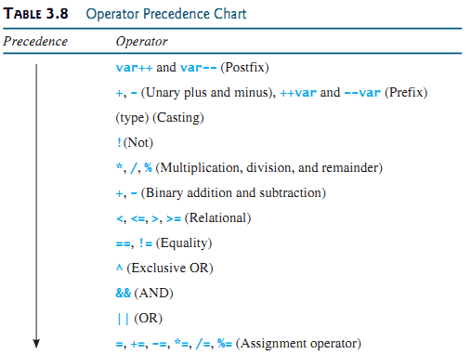
Operator Precedence and Associativity

Slide 26
Example
true || true && false
true && true || false
2 * 2 - 3 > 2 && 4 - 2 > 5
2 * 2 - 3 > 2 || 4 - 2 > 5
Is x > 0 && x < 10 the same as(x > 0) && (x < 10) ?
Is (x > 0 || x < 10) the same as ((x > 0) || (x < 10))?
Is (x > 0 || x < 10 && y < 0) the same as (x > 0 || (x < 10 && y < 0))?
3 + 4 * 4 > 5 * (4 + 3) – 1 && (4 - 3 > 5)

Slide 27
Summary
Switch Statement
Logical Operators
Conditional Expression

