Slide 1
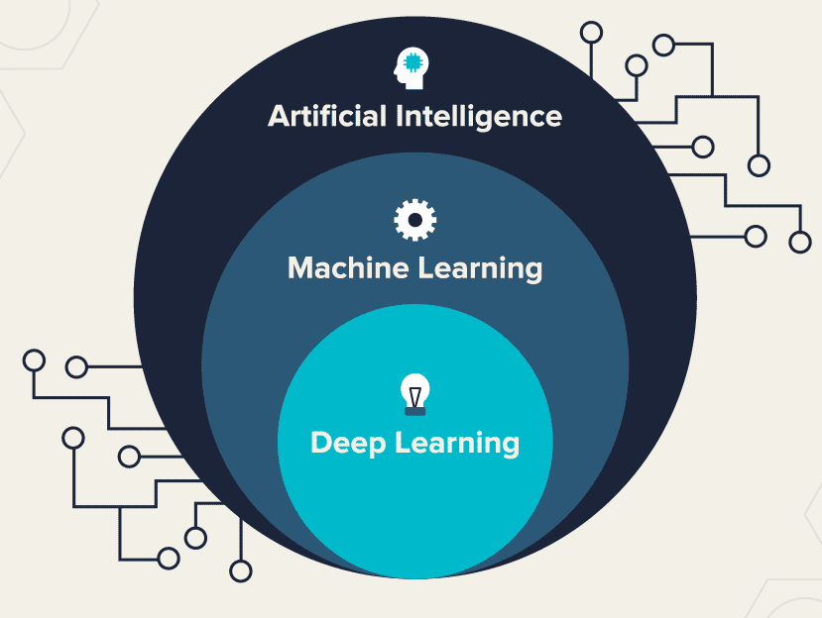
Introduction to machine learning

Slide 2
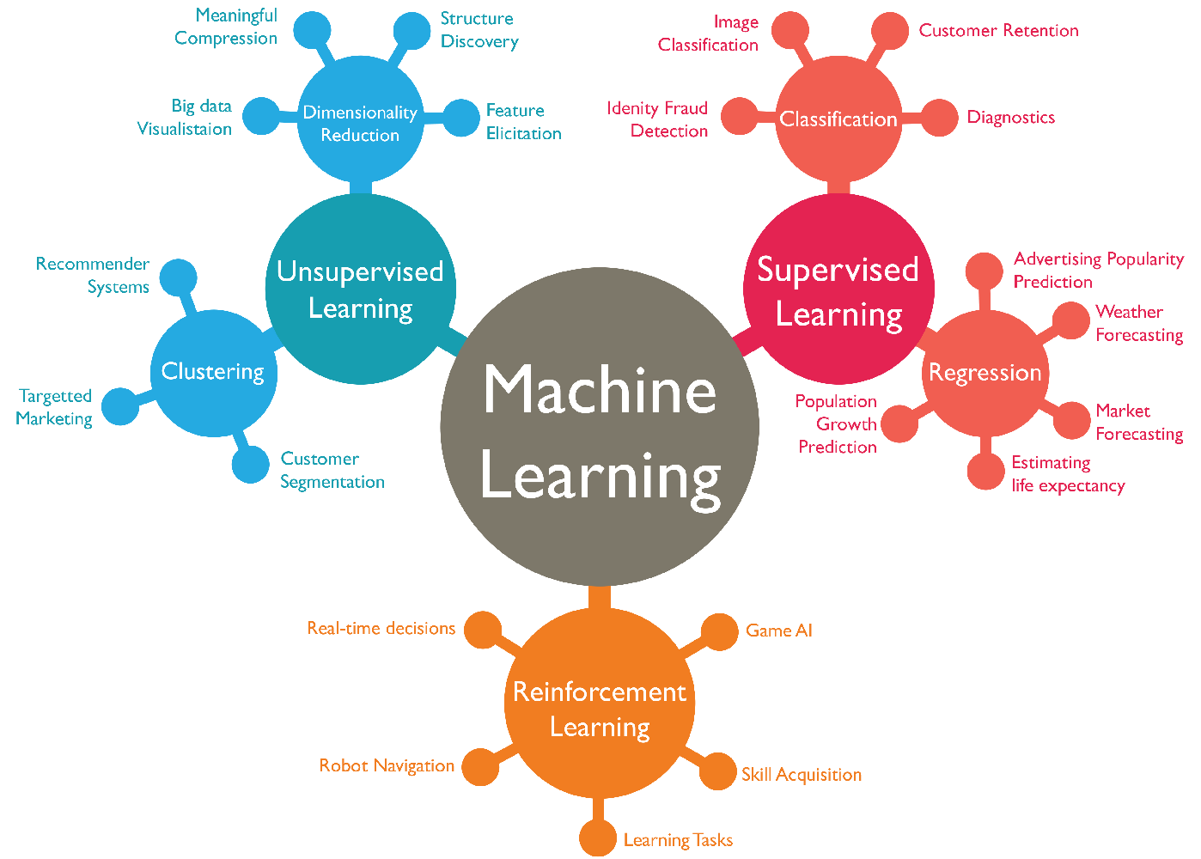
Overview of ML

Slide 3
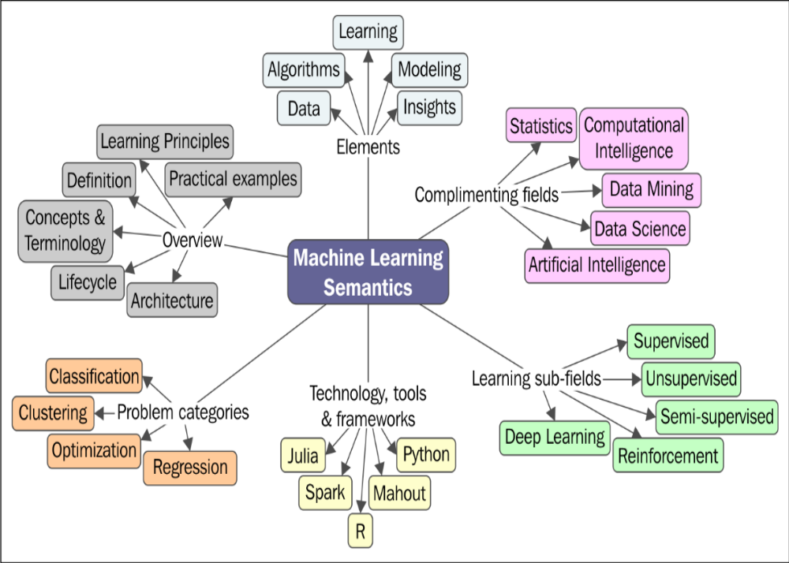
Overview of ML
2
1
5
4
3
6

Slide 4
What is machine learning?
A branch of artificial intelligence, concerned with the design and development of algorithms that allow computers to evolve behaviors based on empirical data.
As intelligence requires knowledge, it is necessary for the computers to acquire knowledge.

Slide 5
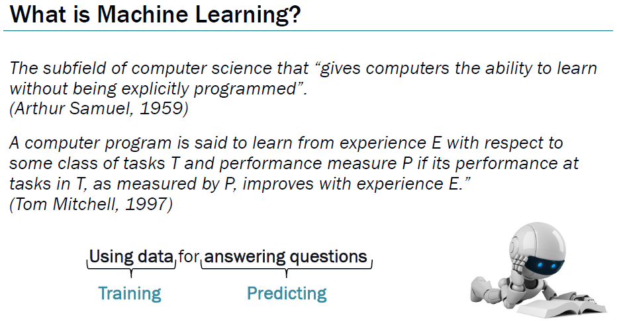

Slide 6
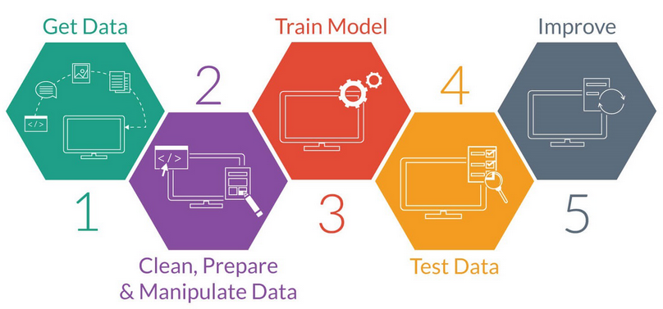
Machine Learning Process Lifecycle
Notes:
ML is a complex process and it touches all aspects of data in the enterprise. Machine learning algorithms learn from data. It is critical that you feed them the right data for the problem you want to solve. Even if you have good data, you need to make sure that it is in a useful scale, format and even that meaningful features are included.
The actual data preparation process is three step as follows:
Step 1: Data Selection: Consider what data is available and sources must be identified, what data is missing and what data can be removed.
Step 2: Data Preprocessing: Organize your selected data by formatting, cleaning and sampling from it.
Step 3: Data Transformation: Transform preprocessed data ready for machine learning by engineering features using scaling, attribute decomposition and attribute aggregation
In summary, the process of improving results involves:
Algorithm Tuning: where discovering the best models is treated like a search problem through model parameter space.
Ensemble Methods: where the predictions made by multiple models are combined.
Extreme Feature Engineering: where the attribute decomposition and aggregation seen in data preparation is pushed to the limits.

Slide 7
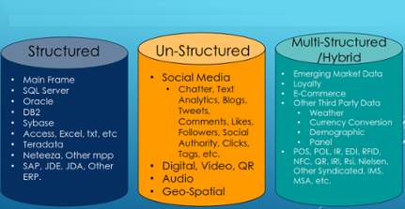

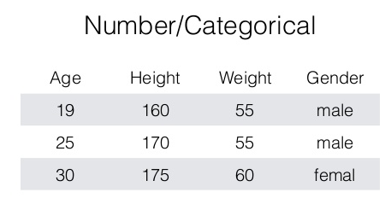
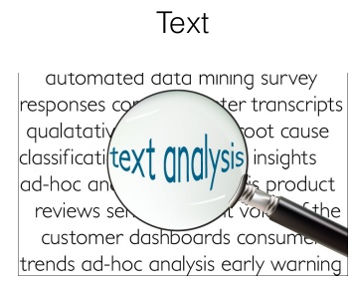
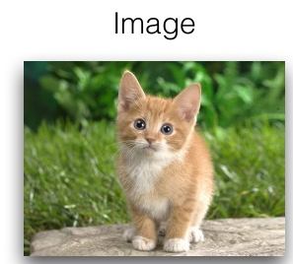
Data
Notes:
Data sets differ in a number of ways. For example, the attributes used to describe data objects can be of different types-quantitative
or qualitative--and data sets may have special characteristics; e.g., some data sets contain time series or objects with explicit relationships to one another.
Not surprisingly, the type of data determines which tools and techniques can be used to analyze the data. Furthermore, new research in data mining is
often driven by t he need to accommodate new application areas and their new types of data.

Slide 8
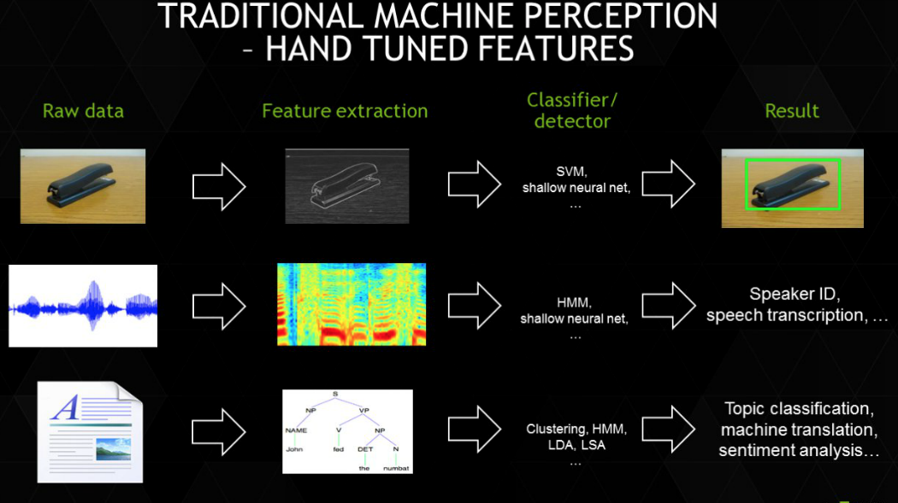
Features
Notes:
Feature extraction is automatic (without human intervention) and multi-layered. The power of deep learning is not in its classification skills, but rather in its feature extraction skills.
Feature engineering involves finding connections between variables and packaging them into a new single variable is called. Deep Learning performs automated feature engineering. Automated feature engineering is the defining characteristic of Deep Learning especially for unstructured data such as images.

Slide 9
Algorithms
The success of machine learning system also depends on the algorithms.
The algorithms control the search to find and build the knowledge structures.
The learning algorithms should extract useful information from training examples.

Slide 10
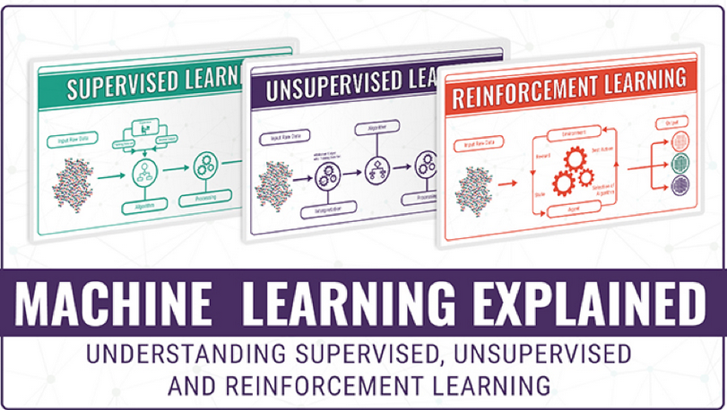
Learning Dimensions

Slide 11
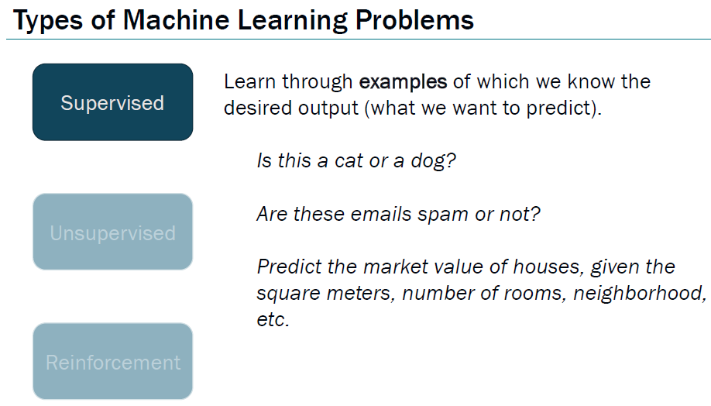

Slide 12
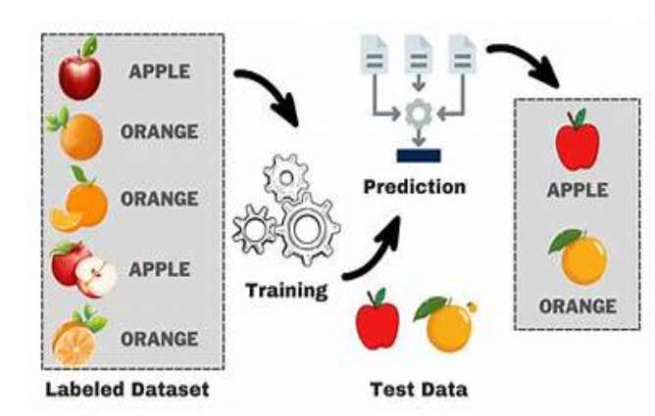
Supervised Learning
has seen the most advancements in recent years
Has many applications

Slide 13
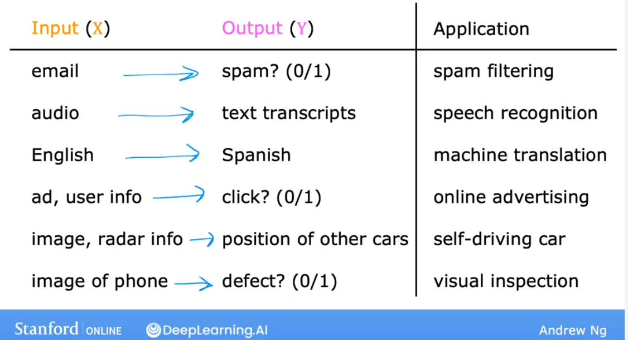
Supervised Learning

Slide 14
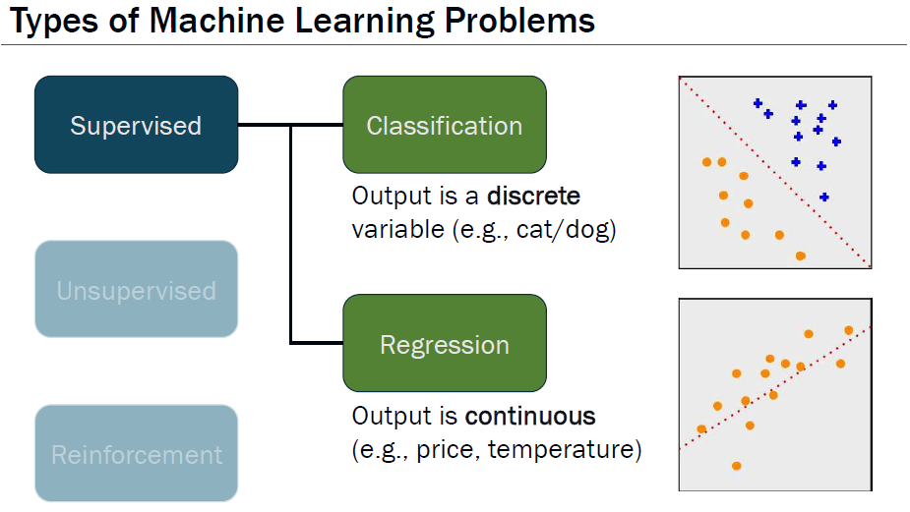

Slide 15
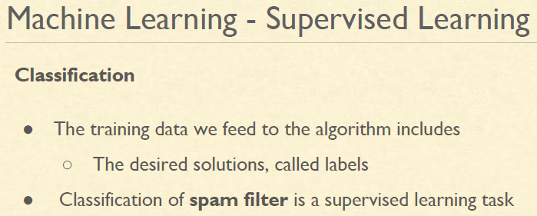

Slide 16
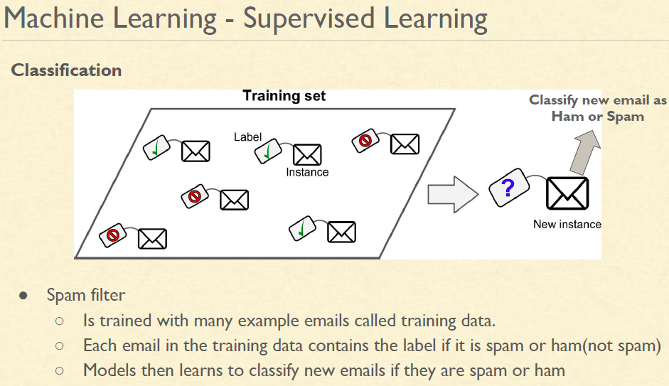

Slide 17
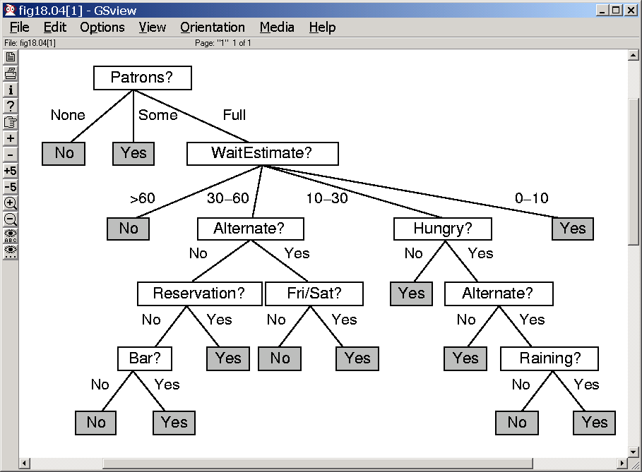
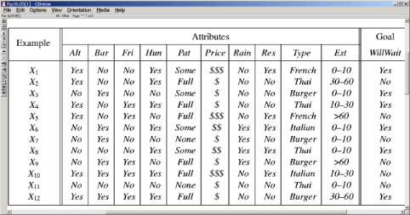

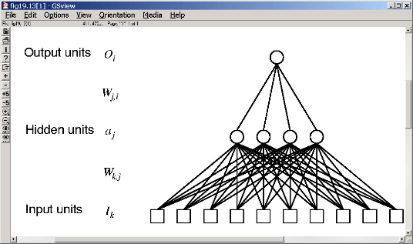
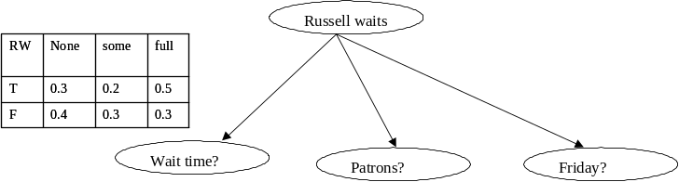
Some useful classifier
Decision Trees
--Examples are used to
--Learn topology
--Order of questions
If patrons=full and day=Friday
then wait (0.3/0.7)
If wait>60 and Reservation=no
then wait (0.4/0.9)
K-nearest
neighbors
Association rules
--Examples are used to
--Learn support and
confidence of association
rules
SVMs
Neural Nets
--Examples are used to
--Learn topology
--Learn edge weights
Naïve bayes
(bayesnet learning)
--Examples are used to
--Learn topology
--Learn CPTs

Slide 18
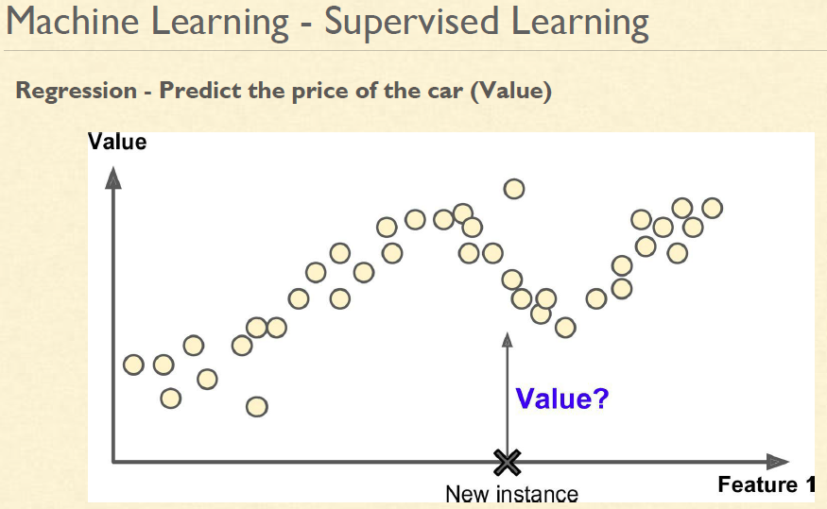

Slide 19
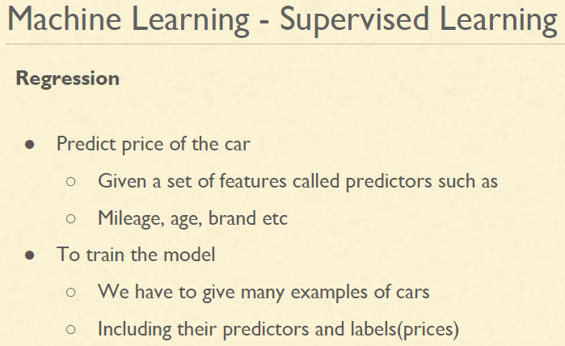

Slide 20
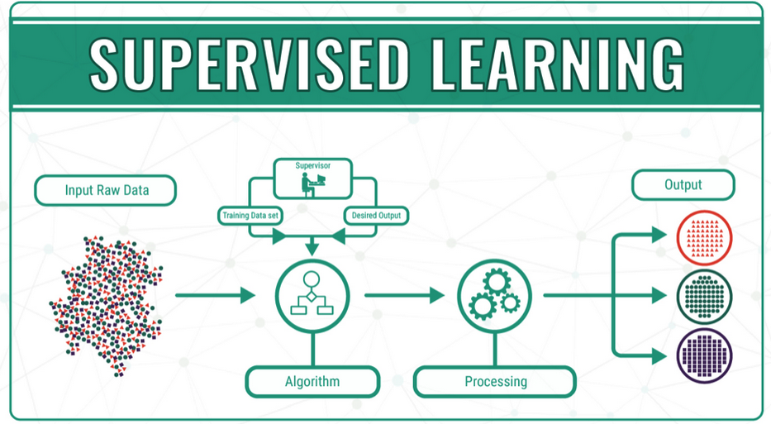
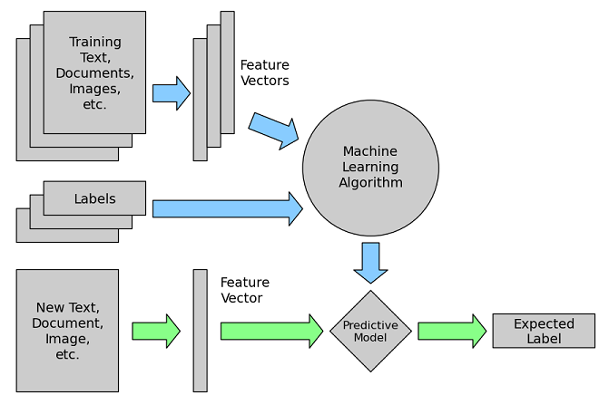
Supervised Learning
Notes:
The main goal in supervised learning is to learn a model from labeled training data that allows us to make predictions about unseen or future data.
OR
supervised learning where the goal is to predict the categorical/continuous class labels of new instances, based on past observations.
In unsupervised learning, there is no label or target attribute. A typical example would be clustering data based on learned patterns.

Slide 21
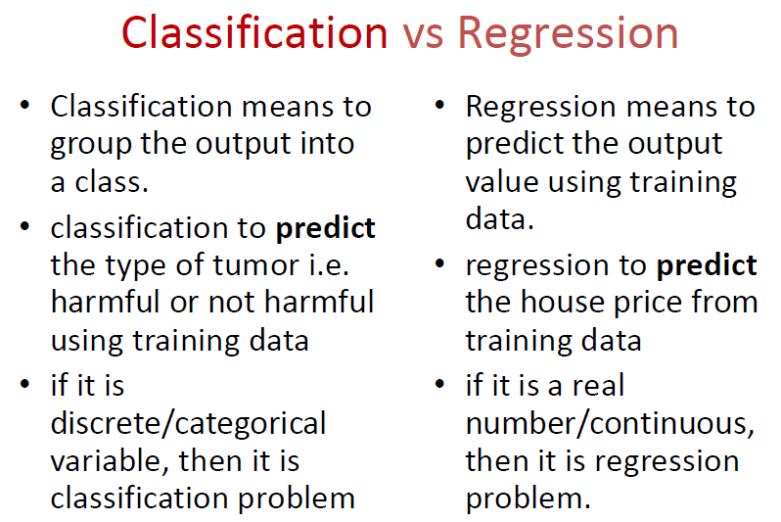

Slide 22
Applications of Supervised Learning
Credit card fraud detection
Image classification
Weather forecasting
Heart Disease Prediction

Slide 23
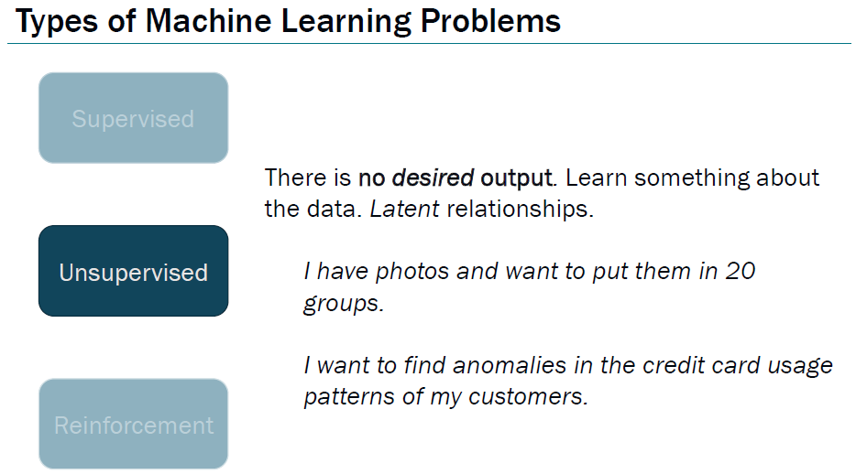

Slide 24
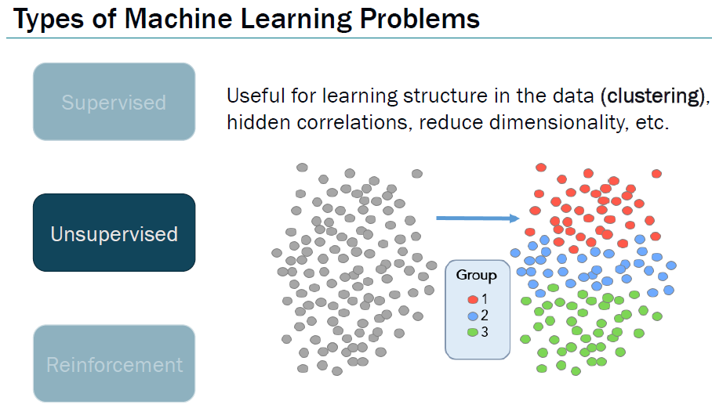

Slide 25
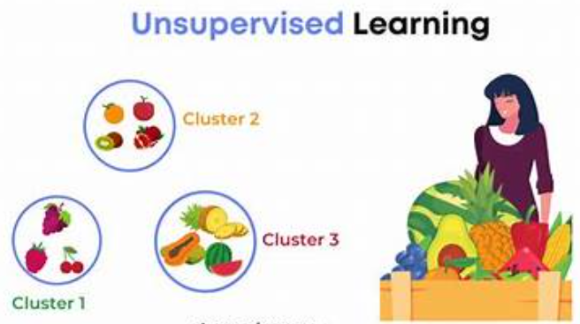
Unsupervised Learning
No labels, discover patterns
Examples: Customer segmentation, topic modeling

Slide 26
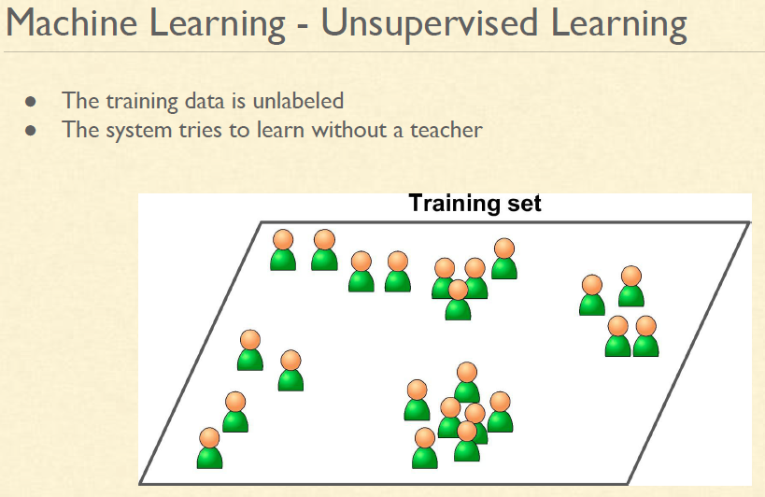

Slide 27
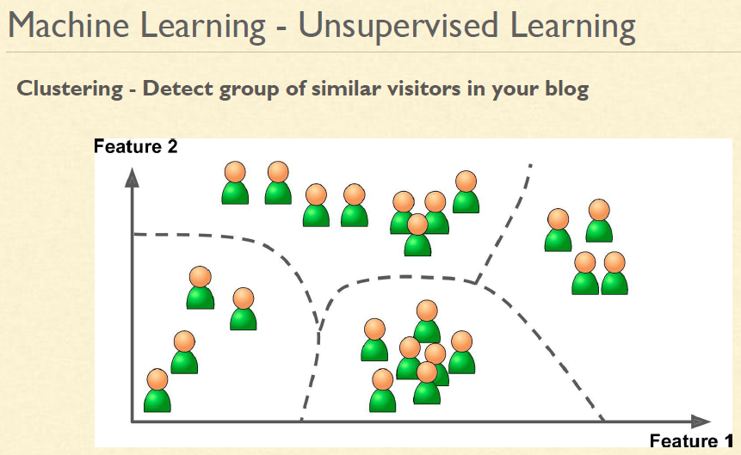

Slide 28
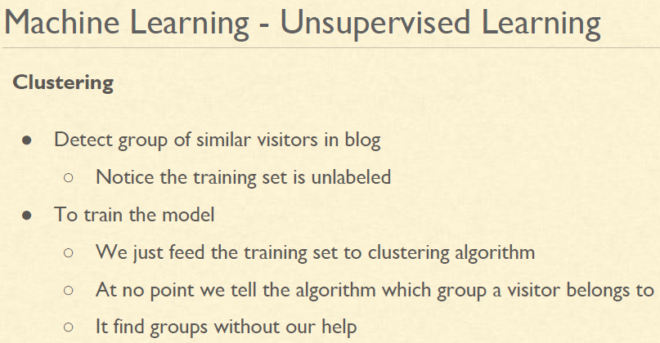

Slide 29
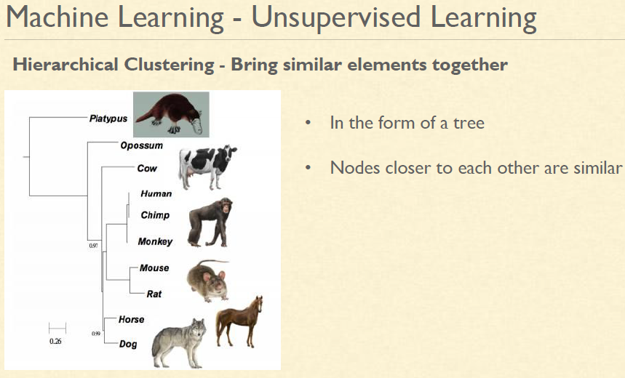

Slide 30
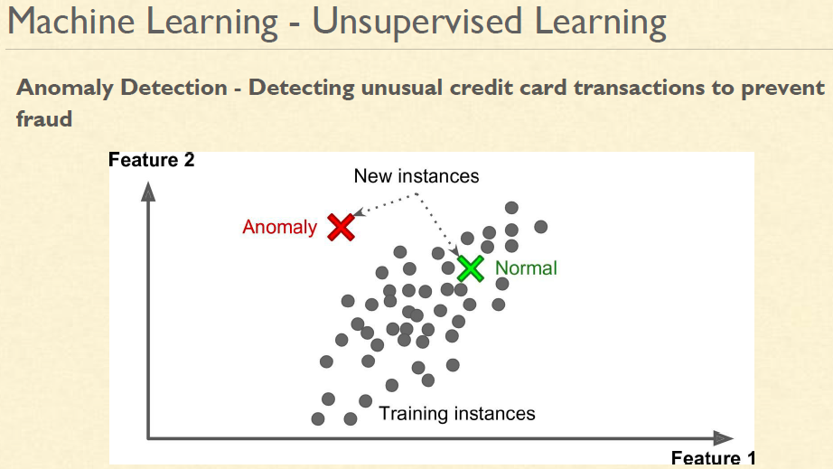

Slide 31
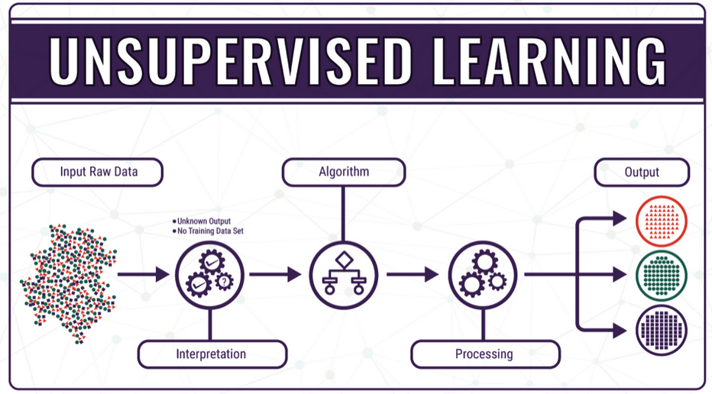
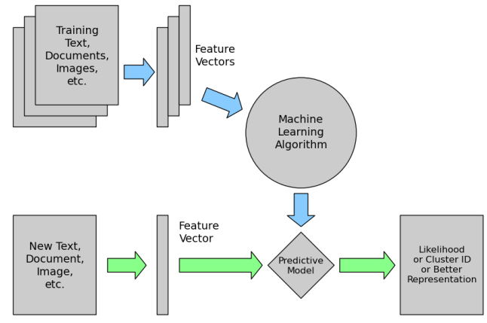
Unsupervised Learning
Notes:
The main goal in supervised learning is to learn a model from labeled training data that allows us to make predictions about unseen or future data.
OR
supervised learning where the goal is to predict the categorical/continuous class labels of new instances, based on past observations.
In unsupervised learning, there is no label or target attribute. A typical example would be clustering data based on learned patterns.

Slide 32
Applications of Unsupervised Learning
Customer segmentation
Anomaly detection

Slide 33
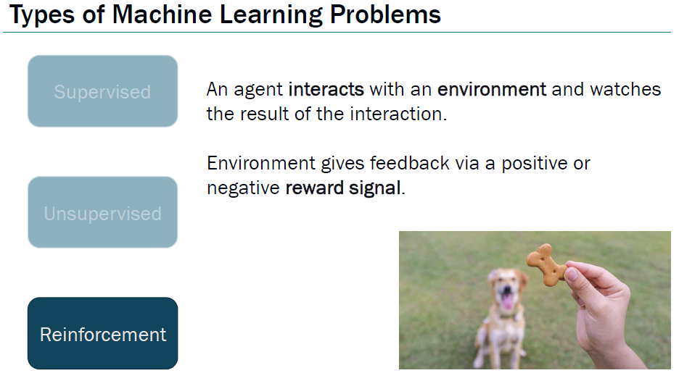

Slide 34
Reinforcement Learning
Is a branch of machine learning that focuses on how agents can learn to make decisions through trial and error to maximize cumulative rewards.

Slide 35
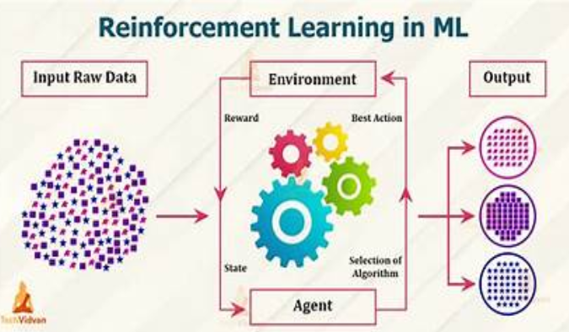
Reinforcement Learning

Slide 36
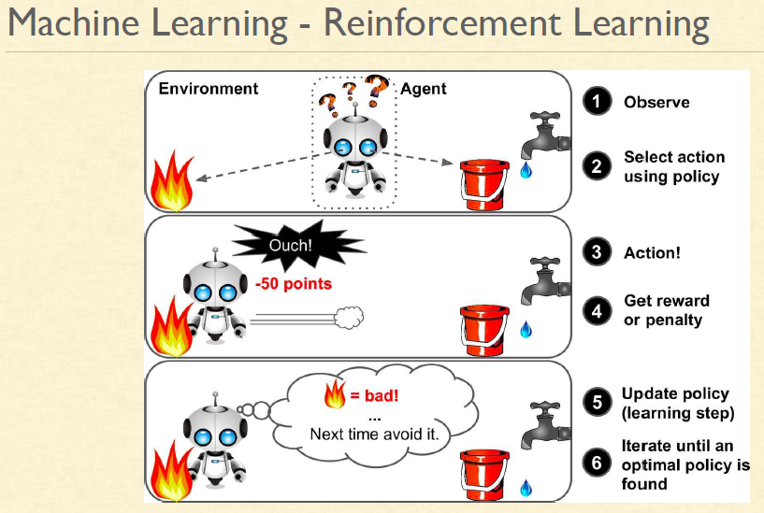

Slide 37
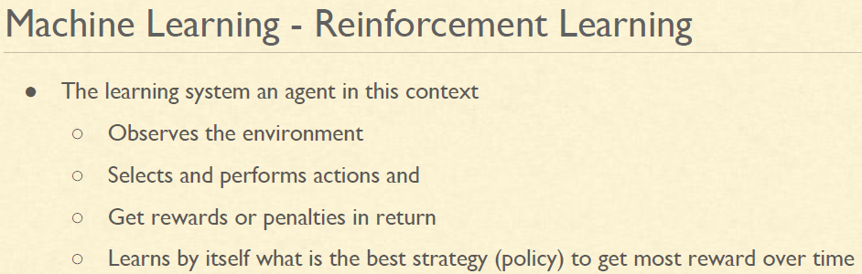

Slide 38
Applications of Reinforcement Learning
Chat bots
Text Summarization
Robotics
Gaming

Slide 39
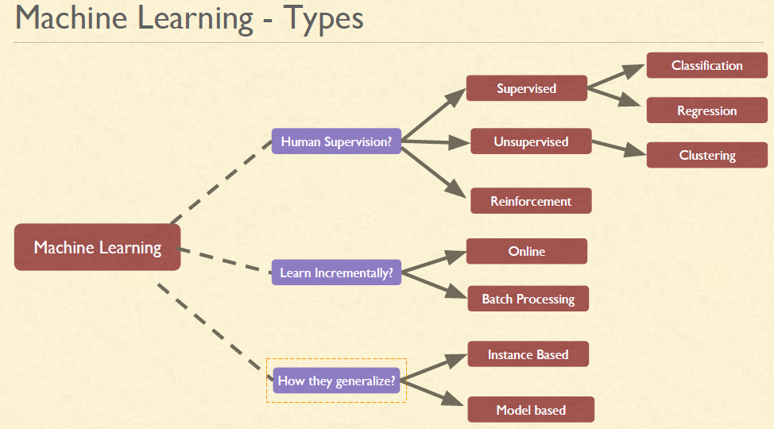

Slide 40
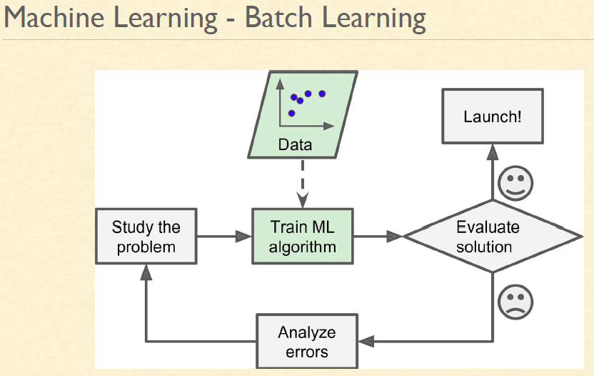

Slide 41
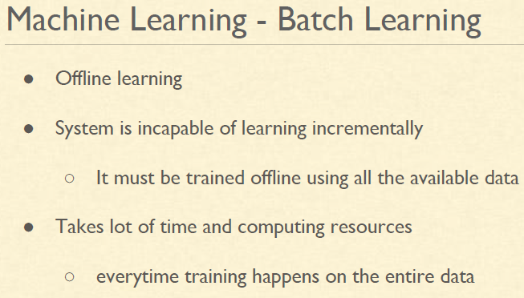

Slide 42
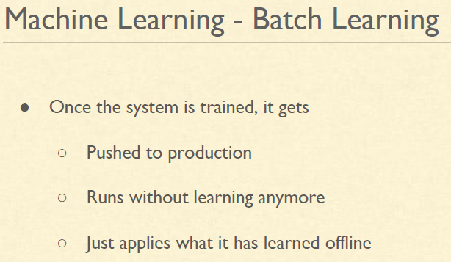

Slide 43
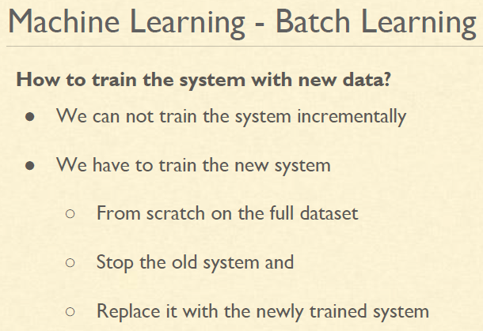

Slide 44
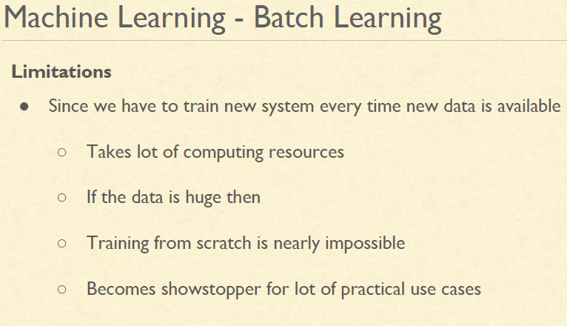

Slide 45
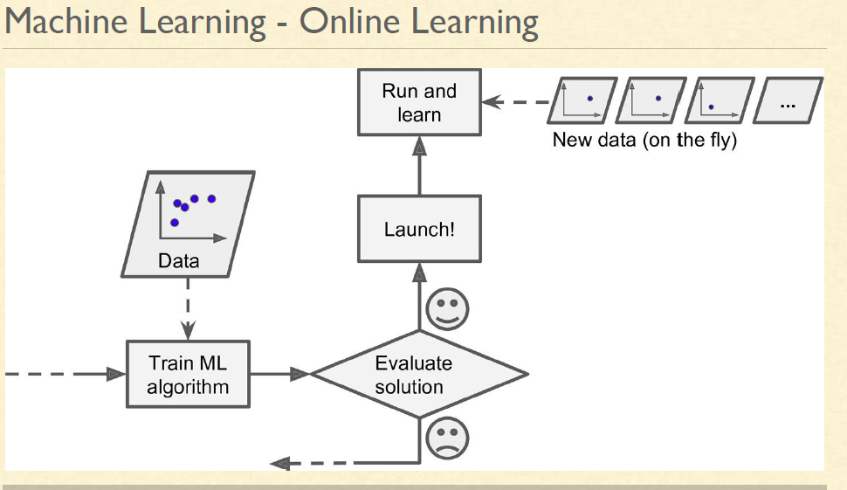

Slide 46
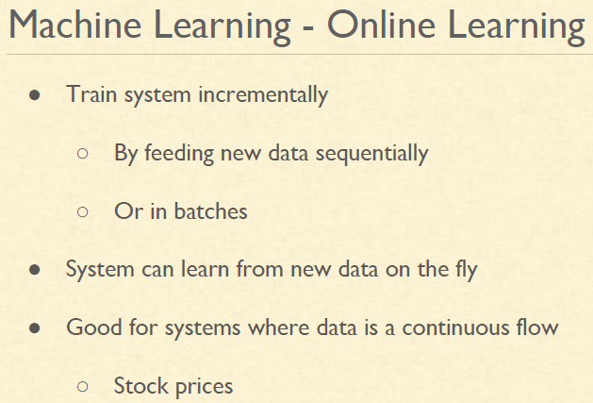

Slide 47
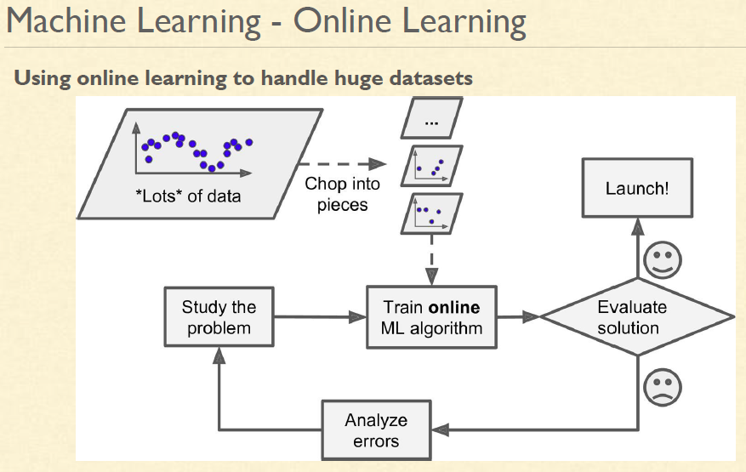

Slide 48
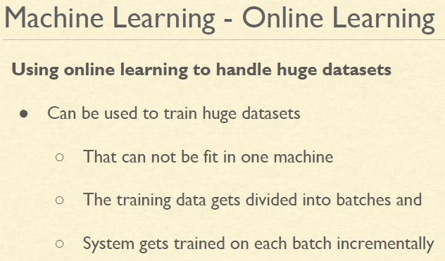

Slide 49


Slide 50


Slide 52


Slide 53


Slide 54


Slide 55


Slide 56
Instance Based Learning Algorithms
Instances are nothing but subsets of datasets, and instance based learning models work on an identified instance or groups of instances that are critical to the problem.
The results across instances are compared, which can include an instance of new data as well.
This comparison uses a particular similarity measure to find the best match and predict.
Instance based methods are also called lazy learning Algorithms
Here the focus is on the representation of the instances and similarity measures for comparison between instances.
Basic idea:
  If it walks like a duck, quacks like a duck, then it’s probably a duck

Slide 57


Slide 58


Slide 59



Slide 60
Training and testing
Data acquisition
Practical usage
Universal set
(unobserved)
Training set (observed)
Testing set
(unobserved)

Slide 61
Training and testing
Training is the process of making the system able to learn.
No free lunch rule:
  Training set and testing set come from the same distribution
  Need to make some assumptions or bias

Slide 62

Challenges in ML
Overfitting vs underfitting

Slide 63

Bias in Data → Biased Predictions

Slide 64
Bias in Data → Biased Predictions
ML models mirror the data they are trained on
If data has imbalance or prejudice, predictions will
also be biased
Examples:
Hiring algorithms favoring one gender over another
Facial recognition less accurate on certain ethnic groups

Slide 65
Ethical Implications of ML
Questions to ask:
Should all ML applications be pursued?
Who is accountable when AI makes mistakes?
How do we ensure fairness and transparency?
Examples:
Predictive policing → may reinforce systemic bias
Healthcare AI → must work equally well for all patients

