Slide 1
Reported Speech in Software Engineering Context
English for Grade XI – RPL
Disusun oleh Budi Suryawan

Slide 2
Learning Objectives
Explain the concept of reported speech
Differentiate statements, questions, and commands
Apply reported speech in software engineering context
Practice with Daddy as the main character

Slide 3
What is Reported Speech?
Definition: Reporting what someone said without exact words ( Reported Speech (kalimat tidak langsung) adalah cara untuk menyampaikan kembali apa yang dikatakan seseorang tanpa mengutip kata-kata persisnya)
Direct: Daddy said, “I am fixing the bug.”
Reported: Daddy said (that) he was fixing the bug.

Slide 4
Changes in Reported Speech
1. Tense shift (backshift): biasanya mundur satu langkah (backshift)
2. Pronouns change : Menyesuikan dengan subjek
3.Time expressions change:
now → then
today → that day
tomorrow → the next day
yesterday → the previous day

Slide 5
Reported Statements S + said/told (that) + clause
Digunakan untuk melaporkan kalimat berita atau informasi
Direct: Daddy said, “I am coding a new program.”
Reported: Daddy said (that) he was coding a new program.
Direct: Daddy said, “We use JavaScript for the front-end.”
Reported: Daddy said (that) they used JavaScript for the front-end

Slide 6
Reported Questions S + asked/wanted to know + if/whether + clause
Digunakan untuk melaporkan pertanyaan
Yes/No Questions: S + asked + if/whether + clause
Direct: Daddy asked, “Do you know Python?”
Reported: Daddy asked if I knew Python.
Wh- Questions: S + asked + wh-word + clause
Direct: Daddy asked, “Where is the server?”
Reported: Daddy asked where the server was.

Slide 7
Reported Commands/Requests S + told/asked + object + to + V1
Digunakan untuk melaporkan perintah atau instruksi
Direct: Daddy said, “Install the database.”
Reported: Daddy told me to install the database.
Direct: Daddy said, “Don’t delete the source code!”
Reported: Daddy told me not to delete the source code.

Slide 8
Summary of Tense Changes
Present → Past: “I write code” → He said he wrote code
Present Cont. → Past Cont.: “I am debugging” → He said he was debugging
Present Perf. → Past Perf.: “I have finished” → He said he had finished
Past → Past Perf.: “I wrote code” → He said he had written code
Future (will) → would: “I will deploy” → He said he would deploy

Slide 9
Practice with Daddy
Daddy said, “I am fixing the login bug.”
Daddy asked, “Did you finish the coding task?”
Daddy said, “Create a database schema.”
Daddy asked, “How does this algorithm work?”
Daddy said, “Don’t forget to commit your code.”

Slide 10
Closing
Reported speech helps programmers communicate clearly in team projects.
Daddy’s rules: Listen → Report → Apply.
Disusun oleh Budi Suryawan

Slide 11
Direct Speech (kata langsung)
Present Simple → Past Simple
Present Continuous → Past Continuous
Present Perfect → Past Perfect
Past Simple → Past Perfect
Future (will) → would
Reported Speech (kata tidak langsung)
“I write code” → He said he wrote code
“I am debugging” → He said he was debugging
“I have finished” → He said he had finished
“I wrote the code” → He said he had written the code
“I will deploy it” → He said he would deploy it

Slide 12
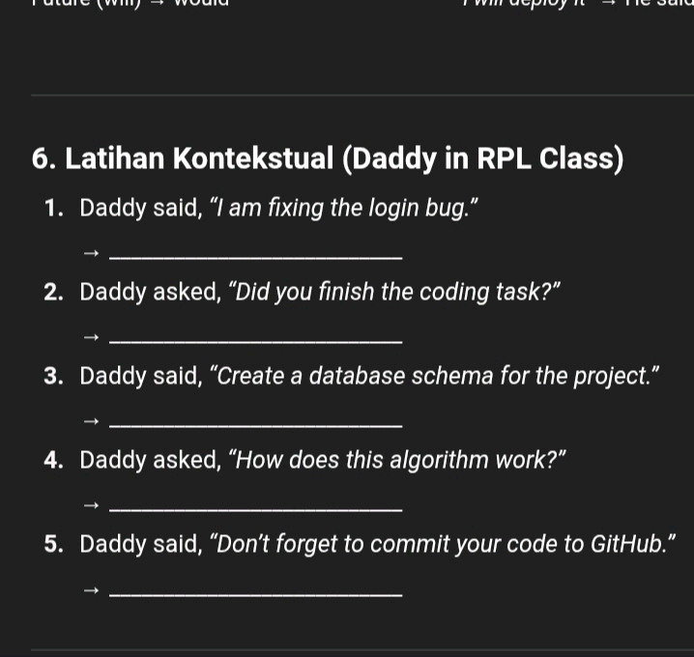

Slide 13
Closing
Reported speech helps programmers communicate clearly in team projects.
Daddy’s rules: Listen → Report → Apply.

