Slide 1

MTA Turnstile Data Analysis
1

Slide 2
Table of contents
Problem Statement
Dataset
Preprocessing
Result
Conclusion
2

Slide 3
Problem Statement
3

Slide 4


Targets
4

Slide 5
Dataset
5

Slide 6

Features of Dataset
C/A | UNIT | SCP | STATION | LINENAME | DIVISION | DATE | TIME | DESc | ENTRIES | EXIST
6

Slide 7
Derived Features
datetime | day_of_week | weekday_OR_weekend | PREV_EXITS | EXISTS2 | Num_of_EXITS_in_1_hour
7

Slide 8
Preprocessing
8

Slide 9
Dataset
Subset
Number of EXITS
Last 3 months
Time = 08:00:00
& 12:00:00
Exact number of Exits for each 4 hours
9

Slide 10
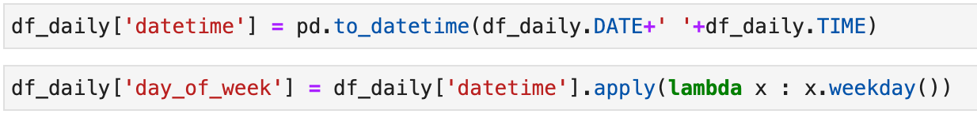
10

Slide 11
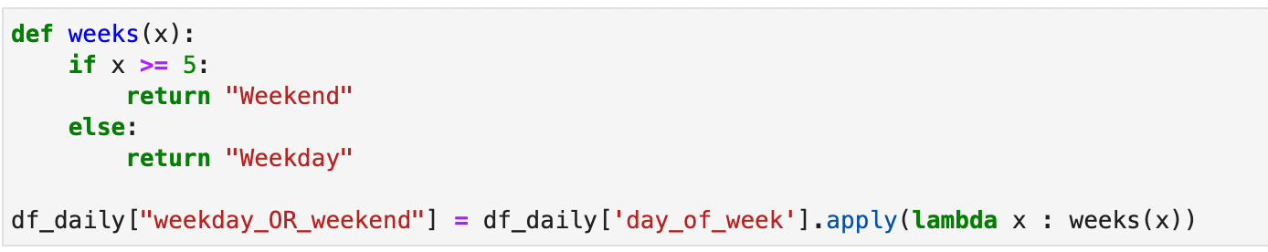
11

Slide 12
Subset of weekday
12

Slide 13
Number of Exits
For each row
13

Slide 14
Number of EXITS = 2000 at 12:00:00
Hours | EXITS
08:00:00 - 09:00:00 | 500
09:00:00 - 10:00:00 | 500
10:00:00 - 11:00:00 | 500
11:00:00 – 12:00:00 | 500
14

Slide 15
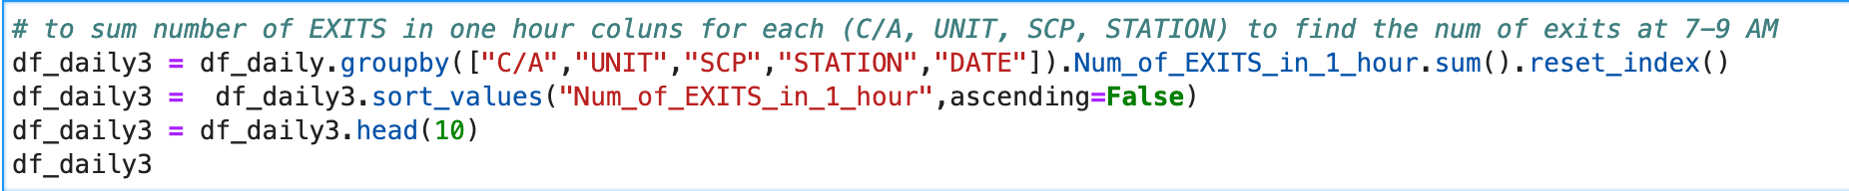
To reach my goal
15

Slide 16
Result
16

Slide 17
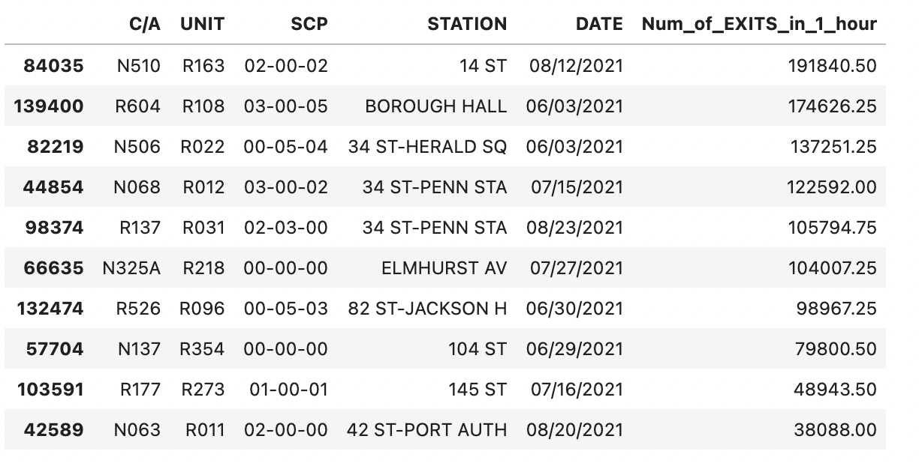
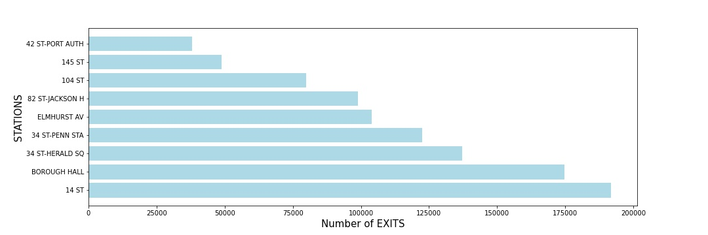
17

Slide 18
Conclusion
18

Slide 19
THANK YOU
By
Fatimah AlShammari
19

