Slide 1

Esmad

Slide 2
What is Esmad ?
Smart machine for converting food waste into fertilizer

Slide 3
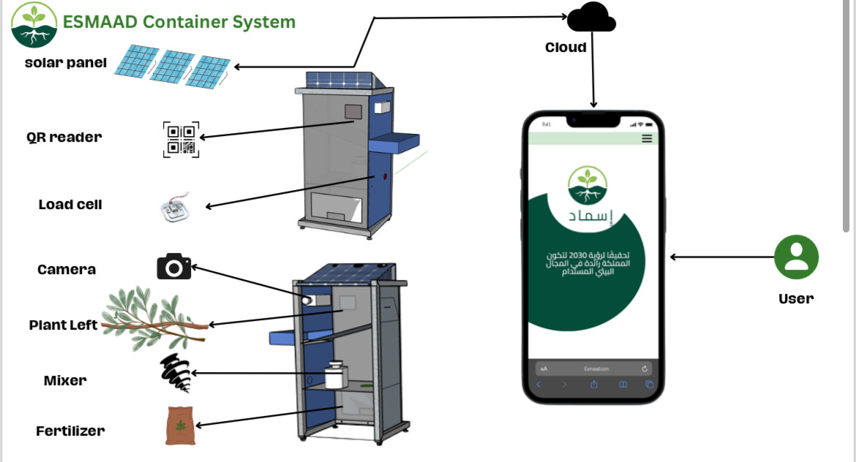
How?
Food waste

Slide 4
Why Esmad ?

Slide 5
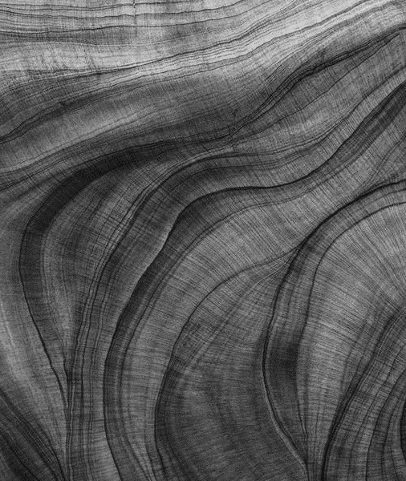
Low cost
100kg Bin (Approximate cost: SAR 822) ; -Grinder: 166,000 watts for every 100 kg of Food waste, costing 65 SAR -Sensor to initiate the conversion process (60 kg):
214 SAR -Solar panels: 553 SAR -Domain name: 35 SAR
The cost will be covered from the first time !

Slide 6
Decentralized
-Can be reached by everyone any time
-Increase the community responsibility

Slide 7
Impact
Food waste in Saudi Arabia cost 40 billion in a year
250Kg per person
Lower the Fertilizer price as well as enrich the market

Slide 8
Thank you for listening

