Slide 1
TaskMatrix
Task Prioritization Web Application
using Eisenhower Matrix and AI Suggestions
Software Engineering Project · Group 3
MERN Stack · AI-Powered · Collaborative
Q1 · Urgent / Important
Q2 · Schedule
Q3 · Delegate
Q4 · Eliminate

Slide 2
Problem Statement
Why task management is broken for most users and teams
1
People struggle to prioritize tasks
With so many tasks competing for attention, users waste time on low-impact work.
2
Existing apps overwhelm users
Traditional to-do apps offer no guidance — just lists that grow endlessly.
3
Urgent vs. Important confusion
Users conflate "urgent" and "important," leading to Q1 firefighting loops.
4
Teams lack coordination
Shared task ownership is unclear, causing duplicated effort and missed deadlines.

Slide 3
Proposed Solution — TaskMatrix
An intelligent, collaborative task prioritization platform
Eisenhower Matrix
AI Suggestions
Analytics Dashboard
Team Collaboration
Visual 2×2 board organizes tasks by urgency and importance.
Anthropic Claude API auto-classifies tasks and suggests quadrants.
Track completion rates, quadrant distribution, and productivity trends.
Shared boards with real-time updates, role-based access, and comments.

Slide 4
Project Objectives
1
Develop a responsive MERN stack web application (MongoDB, Express, React, Node.js)
2
Implement a four-quadrant Eisenhower Matrix board with drag-and-drop task management
3
Integrate an AI-powered prioritization engine using the Anthropic Claude API
4
Support real-time team collaboration with role-based access control
5
Provide analytics and productivity tracking via an interactive dashboard
6
Ensure accessibility (WCAG 2.1 AA), security (OWASP Top 10), and mobile responsiveness

Slide 5
Feature Overview
Eight core feature areas across the platform
Authentication
Matrix Board
AI Suggestions
Analytics Dashboard
Email/password + Google OAuth, MFA, JWT sessions
Drag-and-drop 2×2 Eisenhower board with quadrant analytics
Claude API classifies tasks with confidence scores
Completion rate, trends, quadrant distribution charts
Notifications
Team Collaboration
Integrations
Responsive UI
Email reminders, in-app alerts, browser push, daily digest
Shared boards, @mentions, activity history, real-time sync
Calendar sync, Slack, Zapier, REST API & webhooks
Mobile-first design, dark mode, WCAG 2.1 AA compliant

Slide 6
System Architecture
MERN stack with AI integration and cloud deployment
Frontend
React 18 + Vite · Tailwind CSS · React Router · Zustand
Backend
Node.js + Express · REST API · JWT Auth · Socket.io
Database
MongoDB (Atlas) · Mongoose ODM · Redis (session cache)
AI Engine
Anthropic Claude API · Task classification · Confidence scoring

Slide 7
Technology Stack
Frontend
Backend
Database
· React 18
· Vite
· Tailwind CSS
· Axios
· Socket.io-client
· Node.js
· Express.js
· Mongoose
· JWT
· Socket.io
· MongoDB Atlas
· Redis
· GridFS (files)
AI & APIs
DevOps
· Anthropic Claude
· Google OAuth 2.0
· SendGrid
· GitHub Actions
· Docker
· AWS/GCP
· Postman

Slide 8
The Eisenhower Matrix
A proven decision framework for task prioritization
← NOT URGENT URGENT →
Q1 — Do First
Q2 — Schedule
IMPORTANT
Urgent + Important
Not Urgent + Important
Deadlines, crises, emergencies. Act immediately.
Long-term goals, planning. Block time for these.
Q3 — Delegate
Q4 — Eliminate
NOT IMPORTANT
Urgent + Not Important
Not Urgent + Not Important
Interruptions, some emails. Delegate where possible.
Trivial busy-work. Eliminate or minimize.

Slide 9
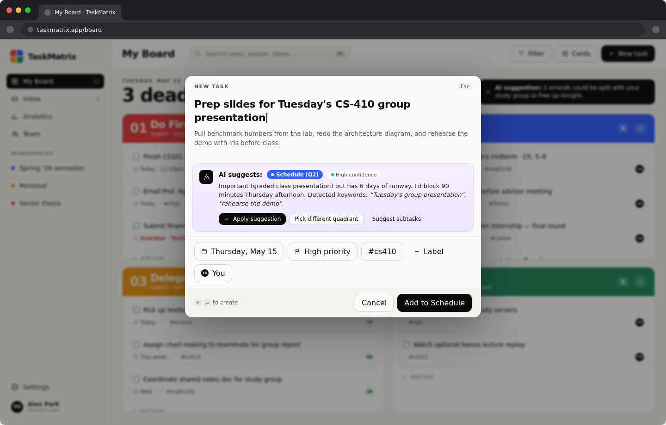
AI Suggestion Engine
Powered by Anthropic Claude API — smart task classification
1
User Input
Enter task title and description
2
AI Analysis
Claude API evaluates urgency & importance signals
3
Quadrant Suggest
AI recommends Q1–Q4 with confidence score
4
User Confirmation
Accept, override, or request explanation
✓ Confidence indicator: High / Medium / Low ✓ Users can disable AI from settings ✓ Response caching for identical inputs

Slide 10
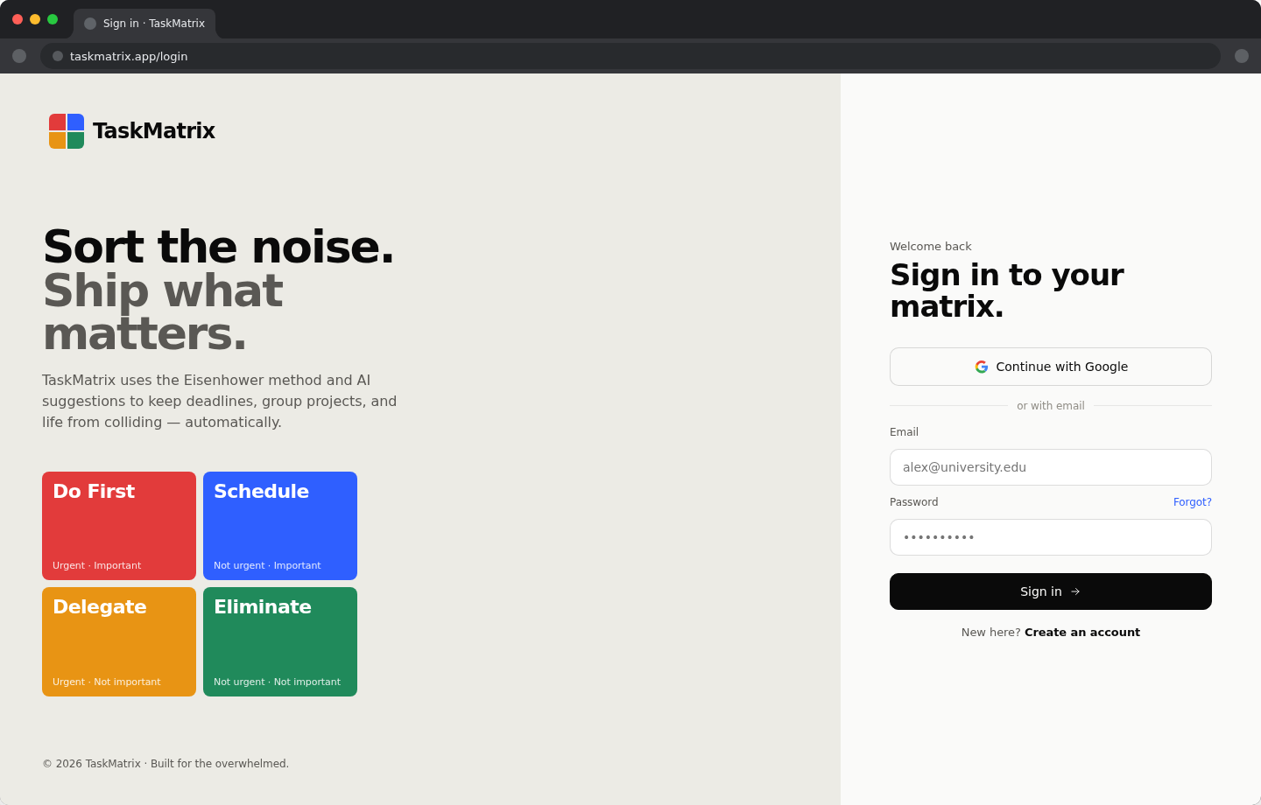
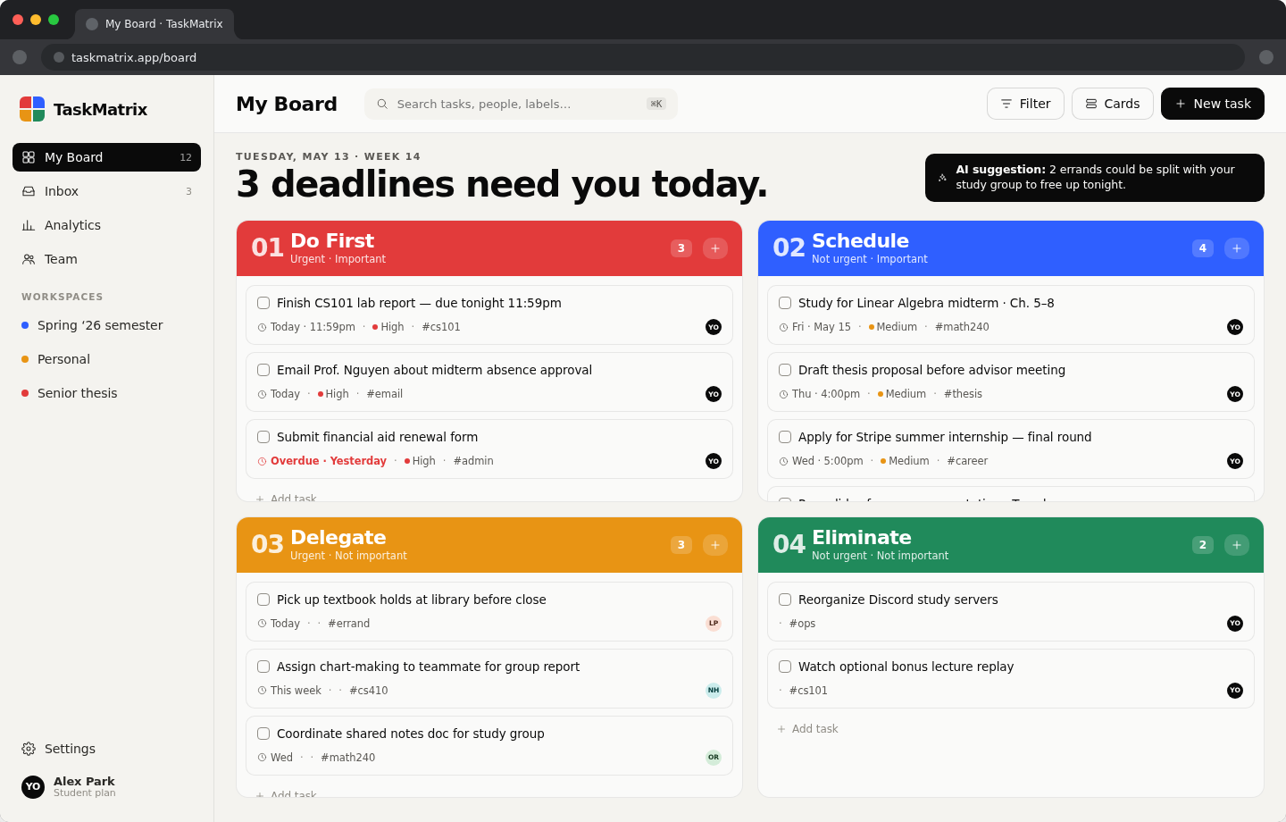
User Interface Overview
Clean, dark-themed interface with Eisenhower board at its center
Sign-in / Authentication
Eisenhower Matrix Board (Direction A)
Google OAuth · Email/Password · MFA support Drag-and-drop tasks · Color-coded quadrants · Real-time sync

Slide 11
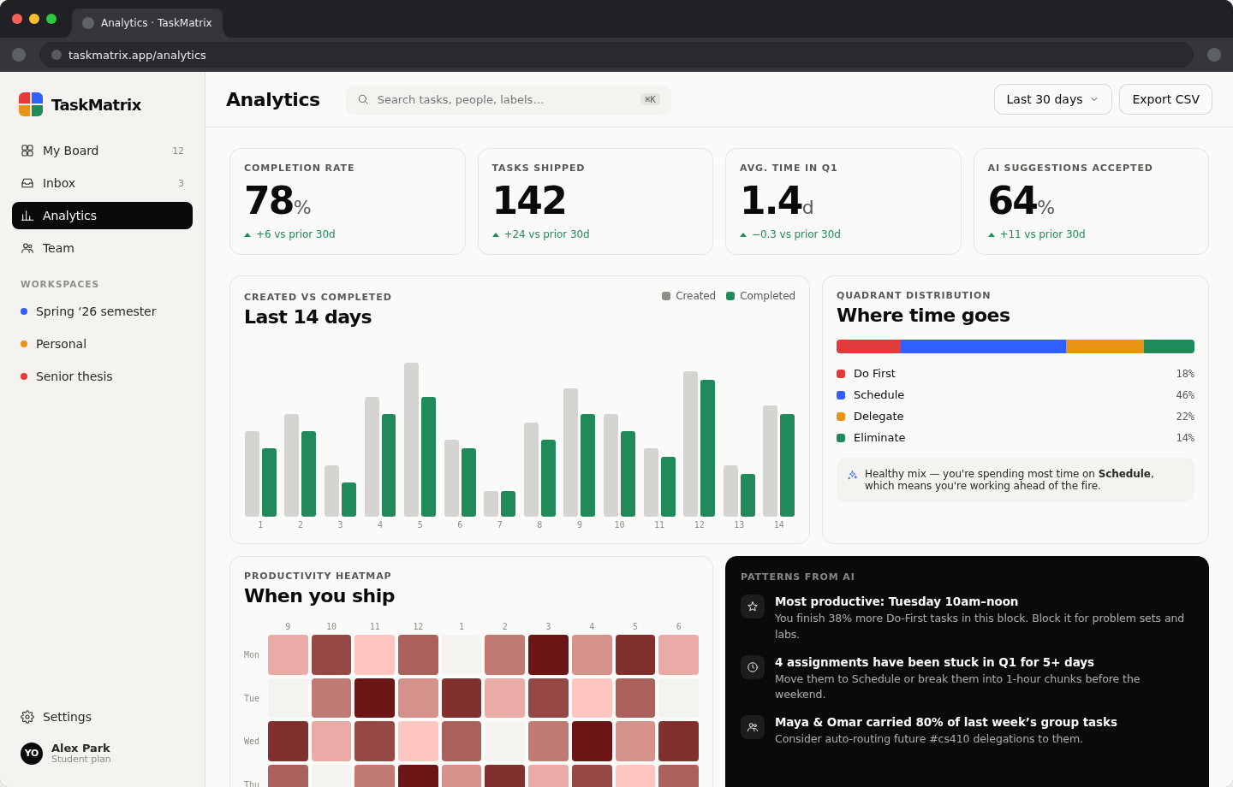
Analytics Dashboard
Real-time productivity insights and task completion tracking
Completion Rate
Track % of tasks completed over time
Quadrant Split
Visualize distribution across all 4 quadrants
Weekly Trends
Created vs. completed chart per week/month
Productivity
Identify most productive days and patterns
📤 Export as CSV or PDF available

Slide 12
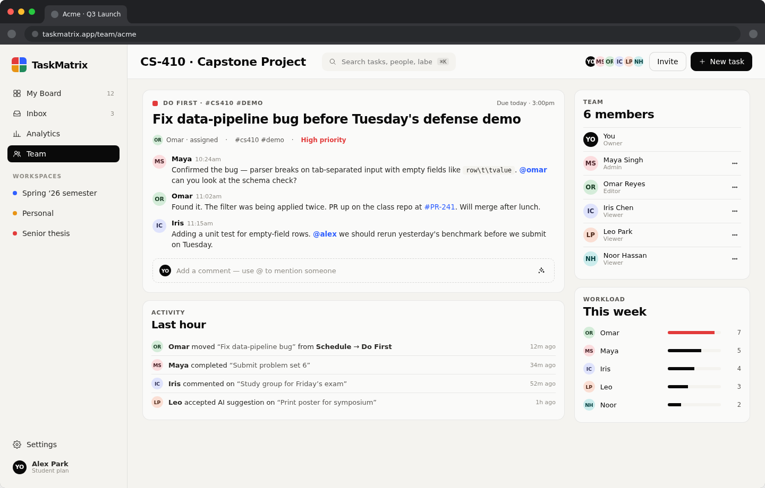
Team Collaboration
Shared workspaces with roles, comments, and real-time sync
Team Workspaces
Create shared boards and invite members via email
Role-Based Access
Admin / Editor / Viewer roles per workspace
@Mentions
Comment on tasks with @mention notifications
Real-Time Sync
Changes instantly visible to all team members
Activity History
Full audit log of task and workspace changes

Slide 13
Development Lifecycle
Agile sprints, CI/CD pipeline, and collaborative tooling
Phase 1 Planning
Phase 2 Design
Phase 3 Development
Phase 4 Testing
Phase 5 Deployment
Requirements gathering, SRS, wireframes, tech selection
UI/UX design canvas, component library, data modelling
MERN stack implementation, AI integration, unit testing
Integration tests, user acceptance testing, performance
CI/CD pipeline, cloud hosting, monitoring & alerting

Slide 14
Challenges Faced & How We Solved Them
AI API Reliability
Problem: Third-party Claude API downtime risks
Solution: Implemented fallback mode with rule-based classification + response caching
Real-Time Sync
Problem: Concurrent edits causing data conflicts
Solution: Used Socket.io with optimistic UI updates and server-side conflict resolution
Mobile Responsiveness
Problem: Complex 2×2 board layout on small screens
Solution: Adaptive layout switching board to single-column scroll view on mobile
Performance
Problem: Large task lists slowing board rendering
Solution: Virtual scrolling, pagination, and indexed MongoDB queries

Slide 15
Future Improvements & Roadmap
Q2 2026
Q3 2026
Q4 2026
2027+
▸ Native iOS & Android mobile apps
▸ Offline mode with local-first sync
▸ Slack & Microsoft Teams deep integration
▸ AI weekly digest and proactive suggestions
▸ Time-tracking per task and quadrant
▸ Organization-level multi-team management
▸ Enterprise SSO and audit compliance (SOC 2)
▸ Marketplace for third-party task integrations

Slide 16
Conclusion
Objectives Achieved
Delivered a full MERN stack web app with Eisenhower Matrix, AI integration, team features, and analytics.
Technical Learning
Gained hands-on experience with React, Node.js, MongoDB, REST APIs, WebSockets, and LLM integration.
Real-World Impact
TaskMatrix addresses genuine productivity challenges with a scalable, accessible, and intelligent solution.
Team Collaboration
Agile workflow, GitHub version control, and shared ownership drove successful delivery across all team members.

Slide 17
Thank You
Questions & Discussion
TaskMatrix · Group 3 · MERN Stack + AI Suggestions
Q1 · Do First
Q2 · Schedule
Q3 · Delegate
Q4 · Eliminate

