Slide 1
Fashion clothing products dataset
By Fatima Shamilova

Slide 2
Introduction
We selected the Myntra company for our group project.
Myntra is a major Indian fashion e-commerce company headquartered in Bengaluru, Karnataka, India. The company was founded in 2007 to sell personalized clothing items.
Nowadays, the online shopping is a fast-growing area, where people get many options and flexibility on a single platform compared to in-store shopping. So, we chose the online shopping as this industry considered as one of the profitable categories of business.
On this project we will analyze the Fashion Clothing Products dataset using one of the Python IDE.

Slide 3

The Python IDE selection
The Google Colab IDE has been used to analyze Fashion Clothing Products dataset. The Colab is a cloud-based notebook environment tool and doesn’t require any software installation. Another convenient feature is that the dataset can be pulled from Google Drive.

Slide 4
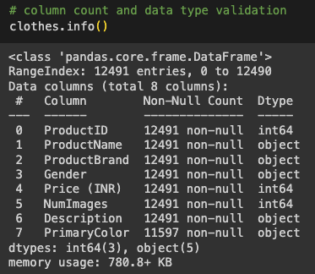
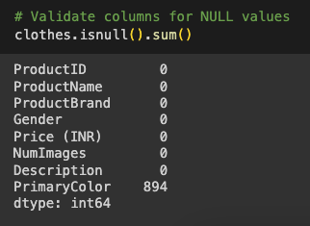
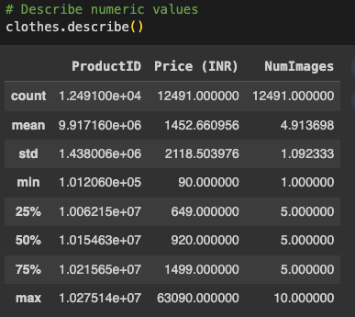
The dataset analysis and summary
Dataset contains 12,491 rows and 8 columns with 3 integer and 5 object data types.
Only PrimaryColor column has 894 null values.
Statistical summary applicable only for Price (INR) and NumImages columns. The average price is 1452.66 and the average number of images is 4.91.

Slide 5
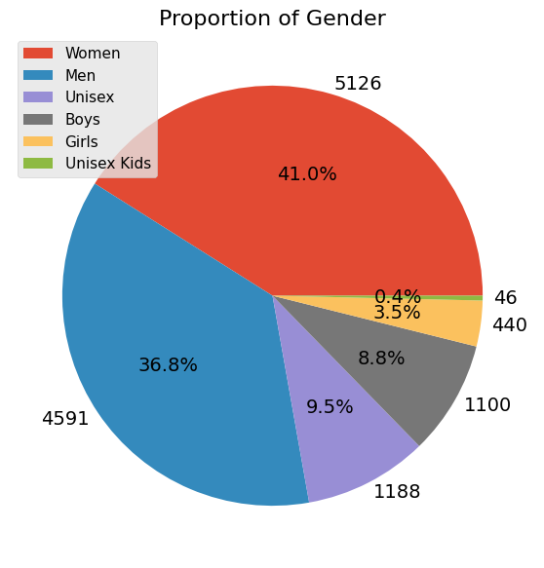
Gender analysis
The majority of the proportion belongs to women (41%). The second most counted gender is men - 36.8%. The unisex and boys groups have relatively the same amount. The lowest count in unisex kids' clothes (0.4%).

Slide 6
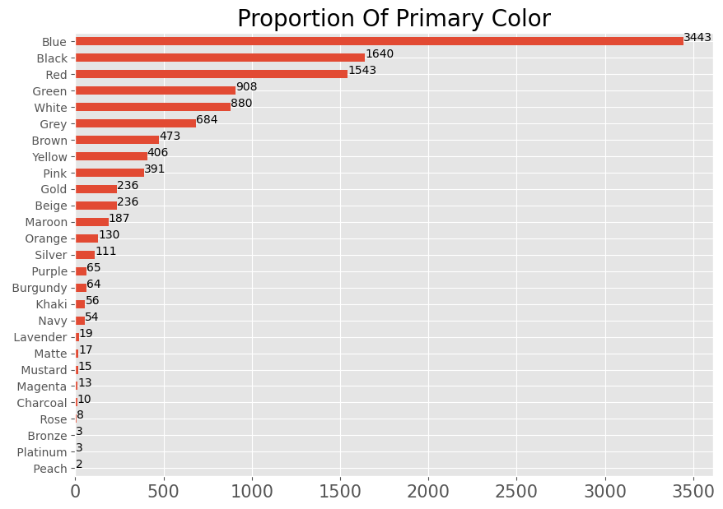
Primary color category analysis
Regarding this barchart, we can say that the Myntra’s primary colour is black as they have 3443 items on their current stock. The other colours that they use more in production is black (1640) and red (1543 items). Clothes with bronze, platinum and peach are the less use colours in their production.

Slide 7
Summary page
All required steps have been performed to install Python and libraries to analyse database of the online shopping. The Fashion Clothing Products was chosen as a project title. As an example, we used the database of the Myntra company downloaded from the Kaggle.com.
To finish up, utilizing Python and its library assists us with finding the specific information result for the online based style of Myntra Organization. Python is the best tool for tracking down the best outcome, particularly for chart and class examination.

