Slide 1

Course Title: Mining Source Code Repositories Course Code: Instructor: Dr. Fatima Sabir
Punjab university college of information and technology(PUcit)

Slide 2
Topic Modeling in MSR
Latent Dirichlet Allocation (LDA)

Slide 3
Problem in MSR Without Topic Modeling
Software repositories contain huge amounts of text, such as:
Thousands of GitHub issues
Hundreds of developer discussions
Long commit histories
Manual reading is impossible because:
Data is very large (big text corpora)
Text is unstructured
Problems are mixed together
So, Need an automatic technique to discover patterns.

Slide 4
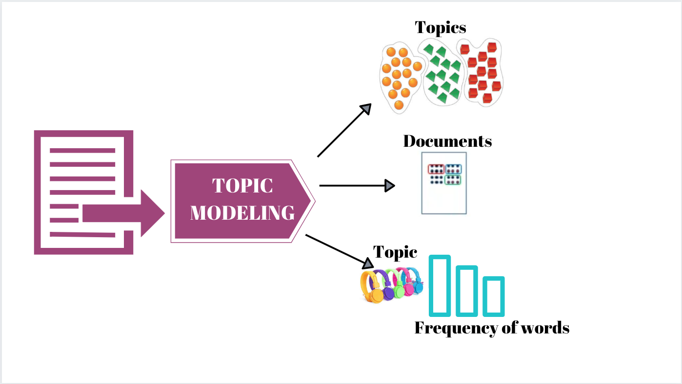
Topic Modeling
Topic modeling is an unsupervised machine learning technique used to automatically identify latent topics from a collection of text documents, where each topic is represented by a group of frequently co-occurring words.
Topic modeling finds what people are talking about
It does not need labels
It discovers patterns based on word usage
Handles large-scale unlabeled data
Works without predefined categories
Extracts knowledge from textual repositories

Slide 5
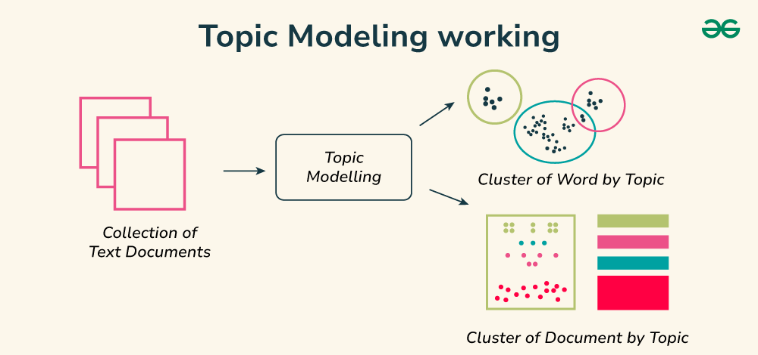
What Is a Topic?
A topic is:
A group of words that frequently appear together
A probability distribution over words
Not a single word
Example
bug, error, crash, exception, fail
This topic represents a bug-related concern.

Slide 6
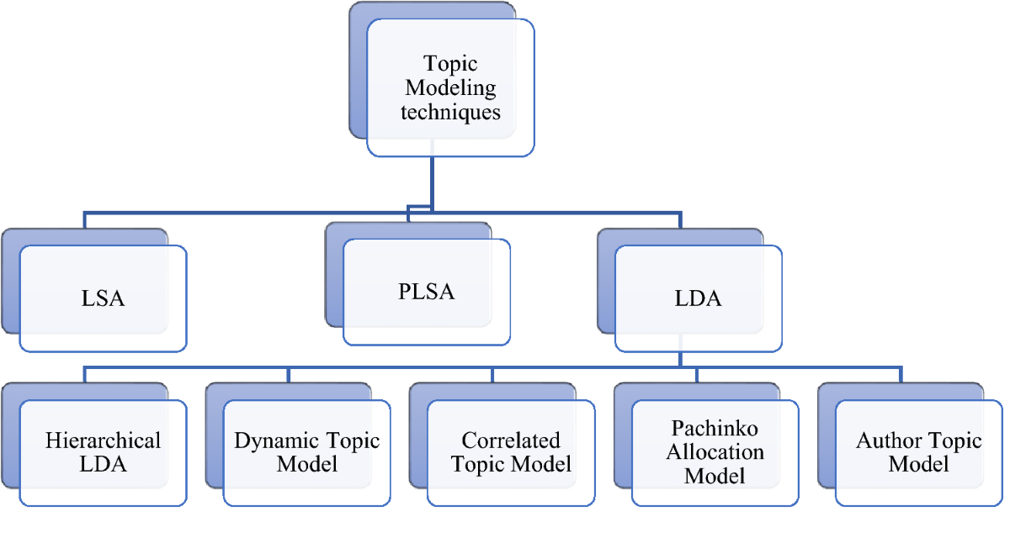
Common Topic Modeling Techniques
Some topic modeling techniques are:
Latent Dirichlet Allocation (LDA)
Latent Semantic Analysis (LSA)
Non-negative Matrix Factorization (NMF)
LDA is the most widely used technique in MSR.

Slide 7
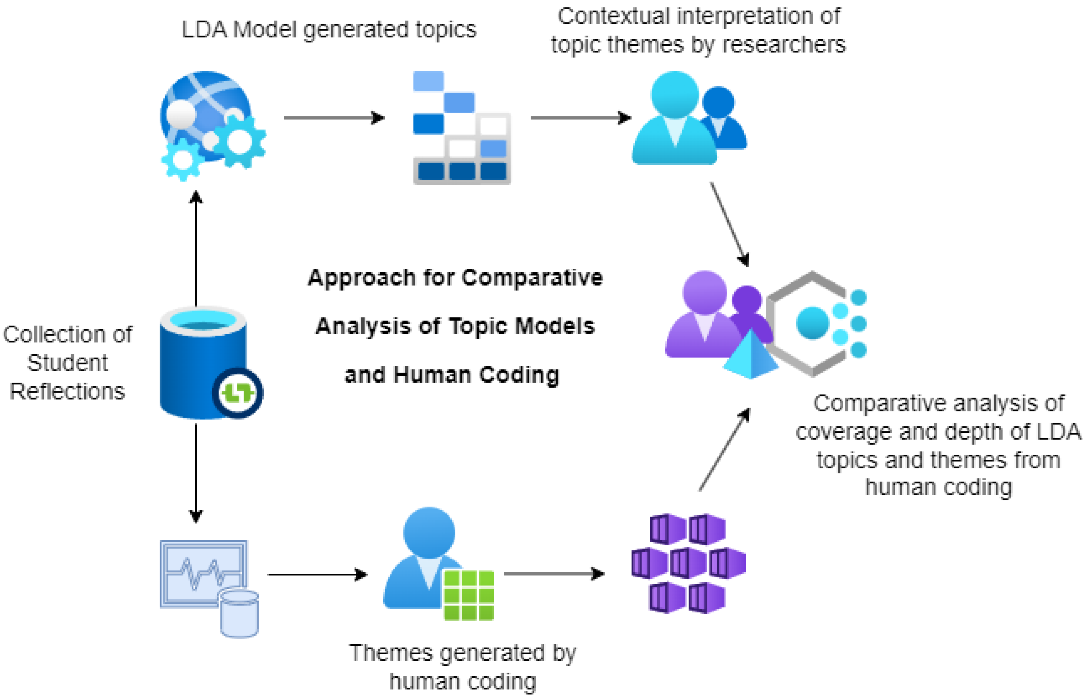
Latent Dirichlet Allocation (LDA)
Latent Dirichlet Allocation (LDA) is a probabilistic topic modeling algorithm that represents each document as a mixture of topics and each topic as a mixture of words
LDA assumes:
A document can talk about multiple topics
Topics are hidden (latent)
Words appear because of topics
Why Is It Called “Latent Dirichlet Allocation”?
Latent → topics are hidden, not directly observed
Allocation → words are allocated to topics
Dirichlet → probability distributions are drawn from Dirichlet distributions

Slide 8
Latent Dirichlet Allocation (LDA)
LDA makes three key assumptions:
Each document is a mixture of topics
Each topic is a mixture of words
Topic proportions differ from document to document
How LDA Works
For each document:
Choose topic proportions
For each word:
Select a topic
Select a word from that topic
This process is repeated for all documents.

Slide 9
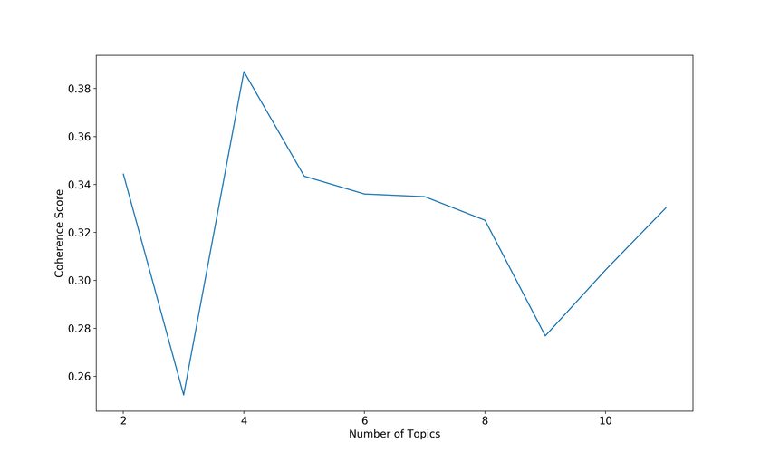
Topic Coherence in LDA
Topic coherence is a measure of how semantically meaningful and interpretable the words within a topic are, based on how frequently those words co-occur in the dataset.
LDA always produces topics, but:
Some topics are meaningful
Some topics are random or noisy
Topic coherence helps to:
Evaluate topic quality
Compare different LDA models
Choose the best number of topics (K)
Higher coherence → better topic quality

Slide 10
“K” in LDA
K is the number of topics that an LDA model is instructed to discover from a collection of documents.
Why K is Important
Choosing K determines:
How many themes will be discovered
How detailed or broad the topics will be
Incorrect K leads to poor topic modeling results.

Slide 11
“K” in LDA
Effect of Different K Values
Small K (e.g., K = 5)
Topics are very broad
Different concerns get mixed
Low interpretability
Large K (e.g., K = 50)
Topics become fragmented
Similar topics split unnecessarily
Hard to interpret
Goal: Balance between too broad and too fragmented topics.

Slide 12
Latent Dirichlet Allocation (LDA) K and Topic Coherence
K | Topic Coherence
5 | 0.31
10 | 0.42
15 | 0.55
20 | 0.47

Slide 13
Latent Dirichlet Allocation (LDA)
Input Required for LDA
Before applying LDA, we must have:
Cleaned text
Tokenized words
Stop-words removed
Stemmed or lemmatized tokens
LDA does NOT work on raw text.

Slide 14
Latent Dirichlet Allocation (LDA)
Output of LDA
LDA produces three main outputs:
1. Topics
List of words per topic
2. Topic–Word Distribution
Probability of each word in a topic
3. Document–Topic Distribution
Probability of each topic in a document
Example of output
Topic 1(BUG)
bug, fix, error, crash, exception
Topic 2(Performance)
memory, leak, speed, slow, optimize

Slide 15
Latent Dirichlet Allocation (LDA)
Use of LDA in MSR
LDA is used in MSR to:
Categorize GitHub issues
Analyze commit messages
Understand developer discussions
Discover recurring software problems
Study software evolution over time

Slide 16
Topic Modeling vs Manual Classification
Aspect | Manual | Topic Modeling
Scalability | Low | High
Human bias | High | Low
Effort | Very high | Low
Consistency | Low | High

Slide 17
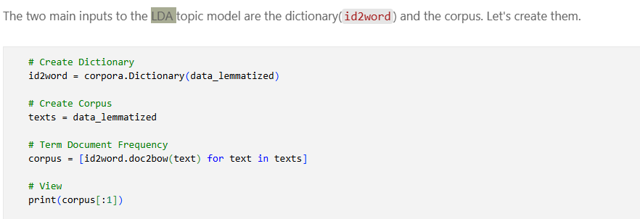
LDA -> Pre-processing

Slide 18
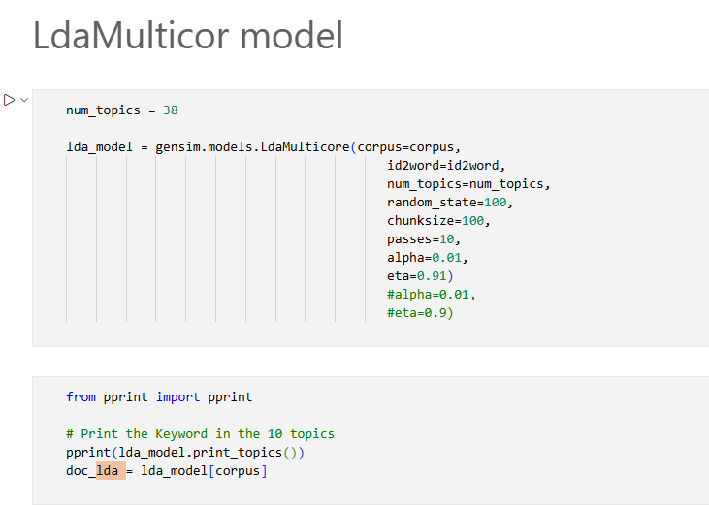
Train LDA Model

Slide 19
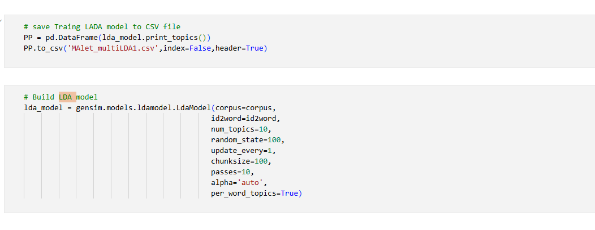
Train LDA Model

Slide 20
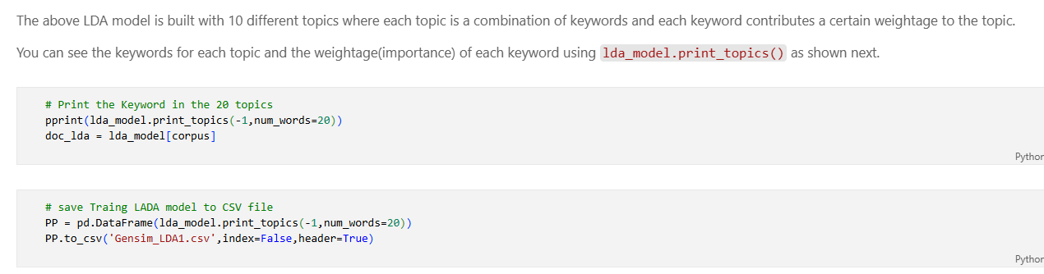
LDA -> Keywords of Topics

Slide 21
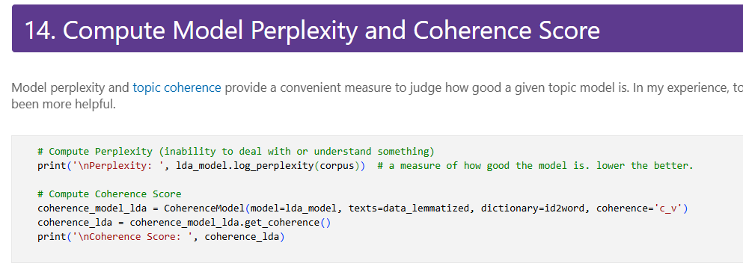
LDA -> Coherence

Slide 22
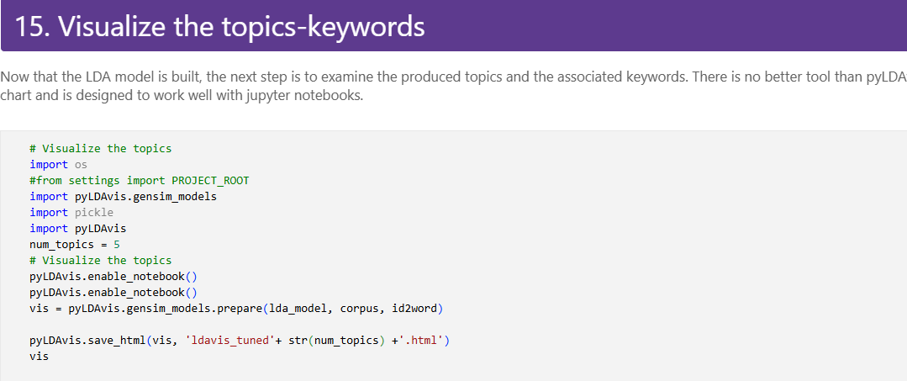
LDA

Slide 23
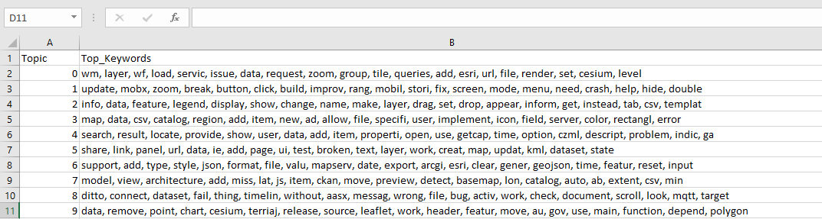
Topics after LDA model implementation
When K = 10

Slide 24
References
Blei, D. M., Ng, A. Y., & Jordan, M. I. (2003). Latent Dirichlet Allocation. Journal of Machine Learning Research (JMLR), 3, 993–1022.
Murgia, A., Tourwé, T., Claes, M., Demeyer, S., & Dejaeger, K. (2015). An Empirical Comparison of Four Topic Modeling Algorithms on Stack Overflow. Empirical Software Engineering, 20(6), 1563–1610.
Murgia, A., Tourwé, T., Claes, M., Demeyer, S., & Dejaeger, K. (2015). An Empirical Comparison of Four Topic Modeling Algorithms on Stack Overflow. Empirical Software Engineering, 20(6), 1563–1610.

