Slide 1
lT Infrastructure Management Project
Topology no.9

Slide 2
Table of contents
01
02
03
ADDRESSING Table
Configure VLAN's
05
Configure RIP&OSPF Routing
Case Study
WLC and Access Point configuration
04
Configure RIP&OSPF Routing

Slide 3
INTRODUCTION

Slide 4
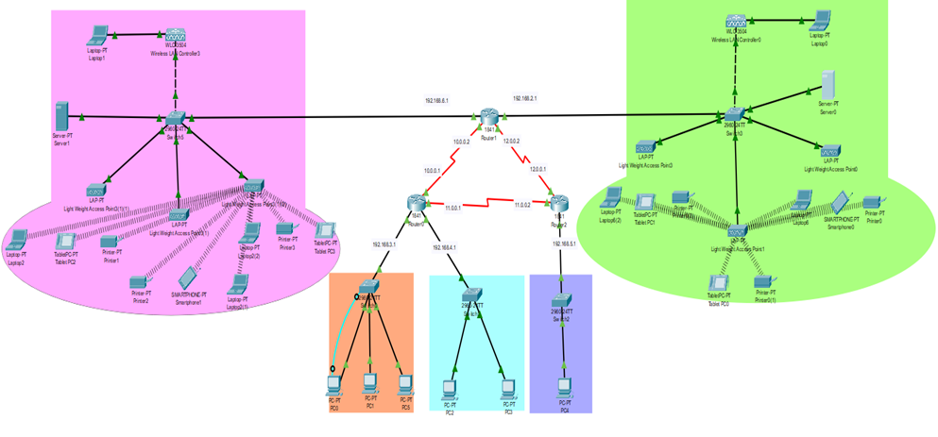
01
ADDRESSING Table

Slide 5
02
Configure VLAN's

Slide 6
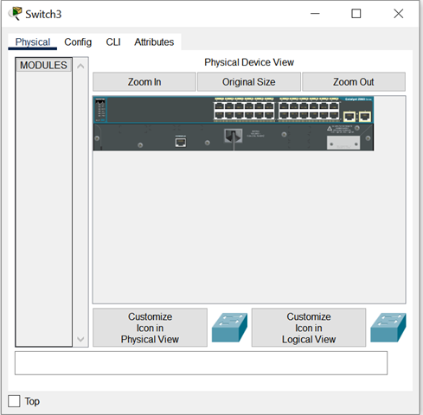
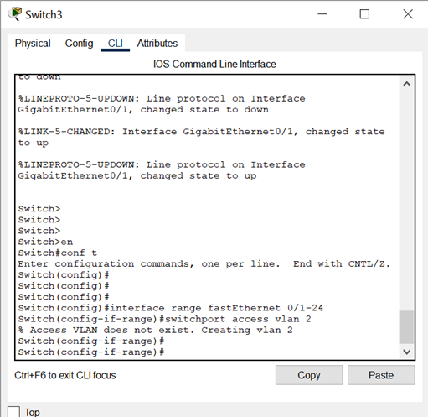
Configure VLAN's

Slide 7
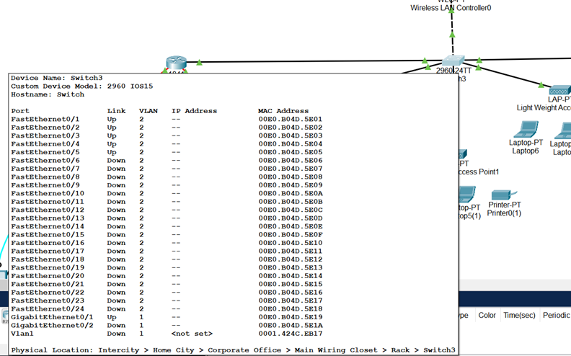
Configure VLAN's
SWITCH3

Slide 8
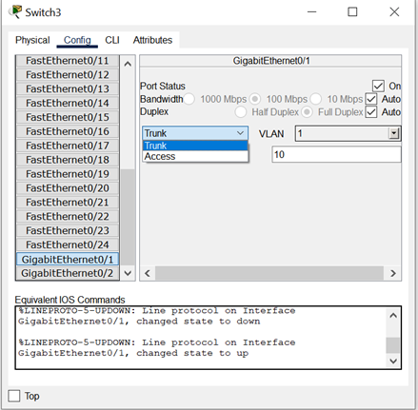
Configure VLAN's

Slide 9
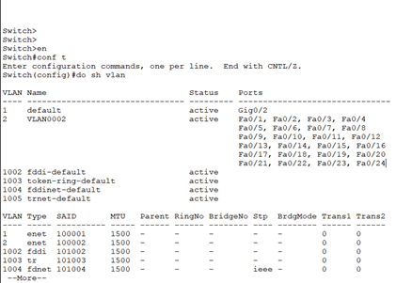
Configure VLAN's

Slide 10
03
WLC and Access Point configuration

Slide 11
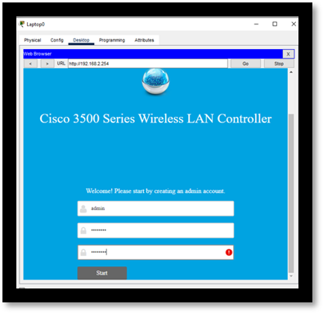
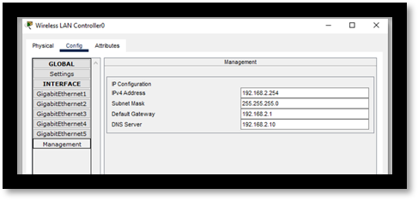
Step 1
Step 2

Slide 12
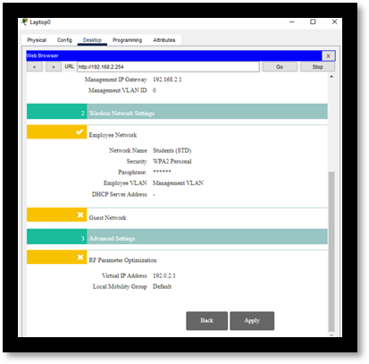
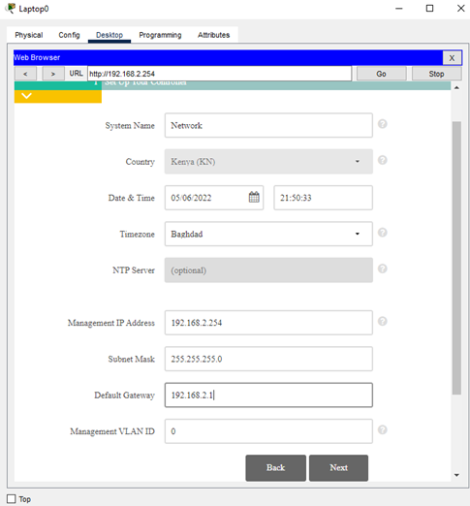
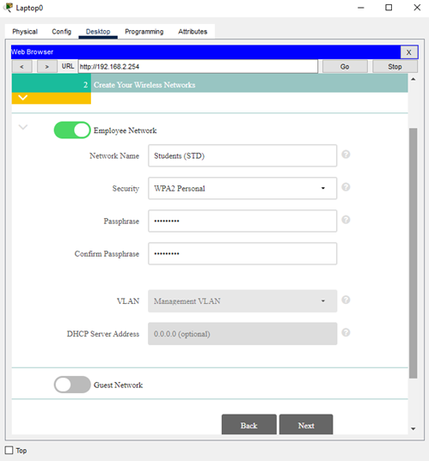
Step 3

Slide 13
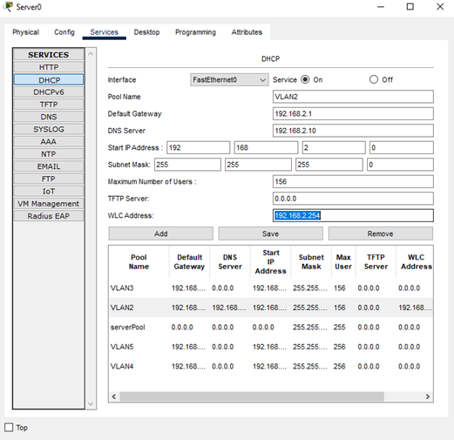
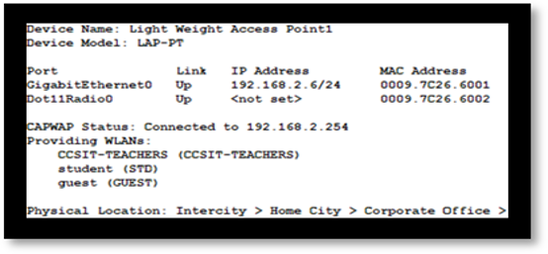
Step 4
Step 5

Slide 14
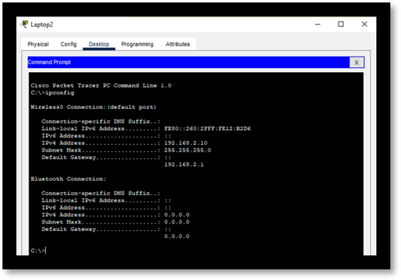
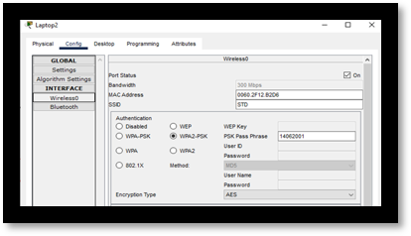
Step 6
Step 7

Slide 15
04
Configure RIP&OSPF Routing

Slide 16
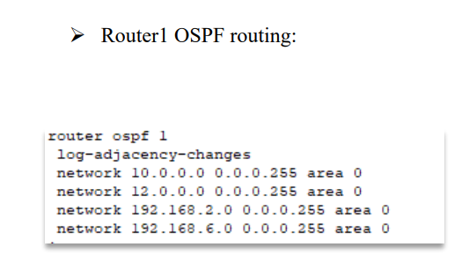
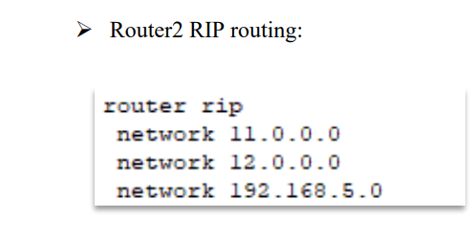
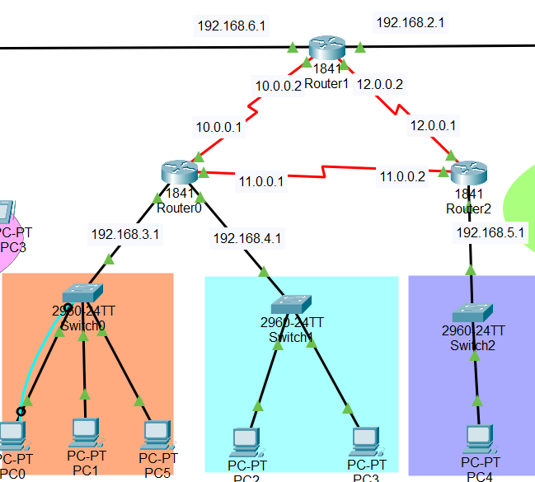
RIP&OSPF

Slide 17
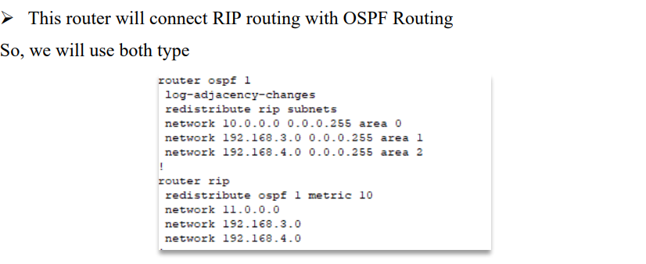
RIP&OSPF

Slide 18
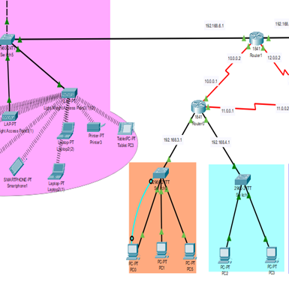
RIP & OSPF
Before
NOTE:
After
VLAN6 x VLAN3

Slide 19
05
Case Study

Slide 20
Differences between Cloud and Grid computing
Architecture used and rescuers
accessibility
Software set up
It’s composed of hydrogen and helium
payment
It’s the farthest planet from the Sun

Slide 21
scenarios for cloud computing
Scenario 1
Scenario 2
Scenario 3

Slide 22
CONCLUSION

Slide 23
Thanks!
Do you have any questions?
Leader | ID | Member Name
✓ | 2200400128 | Reem alanazi
 | 2200002749 | Fatimah Hassan Almansoor
 | 2190001445 | Amal almuslim
 | 2200002685 | Fatima Habib Algharash

