Slide 1


Department of Computer Science & Engineering University of Ioannina
MSc Thesis
A Study of Schema & Software Co-evolution for Relational Databases in Free Open Source Projects
Fation K. Shehaj
Supervisor: Dr. Panos Vassiliadis
July 19, 2021

Slide 2
Outline
Introduction
Aims and Objective
Review of Literature
Dataset used
Manual analysis of schema and software co-evolution
Methods
Results
Evolution Chart Exporter, First version
Cumulative analysis
Methods
Evolution Chart Exporter, Second version
Research Questions
Results
Conclusions
Future Work

Slide 3
Introduction
Software product includes a series of changes.
Correct potential faults.
Extend functionalities.
Applications are becoming more dependent on their databases.
What is schema and software co-evolution.
How the evolution of one depends on the evolution of the other.
Understand how they affect each other.
Why we care about schema and software co-evolution.
Minimize or eliminate software crashes, bugs, wrong data.
Reduce time and effort for maintenance.
Improve software performance.

Slide 4
Aims and Objective
Study the schema and software co-evolution using a large collection of projects.
Manual analysis to better understand co-evolution and history.
Create a tool to automate the process.
Introduce 2 research question and present our findings.
Research Question 1: What percentage of the projects demonstrates a "hand-in-hand" co-evolution?
Research Question 2: What percentage of projects demonstrates the 80-20 rule reported in the literature.

Slide 5
Review of Literature
In 2009, Dien-Yen Lin and Iulian Neamtiu focused their research on the collateral evolution of applications and databases.
The most frequent modifications are table additions and deletions followed by attribute additions and deletions.
In 2011, Shengfeng Wu and Iulian Neamtiu presented their work on schema evolution analysis for embedded databases and proposed a system to automatically extract embedded database schemas and source code.
A high-frequency of table and attribute deletions denotes that embedded databases are more prone to restructuring, rather than continuous growth.
The early stages in schemas tend to have a higher number of changes, while the later versions include few changes and the database stabilizes over time.

Slide 6
Review of Literature
In 2013, Dong Qiu, Bixin Li and Zhendong Su made an empirical analysis for the co-evolution of schema and code in database applications.
Database schemas evolve at a high rate during their lifecycle, on average 90 schema changes per year.
In most of the projects, approximately 80% of their schema changes happened within the first 20% of their lifetimes (80-20 rule).
More schema changes happened in a small number of tables and nearly half of schema tables did not change.

Slide 7
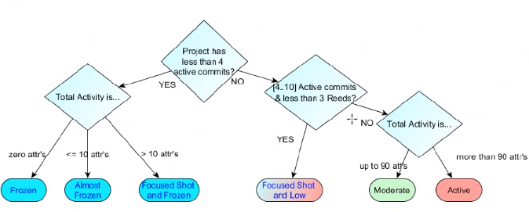
Dataset used
Collection of 350 open source projects.
Categorize 195 of them to six taxa.
Classification depends on schema activity.
* Collection and categorization was made by P. Vassiliadis.
* The algorithm used to classify the 195 projects was firstly introduced in [Vass21].
TAXA
Frozen
Almost frozen
Focused Shot and Frozen
Moderate
Focused Shot and Low
Active

Slide 8
Manual analysis of schema and software co-evolution
Manual analysis of six random selected projects.
3 from the ALMOS_FROZEN taxon.
2 from the FOCUSED-SHOT_n_FROZEN taxon.
1 from the MODERATE taxon.
Better understanding of commits history.
Evaluate what developers commits.
Triggered by schema changes?
Locate ‘real’ changes.

Slide 9
Manual analysis - Method
Examine all commits with schema changes.
Window of ± 3 commits.
Note before and after for both schema and source code.
Create table for each project with:
Commit date.
Who made the commit.
Number of Source code files changed.
Number of SQL files changed.
State before (for DB and CODE).
State after (for DB and CODE).

Slide 10
Manual analysis - Method
Answer six questions (for each project and overall).
What kind of changes happened to the schema and at the src to sync with schema evolution?
Why did these changes happened?
When does schema evolution take place?
Where in the code/src is the impact of schema evolution and where is the maintenance effort located?
How do people change the schema and maintain the source code?
Who is related to the db/src changes?

Slide 11
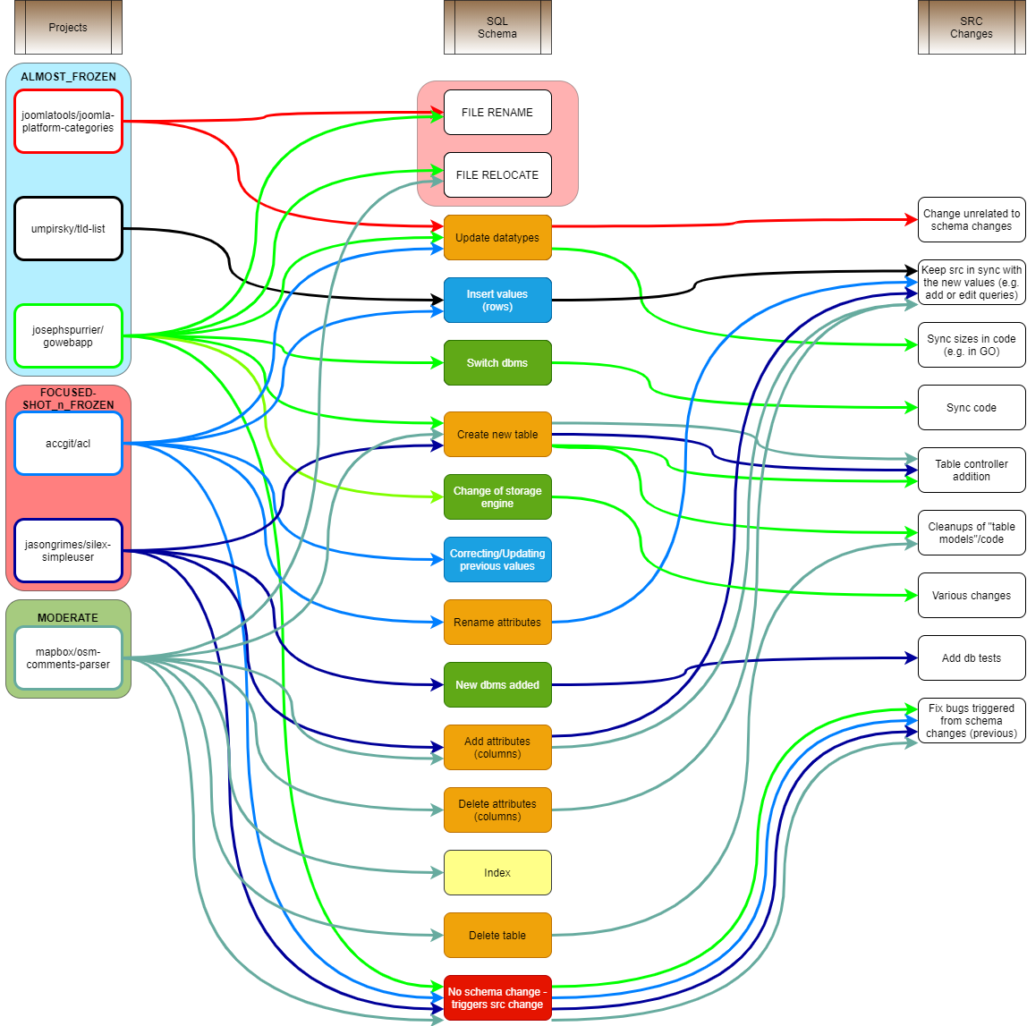
Manual analysis - Results
WHAT
We have mapped the schema and src changes for a better understanding what each group of schema changes cost to source code.
Projects examined.
SQL Schema.
Src changes.

Slide 12
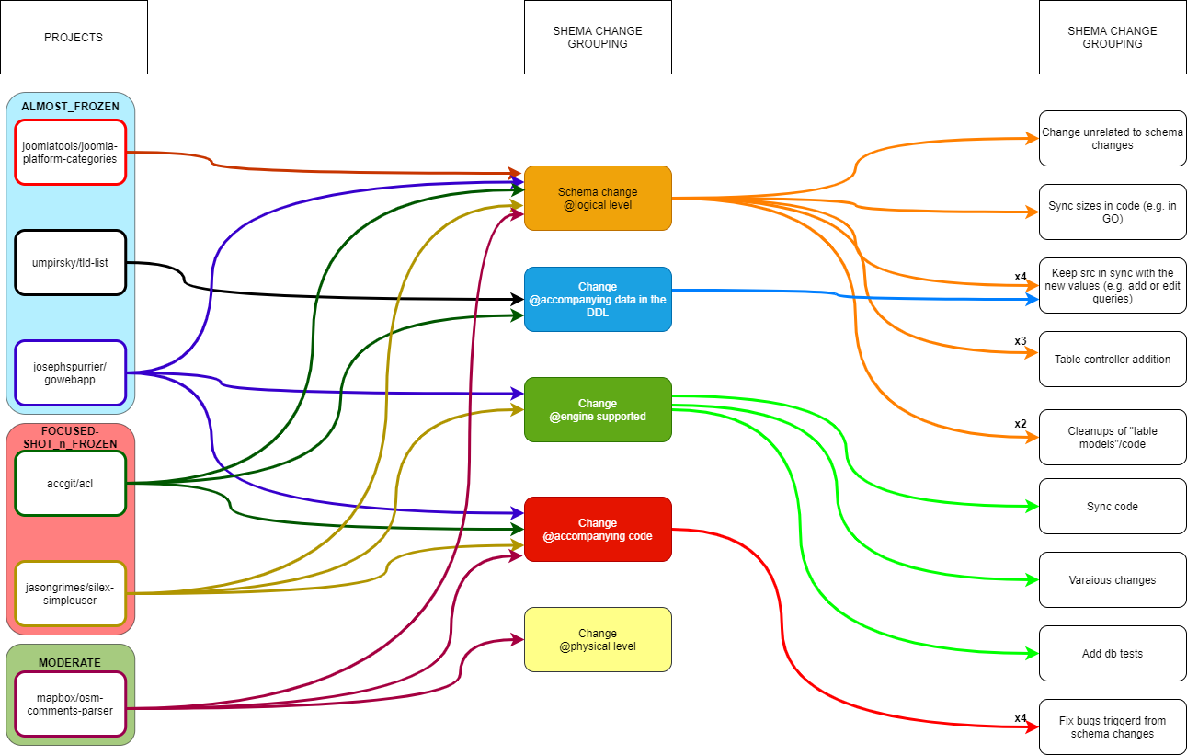
Manual analysis - Results
WHAT
To make it easier to find patterns, we categorized the schema changes to a more higher level.
Schema categories:
Schema change @logical level (orange).
Change @accompanying data in the Data Definition Language File (blue).
Change @engine supported (green).
Change @accompanying database code (red).
Change @physical level (yellow).

Slide 13
Manual analysis - Results
WHY
Most commits were to insert new values, e.g. new default values, to add more features to the project (e.g. a new table to save extra information or the user) and code refactoring or bug fixes after schema changed.
Project | Reasons
joomlatools__joomla-platform-categories | Changes to match joomla changes and joomlatools repository.
umpirsky__tld-list | To include more tld domains (add rows).
josephspurrier__gowebapp | Refactor the code and add extra information (a new table note was added).
accgit__acl | Most commits were to change default values (inserted rows e.g. admin).
jasongrimes__silex-simpleuser | Update schema with more info, add new DBMS and migration ability.
mapbox__osm-comments-parser | Add new features, bug fixes and code refactoring.

Slide 14
Manual analysis - Results
WHEN
On most of them, commits were uniformly spread in relation to the project’s life.
Project | Reasons
joomlatools__joomla-platform-categories | Two commits at the beginning of the project’s life and one at the end.
umpirsky__tld-list | Three commits, one at the beginning, one in the middle and one at the end of the project’s life.
josephspurrier__gowebapp | Uniformly spread commits to the database in the project’s life.
accgit__acl | Most of the commits were at the beginning of the project, but there are also commits at the middle and the end of the project’s life.
jasongrimes__silex-simpleuser | Uniform commits, at the beginning, in the middle and at the end of the project’s life.
mapbox__osm-comments-parser | Uniformly spread commits.

Slide 15
Manual analysis - Results
WHERE
In most of the projects we examined, there were object related mapping (ORM) files to handle the SQL tables. Most of the commits happened to those files. For the smaller projects, e.g. in the almost_frozen taxon, changes happened to the packets with files related to the database. Overall, the changes were at the same set or subset of files.
HOW
We observed a huge variety of schema changes, the most common were: update datatypes, create table, add attributes and insert values. Src commits to fix bugs created from schema changes to their code.

Slide 16
Manual analysis - Results
WHO
From what we can see, the projects with more active schema evolution, tend to have most of the commits made to the project concentrated to one person.
Projects | Percentage (%) of developers committing schema changes | Percentage (%) of commits made by the developer with the highest percentage of changes
joomlatools__joomla-platform-categories | 50% | 66.6%
umpirsky__tld-list | 100% | 50%
josephspurrier__gowebapp | 66.6% | 88.8%
accgit__acl | 50% | 100%
jasongrimes__silex-simpleuser | 25% | 73.3%
mapbox__osm-comments-parser | 50% | 90%

Slide 17
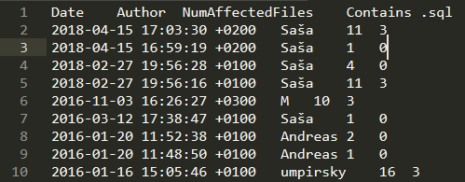
Evolution Chart Exporter (v1)
Main reason: A tool to visualize how much code and schema changes have been committed over time.
Use of HeraclitusFire as base (charts).
Input: commit history file (4 columns).
Date
Author
Number of Affected Files (* col. 3 contains col. 4, src and SQL)
Number of SQL files.
* GitHub link: https://github.com/FationSH/EvolutionChartExporter

Slide 18
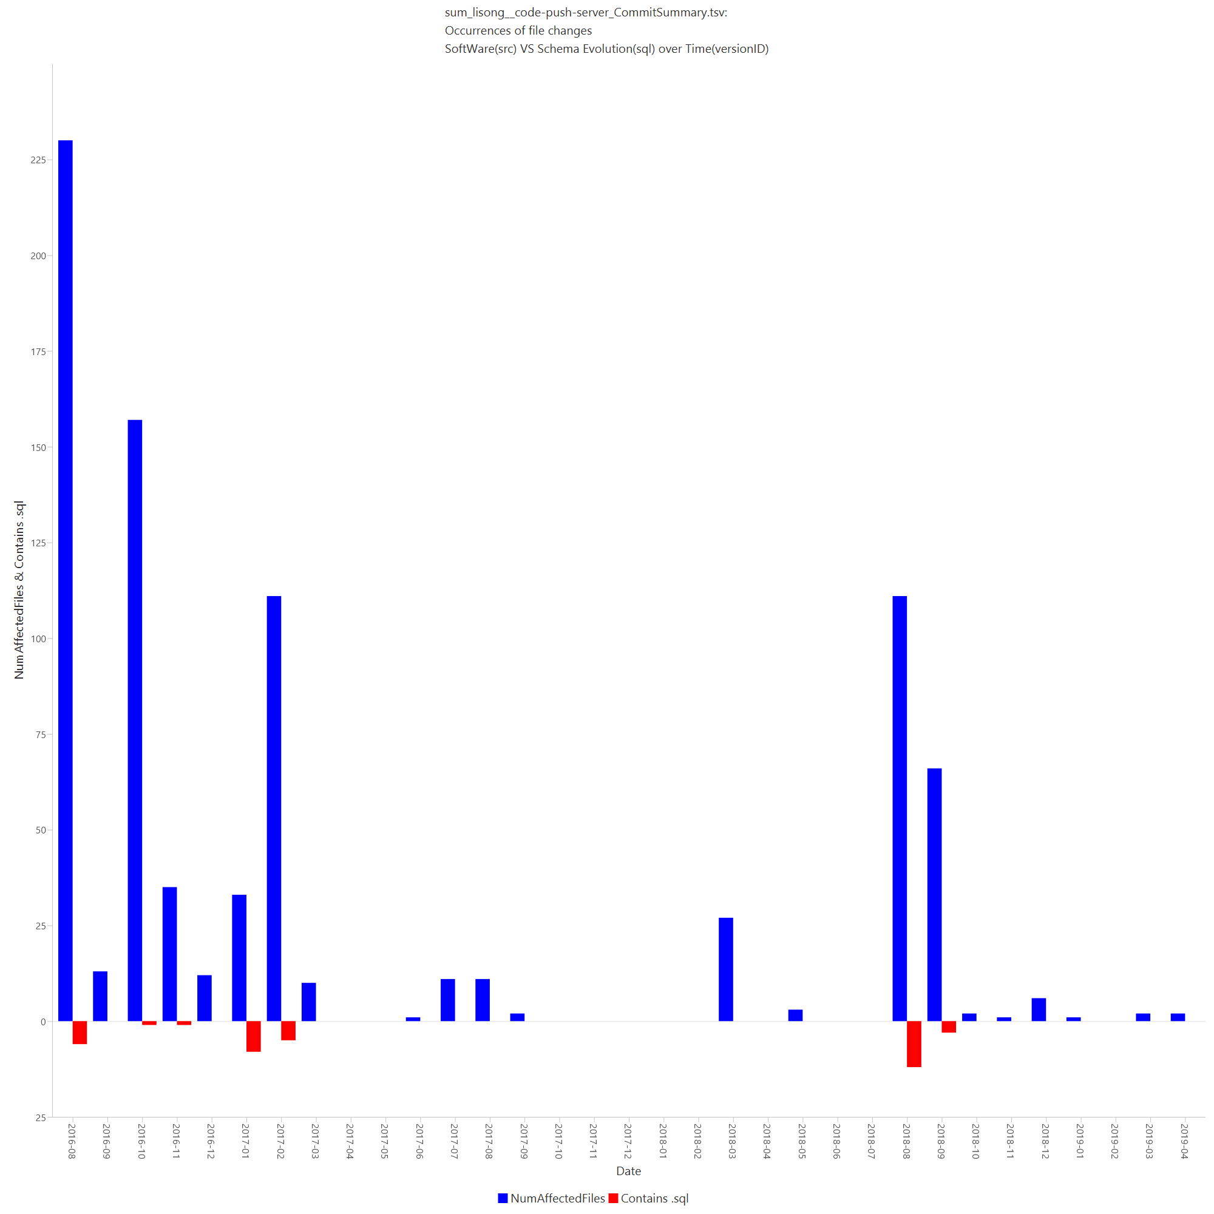
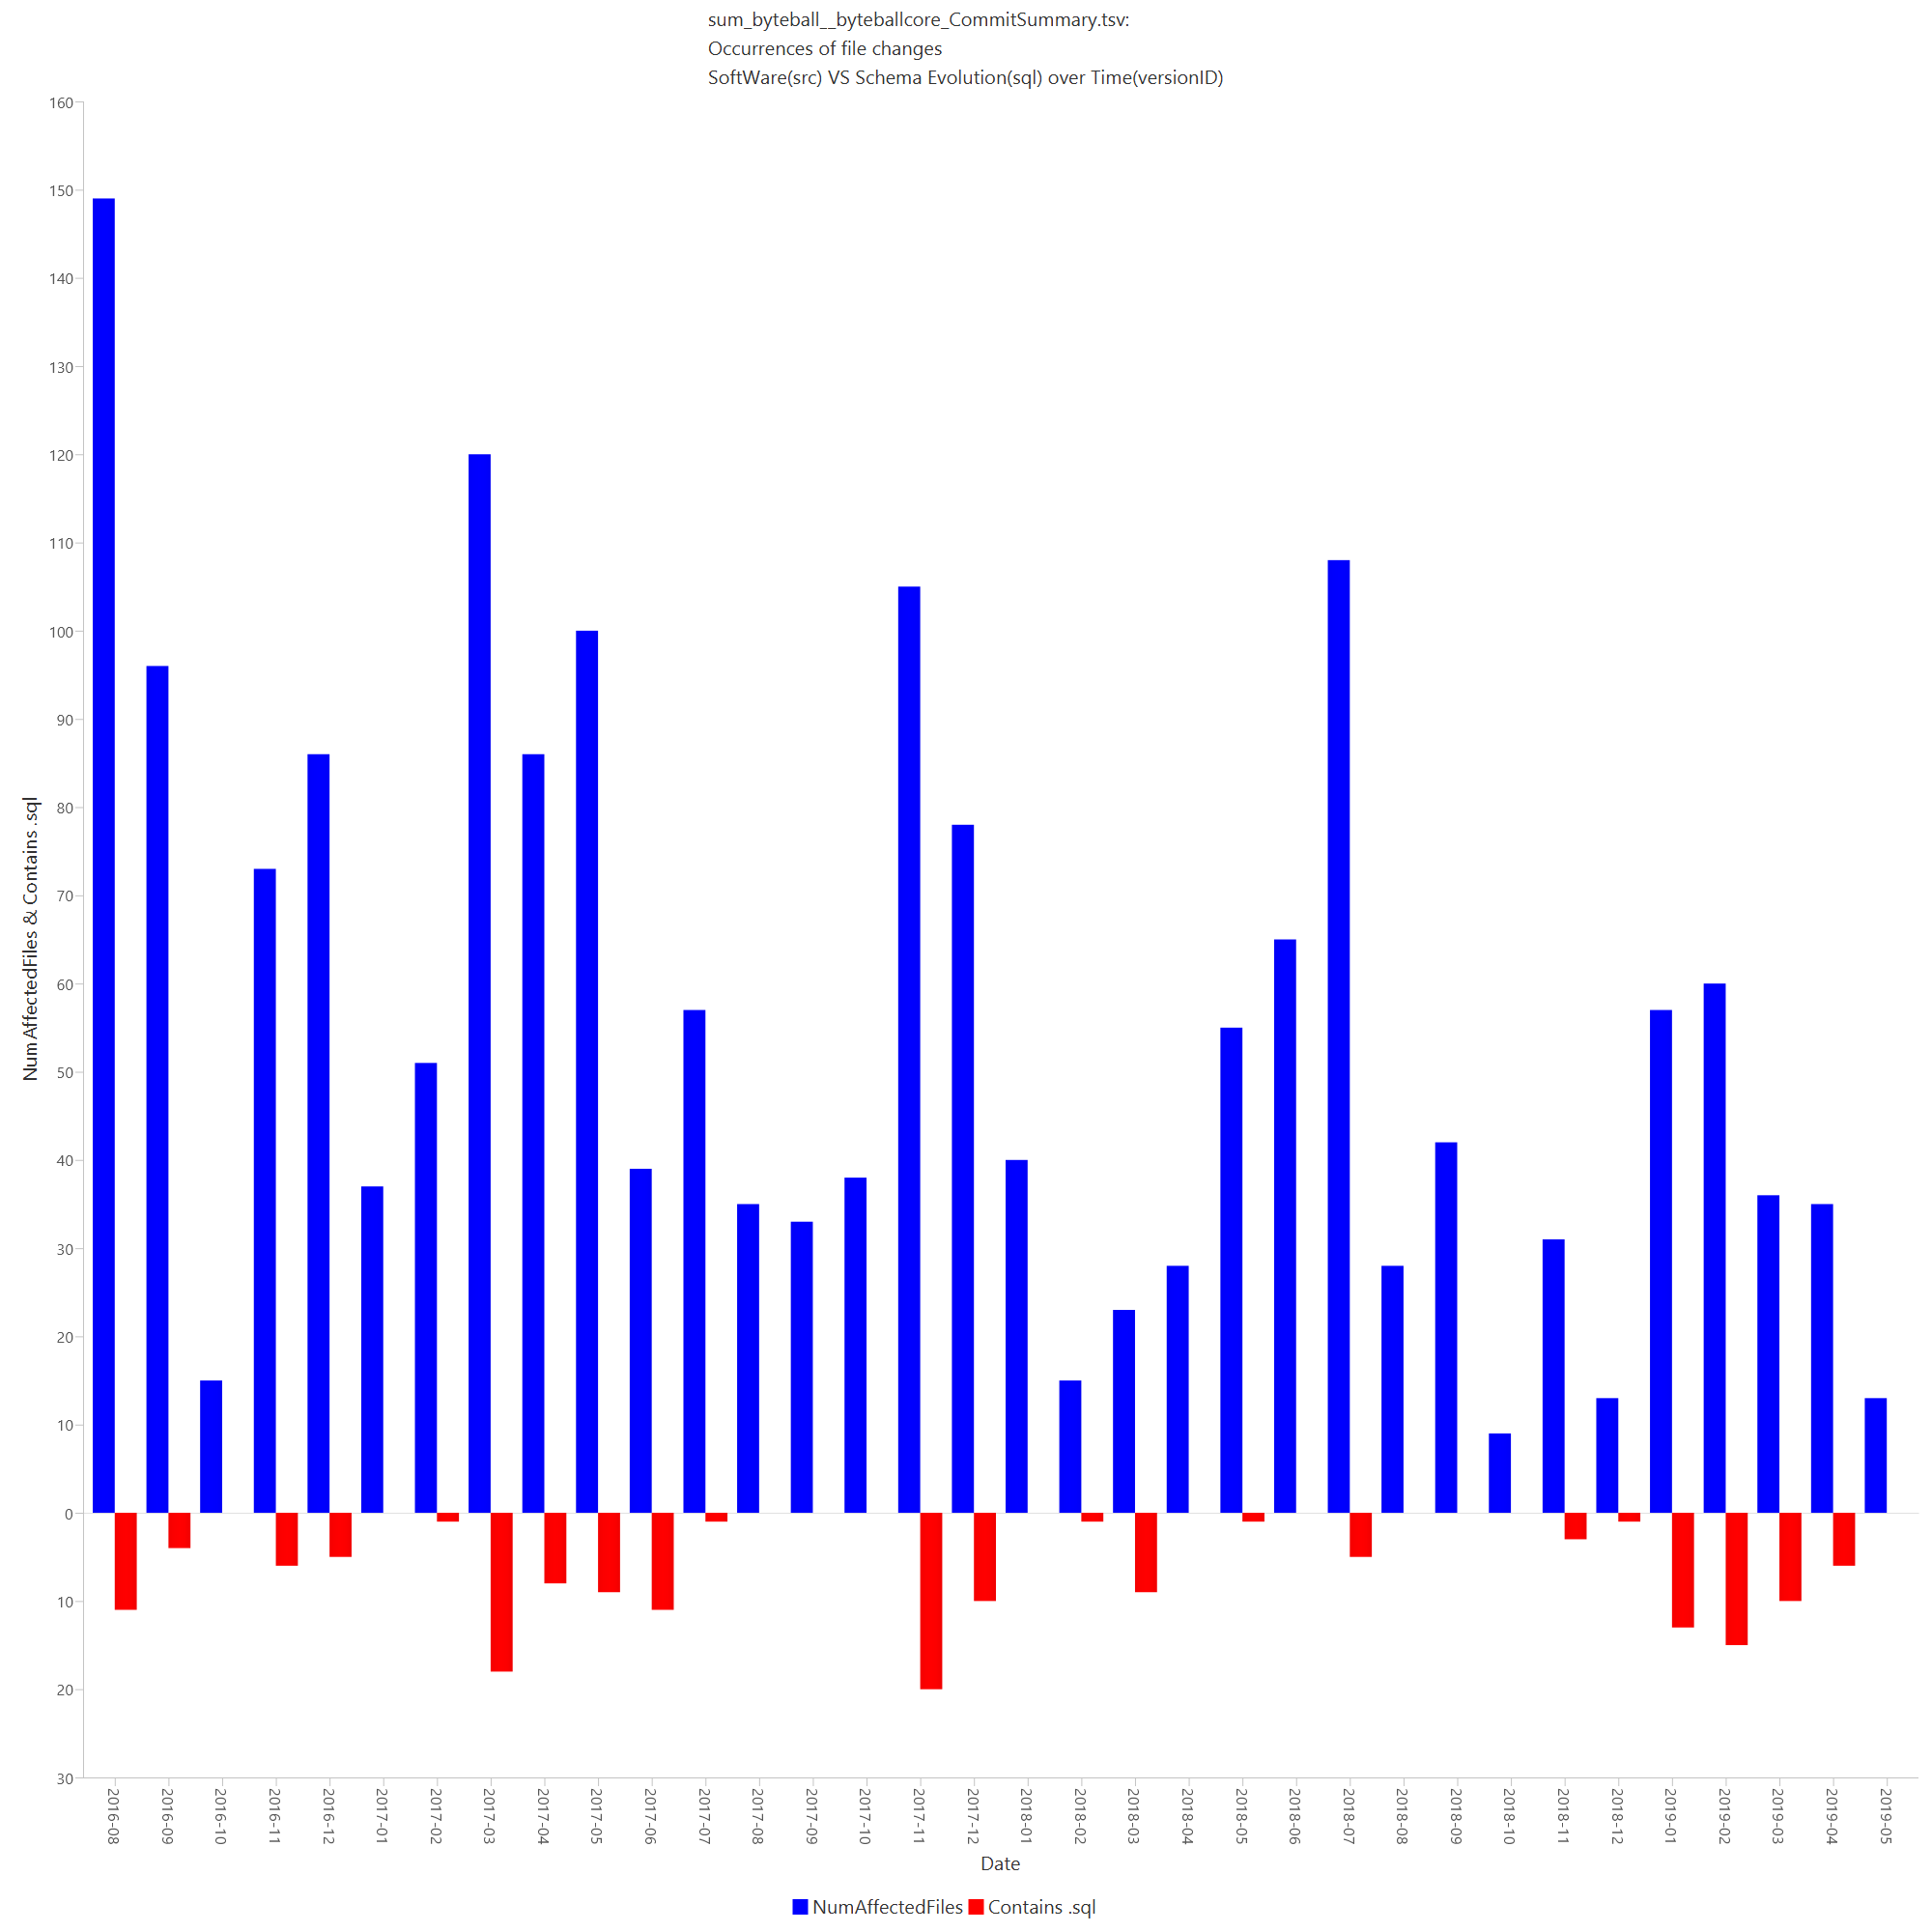
Evolution Chart Exporter (v1)
Exports Bar Chart
Blue represent source code changes (number of src files).
Red represent SQL changes (number of SQL files).
Variations
One bar for each commit.
One bar for each month.
Zero for months without commits.
Testing
Junit tests.
Visual tests.

Slide 19
Evolution Chart Exporter (v1)
How ECE helped us
When most schema changes happens (e.g. red bars at the begging)?
If and how they depend (e.g. red bars are a “mirror” of blue bars)?
Difficulties
Commit history files (basic information).
Lot of work made locally (before the first commit).
No frequent commits (not structured, e.g. every week).
Lot of “useless” changes (e.g. ReadMe, add comments, fix indentation, add empty lines).
How to measure changes?

Slide 20
Cumulative analysis
Idea: Use Heraclitus files for more information.
Use of Monthly Schema Stats files from HeraclitusFire
More information about schema changes.
The cumulative percentage is a running total of the percentage values occurring across a set of responses.
The total will either remain the same or increase, reaching the highest value of 100% after totaling all of the previous percentages.

Slide 21

Cumulative analysis Methods
The formula for the cumulative percentage is as follows:
$${cumPct}_{i }= \frac{1}{TotalActivity} \sum_{k=0}^{i}{{activity}_{k}}= {cumPct}_{i−1} + \frac{{activity}_{i}}{TotalActivity}$$
* With acitvity_{k} being the activity in the k-th time unit, and TotalActivity the total amount of activity measured for the entire lifetime of a project.
The above formula obviously applies to all kinds of activity measurements, like projectActivity, schemaEvolutionActivity, Expansion, Maintenance, etc.

Slide 22
Evolution Chart Exporter (v2)
Use commit history files for project activity.
Use MonthlySchemaStats (from Heraclitus) for schema activity.
Create new file with six columns:
Month: 0…n, with n project life in months.
Schema Activity: TotalAttrActivity column of the MonthlySchemaStats file.
Project Activity: number of changed files (counts src and sql files).
Cumulative Project Time: cumulative percentage of project’s life.
Cumulative Schema Activity: cumulative percentage of schema activity (attributes changed) over time.
Cumulative Project Activity: cumulative percentage of project activity over time.

Slide 23
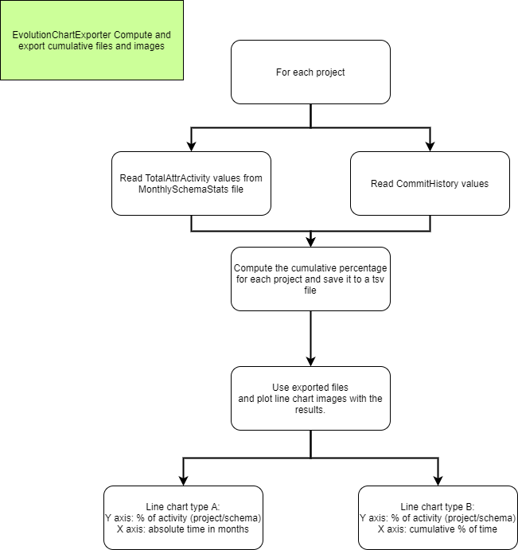
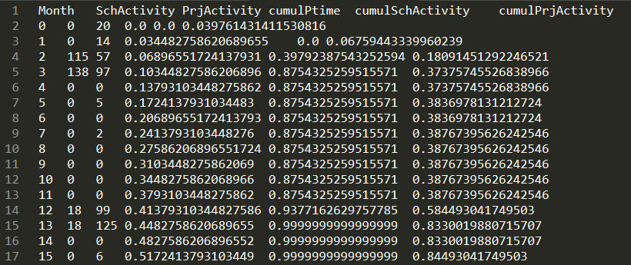
Evolution Chart Exporter (v2)
Exported file format
Flow of Evolution Chart Exporter

Slide 24
Evolution Chart Exporter (v2)
Algorithm:
int totDur = getTotalDuration() // total duration/life of the project in months
int totPrjAct = getTotalPrjActivity() // total number of changed files
int totSchAct = getTotalSchemaActivity() // total number of changed attributes
prjActivity[] = getPrjActivity() // array with the number of the changed files every month
SchActivity[] = getSchActivity() // array with the number of changed attributes each month
cumulPrjActivity[0] = prjActivity[0] / totPrjAct
cumulSchActivity[0] = SchActivity[0] / totSchAct
cumulPTime[0] = 0
for each month i in 1..totDur
cumulPrjActivity[i] = cumulPrjActivity[i-1] + (PrjActivity[i] /TotPrjActivity)
cumulSchActivity[i] = cumulSchActivity[i-1] + (SchActivity[i]/TotSchActivity)
cumulPtime[i] = i / totDur
end for

Slide 25
Evolution Chart Exporter (v2)
Comment on Heraclitus
Heraclitus produces two kinds of statistics.
Monthly statistics for the heartbeat of the schema evolution, that compute the number of changes for each month, and, in which, the originating version is included.
Evolutionary statistics for the heartbeat of the schema evolution, in which, the originating version of the schema life is not included: the aim of these statistics is to quantify how much the schema has changed after its birth.
In the rest of our deliberations, we will refer to the monthly stats, as this is the respective measure that we can use to compare against the monthly stats of the project activity

Slide 26
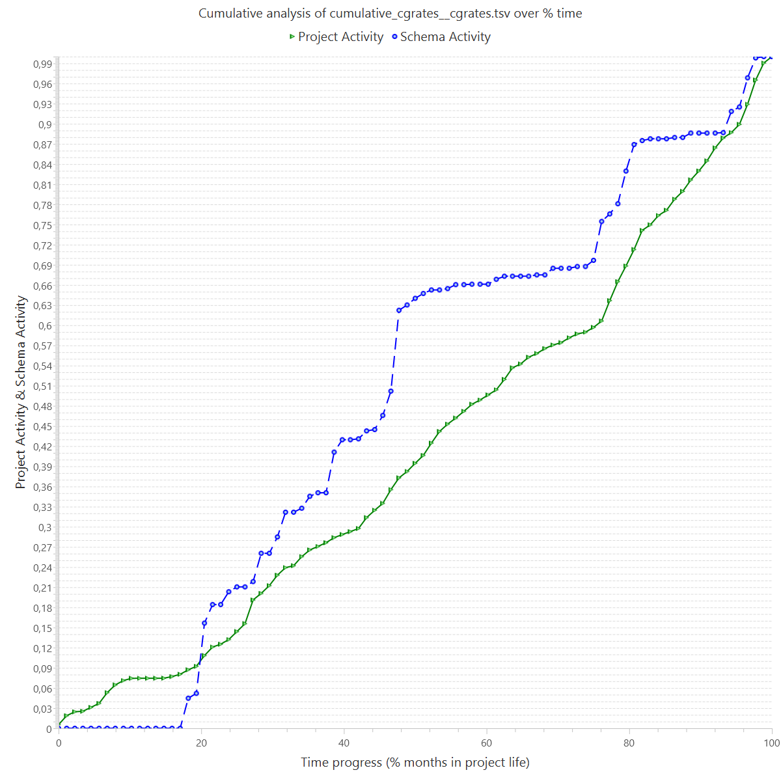
Evolution Chart Exporter (v2)
Example of a line chart created by ECE.
Blue line represents the schema activity.
Green line represents the project activity.
Testing
Junit test, 2 files representing commit history and MonthlySchemaStats and one expected.
Visual tests.
Ability to export a html with all images for each taxon (for both v1 and v2).

Slide 27
Research Questions
Research Question 1: What percentage of the projects demonstrates a "hand-in-hand" co-evolution, where the schema evolution heartbeat closely follows the heartbeat of the project?
Research Question 2: What percentage of projects demonstrates the 80-20 rule reported in the literature, i.e., 80% of the schema evolution activity was obtained in the first 20% of the project’s life?

Slide 28
Research Question 1
What percentage of the projects demonstrates a "hand-in-hand" schema and source code co-evolution?
Understand if and how much the schema evolution closely follows the projects’ evolution.
To measure the percentage of each project that fulfills the prerequisites, "hand-in-hand" co-evolution, we used two range windows, ±5% and ±10%.

Slide 29
Research Question 1
Algorithm: Computation of "hand-in-hand" co-evolution
for each taxon txn:
for each project prj:
prjLife = getProjectLife(); /* a list of months */
cnt10 = 0;
cnt5 = 0;
for each month m in prjLife:
if ( abs(cumulPrjActivity – cumulSchActivity) ≤ 0.1):
cnt10++;
if ( abs(cumulPrjActivity – cumulSchActivity) ≤ 0.05):
cnt5++;
end if
end if
end for
handInHand10perc = (100*cnt10)/prjLife;
handInHand5perc = (100*cnt5)/prjLife;
end for
end for
The algorithm counts for each month the distance between the schema evolution and the project evolution, and divide it by the projects’ life to measure the "hand-in-hand" percentage co-evolution.

Slide 30
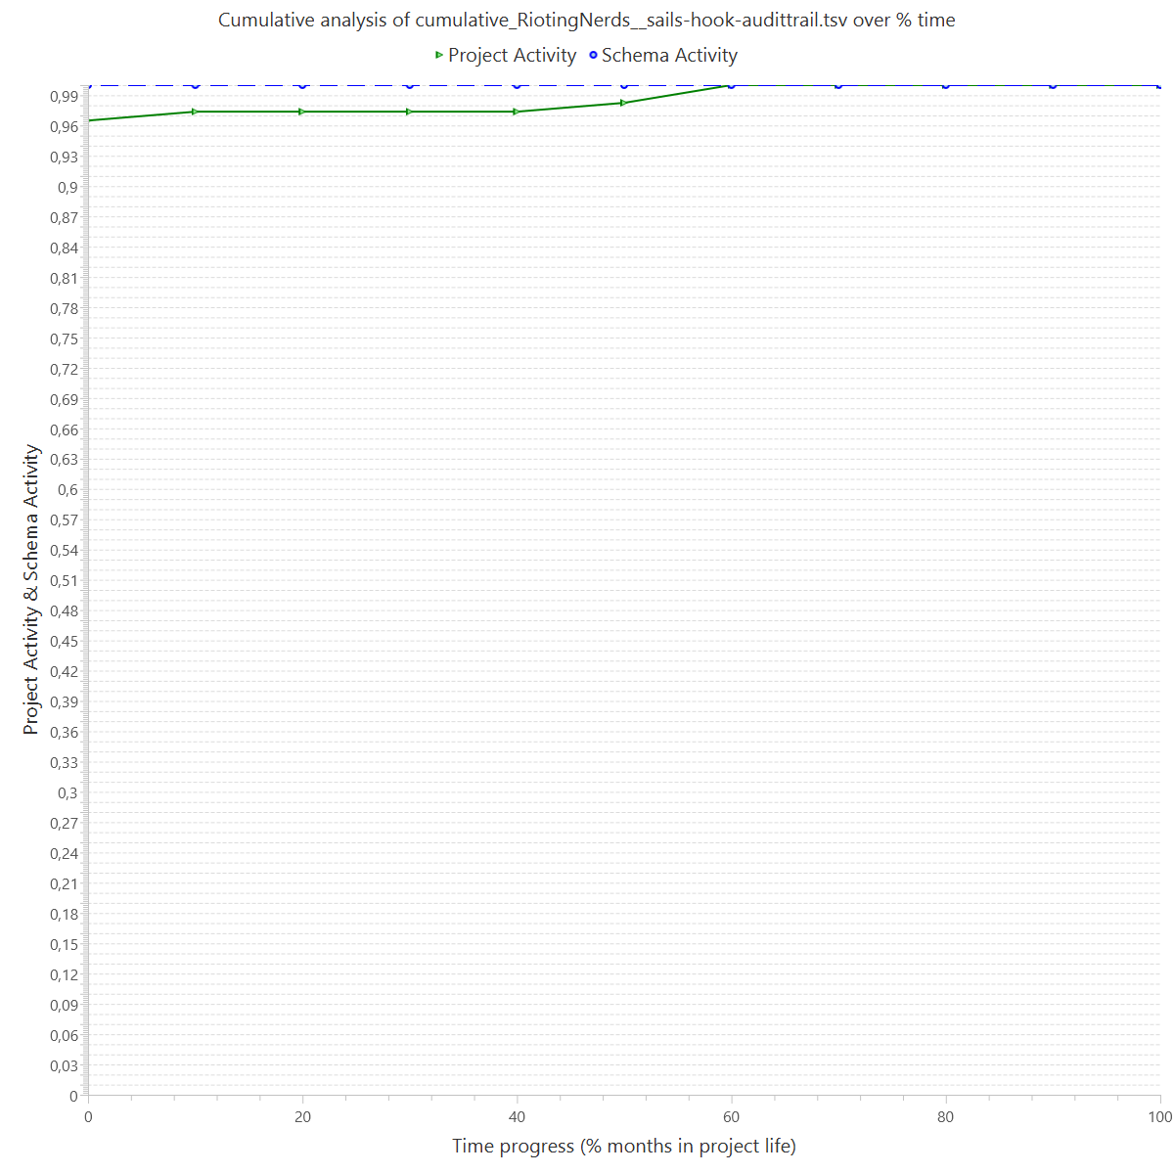
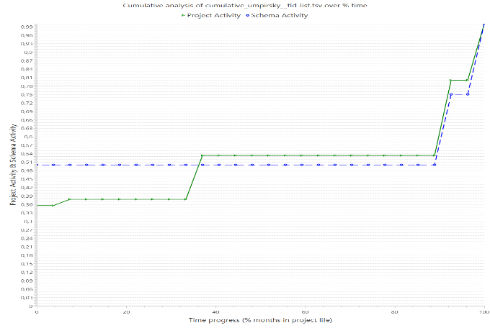
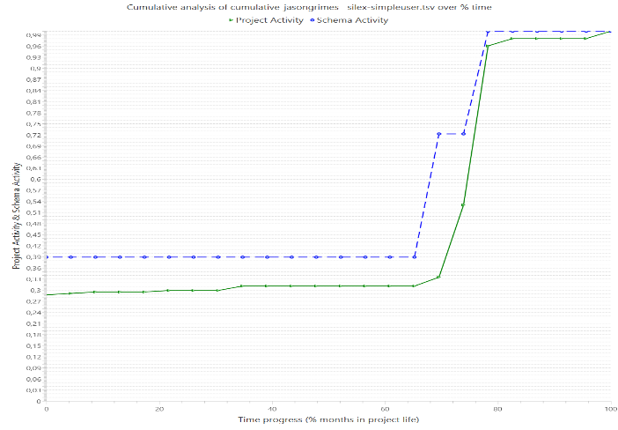
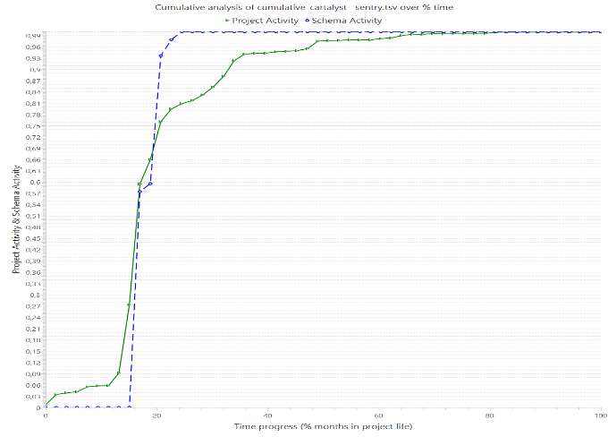
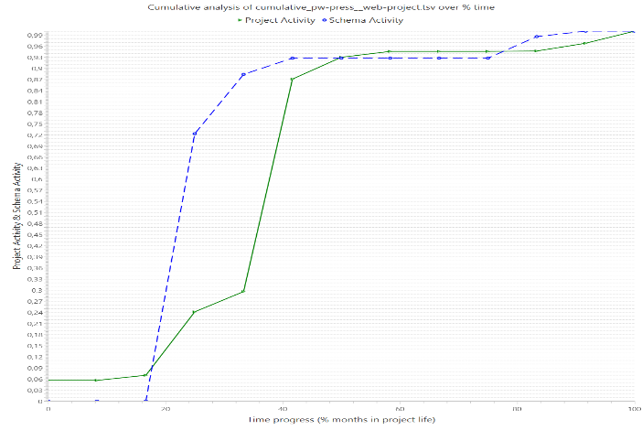
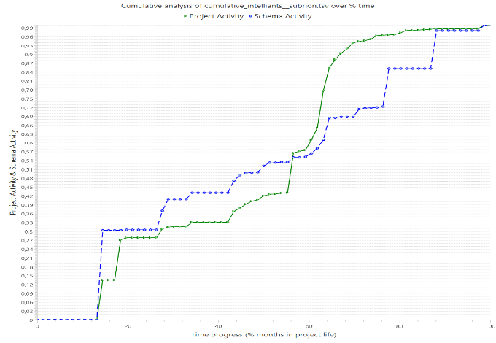
Hand-in-Hand example cases
(a) (b) (c)
(d) (e) (f)
Line charts were "hand-in-hand" co-evolution is applied for the taxa: (a) FROZEN, (b) ALMOST FROZEN, (c) FocusedShot n FROZEN, (d) MODERATE, (e) FocudesShot n LOW, (f) ACTIVE

Slide 31
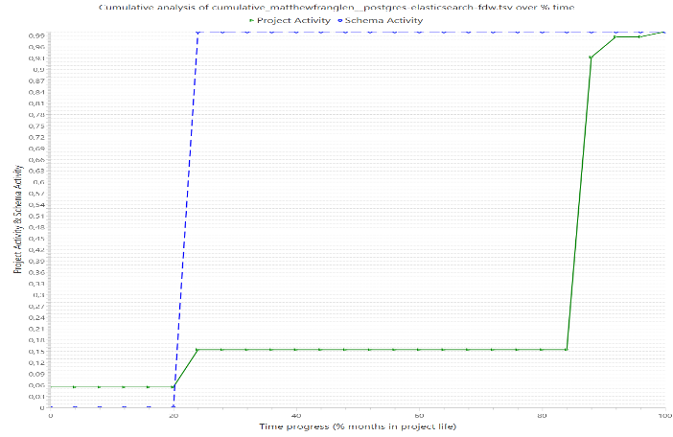
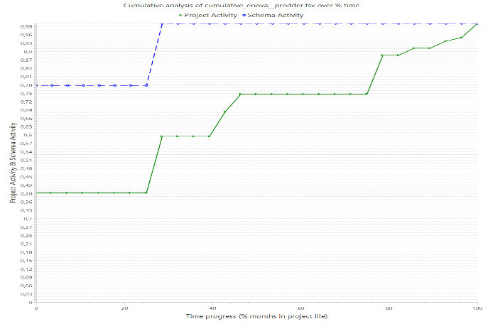
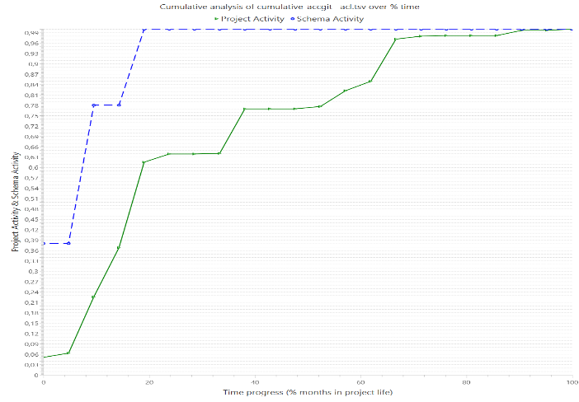
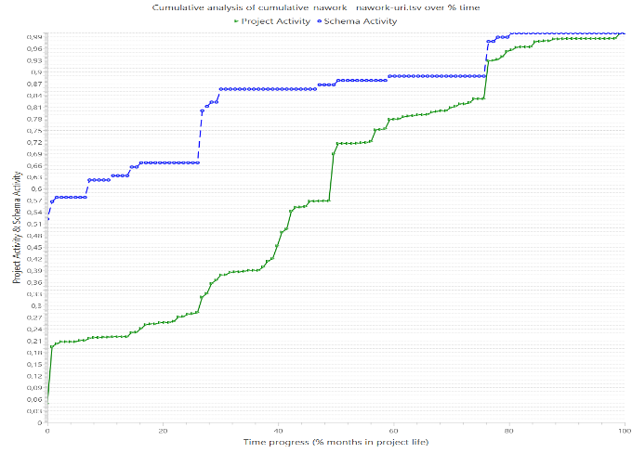
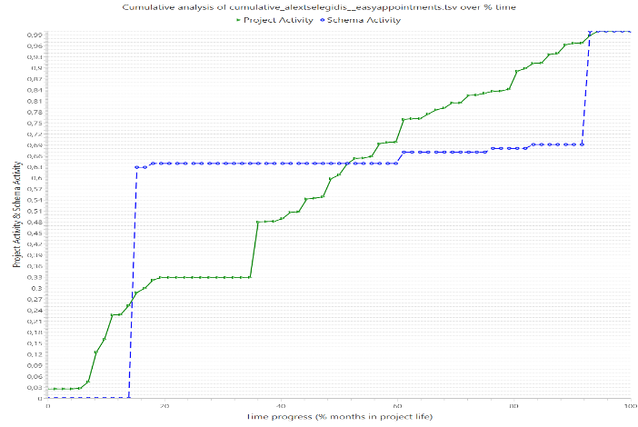
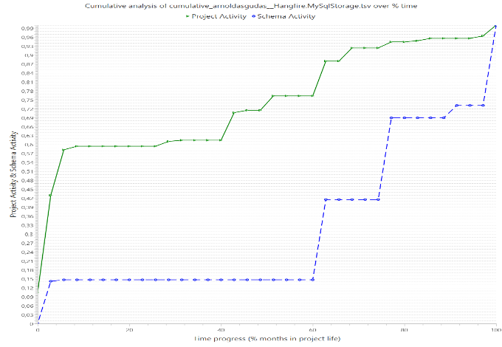
No Hand-in-Hand example cases
(a) (b) (c)
(d) (e) (f)
Line charts were "hand-in-hand" co-evolution is not applied for the taxa: (a) FROZEN, (b) ALMOST FROZEN, (c) FocusedShot n FROZEN, (d) MODERATE, (e) FocudesShot n LOW, (f) ACTIVE

Slide 32
Research Question 1 - Method
We grouped the projects into five ‘buckets’.
These are: [0%-20%) – [20%-40%) – [40%-60%) – [60%-80%) – [80%-100%].
Each ‘bucket’ shows the percentage of time which the project and schema evolution are "hand-in-hand".
Bar charts to visualize results.

Slide 33
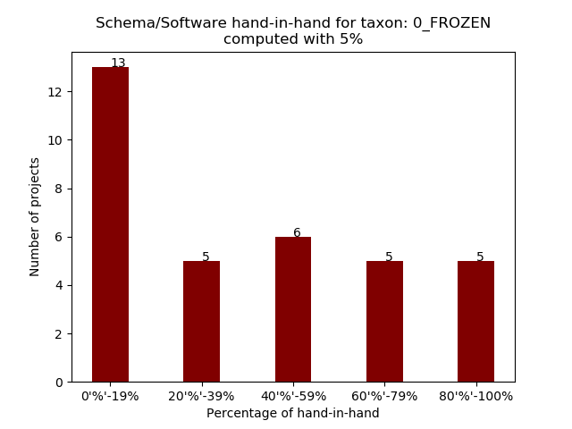
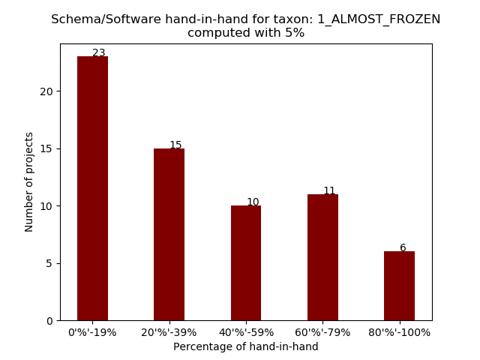
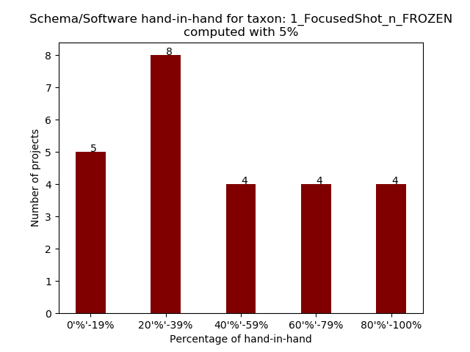
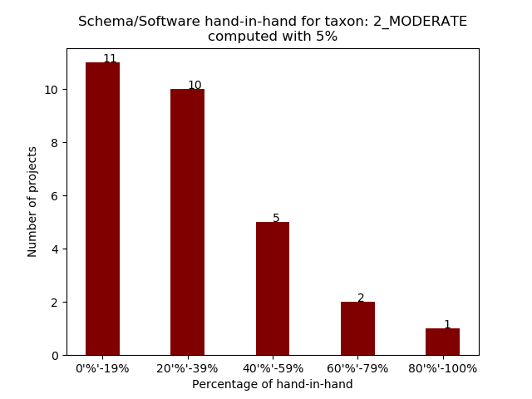
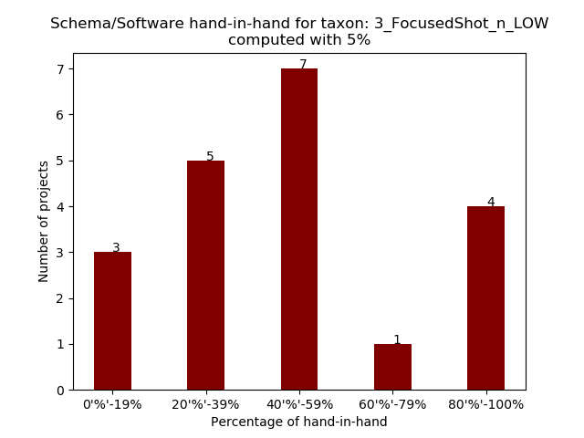
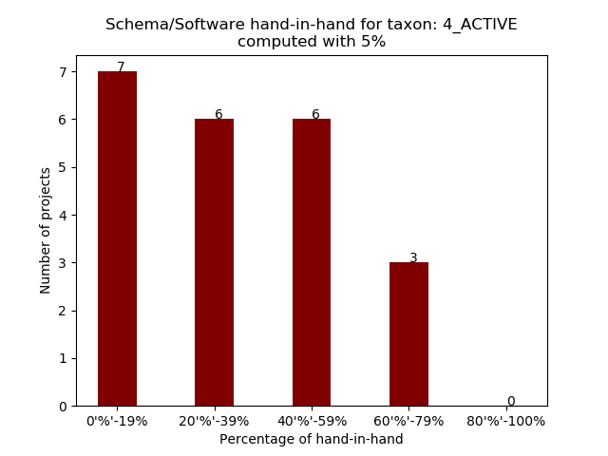
Research Question 1 - Results
(a) (b) (c)
(d) (e) (f)
“Hand-in-hand" co-evolution for ±5% range for the taxa: (a) FROZEN, (b) ALMOST FROZEN, (c) FocusedShot n FROZEN, (d) MODERATE, (e) FocudesShot n LOW, (f) ACTIVE

Slide 34
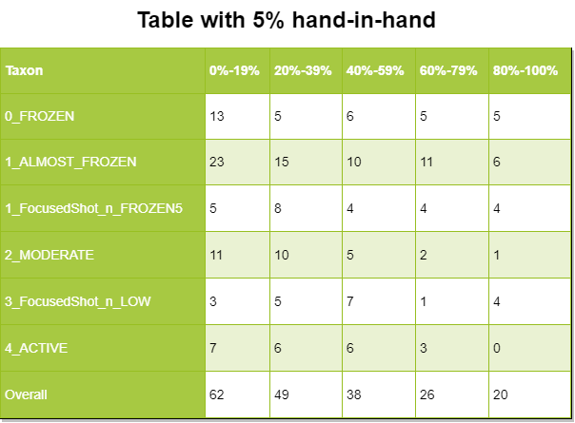
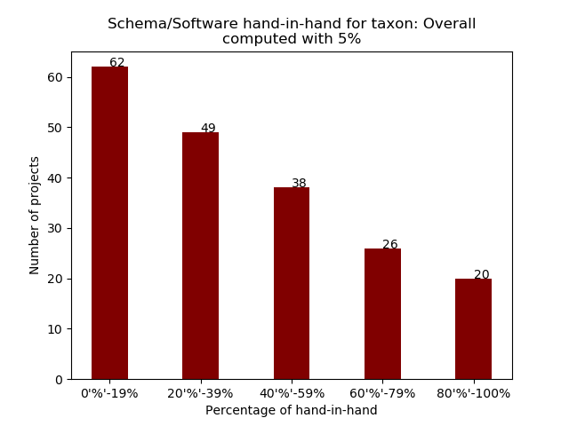
Research Question 1 - Results
For the ±5% window range
The "hand-in-hand" co-evolution decreases over time (clearly in overall results).
The less active, smaller percentage of "hand-in-hand" co-evolution.
The most active taxa, tend to have an average percentage of "hand-in-hand" co-evolution.

Slide 35
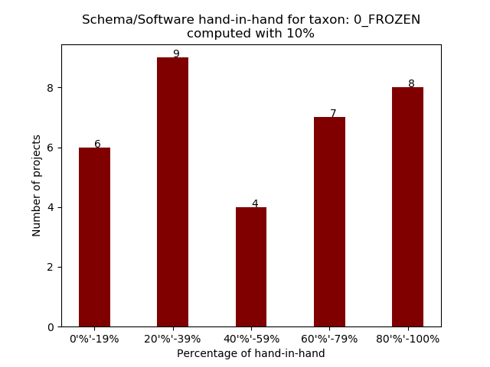
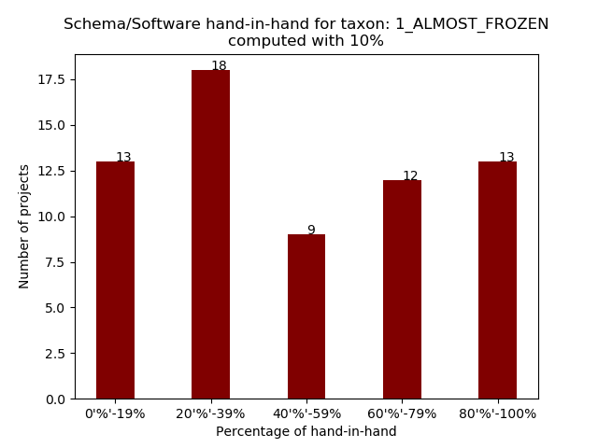
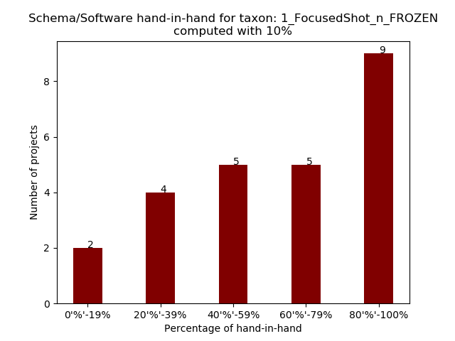
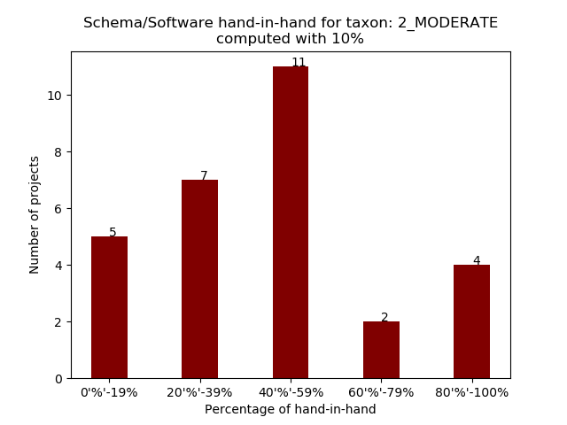
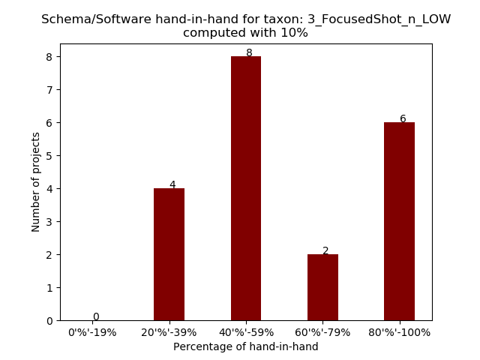
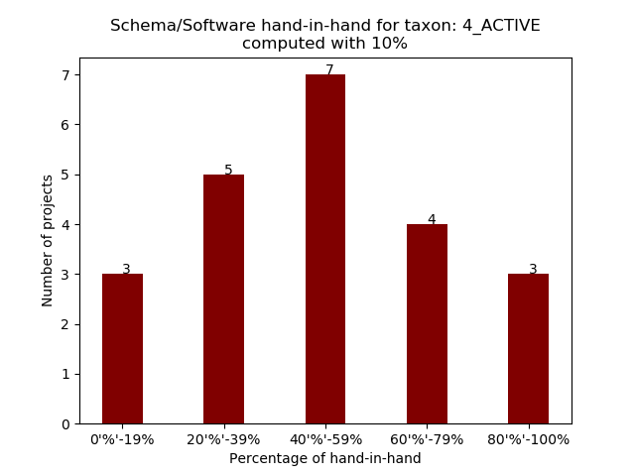
Research Question 1 - Results
(a) (b) (c)
(d) (e) (f)
“Hand-in-hand" co-evolution for ±10% range for the taxa: (a) FROZEN, (b) ALMOST FROZEN, (c) FocusedShot n FROZEN, (d) MODERATE, (e) FocudesShot n LOW, (f) ACTIVE

Slide 36
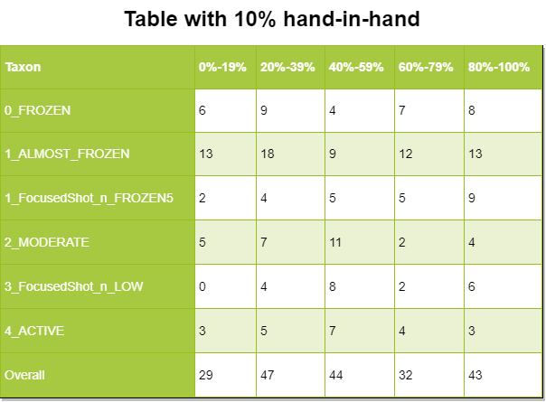
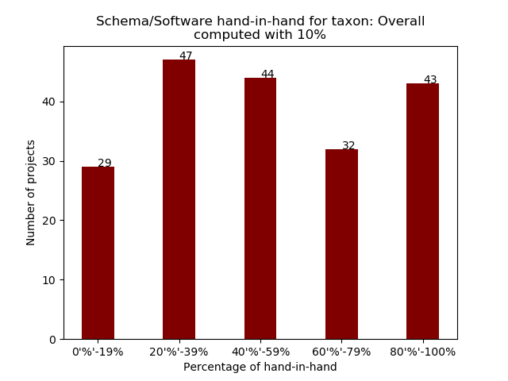
Research Question 1 - Results
For the ±10% window range
Slight move to the “right” (expected for the bigger window range).
We can observe that more than 1/5 of the projects are "hand-in-hand“ co-evolving almost completely.

Slide 37
Research Question 2
The second research question, is a result reported in the literature, the “80-20 rule”, suggesting that 80% of the schema changes are obtained in the first 20% of the projects’ life.
Is this rule applicable to a large number of projects?
Expand our research:
Four cases, when the schema activity reaches 50%, 75%, 80% and 100%.

Slide 38
Research Question 2
Algorithm: Computation of 80-20 rule, and more
for each taxon txn:
for each project prj:
time = [0, 0, 0, 0]; // for [50%, 75%, 80%, 100%]
for each month m in prjLife:
if (cumulSchActivity = 1.0):
time[3] = cumulPTime;
else if (cumulSchActivity ≥ 0.8):
time[2] = cumulPTime;
else if (cumulSchActivity ≥ 0.75):
time[1] = cumulPTime;
else if (cumulSchActivity ≥ 0.5):
time[0] = cumulPTime;
end if
end for
end for
end for
The algorithm tracks when the cumulative schema activity passed the barriers.
E.g. cumulSchActivity in month i was 35%
in month i+1 was 56% =>
prj life time that passed the 50% is the i+1 month.

Slide 39
Research Question 2
For each schema activity barrier, we computed the cumulative time it reached it.
For the project time, we also used 4 barriers.
These are 20% - 50% - 80% and 100%.
Bar charts with 4 groups.
Each group represent the schema activity.
In each group are 4 bars, one for each project activity.
The horizontal axis (x) refers to the percentage of schema activity measured.
The series refers to the range of project lifetime within which this activity was obtained.
The vertical axis (y) counts how many projects refer to this combination.

Slide 40
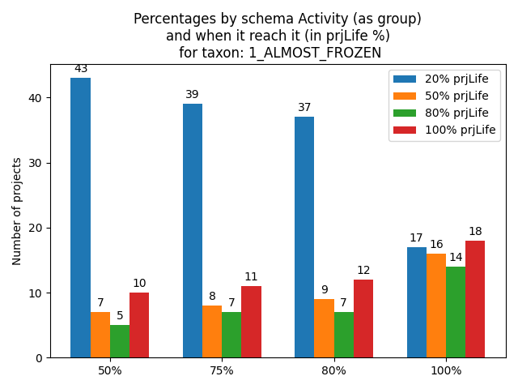
Research Question 2 - Results
For example, the x-axis value 80% (meaning that we measure when 80% of evolutionary activity was reached), we see that out of the 65 projects, 37 of them completed this 80% of activity within 20% of their project lifetime (the blue bar), 9 of them completed this 80% of activity between 21%-50% of their lifetime, 7 of them between 51% - 80% of their lifetime, and 12 of them between 81%-100% of their lifetime.

Slide 41
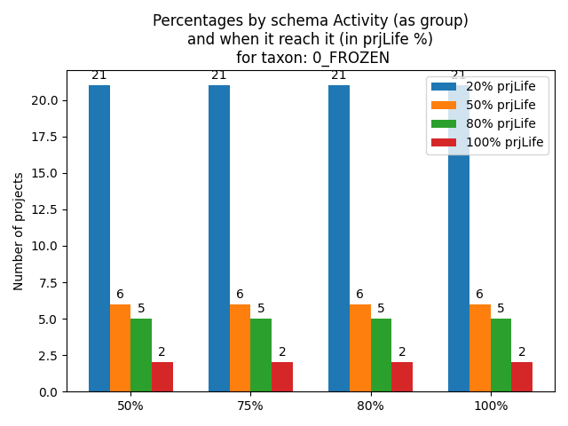
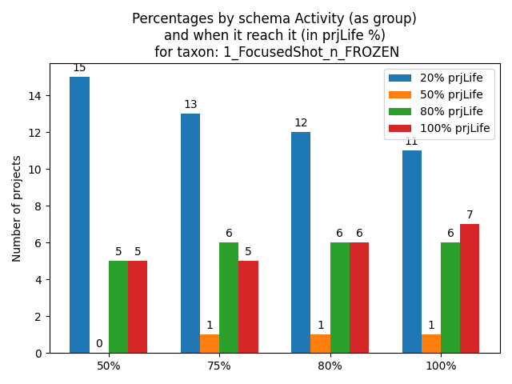
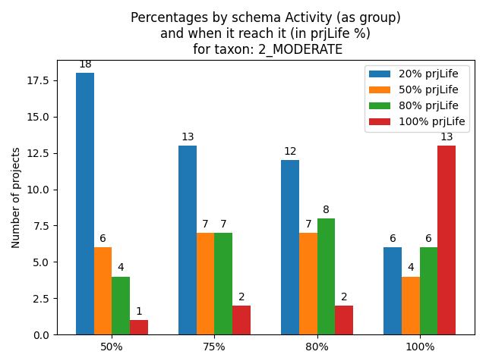
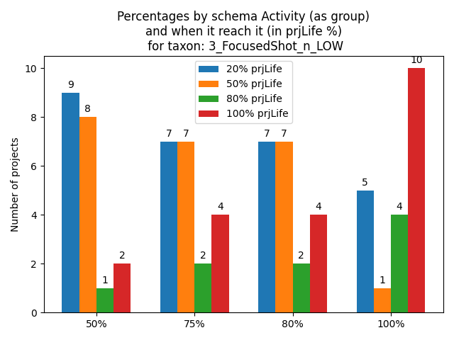
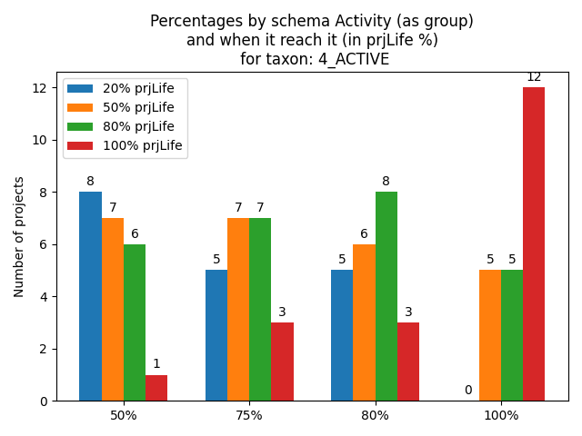
Research Question 2 - Results
(a) (b) (c)
(d) (e) (f)
When (in %) each project reached a specific schema activity for the taxa: (a) FROZEN, (b) ALMOST FROZEN, (c) FocusedShot n FROZEN, (d) MODERATE, (e) FocudesShot n LOW, (f) ACTIVE

Slide 42
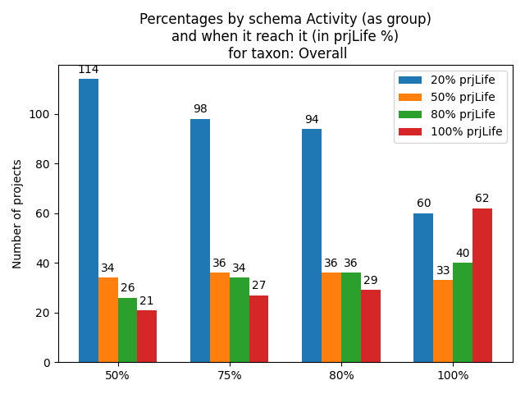
Research Question 2 - Results
It is important to understand that each group is computed separate from the other (all projects appear in every group).
For example, a project that in its 20% of life have a schema activity of 76%, is counted in both 50% and 75% groups in the same bar.
The sum of the projects in each group is equal to the number of projects in the taxon (all for the overall, shown in the image.
The 80-20 rule is represented by the blue bar (the first 20% of the project’s life) in the 80% group.

Slide 43
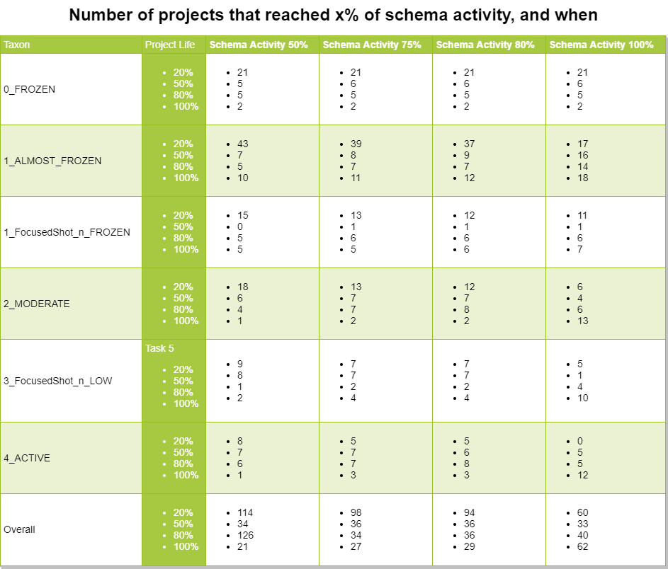
Research Question 2 - Results
We can observe that the 80-20 rule, applies to the overall of the projects, almost half of them.
We can also observe that this rule happens more often into the none so active projects.

Slide 44
Conclusions
The aim of this thesis was to study the schema and software co-evolution.
Large collection of projects.
Automate the process.
Manual investigation of 6 projects and answer 6 questions.
Creation of Evolution Chart Exporter.
Present and answer 2 research questions.

Slide 45
Conclusions
What: schema changes in logical level and change the accompanying code => keep src in sync and fix bugs.
Why: Insert new attributes or values to database (add extra features).
When: Uniformly spread in relation to the project’s life.
Where: ORM files or in specific packets handling the data.
How: Update datatypes, create table, add attributes and insert values.
Who: Projects with more active schema evolution, tend to have most of the commits made to the project concentrated to one person.

Slide 46
Conclusions
Research Question 1: What percentage of the projects demonstrates a "hand-in-hand" co-evolution?
The less active, smaller percentage of "hand-in-hand" co-evolution.
The most active taxa, tend to have an average percentage of "hand-in-hand" co-evolution.
More than 1/5 of the projects are "hand-in-hand“ co-evolving almost completely.
Research Question 2: What percentage of projects demonstrates the 80-20 rule reported in the literature.
The 80-20 rule, applies to the overall of the projects, almost half of them.
This rule happens more often into the none so active projects.

Slide 47
Future Work
Define in a different (better) way the source code activity and extract the actual software changes.
Deeply investigation of the schema activity, can possibly give better taxa, and as a result of these a better understanding of the schema and software co-evolution.
Add new features and metrics to the EvolutionChartExporter.

Slide 48
Thank you for your attention!!!

