Slide 1
TheBPlace
The All-in-one platform

Slide 2
What if?
What if the digital world wasn’t divided? What if Amazon,AliBaba, LinkedIn, Fiverr and Booking had one child — Welcome to TheBPlace ,The everything-economy platform.

Slide 3
The Problem – “Fragmentation is Killing the bussinesses”
Need a product? That’s one platform. Need a service? Different site. Looking to hire? Another login. Looking for a job? Somewhere else entirely. Want to book a local pro? Better download five more apps.

Slide 4
The Solution – “One Platform. No more webapps needed.”
A digital supercontinent — where services, manufacturing, and job markets live under one sun. Where a baker sells cakes, a factory sells parts, a designer sells logos, and a business hires all three. Where a job seeker finds work, a tourist books a mechanic, and a construction company finds workers and a supplier in one move

Slide 5
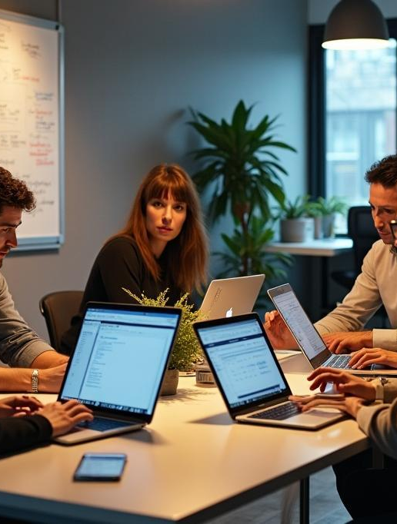
The Vision – “World economy in one place”
TheBPlace is not a website. It’s not an app. It’s a borderless digital nation. A place where any human — with skills, products, or ideas — can launch, scale, hire, book, or sell, globally or locally, in one account. A digital city with infinite skyscrapers built by its users. It is the future infrastructure for entrepreneurship.

Slide 6
The Market – “$12 Trillion. And Growing.”
E-commerce: $6T+ Freelance & gig: $1.5T Online hiring: $500B B2B Manufacturing: $4T+ Service Booking: $800B

Slide 7
How we generate revenue?
-Business Subscriptions (Pro Tools, Hiring, Promotion)
-Transaction Fees + Premium Ads
-Data

Slide 8
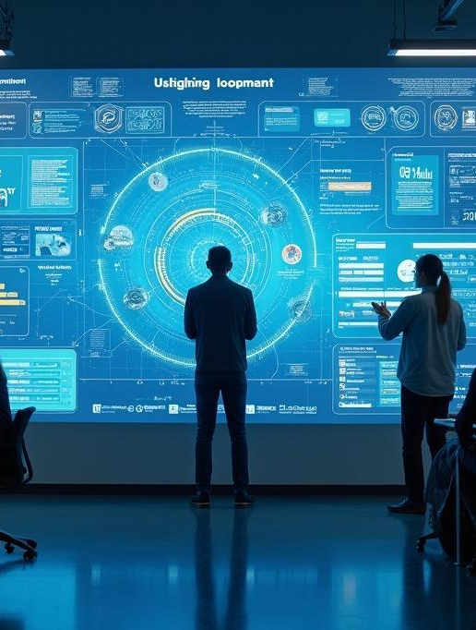
The Product – “Built to Move Fast”
Unlike standalone platforms, TheBPlace provides a holistic ecosystem that integrates diverse functionalities. Whereas users typically face the hassle of managing multiple subscriptions and accounts, TheBPlace’s unified approach offers streamlined workflows and a singular user experience. Lower transaction fees and a built-in job board enhance the overall value proposition, making TheBPlace the choice for savvy users looking to maximize their impact and reach.

Slide 9
We’re raising 500,000$ to:
- Launch the beta with our headquarters based in Texas. - Fuel our AI-driven matching engine - Scale across industries fast - Onboard 10,000+ businesses in 6 months - Dominate underserved markets globally
fatlumsyla17@gmail.com

