Slide 1
Object Oriented Programming
</
/>
Tasneem bahaa

Slide 2
</OOP concept
Classes
Objects
Encapsulation
Inheritance
Polymorphism
Abstraction
Association
Composition
aggregation

Slide 3
</ Agenda
Data types
classes
objects
Access modifier vs non-access modifier
Object class
constructors

Slide 4
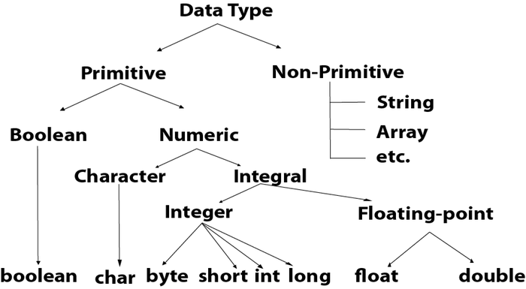
Data types

Slide 5
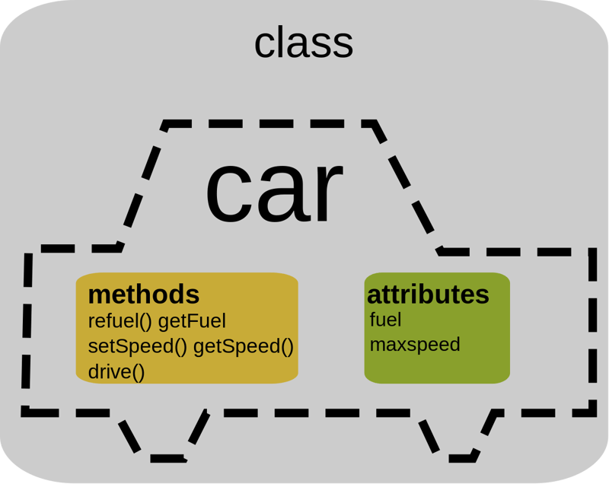
</Classes
A class is a user-defined data type. It consists of data members and member functions, which can be accessed and used by creating an instance of that class. It represents the set of properties or methods that are common to all objects of one type. A class is like a blueprint for an object.

Slide 6
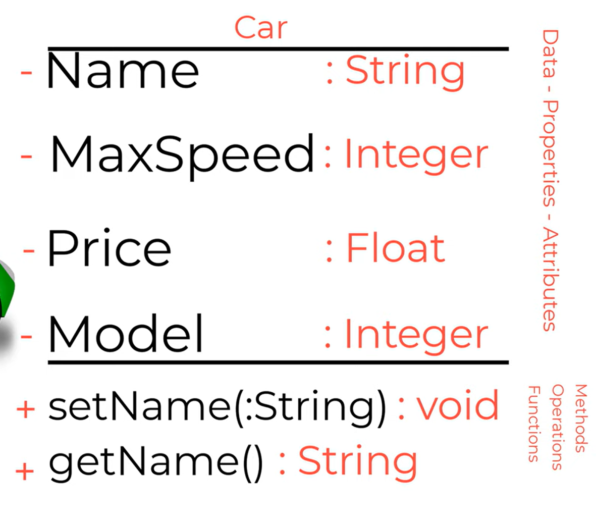
Class diagram

Slide 7
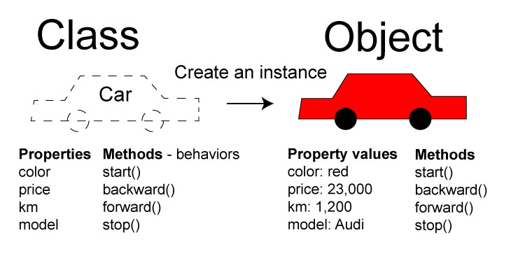
</Objects
It is a basic unit of Object-Oriented Programming and represents the real-life entities. An Object is an instance of a Class.

Slide 8
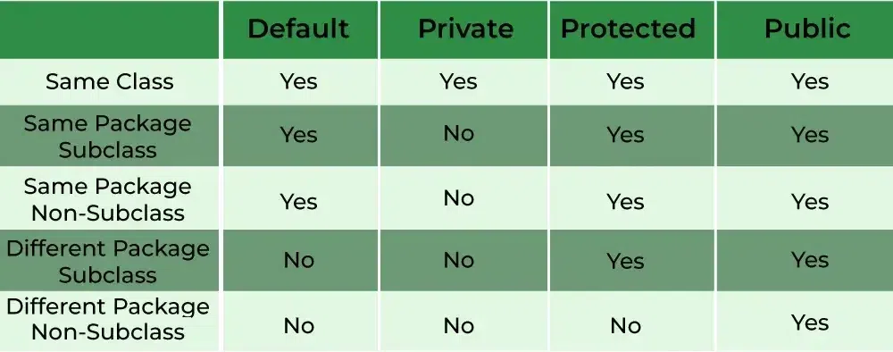
</Access modifier

Slide 9
Public
default
Classes ?
Public
Default
Protected
private
attributes, methods and constructors ?

Slide 10
</Non-Access modifier
static
final
abstract
synchronized
transient
Volatile (variable)
native

Slide 11
final
abstract
Classes ?
attributes, methods and constructors ?
Final
Static
Abstract
Volatile
Synchronized
transient

Slide 12
</Object class
Object class is present in java.lang package. Every class in Java is directly or indirectly derived from the Object class. If a class does not extend any other class then it is a direct child class of Object and if extends another class then it is indirectly derived. Therefore the Object class methods are available to all Java classes. Hence Object class acts as a root of the inheritance hierarchy in any Java Program.

Slide 13
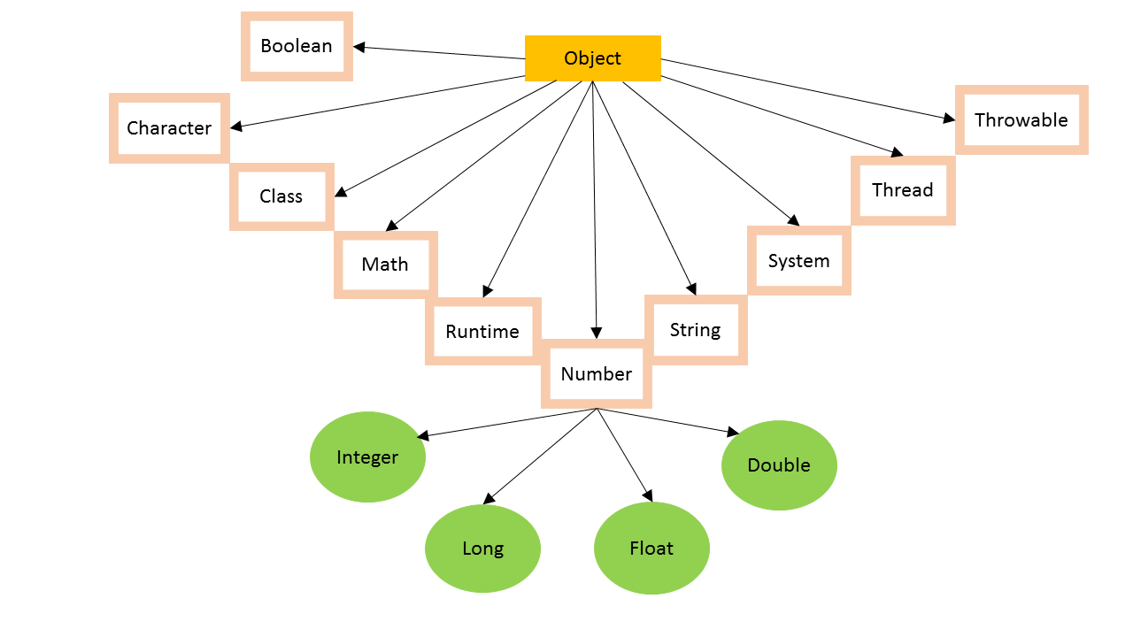

Slide 14
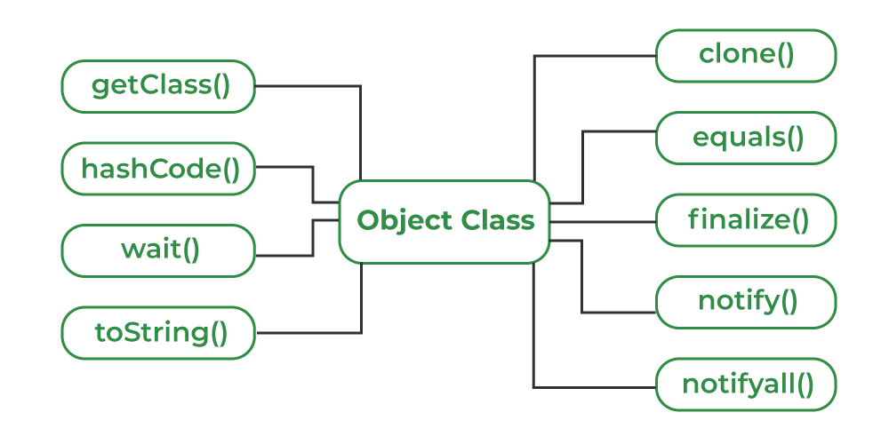

Slide 15
</Constructor
In Java, a Constructor is a block of codes similar to the method. It is called when an instance of the class is created. At the time of calling the constructor, memory for the object is allocated in the memory. It is a special type of method that is used to initialize the object.
Constructors must have the same name as the class within which it is defined it is not necessary for the method in Java.
Constructors do not return any type while method(s) have the return type or void if does not return any value.
Constructors are called only once at the time of Object creation while method(s) can be called any number of times.

Slide 16
Types of Constructors in Java
1 - Default Constructor
If you define any constructor explicitly (e.g., a no-argument constructor or a parameterized constructor), the compiler does not create a default constructor.
The default constructor initializes the object but does not perform any custom initialization.
2 - Private Constructor
A constructor declared as private.
Purpose: Used to restrict object creation from outside the class, often in singleton design patterns.

Slide 17
Types of Constructors in Java
3 - Copy Constructor
A constructor that creates a new object by copying the values of an existing object.
Used to duplicate an object.

Slide 18
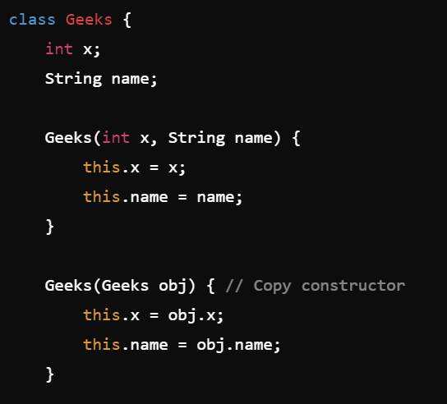
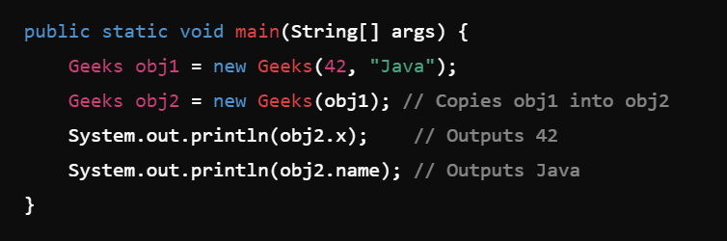

Slide 19
Types of Constructors in Java
4 - Parameterized Constructor
Definition: A constructor that takes arguments to initialize an object with specific values.
Purpose: Allows custom initialization of object fields during object creation.

Slide 20
Thank you !
</
/>
Any Questions?

