Slide 1
E Wallet

Slide 2
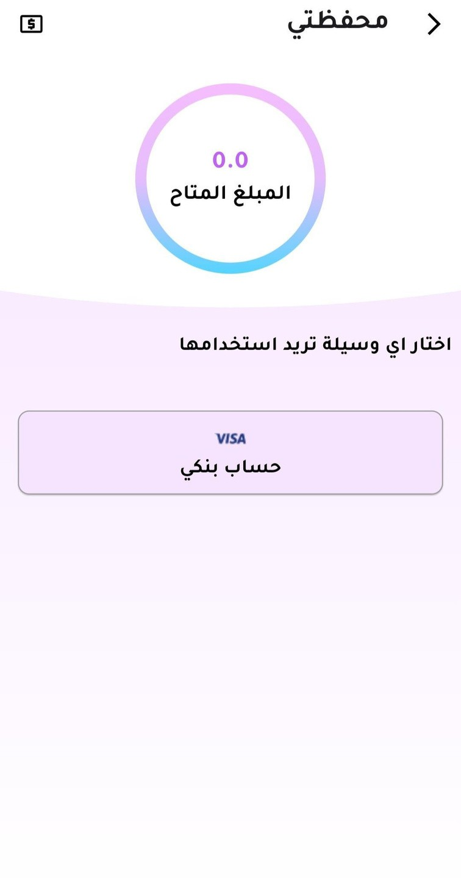
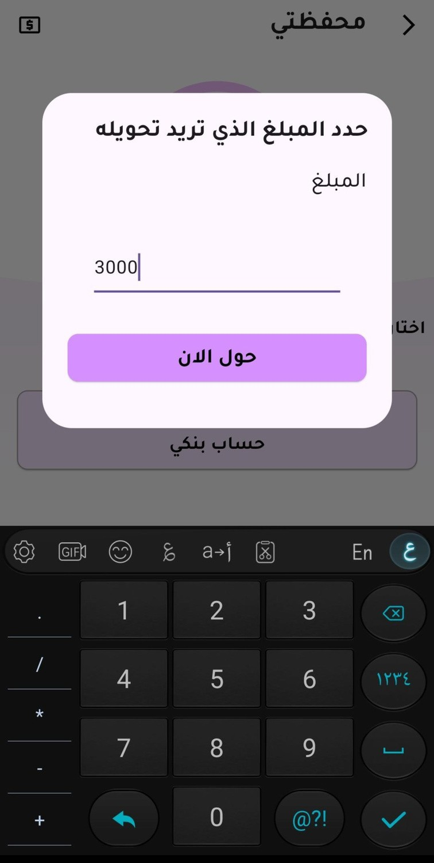
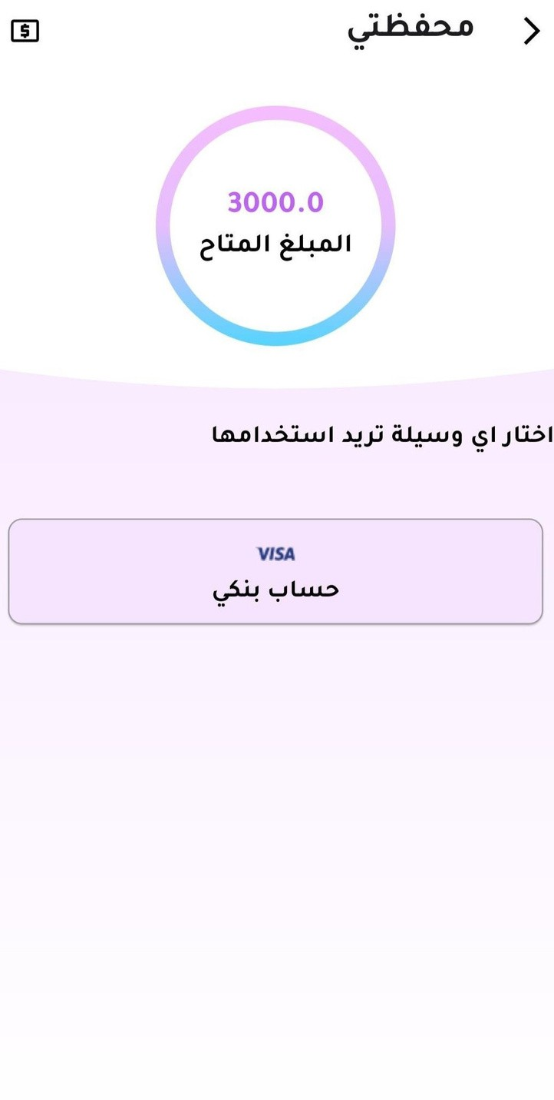
Introduction
This code snippet showcases a core component of a mobile wallet application developed using the Flutter framework. The application caters to Arabic users.
Key Functionalities
Balance Display: The code retrieves the user's current wallet balance from a Firestore collection and displays it within a circular container with a gradient background.
Add Money Functionality: This dialog allows the user to enter a transfer amount of money. Upon confirmation, the entered amount is stored in the Firestore collection with a document ID representing the month (YYYY-MM format).

Slide 3
Code Breakdown
1. WalletScreen Class:
A StatefulWidget class managing the application state for various elements like the user's entered amount.
Builds the user interface (body) of the wallet screen.
2. _derirmMonneyPopup Function:
This function presents a popup dialog using showDialog.
The dialog displays a title asking the user to specify the transferred money and performs some actions :
Stores the entered amount of money in the Firestore collection.
Navigates back to the WalletScreen.
3. UserHistoryPage Class:
(Not relevant to core functionality in this snippet)
A class representing a future screen for displaying user transaction history (not implemented in this code snippet).

