Slide 1
Offline Signature Verification with Convolutional Neural Networks

Slide 2
1.
What is a CNN?

Slide 3
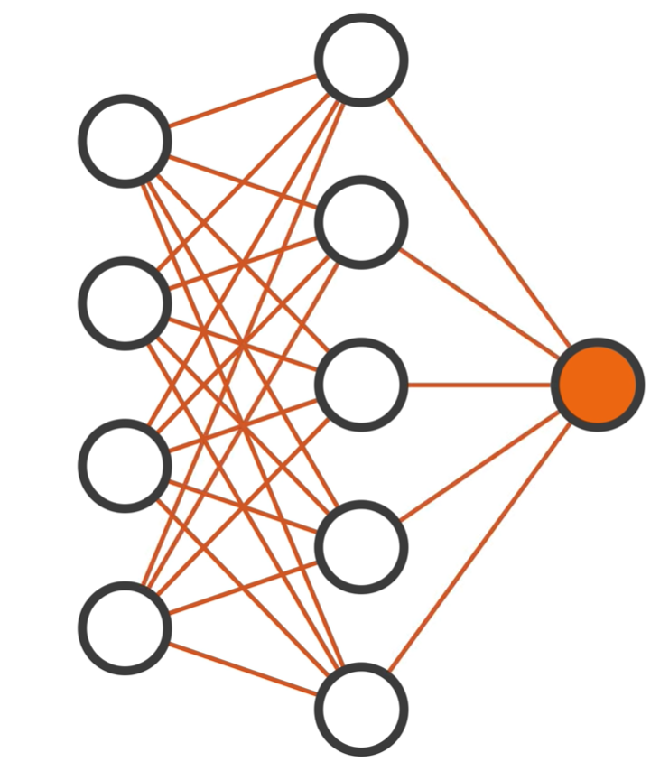
Input
Layer
Output
Layer
Hidden
Layer

Slide 4
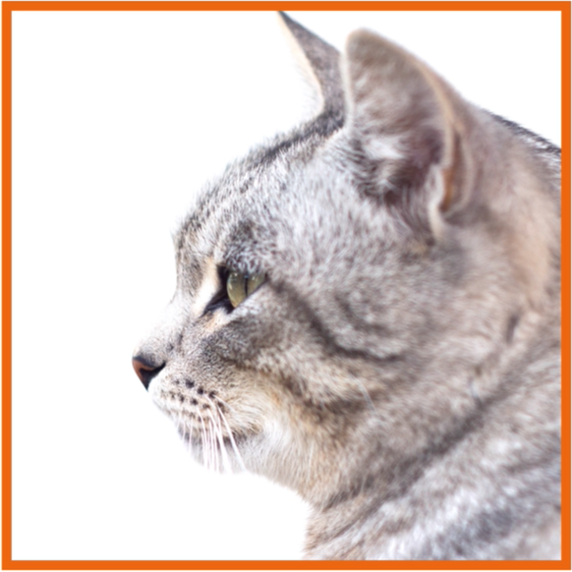
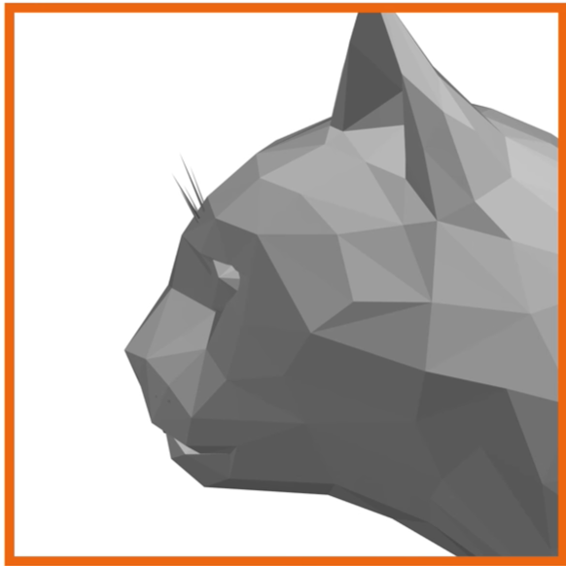
Filtering

Slide 5
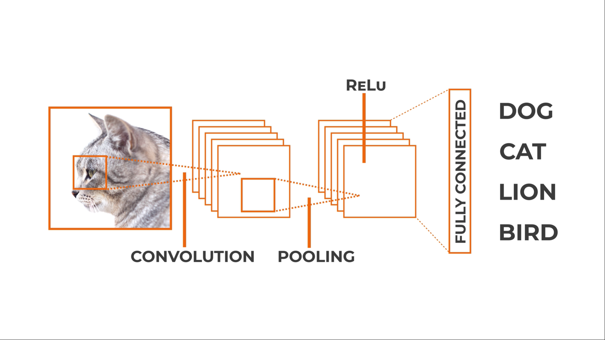
CNN Architecture

Slide 6
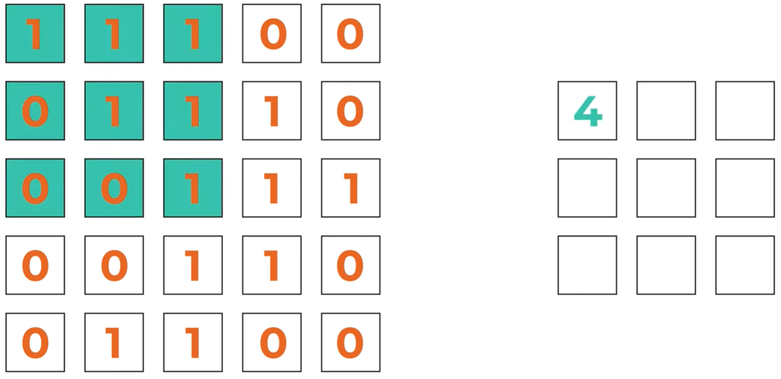
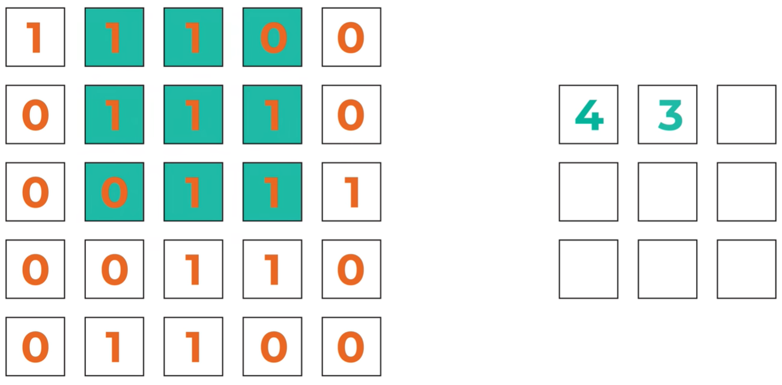
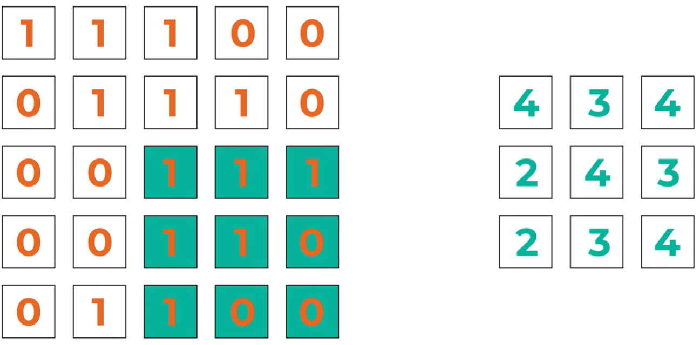
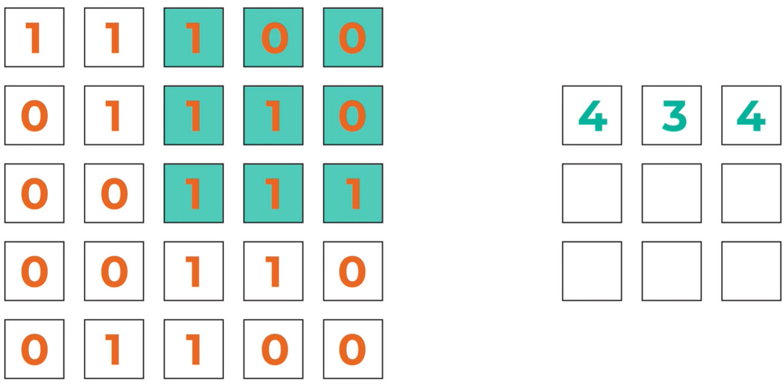
Convolution layer
Notes:
Filters

Slide 7
Convolution layer
Convolving
Filters
Padding
Stride
Flattening

Slide 8
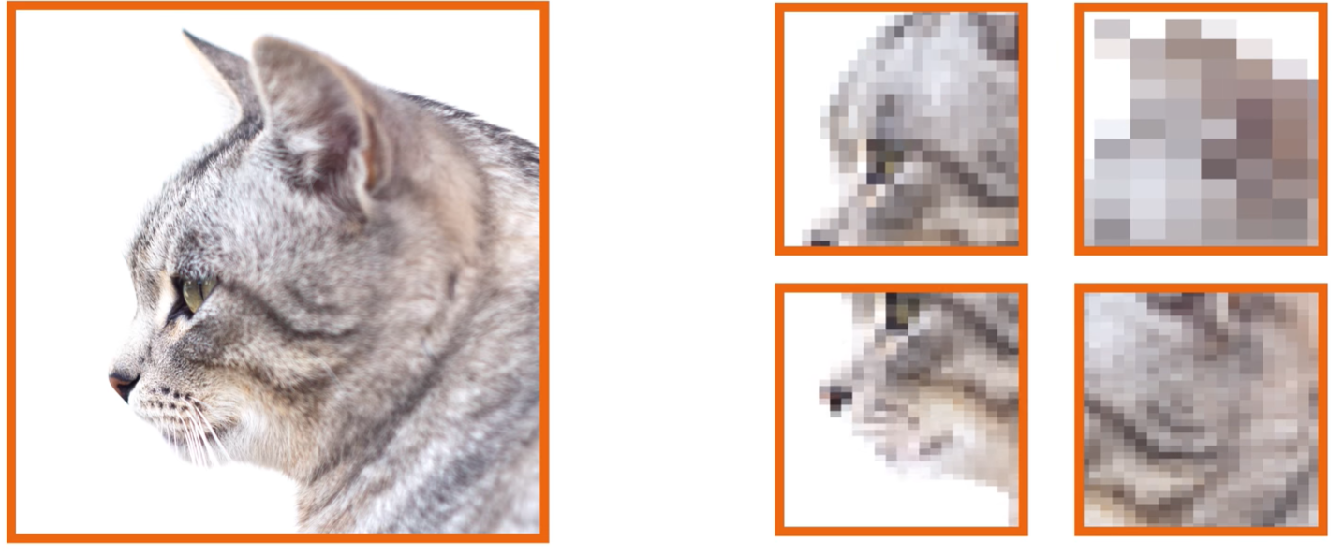
Pooling layer
Max pooling, average pooling…
Notes:
Reducing parameters, speeding up calculations ➔ feature extraction

Slide 9
Fully connected layer
Classification
Linear data
Flattening

Slide 10
2.
Alvarez 2016

Slide 11
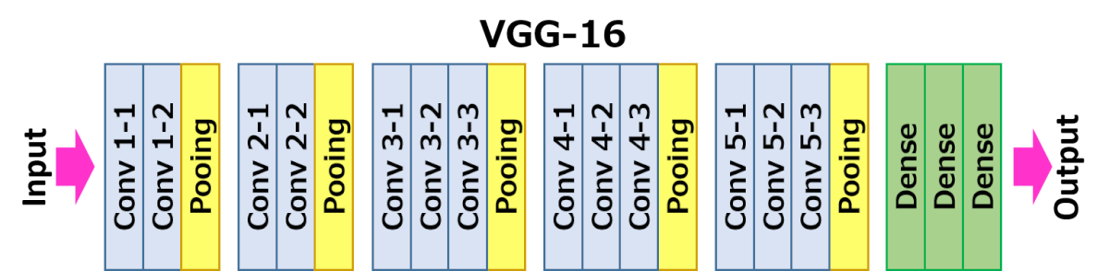
VGG 16 Architecture
Notes:
There are 13 convolutional layers, 5 Max Pooling layers and 3 Dense layers which sums up to 21 layers but only 16 weight layers.
Conv 1 has number of filters as 64 while Conv 2 has 128 filters, Conv 3 has 256 filters while Conv 4 and Conv 5 has 512 filters.

Slide 12
Loss function, transfer learning
Notes:
There are 13 convolutional layers, 5 Max Pooling layers and 3 Dense layers which sums up to 21 layers but only 16 weight layers.
Conv 1 has number of filters as 64 while Conv 2 has 128 filters, Conv 3 has 256 filters while Conv 4 and Conv 5 has 512 filters.

Slide 13
3.
Haffeman 2018

Slide 15
4.
Tekerek 2019
Presented By KACHOURI Maraoune

Slide 17
THANKS!
😉

