Slide 1
THE QUESTION
Can I predict heart disease?
Using clinical measurements to identify patterns in 918 patient records.
From patient data to a prediction
A machine learning project by Fatma Çakir
FATMA ÇAKIR • HEART DISEASE PREDICTION
01
Notes:
~18 seconds. Hello, I am Fatma Çakir. I built a machine learning project to predict the recorded presence of heart disease based on routine clinical measurements. I will focus on what the model learned and what the results tell us.

Slide 2
WHY THIS MATTERS
The goal: identify patients at higher risk
The model predicts the dataset’s HeartDisease label, not a medical diagnosis.
INPUT
PREDICTION
11 clinical indicators
Age • chest pain • cholesterol
Heart rate • ECG • exercise symptoms
HeartDisease = 0 or 1
A binary classification task
Useful for exploring screening patterns
FATMA ÇAKIR • HEART DISEASE PREDICTION
02
Notes:
~25 seconds. The question was whether 11 measurements could help us predict a binary heart disease label. These include age, cholesterol, blood pressure, chest pain type, ECG and exercise-related variables. This is classification, because we predict one of two categories.

Slide 3
THE DATASET
918 records. Two outcome groups.
I used the Kaggle Heart Failure Prediction dataset suggested by my teacher.
918
508
410
Patient records
Labeled with heart disease
Labeled without heart disease
The two groups are reasonably represented, but this is still a limited dataset.
FATMA ÇAKIR • HEART DISEASE PREDICTION
03
Notes:
~24 seconds. The data contains 918 records: 508 with the heart disease label and 410 without it. This provides examples for both classes, although the dataset is not large enough to assume clinical generalizability.

Slide 4
DATA QUALITY
Some measurements were not realistic
I treated these unrealistic zero values as missing measurements.
172
1
Cholesterol values recorded as zero
Resting blood pressure value recorded as zero
I imputed missing values and encoded categories inside the training pipeline.
FATMA ÇAKIR • HEART DISEASE PREDICTION
04
Notes:
~26 seconds. A key challenge was data quality. I found 172 zero cholesterol measurements and one zero resting blood pressure measurement. I treated these as missing values and applied imputation inside the model pipeline, helping avoid leakage into the held-out test data. I also encoded categorical variables.

Slide 5
MODEL EXPERIMENT
A simple model was already competitive
Five-fold cross-validation results on training data.
Baseline
55.3%
Logistic Regression
85.7%
Random Forest
85.3%
Logistic Regression had slightly higher initial accuracy; Random Forest offered flexibility for tuning.
FATMA ÇAKIR • HEART DISEASE PREDICTION
05
Notes:
~28 seconds. I compared a majority-class baseline, Logistic Regression and Random Forest using five-fold cross-validation. The baseline accuracy was about 55%. Logistic Regression achieved 85.7%, and Random Forest 85.3%. This showed that both learned meaningful signals compared with simply predicting the majority class.

Slide 6
WHY TUNE THE MODEL?
Could Random Forest do better?
GridSearchCV tested settings such as tree depth and number of trees.
5-fold CV
0.933
Repeated validation on training data to compare settings.
Best cross-validation ROC-AUC for tuned Random Forest.
FATMA ÇAKIR • HEART DISEASE PREDICTION
06
Notes:
~25 seconds. I used GridSearchCV to tune the Random Forest. It tried combinations of tree depth, number of trees and other settings, using five-fold validation. The best cross-validation ROC-AUC was approximately 0.933. The final test set remained separate until evaluation.

Slide 7
MAIN FINDING
The tuned model found 94% of positive cases
Results on 184 held-out records — data not used for training.
89.1%
94.1%
0.938
Accuracy
Recall
ROC-AUC
Recall matters here: it measures how many truly positive cases the model identifies.
FATMA ÇAKIR • HEART DISEASE PREDICTION
07
Notes:
~30 seconds. On the held-out test set the tuned Random Forest achieved 89.1% accuracy, 94.1% recall and a ROC-AUC of 0.938. Recall is especially important in this context because missing positive cases could have serious implications. These numbers are encouraging for a classroom project, not evidence of diagnostic readiness.

Slide 8
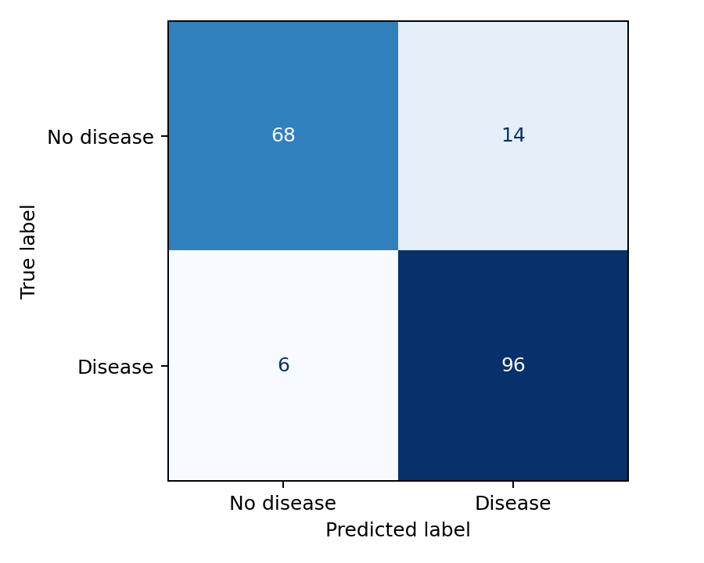
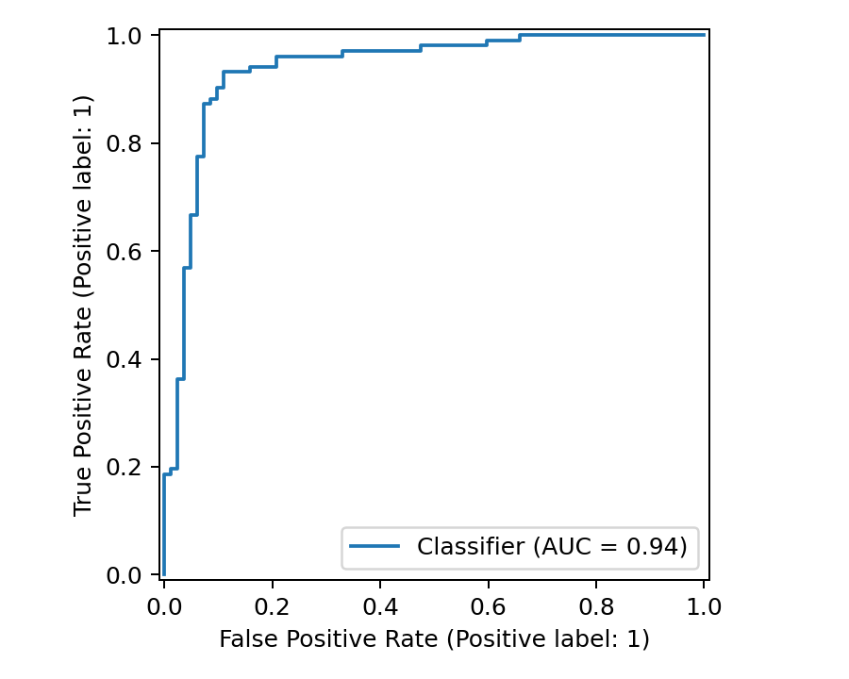
BEYOND ACCURACY
Where did my model make mistakes?
Confusion matrix and ROC curve show what one accuracy number cannot.
Mistakes still occur; evaluating false negatives is essential.
FATMA ÇAKIR • HEART DISEASE PREDICTION
08
Notes:
~29 seconds. Here the confusion matrix reveals both correct predictions and errors. The ROC curve shows how well the model separates the two groups across different decision thresholds. Even with high recall, the model can still miss positive patients. That makes error analysis crucial.

Slide 9
THE MEANING
Promising patterns ≠ clinical readiness
A strong score on one dataset is not enough to support medical decisions.
WHAT I FOUND
WHAT IS STILL NEEDED
Clinical variables contain predictive signal.
Tuning improved the selected model.
External validation
Fairness checks
Calibration and clinician review
FATMA ÇAKIR • HEART DISEASE PREDICTION
09
Notes:
~27 seconds. The model learned meaningful patterns, but performance on one dataset does not automatically transfer to patients in real hospitals. I would need external validation, fairness checks, probability calibration and medical oversight before considering any real-world use.

Slide 10
THANK YOU
What I take away
Machine learning can reveal useful patterns — but context and evaluation matter.
89.1% accuracy • 94.1% recall
A strong classroom result, with important limitations
Fatma Çakir · Questions?
FATMA ÇAKIR • HEART DISEASE PREDICTION
10
Notes:
~18 seconds. In conclusion, the tuned Random Forest performed strongly on this dataset, especially for recall. My main lesson is that machine learning is not just about optimizing scores; it is also about understanding the data, model errors and limitations. Thank you.

