Slide 1
MSc THESIS DEFENSE
Fine-Tuned Encoders or Prompted LLMs for Requirements Classification? The Verdict Inverts Under Distribution Shift
Fine-tuned encoders
Fatma El-Zahraa Samir · Khaled T. Wassif · Lamia AbouZeid — Faculty of Computers and Artificial Intelligence, Cairo University, Giza, Egypt
MSc thesis committee presentation — September 2026
Prompted LLMs

Slide 2
How the argument is built
1
2
3
4
5
6
7
The gap
Three RQs
Design
RQ1 in-domain
RQ2 shift
Mechanism
RQ3 and limits
'Solved' rests on in-distribution evaluation; cost unmeasured; corpora reused
In-domain (RQ1), distribution shift (RQ2), accuracy vs cost (RQ3)
12 configurations, 1,412 requirements, 3 tasks, 3 regimes, one strict scorer
Encoders win 67 of 106 paired tests, lose none
Cross-dataset: prompted models win 48 of 64; class-weighted BERT loses 42.8%
One uncalibrated class prior, three sources
Cost frontier, decision rule, threats to validity, conclusion
Same corpora, same items, same scorer — two evaluation protocols, opposite rankings.
Fine-tuned encoders or prompted LLMs? · The verdict inverts under distribution shift
2

Slide 3
The task, and the field's headline: 'essentially solved'
1
Assign requirement statements to categories: functional (FR) vs non-functional (NFR); security-relevant vs not
4
2
Right: early risk identification and architectural choice; wrong: rework propagating downstream
waves of automation since 2007
3
Four waves: indicator terms (2007) → engineered features → fine-tuned transformers (NoRBERT) → prompted LLMs (2024)
high 80s – mid 90s
4
Headline: encoders, commercial LLMs, well-prompted small open models all report high-80s to mid-90s
reported macro-F1 / accuracy
5
Several studies conclude prompting can replace supervision outright (Binkhonain & Alfayaz 2025; Tang et al. 2025)
2024
prompted generative LLMs take over
This thesis asks whether that headline survives when the evaluation convention behind it is changed.
Fine-tuned encoders or prompted LLMs? · The verdict inverts under distribution shift
3

Slide 4
The evaluation gap: what the field does not measure
1
Almost every result is in-distribution: tuned or exemplars selected on the corpus it is scored on
2
'Generalisability' in prior work means transfer across tasks on the same corpora — not unseen projects
3
NoRBERT itself was motivated by classifiers over-fitting project-specific wording — a fragility then left unmeasured
4
Only the app-review study tests different text: markedly lower precision, an unexplained signal never followed up
5
Cost, latency and model size seldom quantified — yet they decide adoptability without an API budget
6
Same two or three small, ageing public corpora everywhere — contamination acknowledged, never addressed
In-distribution parity is exactly what contamination and corpus reuse would produce spuriously — the settling comparison had not been run.
Fine-tuned encoders or prompted LLMs? · The verdict inverts under distribution shift
4

Slide 5
Evaluation coverage of recent LLM studies (2024–2026)
Study | Open LLMs | Comm. LLMs | Cross-project | Cross-dataset | Cost
El-Hajjami et al. 2024 | ✗ | ✓ | ✗ | ✗ | ✗
Peer et al. 2024 | ✗ | ✓ | ✗ | ✗ | ~
Binkhonain & Alfayaz 2025 | ✓ | ✓ | ✗ | ✗ | ✗
Alhoshan et al. 2025 | ✓ | ✗ | ✗ | ✗ | ✗
Tang et al. 2025 | ✓ | ✓ | ✗ | ✗ | ✗
Chaudhary et al. 2025 | ✗ | ✓ | ✗ | ~ | ✗
Vasudevan et al. 2026 | ✗ | ✓ | ✗ | ✗ | ✗
Levy et al. 2026 | ✓ | ✓ | ✗ | ✗ | ✗
This paper | ✓ | ✓ | ✓ | ✓ | ✓
'Cross-project' = held-out unseen projects; 'cross-dataset' = an independently produced corpus; ~ = partially reported
No prior study reports cross-project or cross-dataset transfer together with cost; this paper reports all five axes.
Fine-tuned encoders or prompted LLMs? · The verdict inverts under distribution shift
5

Slide 6
Three research questions
1
RQ1 — How do open and commercial LLMs compare with fine-tuned encoders in-domain?
3
2
RQ2 — How much is lost cross-project and cross-dataset, and does the loss differ by model class?
research questions
3
RQ3 — What is the accuracy-versus-cost trade-off, and the cheapest freely available option that is good enough?
1
4
Design principle: hold corpus, items, label sets and scoring rule fixed
independent variable: distribution shift
5
Vary only the distribution shift between what a model is tuned on and scored on
RQ1 reproduces the field's convention; RQ2 repairs the first omission (shift); RQ3 repairs the second (cost).
Fine-tuned encoders or prompted LLMs? · The verdict inverts under distribution shift
6

Slide 7
Four contributions
1
1. Paired, multiplicity-controlled benchmark: 12 configurations, 3 tasks, 2 corpora, 3 regimes; 76,115 predictions; 260 McNemar tests
2
2. The inversion: 67 wins / 39 ties / 0 losses in-domain → 3 / 13 / 48 cross-dataset; best encoder −42.8%
3
3. Mechanism: base-rate shift, not lexical novelty — precision collapses, recall holds; prompted models share it (ρ = 0.95)
4
4. Accuracy–cost frontier: $0.0024 vs $0.0216–$0.1132 per 1,000; training repaid within 46–552 items, all 276 pairings
The ranking a benchmark reports is a property of the regime it evaluates, not of the models.
Fine-tuned encoders or prompted LLMs? · The verdict inverts under distribution shift
7

Slide 8
Part I — Study design
One data spine, two model arms, one strict scoring spine — and a regime axis only the encoders traverse
Fine-tuned encoders or prompted LLMs? · The verdict inverts under distribution shift
8

Slide 9
Experimental architecture
PROMISE_exp
969 → 968
47 projects
Encoder arm
BERT, RoBERTa ± weighting
re-fitted per regime
Unified corpus
1,412 requirements
50 project groups
67 duplicates dropped
Frozen splits
14 families, 107 folds
seed 42
SHA-256-pinned ids
Strict scoring
identical test items
unparseable = wrong
76,115 predictions
gate: 81 of 87 cells
Analysis
macro-F1 + bootstrap CI
260 paired McNemar
Holm & BH, α = 0.05
cost, N* = C0 / Δc
SecReq
510 → 444
3 specifications
Prompted arm
8 LLMs, 3 tiers
zero- and few-shot, never fitted
increasing distribution shift →
REGIME
in-domain
stratified 5-fold, one corpus
cross-project
unseen project groups + LOPO
cross-dataset
train PROMISE_exp ↔ test SecReq
Data spine: PROMISE_exp 969→968 (47 projects) + SecReq 510→444 (3 specifications) → 1,412 requirements, 50 groups
Frozen splits: 14 families, 107 folds, seed 42, SHA-256-pinned ids
The band beneath the figure — in-domain → cross-project → cross-dataset — is the study's independent variable.
Fine-tuned encoders or prompted LLMs? · The verdict inverts under distribution shift
9

Slide 10
Corpus: 1,412 requirements with a three-fold base-rate contrast
Corpus | Raw | Final | Groups | FR / NFR | Security prevalence
PROMISE_exp (Lima et al. 2019) | 969 | 968 | 47 | 444 / 524 | 12.9%
SecReq (Knauss et al. 2011) | 510 | 444 | 3 | — | 39.9%
Unified | 1,479 | 1,412 | 50 | 444 / 524 | 21.4%
Texts normalised, exact duplicates removed — 67 rows, none shared between corpora; SecReq = three industrial security specifications · Splits generated once (seed 42), ids pinned to each source file's SHA-256; consumed, never regenerated
Security is 12.9% of PROMISE_exp but 39.9% of SecReq — that contrast, not vocabulary, drives the main result.
Fine-tuned encoders or prompted LLMs? · The verdict inverts under distribution shift
10

Slide 11
Three task families over one unified corpus
1
Binary FR/NFR — native PROMISE_exp labels (444 FR / 524 NFR)
524
2
Binary security — native in SecReq, derived from PROMISE_exp's SE sub-class: same task, two independent corpora
items, all-11 sub-types
3
NFR sub-types — eleven-class Cleland-Huang taxonomy, aligned with ISO/IEC 25010 quality characteristics
433
4
Several tail classes have single-digit support → reduced top-6 and top-4 variants also evaluated
items, top-6
5
Macro-F1 always over the full declared label set: penalised for every class never predicted
353
items, top-4
Security is the one task both corpora annotate — which is why cross-dataset transfer is measured on it alone.
Fine-tuned encoders or prompted LLMs? · The verdict inverts under distribution shift
11

Slide 12
Three evaluation regimes of increasing distribution shift
1
2
3
4
Frozen splits
In-domain
Cross-project
Cross-dataset
14 split families, 107 folds, seed 42; ids pinned to SHA-256 of each source file; stored once, never regenerated
Stratified 5-fold cross-validation within one corpus — the in-distribution reference arm prior work reports
Grouped folds holding out entire unseen project groups + leave-one-project-out over the 47 PROMISE_exp projects
Train the security task on one corpus, test on the other (PROMISE_exp ↔ SecReq): identical labels, different annotation provenance
Same items, same labels, same scorer at every station — only the training distribution moves.
Fine-tuned encoders or prompted LLMs? · The verdict inverts under distribution shift
12

Slide 13
Two model arms, paired on identical items
Encoder arm — consumes training folds
Prompted arm — consumes only test items
Re-trained at every station on that station's training folds
No training distribution → scores regime-invariant by construction: a fixed reference line
Every requirement is a test item exactly once per encoder family — predictions cover the whole corpus
Stratified samples of the same corpus: 300 items per binary cell, 200 per sub-type cell
Allocated in proportion to class prior, floor of ten per class; six local models also answer full frames
BERT and RoBERTa, with and without inverse-frequency class weighting
Their drop across regimes is the measured quantity
8 LLMs in 3 tiers; zero- and few-shot
Every encoder–LLM comparison is paired on identical requirements, aligned by requirement identifier — never by position.
Fine-tuned encoders or prompted LLMs? · The verdict inverts under distribution shift
13

Slide 14
The twelve configurations
Configuration | Checkpoint / endpoint | Params (B) | Access
BERT (w / u) | bert-base-uncased | 0.11 | fine-tuned
RoBERTa (w / u) | roberta-base | 0.13 | fine-tuned
Gemma-2-2B | gemma-2-2b-it | 2.61 | local, 4-bit
SmolLM3-3B | SmolLM3-3B | 3.08 | local, 4-bit
Qwen2.5-3B | Qwen2.5-3B-Instruct | 3.09 | local, 4-bit
Phi-4-mini | Phi-4-mini-instruct | 3.84 | local, 4-bit
Qwen2.5-7B | Qwen2.5-7B-Instruct | 7.62 | local, 4-bit
Llama-3.1-8B | Llama-3.1-8B-Instruct | 8.03 | local, 4-bit
Llama-3.3-70B | llama-3.3-70b-versatile | 70.6 | hosted
Gemini 3.1 Flash-Lite | gemini-3.1-flash-lite | n/a | commercial
Local tier: six instruction-tuned models, 2.6–8.0 B, one free-tier NVIDIA T4, 4-bit NF4; hosted and commercial via free API tiers · A ninth prompted model failed the reportability gate — kept in the raw store, enters no table; Gemini's size undisclosed, recorded as unknown
4 fine-tuned encoder variants + 8 prompted LLMs (6 local, 1 hosted, 1 commercial) = 12 configurations.
Fine-tuned encoders or prompted LLMs? · The verdict inverts under distribution shift
14

Slide 15
Encoder arm: fine-tuning setup
1
bert-base-uncased and roberta-base with a classification head
0.11 B / 0.13 B
2
AdamW, learning rate 2×10⁻⁵, batch 16, max length 128, linear decay without warmup, full precision
parameters, BERT / RoBERTa
3
3 epochs on the binary tasks, 10 on the sub-types
4
'w' = inverse-frequency (balanced) class weighting in the loss; 'u' = unweighted control on the security task
≈277 GPU-seconds
Re-fitted per regime on that regime's training folds; one seed per configuration (see threats)
fine-tuning time, all folds of a family
5
$0.0093
median one-off fine-tuning cost per deployable model
One-off fine-tuning is negligible: a 110 M-parameter encoder costs under a cent to train.
Fine-tuned encoders or prompted LLMs? · The verdict inverts under distribution shift
15

Slide 16
Prompted arm: the base instruction, verbatim
You are classifying a software requirement.
Decide whether it is a FUNCTIONAL requirement (FR) -- something the system must DO -- or a NON-FUNCTIONAL requirement (NFR) -- a quality, constraint or property such as performance, security or usability.
Answer with exactly one word: "FR" or "NFR".
<few-shot conditions only>
Examples:
Requirement: """<exemplar>""" Answer: FR
... k class-balanced exemplars, carved out before the evaluation frames
Now classify this one:
Requirement:
"""<the requirement under test>"""
Answer:
Fixed instruction: names the task, enumerates the labels, demands exactly one word — sent as one user message
Greedy decoding — temperature 0, at most twelve new tokens; the only stochastic element is item sampling
Few-shot: deterministic, class-balanced exemplars — k ∈ {2, 4, 8} total on binary, k ∈ {1, 2} per class on sub-types
Exemplars carved out before the evaluation frames are formed — an exemplar is never also a test item
Sub-studies vary one factor: phrasing (base / terse / verbose) or the few-shot ladder; hosted and commercial run zero-shot only
Fig. 2 of the paper — the terse and verbose phrasings vary only the instruction block; the one-word answer contract is identical.
The answer contract — exactly one word — is identical across all three phrasings and is what the strict parser enforces.
Fine-tuned encoders or prompted LLMs? · The verdict inverts under distribution shift
16

Slide 17
Strict parsing: an unusable answer is not a free pass
1
2
3
4
5
1. Reply generated
2. Leading label
3. Single mention
4. Both or neither
5. Repair pass
Greedy, ≤ 12 new tokens, one-word contract
The reply begins with a label (word-boundary aware) → that label wins
Otherwise exactly one label named anywhere in the reply → that label wins
Reply names both labels or none → unparseable, scored as WRONG
Same rule at generation time and in an idempotent pass over archived raw outputs → stored and scored never diverge silently
Harsher than lenient prior protocols, matching deployment — yet the parser accepted 99.98% of the phrasing sub-study's 11,518 responses.
Fine-tuned encoders or prompted LLMs? · The verdict inverts under distribution shift
17

Slide 18
Metrics, uncertainty, and the reportability gate
76,115
81 of 87
2,000
predictions scored under one rule
cells pass the reportability gate (6 excluded, not imputed)
stratified bootstrap resamples, seed 42
1
Primary metric macro-F1 over the declared label set; weighted F1 and accuracy alongside; baselines through the same scorer
2
Bootstrap resamples drawn within each true class — no resample can lose a rare class
3
Gate per cell (model × task × dataset × regime): every class ≥ 5 items, cell ≥ 40 items, ≥ 50% parsed
4
Store: 24,280 encoder + 35,049 prompted binary + 16,786 prompted sub-type predictions
Failing cells are excluded, never imputed — no reported number rests on a cell the model could not actually answer.
Fine-tuned encoders or prompted LLMs? · The verdict inverts under distribution shift
18

Slide 19
Paired significance: 260 exact McNemar tests, one family
260
175 / 170 / 131
106 + 90 + 64
exact two-sided McNemar tests (encoder–LLM pairs)
significant raw / after Benjamini–Hochberg / after Holm
in-domain + cross-project + cross-dataset = 260
1
One test = one encoder–LLM pair on all items they share, aligned by requirement identifier, over paired disagreements
2
Not one test per item — one test per encoder–LLM pair within a cell
3
All 260 corrected as one family, Holm and Benjamini–Hochberg at α = 0.05; verdicts keyed on BH-adjusted p
4
Wins / ties / losses always stated from the encoder's side
Every ranking claim rests on exact, paired, family-corrected tests — not on point-estimate ordering.
Fine-tuned encoders or prompted LLMs? · The verdict inverts under distribution shift
19

Slide 20
Cost model: what a classification costs and when training pays back
1
Every prediction row records tokens, wall-clock latency and, for encoders, training time — prices frozen at generation
N* = C₀ / (c_alt − c_enc)
2
Local compute priced as imputed rental of the benchmark GPU: AWS g4dn.xlarge, one NVIDIA T4, $0.5260/h
break-even: classifications after which fine-tuning is repaid
3
API list rates per million input/output tokens: Gemini 3.1 Flash-Lite $0.25/$1.50; Llama-3.3-70B $0.59/$0.79
$0.5260 / h
4
Encoder cost separates one-off fine-tuning C₀ from marginal per-item cost c_enc
imputed T4 rental (AWS g4dn.xlarge, on demand)
5
Free-tier latency dominated by provider queueing → projections use per-request median; queue-inflated mean reported separately
N* is a pure cost crossover — how many classifications repay training, regardless of the accuracy gap.
Fine-tuned encoders or prompted LLMs? · The verdict inverts under distribution shift
20

Slide 21
Part II — Results: RQ1 and RQ2
First reproduce the convention — then move the training distribution and watch the ranking
Fine-tuned encoders or prompted LLMs? · The verdict inverts under distribution shift
21

Slide 22
RQ1 — In-domain macro-F1, all twelve configurations
Configuration | FR/NFR PROMISE_exp | Security PROMISE_exp | Security SecReq | Sub-types top-4 | Sub-types top-6 | Sub-types all-11
BERT_w | 0.908 | 0.923 | 0.836 | 0.878 | 0.827 | 0.657
BERT_u | — | 0.907 | — | — | — | —
RoBERTa_w | 0.896 | 0.902 | 0.824 | 0.936 | 0.837 | 0.724
RoBERTa_u | — | 0.903 | — | — | — | —
Gemini 3.1 Flash-Lite | 0.867 | 0.829 | 0.713 | 0.922 | — | —
Llama-3.3-70B | 0.852 | 0.891 | 0.814 | 0.907 | 0.782 | —
Qwen2.5-7B | 0.656 | 0.884 | 0.846 | 0.876 | 0.824 | 0.576
Llama-3.1-8B | 0.682 | 0.872 | 0.845 | 0.700 | 0.717 | 0.629
Gemma-2-2B | 0.663 | 0.900 | 0.821 | 0.760 | 0.603 | 0.527
Phi-4-mini | 0.727 | 0.798 | 0.635 | 0.727 | 0.712 | 0.599
SmolLM3-3B | 0.562 | 0.841 | 0.717 | 0.763 | 0.693 | 0.482
Qwen2.5-3B | 0.554 | 0.707 | 0.741 | 0.732 | 0.689 | 0.543
Majority-class baseline 0.351 / 0.466 / 0.376 / 0.131 / 0.075 / 0.035 — every reportable model clears it; '—' = below gate or not run · Encoder cells: 5-fold CV over all items (n = 968, 968, 444, 353, 433, 524); prompted cells: stratified samples of the same items (n = 59–960)
Encoders post the best score in 5 of 6 columns; the one prompted lead (Qwen2.5-7B 0.846 vs 0.836, SecReq) never reaches significance: McNemar p = 0.696, BH 0.774.
Fine-tuned encoders or prompted LLMs? · The verdict inverts under distribution shift
22

Slide 23
RQ1 qualified — scale does not order the results
The 2.6 B Gemma-2-2B beats the hosted 70 B model on PROMISE_exp security (0.900 vs 0.891)
Small open models collapse on FR/NFR (0.554–0.727) while remaining competitive on security
Encoder advantage widens with the label set: +0.014 top-4, +0.013 top-6, +0.095 all-11 — supervision buys the long tail
Coverage check: top-4 recomputed on the 59 items every model answered — best encoder still leads +0.036 (0.966 vs 0.930)
The ordering is neither an artefact of coverage nor a function of parameter count — and the FR/NFR 'collapse' will turn out to be a prior problem (Part III).
Fine-tuned encoders or prompted LLMs? · The verdict inverts under distribution shift
23

Slide 24
RQ1 verdict — in-domain, encoders win 67 of 106 and lose none
106
67
39
0
in-domain paired McNemar tests
encoder wins (BH-significant)
ties (inconclusive)
encoder losses
1
Verdicts keyed on the BH-adjusted p within the single 260-test family (Holm and BH, alpha = 0.05)
2
In-domain the encoders are never significantly beaten
3
Caveat: commercial arm at n ≈ 60 per cell, 23 of its 26 comparisons inconclusive — partly limited power
RQ1 — under the field's own convention, supervision still wins.
Fine-tuned encoders or prompted LLMs? · The verdict inverts under distribution shift
24

Slide 25
RQ2 (a) — Cross-project transfer is survivable
Task — corpus | Configuration | In-domain macro-F1 | Cross-project macro-F1 | Δ %
Security — PROMISE_exp | BERT_w | 0.923 | 0.865 | −6
Security — PROMISE_exp | RoBERTa_w | 0.902 | 0.876 | −3
Security — SecReq | BERT_w | 0.836 | 0.588 | −30
Security — SecReq | RoBERTa_w | 0.824 | 0.668 | −19
FR/NFR — PROMISE_exp | BERT_w | 0.908 | 0.843 | −7
FR/NFR — PROMISE_exp | RoBERTa_w | 0.896 | 0.853 | −5
Sub-types top-4 | BERT_w | 0.878 | 0.800 | −9
Sub-types top-4 | RoBERTa_w | 0.936 | 0.835 | −11
Sub-types top-6 | BERT_w | 0.827 | 0.735 | −11
Sub-types top-6 | RoBERTa_w | 0.837 | 0.753 | −10
Sub-types all-11 | BERT_w | 0.657 | 0.579 | −12
Sub-types all-11 | RoBERTa_w | 0.724 | 0.688 | −5
Unseen projects cost the encoders 3–12% on PROMISE_exp and up to 30% on the much smaller SecReq · Paired verdict: encoders ahead or tied in 76 of 90 cross-project tests
The degradation NoRBERT anticipated — real but moderate.
Fine-tuned encoders or prompted LLMs? · The verdict inverts under distribution shift
25

Slide 26
RQ2 (b) — Cross-dataset transfer reverses the ranking
Class-weighted BERT: 0.923 → 0.528 on the very same items once trained on SecReq — a loss of 42.8%
RoBERTa more robust: 0.902 → 0.698 (−23%); reverse direction milder: −17% (BERT_w), −16% (RoBERTa_w)
Prompted models, tuning on nothing, move only with corpus difficulty: −0.034 to +0.163
Cross-dataset applies only to security — the one task both corpora annotate
Over 64 cross-dataset tests prompted models win 48, encoders 3, ties 13 — in-domain 67–39–0 becomes 3–13–48.
Fine-tuned encoders or prompted LLMs? · The verdict inverts under distribution shift
26

Slide 27
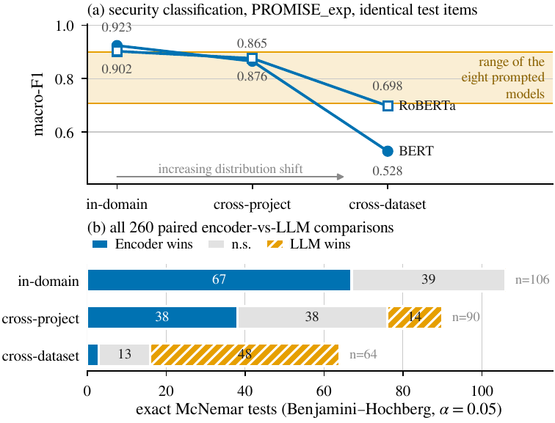
The inversion, in metric and in verdict form
(a) Security on identical PROMISE_exp items: encoders start above all eight prompted models, then fall through
(b) In-domain: 106 tests → encoders 67 wins / 39 ties / 0 losses
(b) Cross-project: 90 tests → encoders ahead or tied in 76 of 90
(b) Cross-dataset: 64 tests → encoders 3 wins / 13 ties / 48 losses
106 + 90 + 64 = 260 exact McNemar tests — one Holm/BH family, split by encoder regime
RQ2 — the loss differs sharply by model class; the ranking is a property of the regime, not of the models.
Fine-tuned encoders or prompted LLMs? · The verdict inverts under distribution shift
27

Slide 28
Aggregate scores hide per-project failure
37
0.000 and 1.000
0.917
0.545–0.750
PROMISE_exp projects with comparable coverage (leave-one-project-out, FR/NFR)
every configuration has at least one project at each extreme
encoder median macro-F1 across projects (s.d. 0.198)
small open models' medians (s.d. 0.213–0.301)
1
Leave-one-project-out arm over the 47 PROMISE_exp projects; 37 have comparable coverage
2
Encoder and prompted alike — every configuration has a project it scores 0.000 on and one at 1.000
3
Only the middle of the distribution separates the two families
A corpus-level average is a weak predictor of what a practitioner meets on their own project.
Fine-tuned encoders or prompted LLMs? · The verdict inverts under distribution shift
28

Slide 29
Part III — Mechanism: one failure mode, three sources
A drop alone does not say why a model fails — unfamiliar vocabulary and shifted class priors imply different fixes
Fine-tuned encoders or prompted LLMs? · The verdict inverts under distribution shift
29

Slide 30
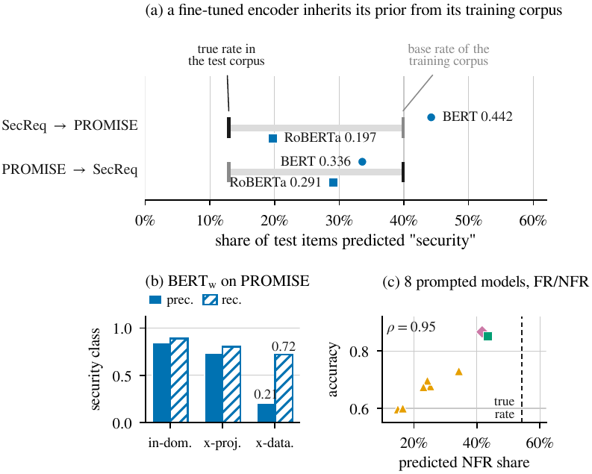
The mechanism is base-rate shift, not unfamiliar vocabulary
(a) Transferred BERT labels 44.2% of PROMISE_exp items security — true prevalence 12.9%, training-corpus prior 39.9%
(b) Security-class precision collapses 0.847 → 0.210
(b) Recall falls far less, 0.888 → 0.720 — it still finds them; it cannot stop finding them
(c) Prompted models: same defect, other source — FR/NFR accuracy ranks with prior miscalibration (ρ = 0.95)
That is the signature of prior shift, not of a model that has failed to understand the text.
Fine-tuned encoders or prompted LLMs? · The verdict inverts under distribution shift
30

Slide 31
Reported as measured: not uniform — and prior shift is correctable
What does not fit the simple story
Why the diagnosis is encouraging
RoBERTa carries less source prior across: 19.7% predicted vs 12.9% true — and loses less accuracy
Prior shift is correctable: threshold or prior adjustment (Saerens et al. 2002; Quiñonero-Candela et al. 2009)
Reverse direction (train PROMISE_exp → test SecReq): both encoders predict below target
Such adjustment needs no labels from the target corpus
33.6% and 29.1% predicted security vs 39.9% true — content differences contribute there too
Applying it would change the quantity measured — transfer as it happens today
Supported claim: the largest collapse's dominant term is a prior the model brought with it
Deliberately left as the obvious next step: future work
We report the asymmetry rather than smoothing it; the claim is scoped to the dominant term of the largest collapse.
Fine-tuned encoders or prompted LLMs? · The verdict inverts under distribution shift
31

Slide 32
Prompted models mis-set the same prior — from a different source
54.2%
14.9%
43.4%
ρ = 0.95
true NFR share on FR/NFR
NFR predicted by Qwen2.5-3B — the lowest
NFR predicted by Llama-3.3-70B — the highest, still below truth
Spearman rank correlation, accuracy vs miscalibration, eight reportable models
1
Every prompted model predicts NFR far less often than the true share
2
The small open models' FR/NFR 'collapse' is a systematic bias toward FR, not an inability to read
3
Same defect as the transferred encoder, acquired from pre-training rather than a training corpus
Miscalibration of the class prior explains most of the prompted models' FR/NFR error.
Fine-tuned encoders or prompted LLMs? · The verdict inverts under distribution shift
32

Slide 33
Re-wording the question moves the prior — the link is causal
Nine paired model × task cells: median base/terse/verbose spread only 0.044 — extreme 0.485
Terse is the only leading yes/no phrasing: Gemma-2-2B answers security for 96.7% of SecReq, 51.3% of PROMISE_exp (true 39.7%, 12.7%)
Qwen2.5-7B shifts the same way but less far
Not a formatting artefact: the strict parser accepted 99.98% of 11,518 responses — well-formed, simply wrong
Rewording the question re-set the model's prior exactly as re-training on another corpus re-set the encoder's (cf. Zhao et al. 2021; Lu et al. 2022).
Fine-tuned encoders or prompted LLMs? · The verdict inverts under distribution shift
33

Slide 34
Few-shot helps precisely where the exemplars carry prior information
Binary tasks (FR/NFR, security) — 54 comparisons
NFR sub-types — 36 comparisons
Mean effect −0.007 macro-F1 — net negative
Mean effect +0.062 — uniformly positive
The 30 BH-significant effects average −0.027
All 14 BH-significant effects are gains, averaging +0.114
Labels are a familiar convention: the model already has a prior, examples mostly perturb it
An unfamiliar eleven-class taxonomy: the exemplars are the only statement of what the classes are
Tang et al.'s over-prompting effect, reproduced
k ∈ {1, 2} per class, carved out before the frames — never a test item
k ∈ {2, 4, 8} exemplars in total, class-balanced
90 paired comparisons on the six local models — the only tier that ran few-shot — median gain +0.024; the sign is decided by whether exemplars supply a missing prior.
Fine-tuned encoders or prompted LLMs? · The verdict inverts under distribution shift
34

Slide 35
One defect, three sources
Fine-tuned encoder — prior from the training corpus
Prompted LLM — prior from pre-training and from the wording
Transferred BERT: 44.2% security predicted vs 12.9% true (source prior 39.9%)
Source 2, pre-training: NFR predicted 14.9%–43.4% vs 54.2% true; ρ = 0.95 with accuracy
Signature: precision 0.847 → 0.210 while recall 0.888 → 0.720
Source 3, wording: terse phrasing → security for 96.7% of SecReq items; spread up to 0.485
Consequence: 0.923 → 0.528 macro-F1 on identical items (−42.8%)
Signature: well-formed answers (99.98% parsed), wrong prior
Remedy implied: label-free prior / threshold adjustment (future work)
Remedy implied: exemplars help only where they carry the prior (sub-types +0.114; binary −0.027)
The task needs a class prior that cannot be read off the text; each approach acquires one somewhere it should not — so neither is safe to deploy on an in-distribution score alone.
Fine-tuned encoders or prompted LLMs? · The verdict inverts under distribution shift
35

Slide 36
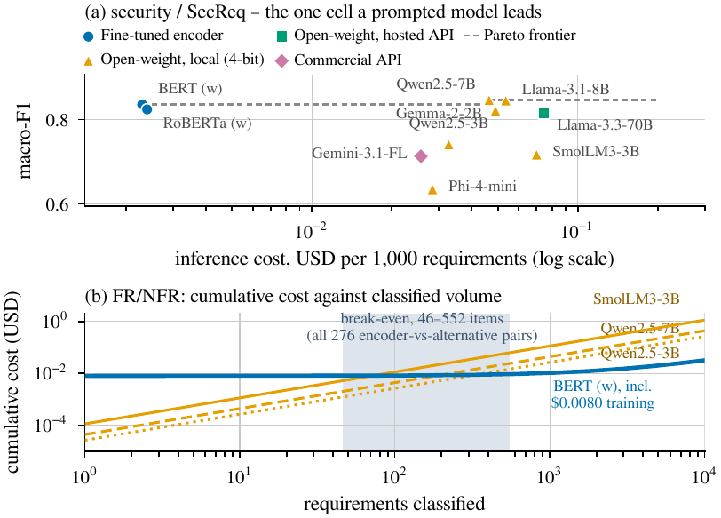
RQ3 — The accuracy–cost frontier: encoders 9–47× cheaper, training repaid within 46–552 items
Encoder inference $0.0024 per 1,000 classifications vs $0.0216–$0.1132 prompted: 9–47×, 18× at medians (prompted median $0.0439)
One-off fine-tuning negligible: median $0.0093 per deployable model, about 277 GPU-seconds
Break-even N* over all 276 encoder-vs-alternative pairings: 46–552 items, median 215
Pareto frontier: 10 cells, 9 encoders; the single prompted point is 4-bit Qwen2.5-7B on SecReq security
Buys +0.011 macro-F1 for ≈19× the cost per item: strongest free fallback where transfer is measured
Cost is what makes the transfer finding a real trade-off rather than a verdict.
Fine-tuned encoders or prompted LLMs? · The verdict inverts under distribution shift
36

Slide 37
RQ3 — Cost and latency by tier
Tier | Models | USD per 1,000 | Median latency (s) | Training (USD)
Fine-tuned encoder | 4 | 0.0024 | 0.016 | 0.0093
Open-weight, local (4-bit) | 6 | 0.0312–0.0522 | 0.194–0.356 | —
Open-weight, hosted API | 1 | 0.0704 | 0.095 | —
Commercial API | 1 | 0.0248 | 0.614 | —
Median latency: encoders 0.016 s; hosted 70 B 0.095 s (fastest prompted tier); local 0.19–0.36 s; commercial 0.61 s · Free-tier queueing inflates the hosted means by up to two orders of magnitude — all projections use medians · Table shows per-model figures by tier; the $0.0216–$0.1132 range on the previous slide spans all reportable prompted cells
Latency behaves differently from cost: the hosted 70 B is the fastest prompted tier, the commercial API the slowest.
Fine-tuned encoders or prompted LLMs? · The verdict inverts under distribution shift
37

Slide 38
Discussion: the regime is part of the claim
The regime is part of the claim
Contamination cuts in our favour
'Which is better?' flips between two protocols the literature treats as interchangeable — same items, same scorer
Both corpora are old, small and public → prompted in-domain scores may be inflated by pre-training contamination
An in-distribution-only benchmark is not a weaker version of one reporting transfer; it can report the opposite
That bias overstates the prompted models in-domain — exactly where we report encoders winning → conservative
Requirements-classification results should state the regime as part of the claim
It cannot produce the cross-dataset reversal: it would help the prompted models in both regimes equally
'Generalisation' should mean held-out projects or independent corpora, not transfer across tasks on one dataset
The most consequential finding is not that one model class is better — it is that the answer depends on the regime.
Fine-tuned encoders or prompted LLMs? · The verdict inverts under distribution shift
38

Slide 39
A decision rule for practitioners
Fine-tune a 110 M-parameter encoder when…
Prompt a mid-size quantised open model when…
You hold a few hundred labelled requirements from the domain you will operate in
Entering an unlabelled or shifting domain
Gives up in-domain accuracy but degrades gracefully: prompted scores move only −0.034 to +0.163 across corpora
Any non-trivial volume: training repaid within 46–552 items (median 215)
Most accurate in-domain (67 wins, 0 losses) and by far the cheapest ($0.0024 per 1,000)
Runs free on one consumer-class GPU (4-bit on a free-tier T4)
The domain is stable and labelled
Strongest free fallback where transfer is measured: 4-bit Qwen2.5-7B (0.846 on SecReq security)
The worst option is the implicit default of much recent work — fine-tuning on one corpus and assuming the result transfers.
Fine-tuned encoders or prompted LLMs? · The verdict inverts under distribution shift
39

Slide 40
Threats to validity
Category | Threat | Direction / mitigation
Internal | Commercial arm at n ≈ 60 per cell; 23 of 26 paired comparisons inconclusive | 'Never significantly beaten' partly reflects limited power
Internal | Free-tier quotas → missing-not-at-random dropout on some hosted configurations | Gate excludes affected cells rather than imputing
Internal | Local models ran 4-bit quantised | May understate full-precision accuracy
Internal | One seed per configuration | Small encoder-to-encoder margins not over-read
Construct | GPU cost imputed from a published rental rate; token prices are 2026 list prices | Ratios more durable than absolutes
Construct | N* is a pure cost crossover; human annotation cost excluded | Favours the encoder — stated explicitly
Construct | Strict scoring counts format non-compliance as error | Matches deployment; differs from lenient protocols
External | Security label sets differ: PROMISE_exp from the SE sub-class (non-functional by construction); SecReq any security-relevant sentence | Cross-dataset carries definitional as well as distributional shift, on one corpus pair
External | Corpora small, dated, public; English requirements; one NFR taxonomy | Scope of the claims
Conclusion | Multiplicity; split regeneration | All paired tests exact, corrected as one family; splits stored once (grouped-fold membership is library-version dependent)
Each limitation is either bounded by the design (gate, one-family correction, frozen splits) or reported with its direction stated — including where it favours us.
Fine-tuned encoders or prompted LLMs? · The verdict inverts under distribution shift
40

Slide 41
Conclusion
76,115
67–39–0 → 3–13–48
42.8%
9–47×
predictions under one strict rule; 260 paired tests corrected as one family
encoder wins–ties–losses, in-domain → cross-dataset
macro-F1 lost by the best in-domain encoder on identical items
encoders cheaper per 1,000 classifications; training repaid within 46–552 items
1
In-domain encoders are never significantly beaten; across corpora prompted models win 48 of 64
2
Both families carry an uncalibrated class prior — from the training corpus, or from pre-training and wording
3
Two protocols the field treats as interchangeable return opposite rankings from the same data
4
Public pipeline, frozen splits, prediction store, regeneration scripts — every number reproduces without re-running a model
An in-distribution score is not a partial answer, it can be the wrong one — so fine-tune for a stable labelled domain, and prompt when the distribution moves.
Fine-tuned encoders or prompted LLMs? · The verdict inverts under distribution shift
41

Slide 42
MSc THESIS DEFENSE
Thank you — questions?
Fine-tuned encoders
Fatma El-Zahraa Samir · fatmaelzahraasamirabdelfattah@gmail.com · Faculty of Computers and Artificial Intelligence, Cairo University
Pipeline, frozen splits, prediction store and regeneration scripts are public
Prompted LLMs

Slide 43
Backup — anticipated questions
Method and statistics
Validity and novelty
Why McNemar? Paired on identical items; exact test on the disagreements only — no independence assumption between models
Contamination? Would inflate prompted in-domain scores — where encoders win anyway — and cannot produce a cross-dataset reversal
Why 260 as one family? Any split into sub-families would make the correction lenient; one family is the conservative choice
Why not prior correction? It changes the quantity measured; we measure transfer as practised today — first item of future work
One seed? Yes — stated; the headline is a 42.8% drop of the same encoder, not a small encoder-to-encoder margin
Novelty vs Binkhonain & Alfayaz / Tang et al.? They evaluate in-distribution without cost; we add cross-project, cross-dataset and cost on identical items
4-bit local models? Needed for a free-tier T4; may understate full-precision accuracy — direction stated
Power of the commercial arm? n ≈ 60 per cell, 23 of 26 inconclusive — reported as a limitation, not hidden
Fine-tuned encoders or prompted LLMs? · The verdict inverts under distribution shift
43

