Slide 1
MSc THESIS · LITERATURE REVIEW
[Thesis Title —
To Be Confirmed]
An Empirical Benchmark of Cross-Dataset Generalization and Cost-Efficiency
2026

Slide 2
Outline
1
Chapter Overview
2
Background: evolution of the task
3
Datasets & benchmarks
4
Review of prior work (2024–2026)
5
State of the art & recurring limitations
6
Research gap
7
Proposed study, research questions & contributions
MSc Thesis — Literature Review
2 / 16

Slide 3
Chapter Overview
What this literature review covers, and in what order.
Evolution of the task
Datasets & benchmarks
1
2
From rule-based methods and classical ML to transformers and LLMs.
The public corpora the field relies on — and their limitations.
Prior work (2024–2026)
State of the art
3
4
Ten influential studies, each with its strengths and weaknesses.
What current models actually achieve on the standard benchmarks.
Recurring limitations
The research gap
5
6
The blind spots shared across almost all prior studies.
The unanswered questions this thesis sets out to address.
MSc Thesis — Literature Review
3 / 16

Slide 4
Background: Evolution of the Task
1
2
3
4
Rule-based
Classical ML
Deep Learning
Transformers & LLMs
mid-2000s
late 2000s–2010s
late 2010s–early 2020s
2020 – now
Keyword / indicator terms. Transparent but brittle; poor generalisation.
SVM, Naïve Bayes + TF-IDF. Needs labelled data and manual features.
CNN / LSTM + word embeddings. More data-hungry; over-fits small sets.
BERT / NoRBERT fine-tuning, then zero-/few-shot prompting of LLMs.
The same obstacles recur across every wave: small datasets, class imbalance, and limited generalisation.
MSc Thesis — Literature Review
4 / 16

Slide 5
Datasets & Benchmarks
PROMISE
PROMISE_exp
SecReq
PURE / App reviews
625
969
510
—
requirements
requirements
requirements
requirements
255 FR / 370 NFR · 11 NFR sub-types · the de facto benchmark
444 FR / 525 NFR · 11 NFR sub-types · same characteristics
187 security / 323 non-security
Longer documents / noisy user-generated text
The catch: these datasets are small, old, imbalanced, and reused across almost every study — raising two concerns this thesis targets: possible data contamination (they may be in the models’ pre-training data) and weak evidence of generalisation to unseen projects.
MSc Thesis — Literature Review
5 / 16

Slide 6
Prior Work — 2024
El-Hajjami et al.
Limitation: Older GPT generation; no open models; no cost analysis; in-distribution only.
SVM & LSTM vs GPT-3.5/4 (zero-/few-shot) across 5 datasets → “no single best technique.”
Kaur & Kaur
Limitation: Secondary study (no new experiments); predates the 2025–26 generative wave.
Systematic mapping of ~2 decades → BERT outperforms classical ML and deep learning.
Sonawane & Puthran
Limitation: No LLMs; single dataset family; no generalisation test; now superseded.
CNN with a flower-pollination optimiser for FR/NFR classification.
Peer et al. (NLP4ReF)
Limitation: Domain-specific; no open-vs-commercial comparison; no generalisation study.
LLM-based classification beats traditional NLP pipelines; low cost, high speed.
MSc Thesis — Literature Review
6 / 16

Slide 7
Prior Work — 2025
★ CLOSEST TO THIS THESIS
Limitation: “Generalizability” means cross-task, not cross-project; commercial-heavy; little cost analysis.
Binkhonain & Alfayaz
5 LLMs × 4 prompting styles × 3 tasks on PROMISE + SecReq vs a fine-tuned baseline; few-shot matches or beats it.
Alhoshan et al.
Limitation: No current commercial models; cost not a dimension; in-distribution.
Open models (Bloom, Gemma, Llama), 400+ experiments across 3 datasets; binary + multi-class.
Tang et al.
Limitation: Focus on prompting mechanics; in-distribution; no cost analysis.
“Over-prompting” effect; TF-IDF few-shot selection lets a small open model beat fine-tuned SOTA by 1%.
Chaudhary et al.
Limitation: One commercial model; one dataset; lower precision on noisy text.
Zero-shot ChatGPT on 1,880 app reviews (FR/NFR/both/neither); F1 = 0.842.
MSc Thesis — Literature Review
7 / 16

Slide 8
Prior Work — 2026
Vasudevan et al.
Limitation: No open generative LLMs; binary task on one dataset; reports neither cost/latency nor cross-dataset generalisation.
Fine-tuned BERT & RoBERTa vs GPT-4o for FR/NFR — GPT-4o reaches up to 96% accuracy. A clean, recent head-to-head of encoders against a leading commercial model.
Levy et al.
Limitation: Commercial-heavy on a standard (contaminable) dataset; expert-judgment design is hard to reproduce; no cost or generalisation analysis.
Claude 3.5 Sonnet, GPT-4o, Llama 3 on PROMISE_exp (FR/NFR + 11 sub-types) vs expert judgment — GPT-4o ≈ 85% on FR/NFR; models show directional biases.
MSc Thesis — Literature Review
8 / 16

Slide 9
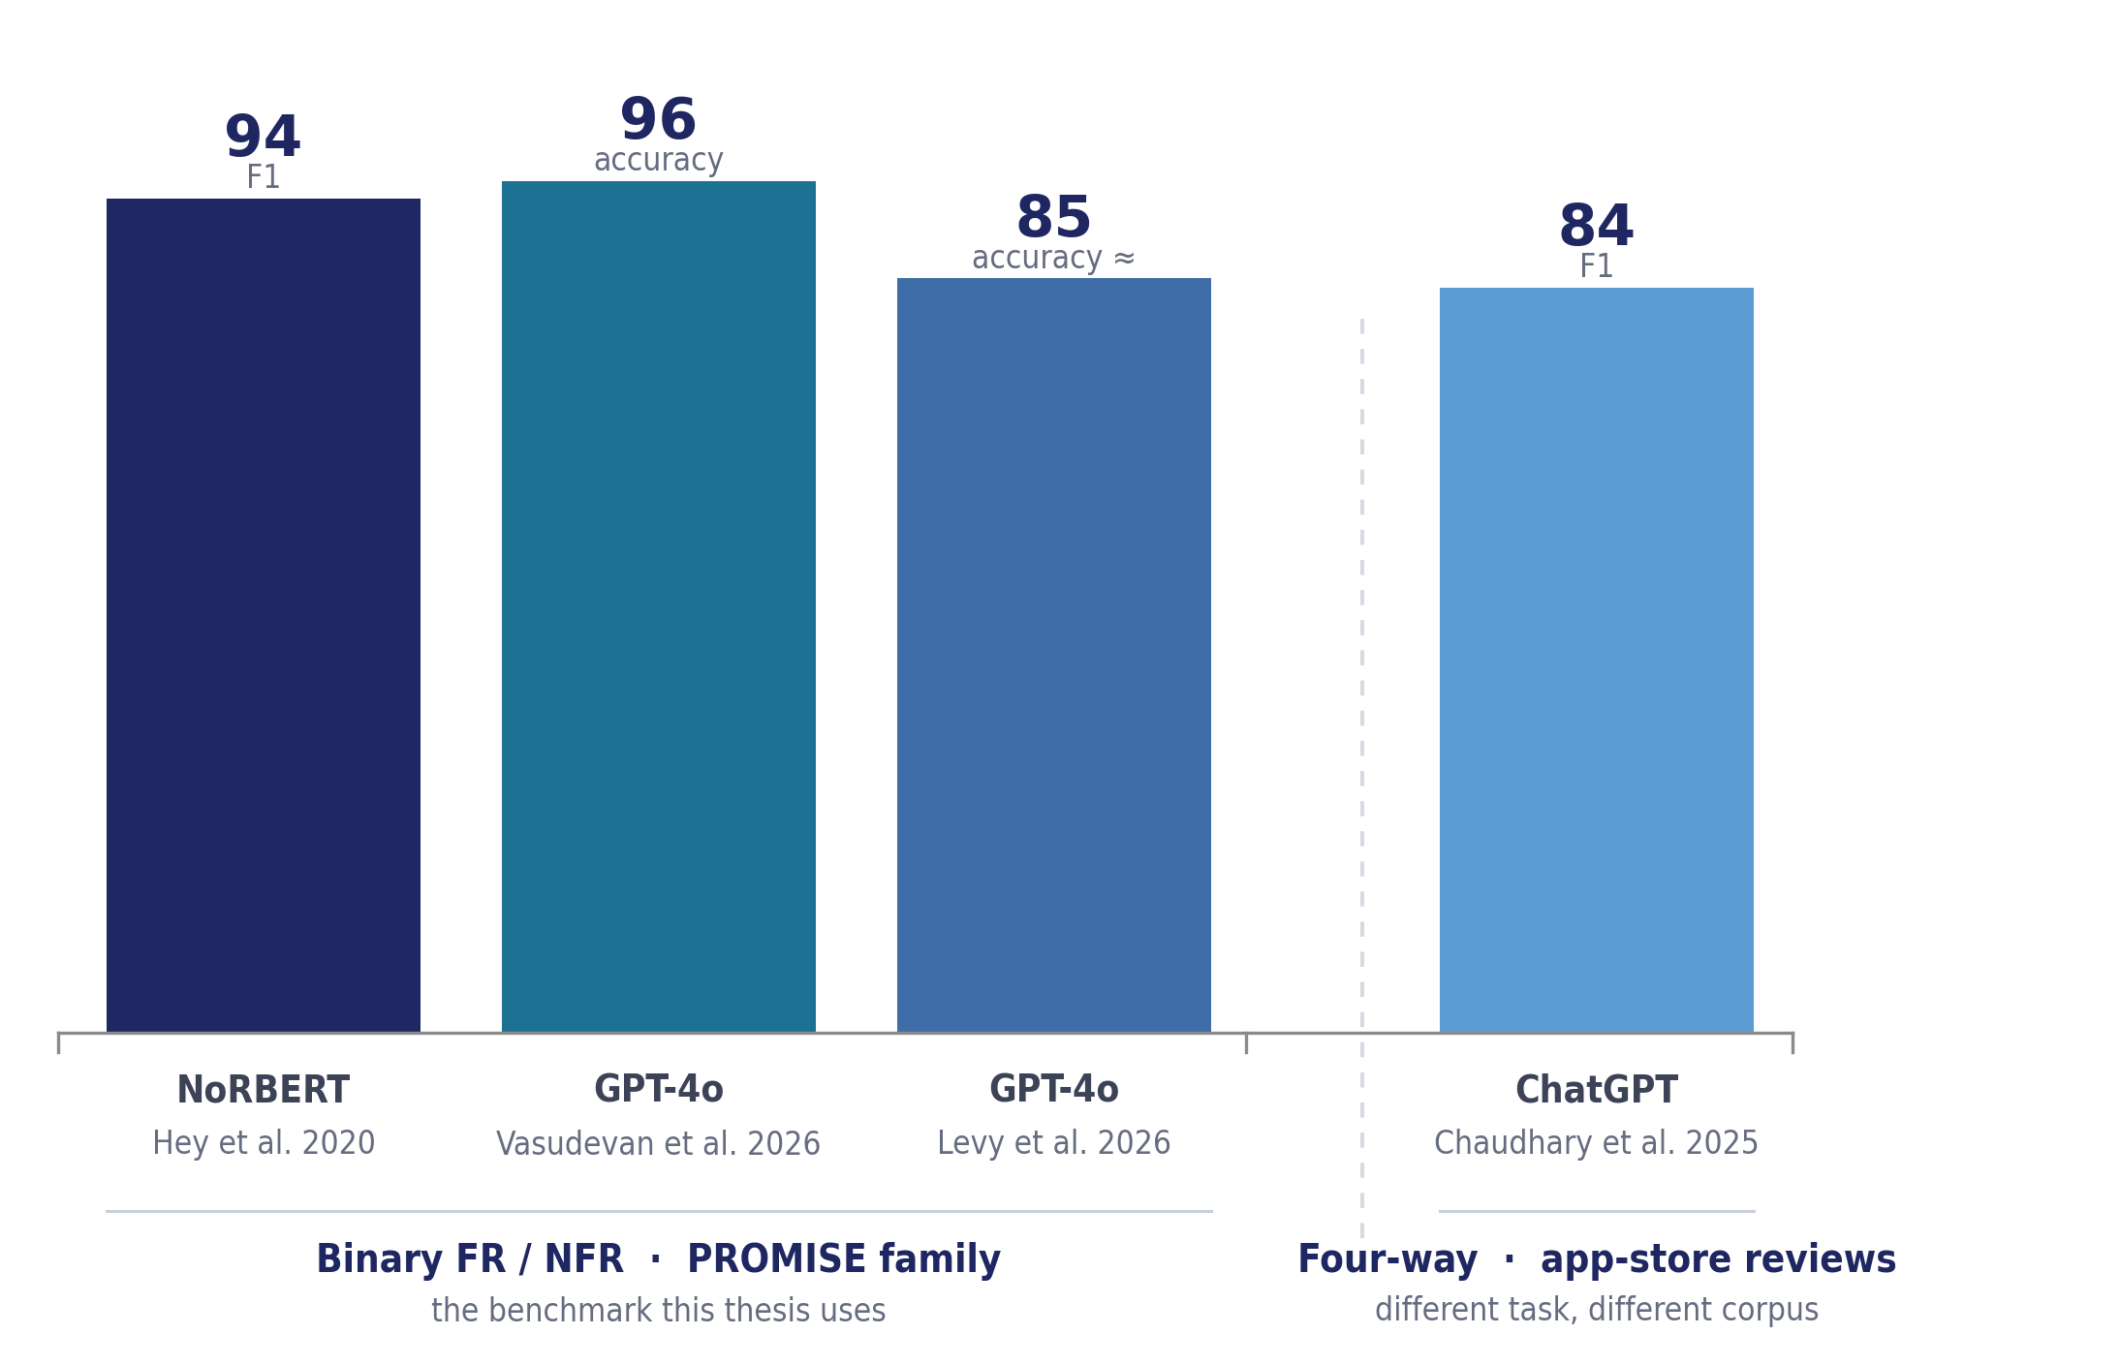
State of the Art: The Task Is Nearly Solved
Takeaway
On the standard benchmarks, functional/non-functional classification is close to solved.
Showing that an LLM “can classify” is no longer a contribution.
Each bar is the headline figure of a different study, on a different dataset, and under a different metric — NoRBERT and Chaudhary report F1, Vasudevan and Levy report accuracy (Levy’s is approximate). Chaudhary’s task is four-way classification of app-store reviews, not binary FR/NFR, so it is shown apart. The bars indicate the performance ceiling the field reports; they are not a ranking.
MSc Thesis — Literature Review
9 / 16

Slide 10
Recurring Limitations of Prior Work
1
2
3
Evaluated in-distribution
Cost is ignored
Small, old, contaminated data
Models are trained and tested on the same dataset. Cross-project / cross-dataset testing is rare — even though NoRBERT warned that classifiers degrade on unseen projects.
Accuracy / F1 is reported in isolation, with a drift toward expensive commercial models. No study asks which free model, on modest hardware, is enough.
A few reused benchmarks that may not reflect real requirements — and may sit in the models’ pre-training data, inflating scores.
MSc Thesis — Literature Review
10 / 16

Slide 11
Research Gap
The success is the gap.
When an off-the-shelf model already classifies clean benchmark requirements accurately, proving that it can is no longer a contribution. The unanswered questions are the ones the literature has systematically avoided:
1
2
3
Generalisation
Cost
Interaction
Does high accuracy survive on unseen projects and datasets — the generalisation gap?
Is an expensive commercial model necessary, or is a free / open model good enough?
Does one class of model (fine-tuned, open, or commercial) generalise more robustly than the others under cross-dataset evaluation?
11 / 16

Slide 12
What This Thesis Does
An empirical benchmark · public data · free tools · no methodological novelty — it evaluates existing models under conditions prior work neglected.
Fine-tuned small transformer
Open generative LLMs
One commercial model
BERT / RoBERTa — the specialized, low-cost supervised baseline
Gemma / Llama / Phi / Qwen / SmolLM — free to run; zero- and few-shot
accessed via a free tier — the high-end reference point
Datasets: PROMISE_exp + SecReq — in-domain, cross-project (leave-project-out), and cross-dataset (security task)
Tasks: FR/NFR · NFR sub-types · security vs. non-security
Key design: measure performance not only in-distribution but under cross-project & cross-dataset evaluation (the generalisation gap) — and report an explicit accuracy-vs-cost profile.
MSc Thesis — Literature Review
12 / 16

Slide 13
Research Questions
RQ1
Baseline
How do current open and commercial LLMs compare with a fine-tuned small transformer (zero-/few-shot) on standard benchmarks?
→ Establishes the reference picture with current-generation models.
RQ2
Generalisation gap ★
How much does performance drop under cross-project / cross-dataset evaluation — and does the drop differ by model class?
→ The central question and primary contribution.
RQ3
Cost
What is the accuracy-vs-cost trade-off, and what is the cheapest freely available option that reaches acceptable performance?
→ Practical, resource-aware guidance for real use.
MSc Thesis — Literature Review
13 / 16

Slide 14
Expected Contributions
1
An up-to-date benchmark
Open vs. commercial vs. fine-tuned models on requirements classification, using current-generation models.
2
The generalisation gap, quantified
A systematic measurement of cross-dataset generalisation for this task in the LLM era.
3
Resource-aware guidance
The cheapest freely available option that reaches acceptable performance — for students, researchers, and small teams.
MSc Thesis — Literature Review
14 / 16

Slide 15
Conclusion
On the standard public benchmarks, requirements classification is close to solved.
But generalisation and cost — the factors that decide real-world usability — remain unaddressed.
This thesis measures both: how open, commercial, and fine-tuned models generalise across projects and datasets, and at what cost — using only public data and free tools.
Next: Chapter 3 — Methodology (experimental design, model set, splits, metrics, and evaluation protocol).
MSc Thesis — Literature Review
15 / 16

Slide 16
Thank you
Questions & discussion

