Slide 1
MSc THESIS · METHODOLOGY & RESULTS
[Thesis Title —
To Be Confirmed]
An Empirical Benchmark of Cross-Dataset Generalization and Cost-Efficiency
2026

Slide 2
The Task Is Solved. The Interesting Questions Are Not.
What the literature already shows
What it does not show
Fine-tuned transformers, commercial LLMs and well-prompted open models all reach the high eighties to mid-nineties on FR/NFR.
Showing that a model “can classify requirements” is no longer a contribution.
Almost every result is in-distribution — same corpus for tuning and testing.
Cost and model size are rarely reported at all.
Contamination of old public corpora is acknowledged but not addressed.
1
In-distribution only
2
Cost is not a dimension
3
Small, ageing, imbalanced data
Even work claiming better generalisability means transfer across tasks on the same two corpora — never unseen corpora.
The field has drifted to large commercial APIs and reports macro-F1 in isolation.
Two or three public corpora underlie nearly every published result.
This thesis reframes a saturated problem around the two axes that decide whether the technique is usable in practice: generalisation and cost.
MSc Thesis — Methodology & Results
2 / 22

Slide 3
Three Questions, One Protocol
In-domain comparison
RQ1
How do open and commercial LLMs compare with fine-tuned encoders on FR/NFR, security, and NFR sub-types?
Establishes the reference point.
Generalisation gap
RQ2
How much does performance degrade under cross-project and cross-dataset evaluation — and does the gap differ by model class?
The primary contribution.
Cost-efficiency
RQ3
What is the accuracy-versus-cost trade-off, and what is the cheapest free option that reaches acceptable performance?
The practitioner’s answer.
Every question is answered on the same corpora, the same items and the same scoring rule — so the three answers are directly comparable.
MSc Thesis — Methodology & Results
3 / 22

Slide 4
The Pipeline at a Glance
Stage 1
Stage 2
Stage 3
Stage 3b
Repair
Stage 4
Stage 5
Data pipeline
Encoders
LLM binary
LLM sub-types
Strict re-parse
Analysis
Cost
1,412 reqs · 14 frozen split families
→
BERT / RoBERTa · 24,280 preds
→
9 models attempted · 35,049 preds
→
16,786 preds
→
idempotent · store-preserving
→
tables 1–11 · figs 1–6 · McNemar
→
cost 1–5 · figs 7–10 · break-even
Design rule: every stage writes a versioned artefact that the next stage consumes; every number in the thesis is read from those artefacts — 76,115 predictions in total, scored once, under one protocol.
MSc Thesis — Methodology & Results
4 / 22

Slide 5
Two Corpora, De-Duplicated Before Anything Else
Corpus | Raw | Final | FR / NFR | Security / Non-sec.
PROMISE_exp | 969 | 968 | 444 / 524 | 125 / 843
SecReq | 510 | 444 | — | 177 / 267
Unified | 1,479 − 67 dup. | 1,412 | 444 / 524 | 302 / 1,110
The prevalence contrast is the pivot
Security requirements are 12.9% of PROMISE_exp but 39.9% of SecReq — a three-fold difference in base rate between the two corpora describing the same concept.
PROMISE 12.9%
SecReq 39.9%
Post-deduplication class counts, from the Stage-1 manifest. Zero duplicate texts across the two corpora.
Eleven NFR sub-types, a very long tail
security
125
maintainability
24
usability
85
scalability
22
operational
77
fault tolerance
18
performance
66
legal
15
look & feel
49
portability
12
availability
31
top-4 and top-6 variants exist because the tail carries single- and double-digit support
MSc Thesis — Methodology & Results
5 / 22

Slide 6
107 Folds Across 14 Families, 12 Configurations
Family group | Families | Folds | Regime
In-domain (6 tasks × datasets) | 6 | 30 | stratified 5-fold CV within the corpus
Cross-project (6 tasks × datasets) | 6 | 28 | held-out unseen project groups
Leave-one-project-out | 1 | 47 | one fold per PROMISE_exp project
Cross-dataset (security) | 1 | 2 | train PROMISE_exp ↔ test SecReq
Total | 14 | 107
Frozen means frozen
Splits are generated once (seed 42) and stored as JSON keyed by stable ids over SHA-256-pinned sources, never regenerated. Project grouping (StratifiedGroupKFold) applies to the cross-project families; the in-domain arm is a plain stratified 5-fold, because it is the in-distribution reference the transfer arms are measured against. Fold membership depends on the version of the library that generated it, which is why the split file is never regenerated.
Paired by construction
Prompted models answer stratified samples of the same test items, so every encoder–LLM comparison is McNemar-paired on identical requirements. Having no training distribution, prompted zero-shot scores are regime-invariant by construction — the encoders’ drop is measured against a baseline that cannot over-fit the source corpus.
MSc Thesis — Methodology & Results
6 / 22

Slide 7
Twelve Configurations at a Glance
Fine-tuned encoders
BERT-base (110 M) · RoBERTa-base (125 M)
± inverse-frequency class weighting · lr 2×10⁻⁵ · batch 16 · max len 128 · 3 epochs (binary), 10 (sub-types)
Open prompted LLMs
Gemma-2-2B · SmolLM3-3B · Qwen2.5-3B · Phi-4-mini · Qwen2.5-7B · Llama-3.1-8B
4-bit NF4 on a free T4 · plus hosted Llama-3.3-70B (free API tier)
Commercial reference
Gemini 3.1 Flash-Lite
free tier · closed weights (parameter count undisclosed — recorded as unknown, not guessed)
A ninth prompted model (hosted Nemotron-3-Nano-30B) failed the reportability gate (21 items per cell, below n ≥ 40) — its 63 predictions stay in the raw store but never enter a results table.
MSc Thesis — Methodology & Results
7 / 22

Slide 8
Prompting Protocol & Strict Parsing
The prompt
The parse rule (strict)
Fixed instruction naming the task and the exact label vocabulary; answer must be one word.
Three phrasings (base · terse · verbose); two-model sub-study.
Few-shot k ∈ {1, 2, 4, 8} (task-dependent): deterministic, class-balanced exemplars carved out of the corpus, never test items. Hosted/commercial: zero-shot only.
Word-boundary matching — “fr” never matches “free”.
A leading label wins; otherwise exactly one label named anywhere wins.
Both labels, or neither → unparseable → scored as wrong.
Applied identically at harness time and in an idempotent repair pass over the stored raw outputs — archived and scored predictions can never diverge silently.
MSc Thesis — Methodology & Results
8 / 22

Slide 9
What Stops the Numbers from Lying
Reportability gate
Strict scoring
Paired significance
A cell is reported only if class support ≥ 5, n ≥ 40, parse rate ≥ 50% — 6 of 87 cells excluded, 81 reportable.
An unparseable answer counts as wrong, never as excluded; macro-F1 always spans the full declared label set.
Exact McNemar on identical items: 260 tests, corrected as one family (Holm + Benjamini–Hochberg, α = 0.05).
Dummy sentinels
Common-set check
Frozen artefacts
Majority-class and stratified-random baselines run through the same scorer — any model below them is flagged, not excused.
Sub-type rankings recomputed on the shared item subset — rank differences cannot hide in coverage differences.
SHA-256-pinned sources, seed 42, immutable splits; every table regenerates from the stores.
Metrics from scikit-learn; paired tests from SciPy’s exact binomial; Holm and Benjamini–Hochberg computed in-notebook over the stored p-values.
MSc Thesis — Methodology & Results
9 / 22

Slide 10
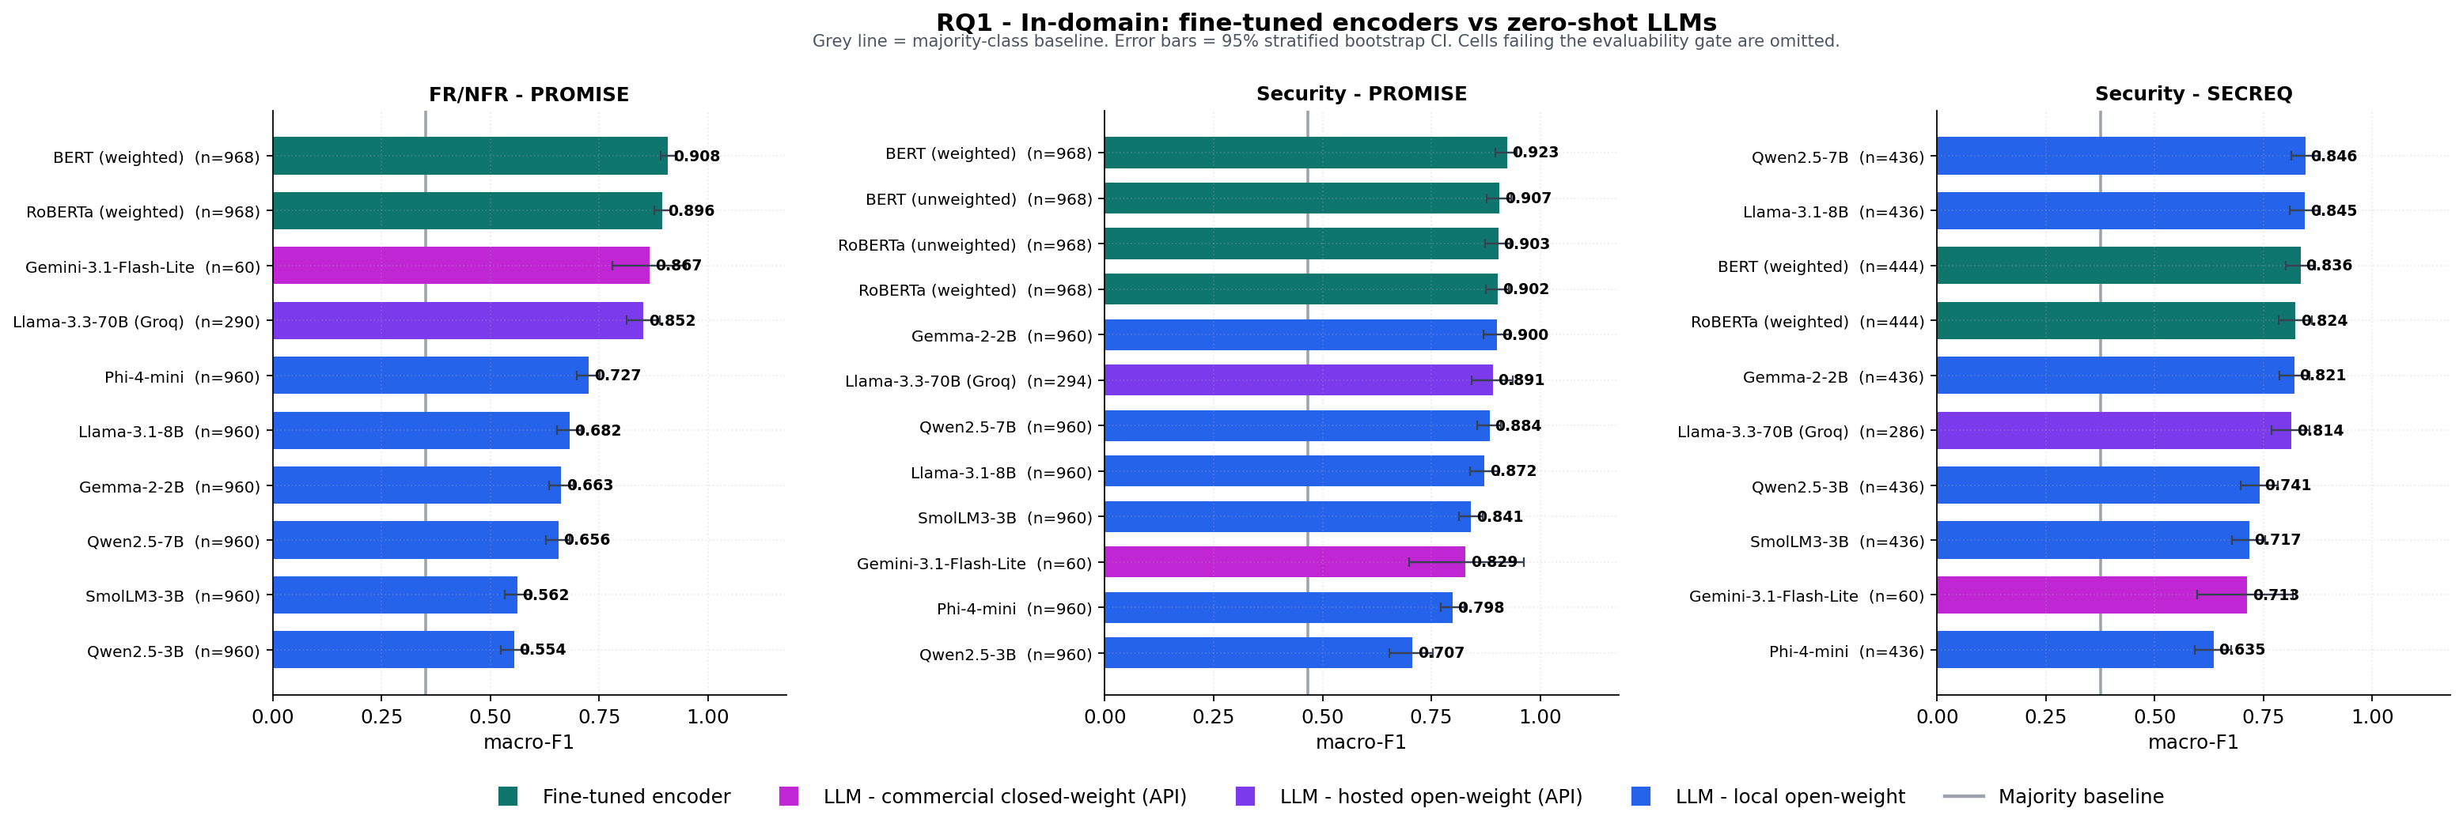
RQ1 — In-Domain: Encoders Lead Five of Six Cells
Takeaway
BERT (weighted): 0.9083 FR/NFR · 0.9235 security-PROMISE.
The one exception: Qwen2.5-7B edges Security-SecReq (0.8461 vs 0.8356) — never significantly.
106 in-domain McNemar tests: 67 encoder wins · 39 ties · 0 losses.
Scale doesn’t order results: Gemma-2-2B (2.6 B) beats the hosted 70 B on PROMISE security (0.8999 vs 0.8910).
MSc Thesis — Methodology & Results
10 / 22

Slide 11
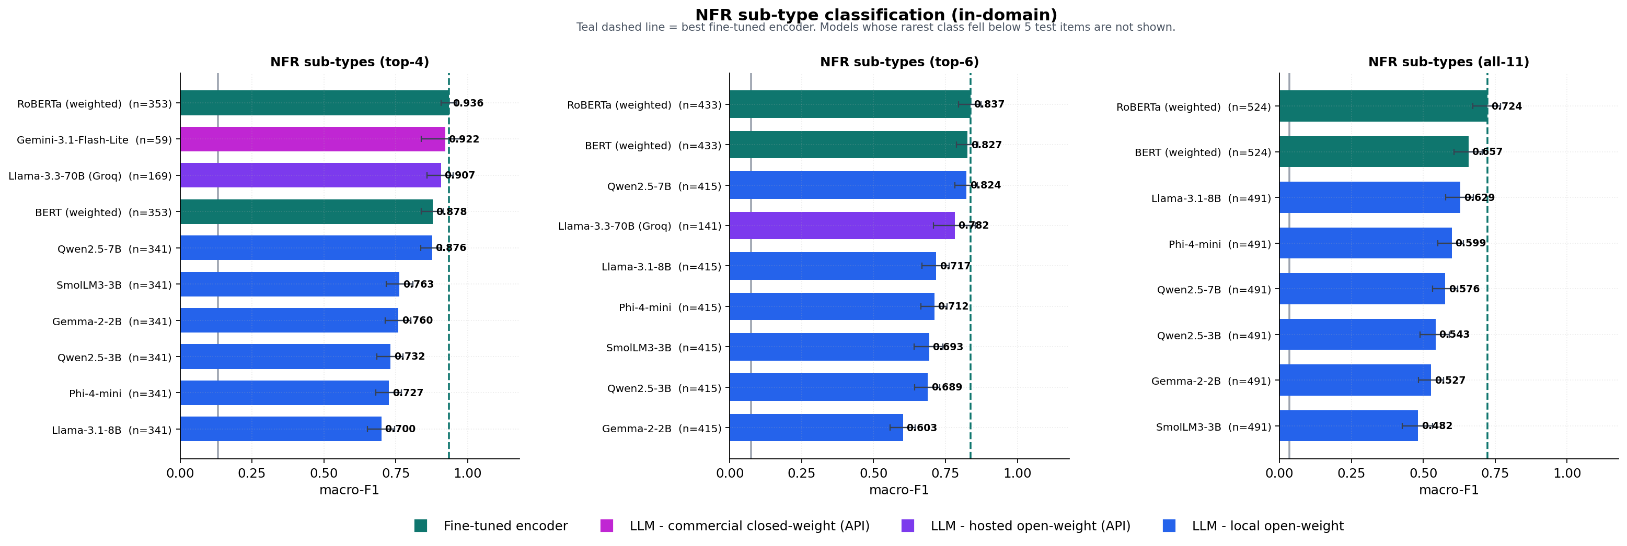
Supervision Buys More as the Label Set Grows
+0.014
top-4 margin
best encoder − best prompted
+0.013
top-6 margin
still within noise
+0.095
all-11 margin
supervision pulls away on the long tail
Margins from Table 3.3: 0.9356−0.9216 · 0.8367−0.8235 · 0.7240−0.6287. Cell sizes differ (n = 59–968); on the 59 shared items the top-4 margin is +0.036. RoBERTa (weighted): 0.9356 top-4 · 0.8367 top-6 · 0.7240 all-11.
MSc Thesis — Methodology & Results
11 / 22

Slide 12
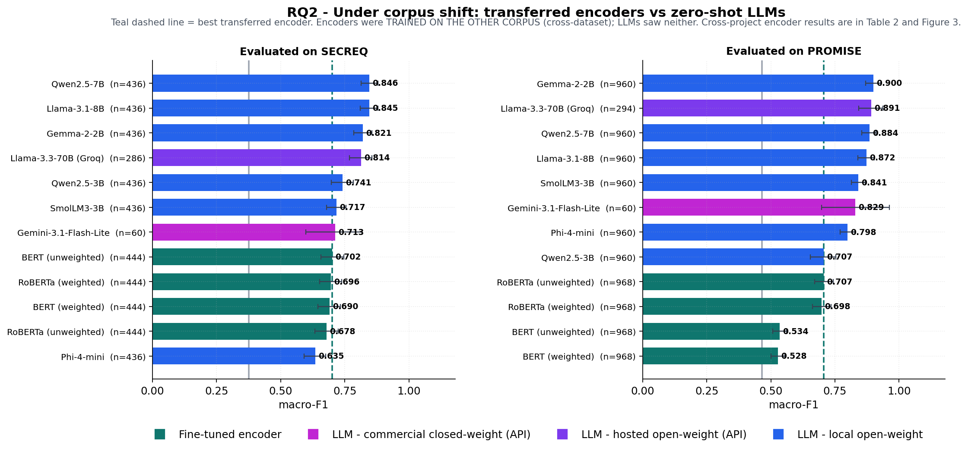
Under Distribution Shift, the Result Reverses Completely
Reading it
Transferred encoders drop below prompted models on the cross-dataset security arms.
Best transferred encoder on SecReq: 0.7015 (unweighted BERT) — Qwen2.5-7B reaches 0.8461 with no tuning at all.
Prompted models win 48 of 64 cross-dataset McNemar tests.
MSc Thesis — Methodology & Results
12 / 22

Slide 13
Same Model. Same Task. Two Kinds of Shift.
Across projects
Across corpora
−6.3%
−42.8%
BERT (weighted), security, PROMISE_exp: 0.9235 → 0.8649 on held-out unseen projects of the same corpus.
The same configuration, trained on SecReq and evaluated on the very same PROMISE_exp items: 0.9235 → 0.5279 (−0.3956) — nearly seven times the cross-project drop. The reverse direction costs 17.4%.
What the contrast suggests
Unseen projects change the vocabulary; an unseen corpus also changes the base rate (security prevalence 12.9% → 39.9%). Per-class evidence is consistent with it: security precision collapses 0.847 → 0.210 while recall falls far less (0.888 → 0.720), and the model labels 44.2% of PROMISE_exp items security against a true prevalence of 12.9% — close to SecReq’s 39.9% prior. The reverse direction is less clean (33.6% predicted, not 12.9%), so content differences contribute there too. Prompted models, carrying no learned prior, shift by at most 0.163.
MSc Thesis — Methodology & Results
13 / 22

Slide 14
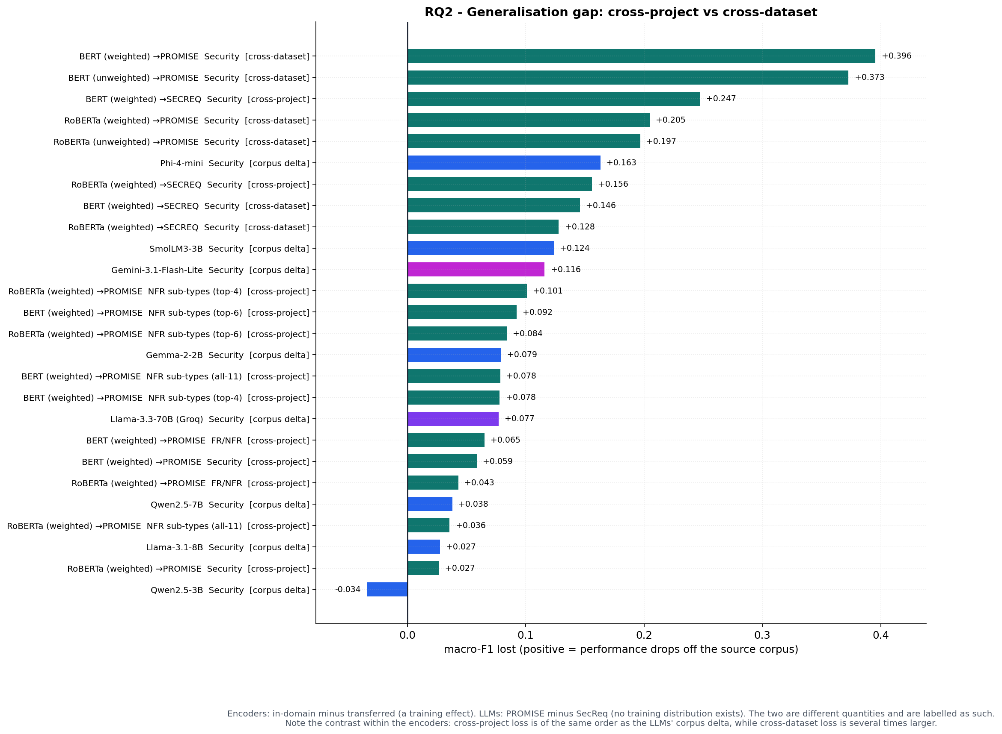
Every Configuration, Ranked by What Transfer Costs It
The numbers
Cross-project (PROMISE_exp): encoders lose 2.7–10.1 points; up to 24.7 points (29.6%) on SecReq.
Cross-dataset security: BERT −42.8%, RoBERTa −22.7% (reverse direction −17.4%).
Prompted corpus deltas: −0.034 to +0.163 — no training distribution to lose.
MSc Thesis — Methodology & Results
14 / 22

Slide 15
260 Paired Tests Say the Same Thing
Regime | Tests | Encoder wins | n.s. | LLM wins
In-domain | 106 | 67 | 39 | 0
Cross-project | 90 | 38 | 38 | 14
Cross-dataset | 64 | 3 | 13 | 48
Total | 260 | 108 | 90 | 62
One sentence
Exact McNemar, BH-corrected at α = 0.05: the in-domain distribution (67–39–0) inverts under cross-dataset transfer (3–13–48). The ranking a benchmark reports depends on the regime it evaluates.
175 of 260 tests significant raw · 170 after BH · 131 after Holm.
MSc Thesis — Methodology & Results
15 / 22

Slide 16
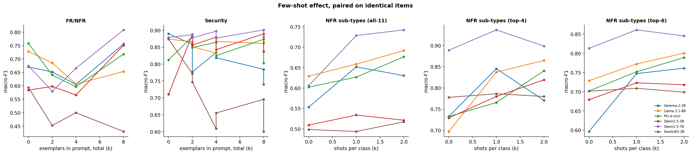
Few-Shot Helps Only Where the Label Set Is Unfamiliar
Binary tasks (FR/NFR + security)
NFR sub-types (top-4 / top-6 / all-11)
−0.007
+0.062
mean paired gain
mean paired gain
54 comparisons · 30 BH-significant · the significant ones average −0.027: examples mostly hurt where the labels are already familiar conventions.
36 comparisons · 14 BH-significant — every one of them a gain (avg +0.114): exemplars communicate an unfamiliar annotation vocabulary.
Overall: 90 paired tests, median gain +0.024, 44 BH-significant splitting 26 gains vs 18 losses — few-shot is a tool for unfamiliar label sets, not a default.
MSc Thesis — Methodology & Results
16 / 22

Slide 17
The Same Model, Reworded, Moves 0.485 Macro-F1
Gemma-2-2B · security · SecReq
What it means
base
0.827
The median spread across the nine paired model × task cells is only 0.044 — phrasing is usually second-order.
But the extremes are catastrophic (Gemma-2-2B also loses 0.345 on PROMISE security to the terse phrasing).
Any single published zero-shot number is one sample from a distribution over phrasings — robustness must be reported per model.
terse
0.343
verbose
0.828
spread = 0.485 — on paired items, same model, same task, same corpus.
MSc Thesis — Methodology & Results
17 / 22

Slide 18
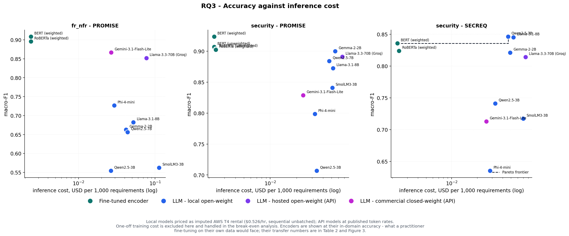
Encoders Hold 9 of the 10 Pareto Points
Frontier
Encoders: ≈ $0.0024 / 1k classifications; prompted models cost 9–47× more per 1k ($0.0216–$0.1132 across all reportable cells).
The single prompted Pareto point: quantised Qwen2.5-7B (SecReq security, 0.8461).
One-off fine-tuning: median $0.0093 per deployable model (≈ 277 GPU-s per family).
MSc Thesis — Methodology & Results
18 / 22

Slide 19
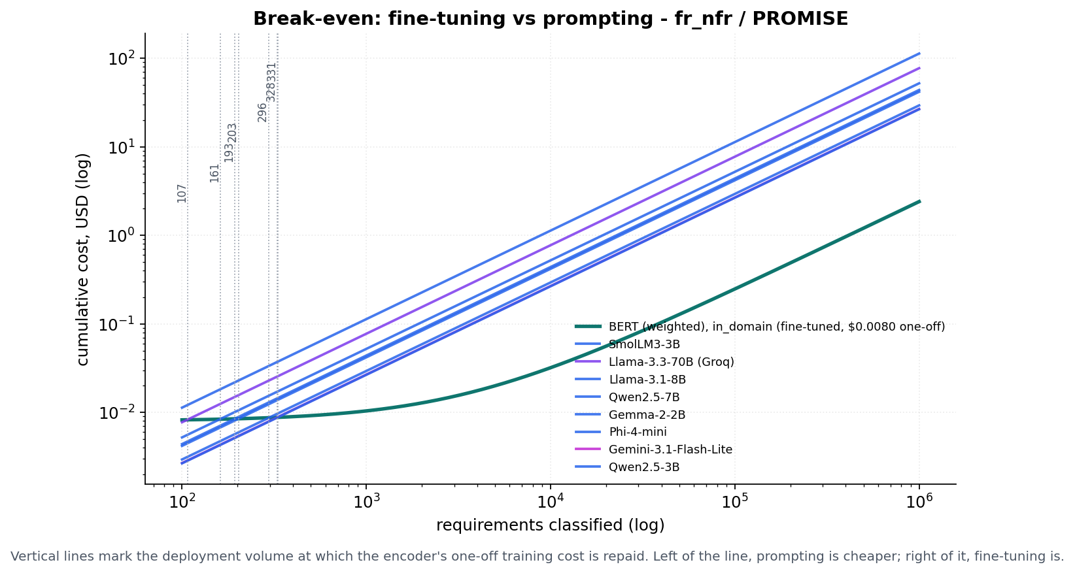
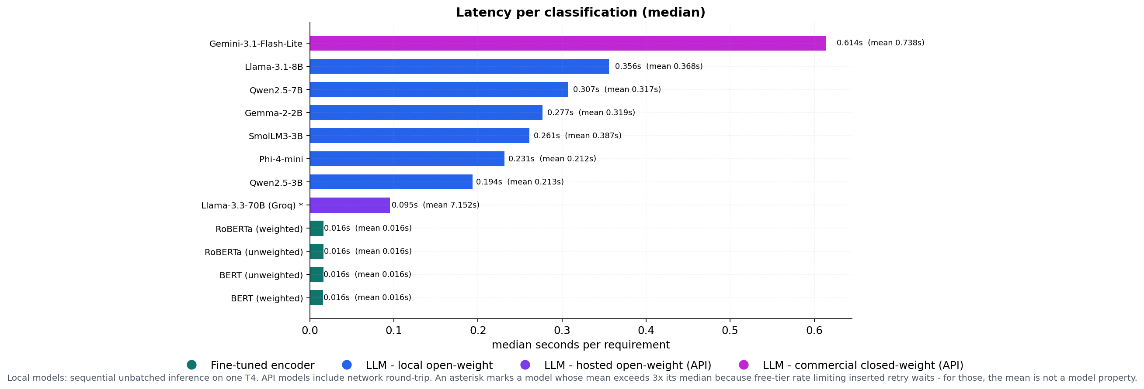
Fine-Tuning Repays Itself Within 46–552 Requirements
All 276 encoder-vs-alternative pairs reach break-even between 46 and 552 classifications (median 215) — and the encoder is cheaper in all 276 pairs by 100,000 items. Hosted-API medians are fast (0.095 s) but queueing inflates the means: projections use medians, means are reported flagged.
MSc Thesis — Methodology & Results
19 / 22

Slide 20
What This Study Cannot Claim
Coverage
Internal
Free-tier quotas caused missing-not-at-random dropout on some hosted arms and capped the commercial sub-type sample; the gate excludes those cells rather than imputing them.
Local models ran under 4-bit quantisation, which may understate full-precision accuracy; GPU costs are an imputed rental rate, token prices are list prices.
External
Conclusion
Both corpora are small, dated and public — contamination would inflate prompted in-domain scores, making the observed encoder advantage conservative. English requirements, one taxonomy.
All paired tests are exact and multiplicity-corrected; frozen splits are stored once and never regenerated. Strict scoring differs from lenient protocols in prior work — deliberately.
Stated in full because a benchmark that hides its own coverage gaps is not a benchmark.
MSc Thesis — Methodology & Results
20 / 22

Slide 21
Three Questions, Three Answers
In-domain, fine-tuned encoders dominate: they win 67 of 106 paired tests and lose none; the one prompted point-estimate lead (Qwen2.5-7B, SecReq security) is not significant.
RQ1
The gap is real and asymmetric: encoders lose up to 42.8% of macro-F1 across corpora, prompted models barely move — the verdict matrix inverts (48 of 64 cross-dataset wins for LLMs).
RQ2
Encoders are cheapest beyond a few hundred classifications on every measured pairing; quantised Qwen2.5-7B is the strongest freely available prompted fallback on the transfer cell, though no prompted model leads on every task.
RQ3
MSc Thesis — Methodology & Results
21 / 22

Slide 22
Choose by data situation, not fashion
Fine-tune a small encoder for a stable, labelled domain.
Prompt a mid-size open model when entering an unlabelled or shifting one.
76,115
260
81 / 87
46–552
predictions scored
paired significance tests
cells passed the gate
items to break even
Thank you — questions & discussion

