Slide 1

NTI • ADVANCED DATA ANALYSIS • GRADUATION PROJECT
SMART AGRICULTURE
From Raw Data to AI-Powered Yield Predictions
Fatma Mohamed Osman
Menna Waleed Abdulrahman
Fatma Hasan Abdulrazek
Data Cleaning & Preprocessing
Dashboard, Insights & Design
AI Model & Deployment
Supervised by Eng. Hager Ayman
Notes:
Welcome the audience. Introduce the project name, the course (NTI Advanced Data Analysis), the supervisor, and the three team members and their roles. Set expectations: this is an end-to-end project from raw data to a deployed AI tool.

Slide 2







AGENDA
What We'll Cover
Business Problem & Objective
The Dataset
Why this project matters
19,572 records across 16 variables
From Raw Data to Insights
Interactive Dashboard
Cleaning, EDA & key patterns
Power BI storytelling
AI Prediction Model
Deployment
Random Forest yield prediction
Mobile app & web (Streamlit)
Recommendations
Actionable next steps
Smart Agriculture — NTI Graduation Project
2
Notes:
Walk through the agenda quickly so the audience knows the structure: problem, data, EDA, dashboard, model, deployment, and recommendations.

Slide 3

THE CHALLENGE
Farming Decisions Are Still Made in the Dark
The Business Problem
Our Objective
Farmers, agribusinesses, and planners often decide what to plant, how much to fertilize, and where to invest — without a clear, data-driven view of what actually drives yield. The result is inconsistent harvests, wasted fertilizer, and missed opportunities across states and seasons.
Turn a real, 19,572-record agricultural dataset into a complete Smart Agriculture solution — cleaned data, a storytelling dashboard, and a deployed AI model that predicts crop yield and recommends concrete actions, accessible through a mobile app and web tool.
19,572
16
2
Records
Variables
Deployment Channels
Smart Agriculture — NTI Graduation Project
3
Notes:
Explain the real-world problem: farming decisions are often made without solid data backing. State the objective clearly: we built a full pipeline that ends in a usable AI tool, not just a report.

Slide 4



THE DATA
The Data Behind the Decisions
A real agricultural dataset sourced from Kaggle, covering multiple states, crops, seasons and years.
Soil Chemistry
Climate Conditions
Farming Context
Inputs & Outcome
Nitrogen (N), Phosphorus (P), Potassium (K), pH
Average Temperature, Total Rainfall, Average Humidity
State, Crop, Season, Year
Area, Fertilizer, Pesticide, Production, Yield
19,572
16
Kaggle
Rows
Columns
Source
Smart Agriculture — NTI Graduation Project
4
Notes:
Introduce the dataset: ~19,572 records, 16 columns, sourced from Kaggle. Briefly describe the four feature groups: soil chemistry, climate, farming context, and inputs/outcome.

Slide 5
METHODOLOGY
One Pipeline, Raw Data to Deployed AI
1
2
3
4
5
Data Cleaning
EDA
Power BI Dashboard
Random Forest Model
Deployment
Fatma M.
Full Team
Menna W.
Fatma H.
Fatma H.
Each stage builds on the last: clean data feeds exploratory analysis, which shapes both the Power BI story and the features used to train the prediction model — which is then shipped into tools people can actually use.
Smart Agriculture — NTI Graduation Project
5
Notes:
Summarize the five-stage pipeline and who owned each stage. Emphasize this was a genuinely collaborative, end-to-end project — not siloed work.

Slide 6

STEP 1 · FOUNDATIONS
Getting the Data Ready to Trust
Led by Fatma Mohamed Osman — every column was checked before any analysis began.
Missing Values
Scanned all 16 columns for nulls and quantified the percentage missing per field before deciding to impute or drop.
Duplicate Records
Checked the full dataset for duplicated rows to avoid double-counting any farm or season.
Outlier Detection
Applied the IQR method (Q1 − 1.5·IQR to Q3 + 1.5·IQR) across every numeric column — soil, climate, and yield alike.
Encoding & Types
Converted categorical fields (State, Crop, Season) into model-ready formats and verified data types column by column.
Smart Agriculture — NTI Graduation Project
6
Notes:
Explain the cleaning process in plain terms: checked for missing values and duplicates, used the IQR method to flag outliers in numeric columns, and encoded categorical fields so they could be used in modeling.

Slide 7
STEP 2 · EXPLORATION
Exploring the Data Uncovered Clear Patterns
Distributions, correlations, and outlier checks across every numeric feature pointed to three consistent drivers of yield.
Rainfall Has a Threshold
Temperature Sweet Spot
Fertilizer, Diminishing Returns
Yield climbs with rainfall up to roughly 2,000–2,500 mm, then drops off sharply beyond it.
The highest yields cluster consistently between 20°C and 25°C average temperature.
Fertilizer use has surged for two decades, but average yield hasn't risen proportionally.
These patterns, confirmed later in the interactive dashboard, directly shaped both our recommendations and our model's feature set.
Smart Agriculture — NTI Graduation Project
7
Notes:
Present the three key patterns found during EDA: the rainfall threshold, the optimal temperature range, and the fertilizer diminishing-returns trend. Note these came from actual analysis of the dataset, not assumptions.

Slide 8
STEP 2 · EXPLORATION
Where and What Drives Production
15bn
4.32
30
55
Total Production
Average Yield
States Covered
Crops Tracked
Top Producing States
Top Crops by Production Share
1
Maharashtra
Sugarcane
40%
2
Karnataka
Coconut
35%
3
Tamil Nadu
Rice
19%
Sugarcane and Rice, concentrated in Maharashtra, Karnataka and Tamil Nadu, anchor total production — a signal that later shaped our expansion recommendation.
Smart Agriculture — NTI Graduation Project
8
Notes:
Highlight the scale of the data (15bn total production, 30 states, 55 crops) and call out Maharashtra, Karnataka and Tamil Nadu as production leaders, with Sugarcane and Rice as leading crops.

Slide 9
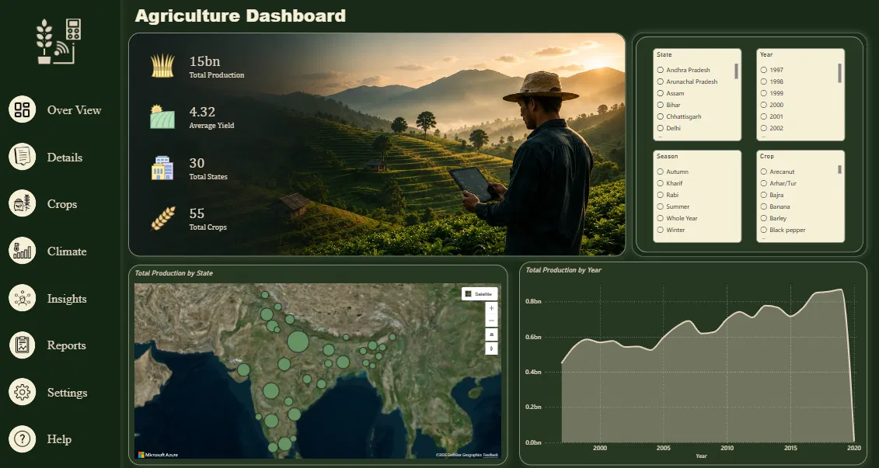
STEP 3 · STORYTELLING
An Interactive Dashboard, Built in Power BI
Led by Menna Waleed Abdulrahman — turning cleaned data into a navigable story for non-technical stakeholders.
One central Overview page with global filters for State, Year, Season and Crop
KPI cards surface scale instantly: production, yield, states, and crops covered
A geo map shows exactly where production concentrates across India
A time trend line reveals how total production has evolved since the late 1990s
Smart Agriculture — NTI Graduation Project
9
Notes:
Introduce the Power BI dashboard as the storytelling layer for non-technical audiences. Walk through the Overview page: KPIs, map, and time trend.

Slide 10
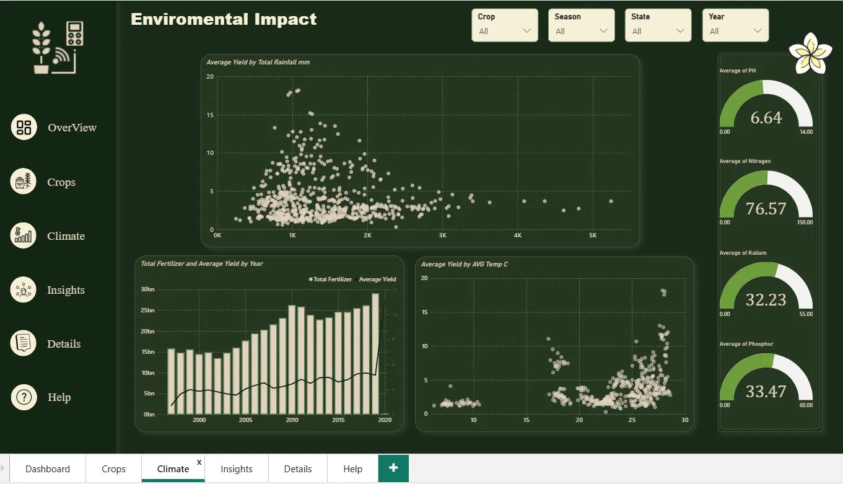
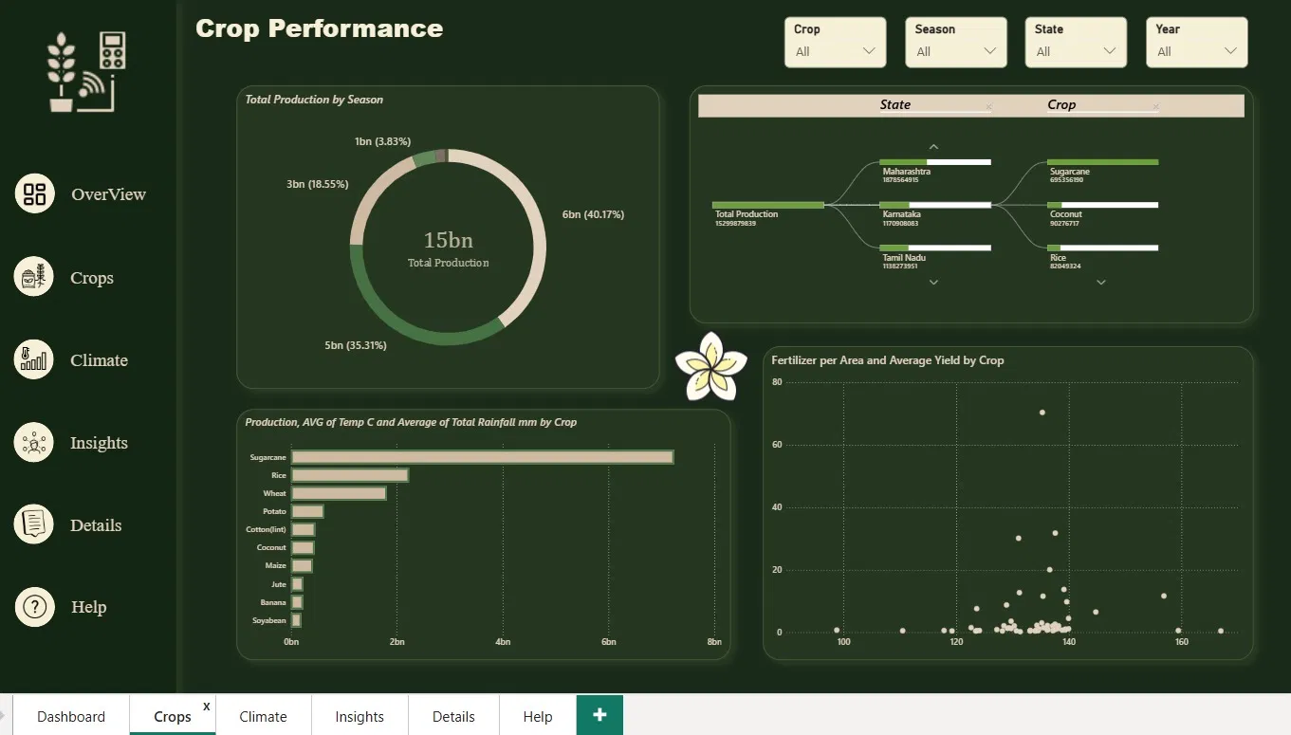
STEP 3 · STORYTELLING
Climate & Crop Performance, Side by Side
Environmental Impact — rainfall, temperature and fertilizer trends vs. yield
Crop Performance — production share by season and top crops by state
Smart Agriculture — NTI Graduation Project
10
Notes:
Show the Environmental Impact and Crop Performance pages side by side. Point out how filters let a user drill into any state, crop, season, or year interactively.

Slide 11
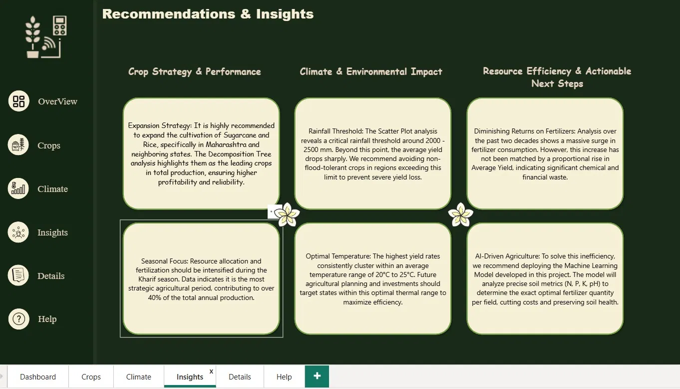
STEP 3 · STORYTELLING
The Dashboard's Own Insights Page
Three lenses on the same data:
Crop Strategy
Sugarcane & Rice lead total production, concentrated in Maharashtra and neighboring states.
Climate Impact
A ~2,000–2,500mm rainfall ceiling and a 20–25°C sweet spot bound optimal yield.
Resource Efficiency
Fertilizer use has surged for two decades without a matching rise in yield.
Smart Agriculture — NTI Graduation Project
11
Notes:
Show the dashboard's own insights page and connect it back to the three EDA findings from earlier — crop strategy, climate impact, and resource efficiency.

Slide 12
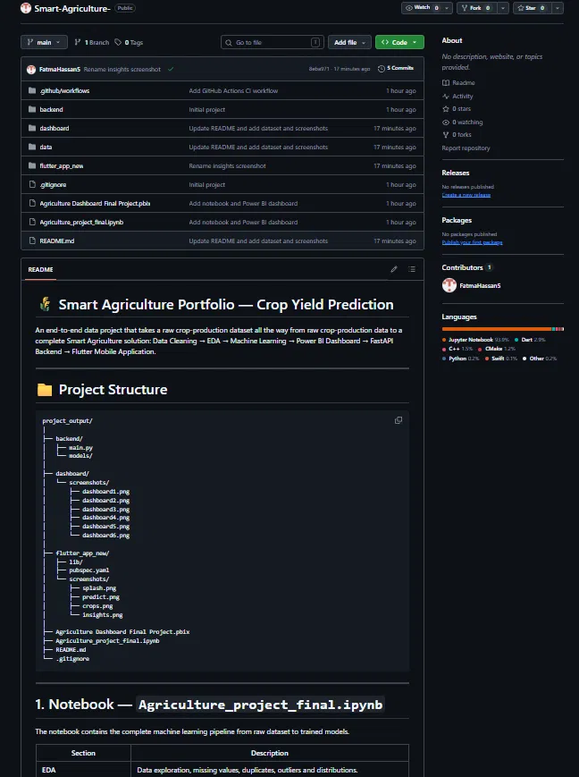

STEP 4 · PREDICTION
Predicting Yield
Led by Fatma Hasan Abdulrazek — from trained notebook to a deployable model.
Random Forest Regressor/Classifier
Trained on soil (N-P-K-pH), climate, crop, season and farm-input features.
Two Outputs
A numeric expected yield plus an easy-to-read category: Low, Medium or High.
Notebook to Backend
The full pipeline — cleaning, EDA, model training — lives in one notebook, then serves predictions through a backend API.
Smart Agriculture — NTI Graduation Project
12
Notes:
Describe the Random Forest model: what it predicts (expected yield and yield category), and what features it uses. Show the GitHub repo structure to demonstrate the technical pipeline from notebook to backend.

Slide 13
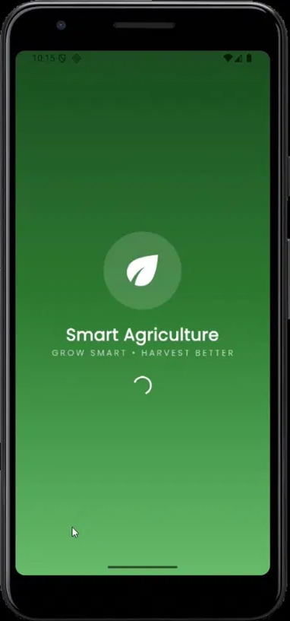
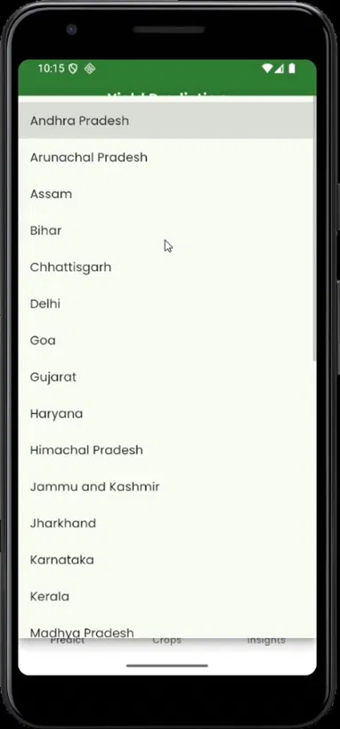
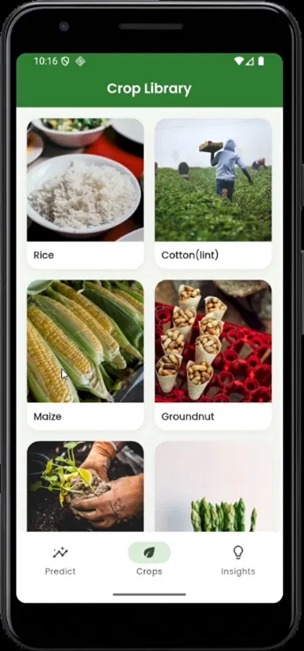
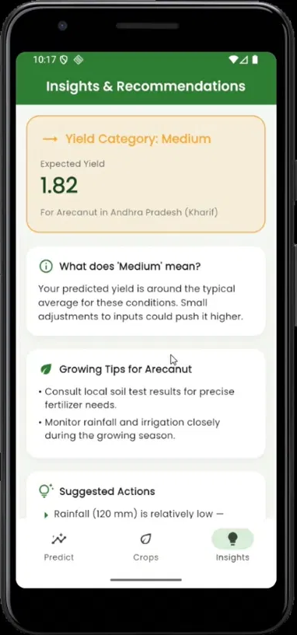
STEP 5 · DEPLOYMENT
From Model to Mobile App & Web
The Random Forest model is deployed two ways: a Flutter mobile app and a Streamlit web app.
1. Launch
2. Select State
3. Browse Crops
4. Get Prediction
Smart Agriculture — NTI Graduation Project
13
Notes:
Walk through the deployment: a Flutter mobile app where users pick a state and crop and get an instant prediction with tips, plus a Streamlit web app for browser-based access. Emphasize this makes the model usable, not just accurate.

Slide 14
RECOMMENDATIONS
What We Recommend, Concretely
Led by Menna Waleed Abdulrahman — turning insights into next steps.
Expand Strategic Crops
Plan Around Rainfall & Temperature
Use AI to Cut Fertilizer Waste
Prioritize Sugarcane and Rice in Maharashtra and neighboring states, where they already lead in production and reliability.
Avoid non-flood-tolerant crops beyond the ~2,000–2,500mm rainfall threshold, and target the 20-25°C optimal window for new investment.
Deploy the Random Forest model to recommend precise fertilizer levels per field, addressing diminishing returns and reducing cost and soil impact.
Smart Agriculture — NTI Graduation Project
14
Notes:
Present the three concrete recommendations: expand Sugarcane/Rice cultivation in leading states, plan around the rainfall and temperature thresholds, and use the AI model to reduce fertilizer waste.

Slide 15

Thank You
From 19,572 raw records to a cleaned dataset, a data-driven story, and an AI tool people can actually use.
Fatma Mohamed Osman
Menna Waleed Abdulrahman
Fatma Hasan Abdulrazek
Supervised by Eng. Hager Ayman • NTI Advanced Data Analysis
Questions?
Notes:
Close by recapping the full journey from raw data to a deployed AI tool. Thank the supervisor and open the floor for questions.

