Slide 1

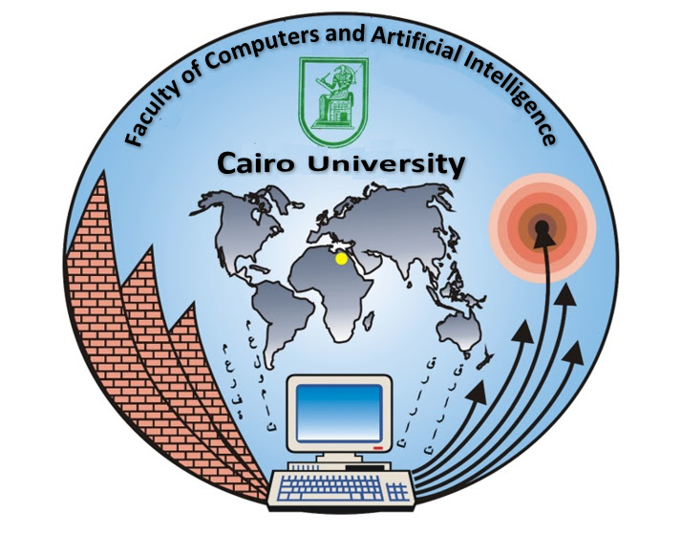




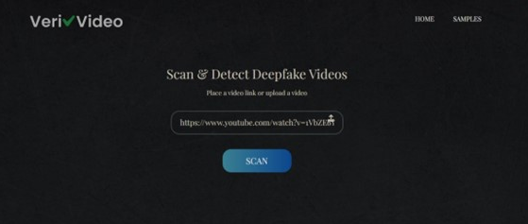
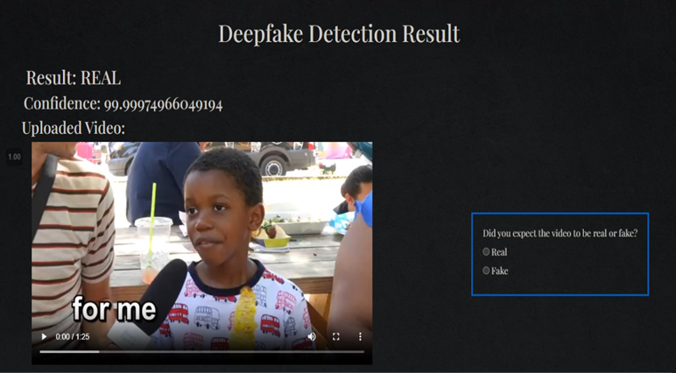
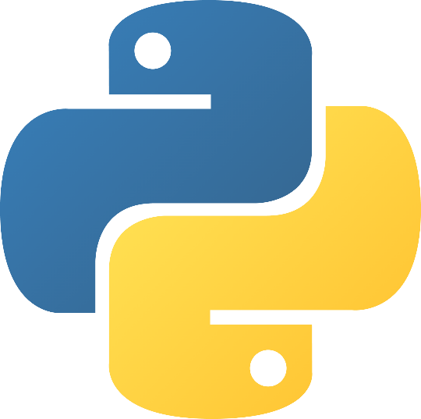
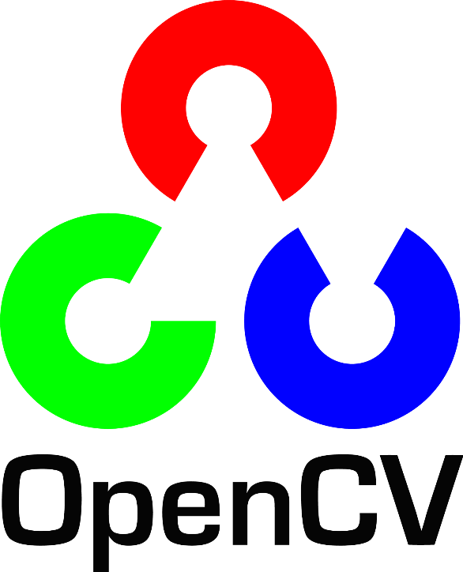
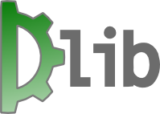
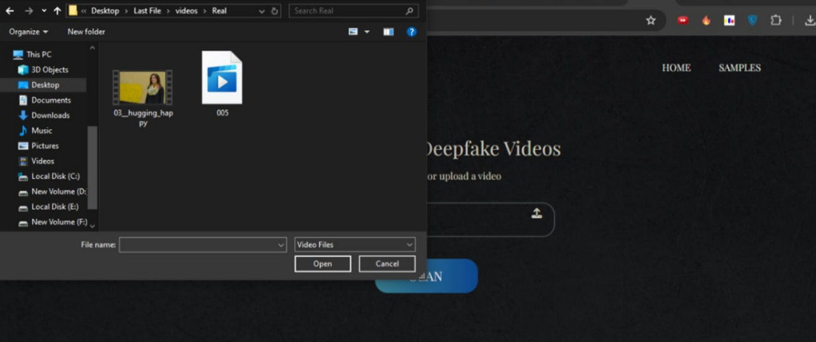
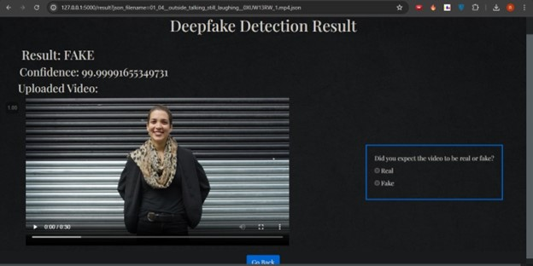
Testing ensures the reliability and accuracy of VeriVideo across various real-world conditions.
Programming Languages: Python (TensorFlow, Keras)
Frameworks and Libraries: OpenCV, NumPy, Flask
Tools: Google Colab (for model training), Google Drive (for dataset storage)
VeriVideo
Cairo University
Supervisor(s): Dr. Lamia Abo Zaid
Team members:
Omar Mahmoud, Fatma Mahmoud, Basmalla Magdy, Esraa Osama, Rahma Mohamed
VISION / OBJECTIVES
METHODOLOGY
To develop a system for deepfake
face detection, ensuring the integrity and authenticity of digital media.
Our objective is to empower users with a reliable tool that mitigates
the risks posed by manipulated videos, fostering trust in digital content.
Data Preprocessing: Videos are split into frames, faces detected and cropped, and noise removed, creating a face-only dataset.
Model Selection: ResNeXt-50 is used for feature extraction, LSTM for temporal analysis, and fully connected layers for classification.
Training: Fine-tuning model parameters for optimal performance and robustness.
Testing: ensure the reliability and accuracy of VeriVideo across various real-world conditions.
Integration and Delivery: Integrating the model into a user-friendly web app with scalable interface.
BENEFICIARIES
General Public: Ensures authenticity of online videos, reducing misinformation risks.
Media Outlets: Safeguards journalistic integrity by verifying video content.
Law Enforcement: Aids forensic investigations by verifying digital evidence authenticity.
USED TECHNOLOGIES
DELIVERABLES / OUTPUT
Python
PyTorch
Google Colab
Website utilizing a DL model for deepfake face detection with an accuracy of 95.22%
OpenCV
Flask
Dlib

