Slide 1


Term Project
Group 22
Name | ID
Fatma Mohamed Ahmed | 300389394
Mayar Mohamed Saad | 300389363
Salwa Youssef Attia | 300389878

Slide 2
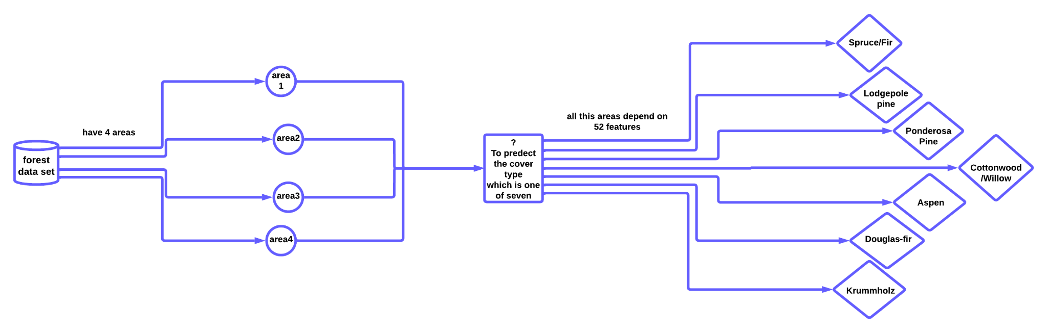
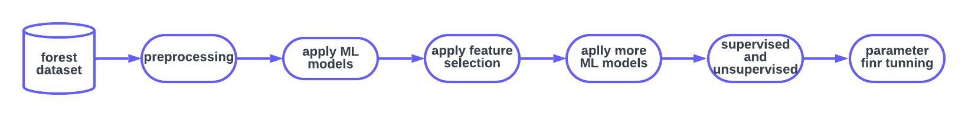
Problem’s overview
The objective of this problem is to predict the forest cover type based on various environmental features. Given a set of features such as elevation, soil type, distance to water sources, etc., the task is to predict which of the seven forest cover types (Spruce/Fir, Lodgepole Pine, Ponderosa Pine, Cottonwood/Willow, Aspen, Douglas-fir, and Krummholz) the observation belongs to.
Notes:
The problem is to build a classification model that can accurately predict the forest cover type based on the available features.
By accurately predicting the forest cover types, we can better understand the ecosystem and make informed decisions about forest management and conservation.

Slide 3
Dataset’s overview
The Forest Cover Type Prediction Dataset contains cartographic variables as input features and the cover type of forests as the output variable.
The dataset has 581,012 rows and 55 columns.
The input features include quantitative variables such as elevation, aspect, slope, and distances to surface water features, roadways, and wildfire ignition points.
The output variable is the cover type of the forest, which can be one of seven types: Spruce/Fir, Lodgepole Pine, Ponderosa Pine, Cottonwood/Willow, Aspen, Douglas-fir, and Krummholz.

Slide 4
Dataset’s overview
The dataset contains no missing values.
The input features:
Have different scales. For instance, elevation ranges from 1859 to 3849 meters, while distances to surface water features range from 0 to 1343 meters.
Have different distributions. For instance, elevation is normally distributed, while distances to surface water features are skewed.
The output variable:
Is imbalanced, with the most common cover type being Lodgepole Pine (36.04% of the samples), and the least common being Krummholz (2.24% of the samples).

Slide 5
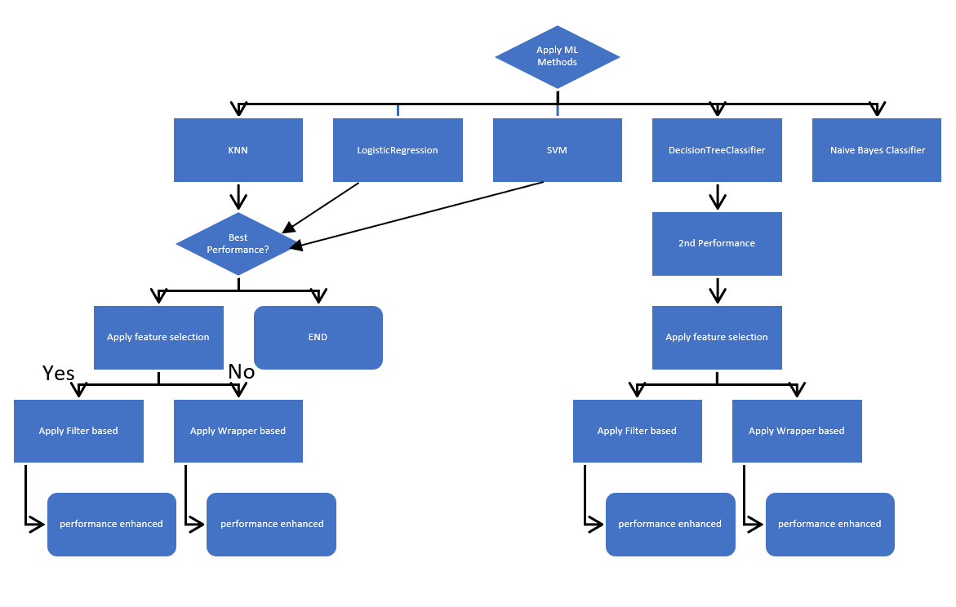
General Flow Chart for summarizing all process

Slide 6
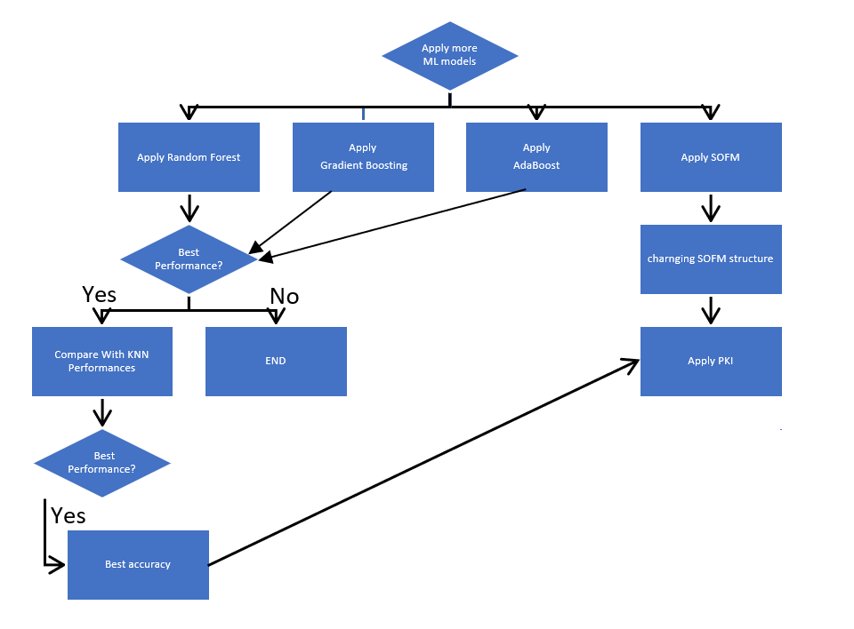
General Flow Chart for summarizing all process

Slide 7
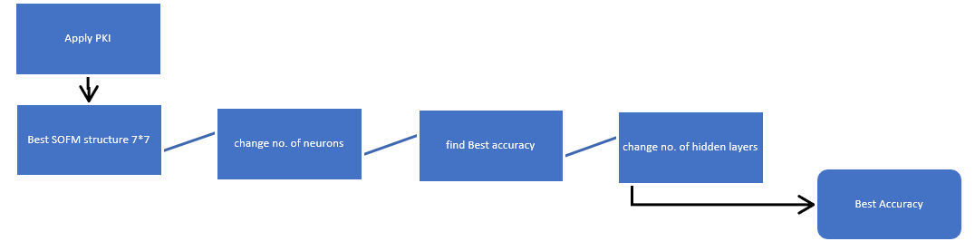
General Flow Chart for summarizing PKI process

Slide 8
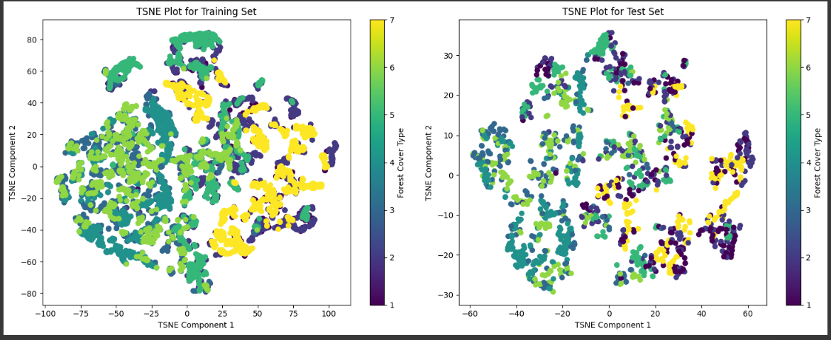
Visualize the training and test set to understand problem nature

Slide 9
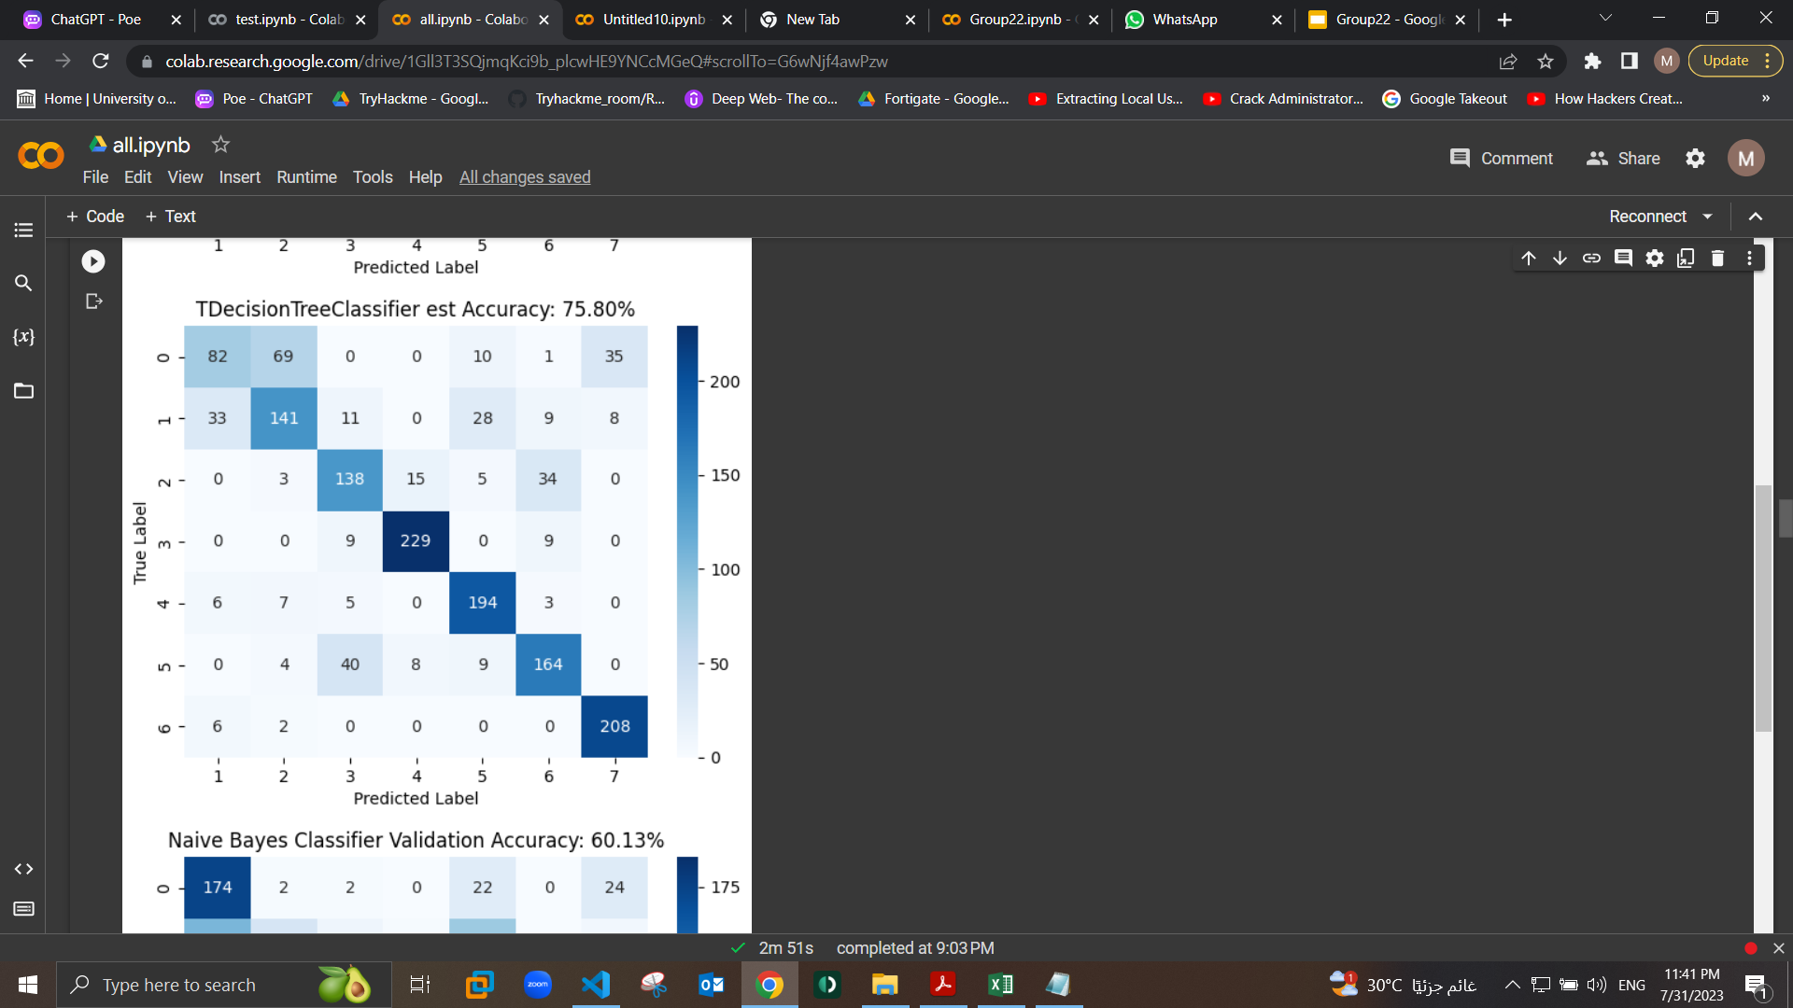
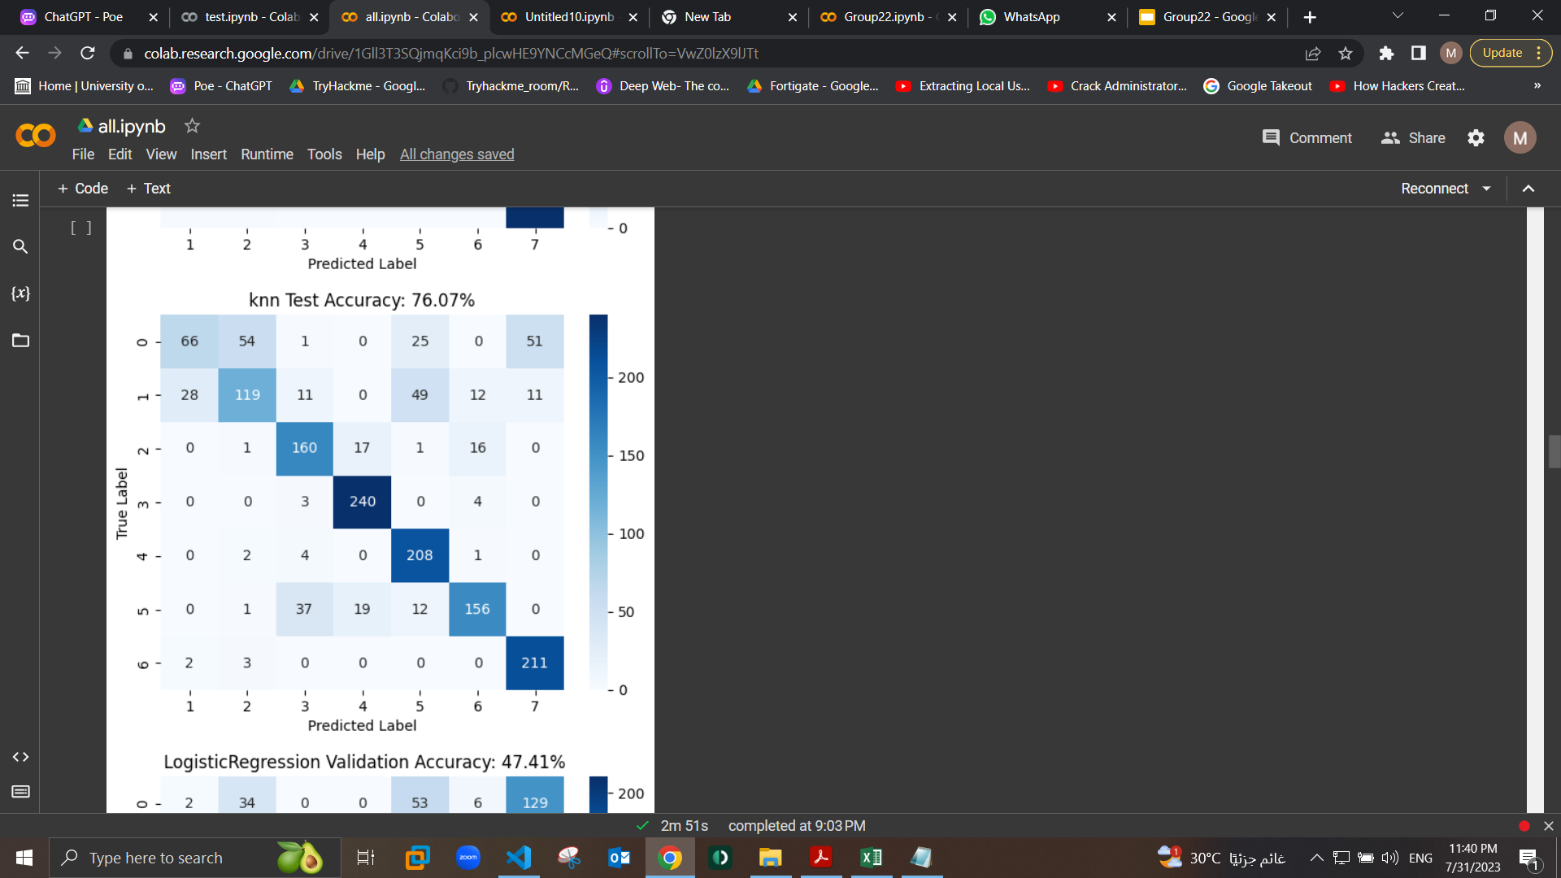
Conclusion
The confusion matrices for the best two ML models
We first applied the five ML models on the dataset using the test and validation data and calculate the accuracy of each one using the test dataset to obtain the baseline performance for each one
We choose the best two models that the highest accuracy (KNN with accuracy of 76.07& Decision tree with accuracy of 75.80)

Slide 10
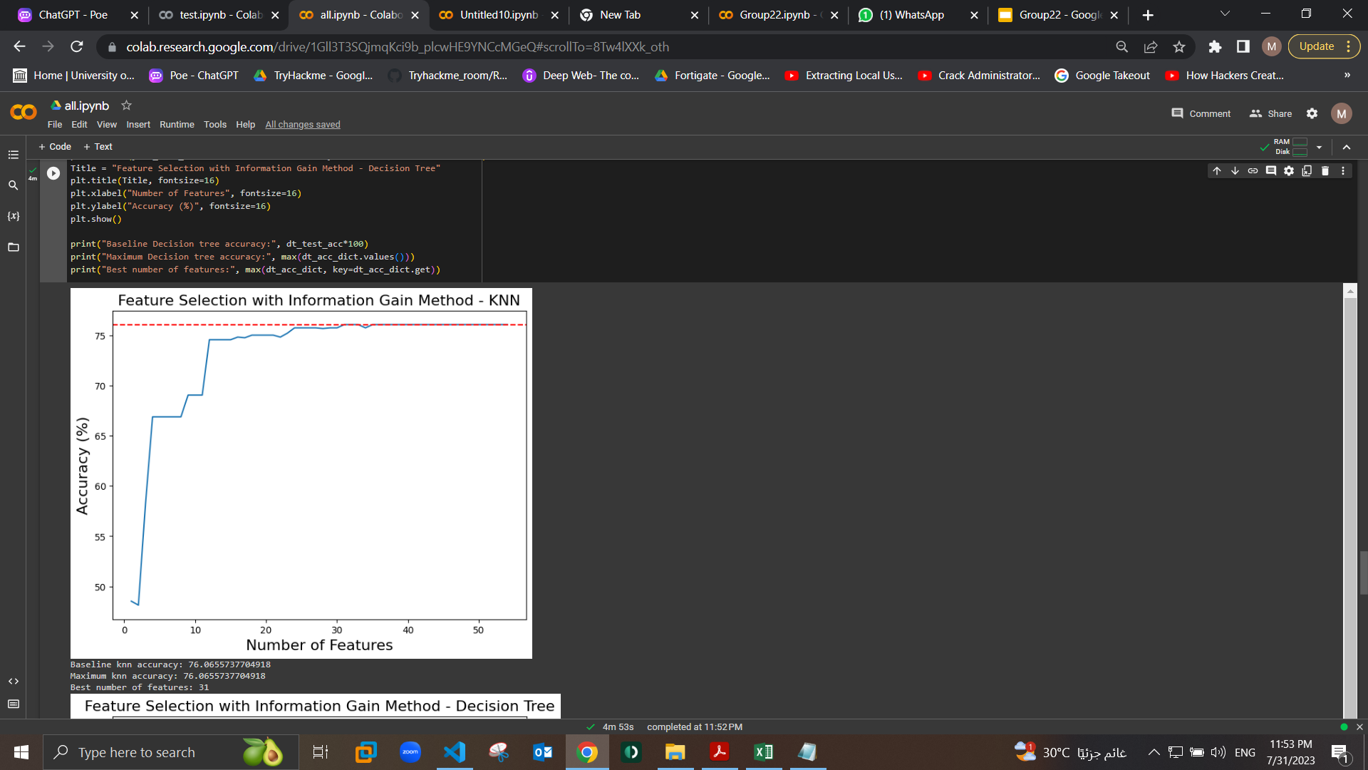
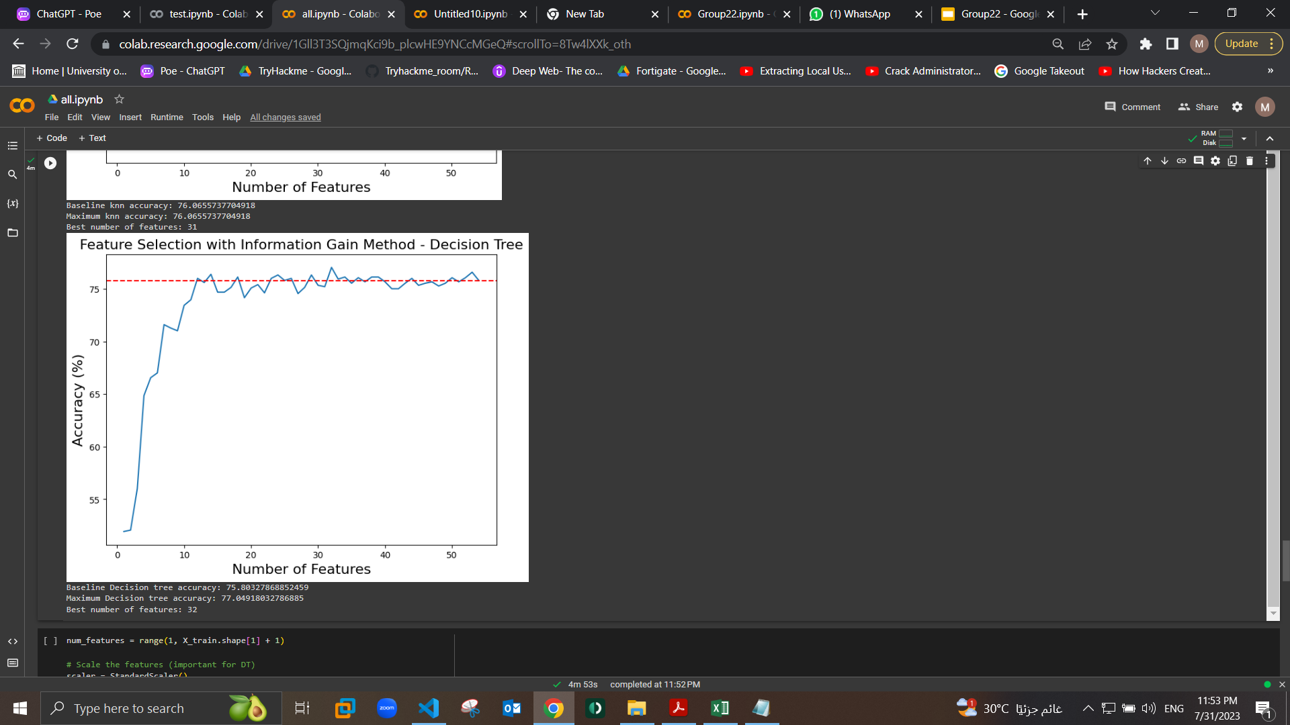
Conclusion
The filter based feature selection
3. Apply filter-based feature selection on those two models (KNN & Decision tree ) using information gain
4. Then we compared the accuracy from the baseline models with the accuracy after the feature selection we found that the accuracy increased with both of them and for the knn the number of the best features was 31 and the accuracy became 78.03 and for the Decision tree the number of the best features was 32 and the accuracy became 77.04

Slide 11
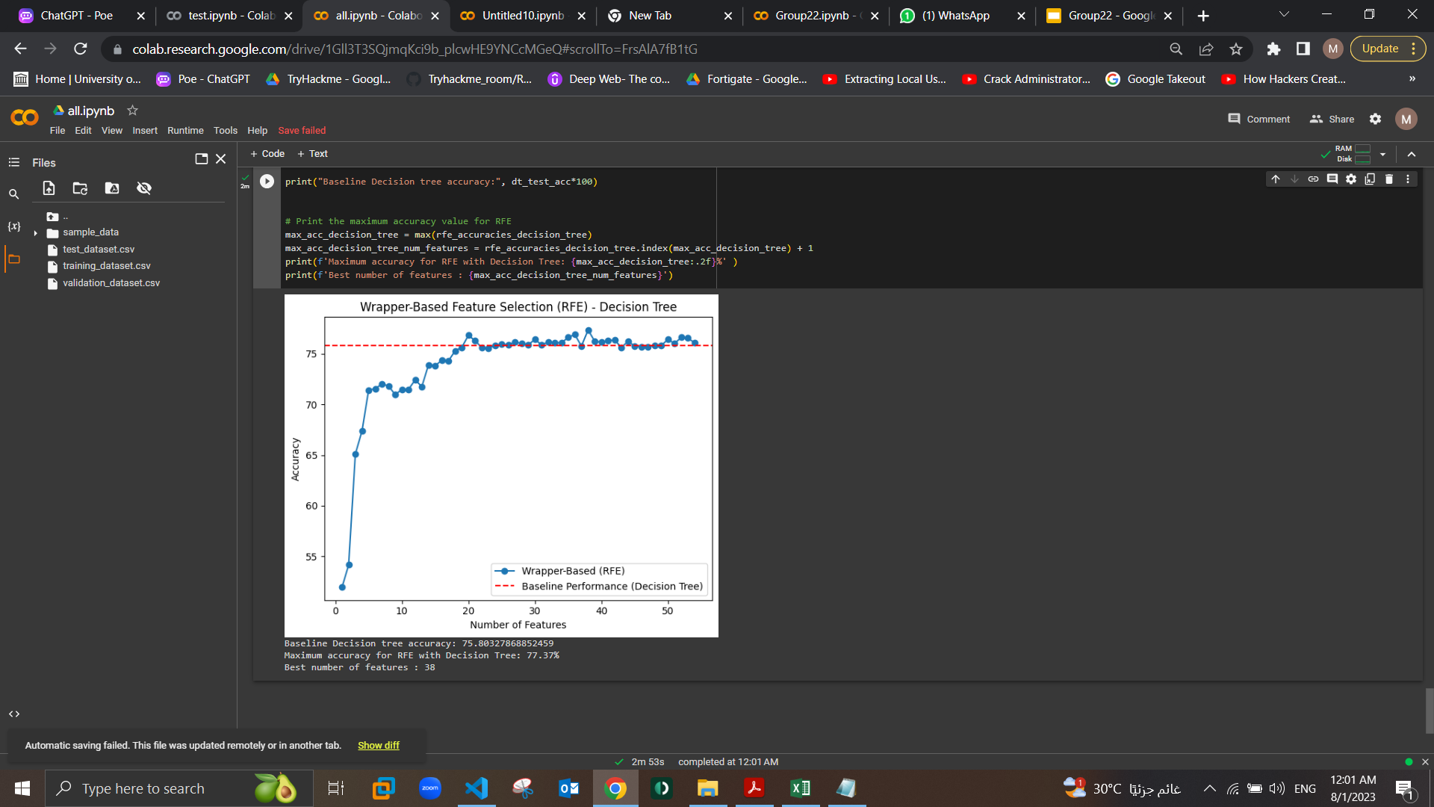
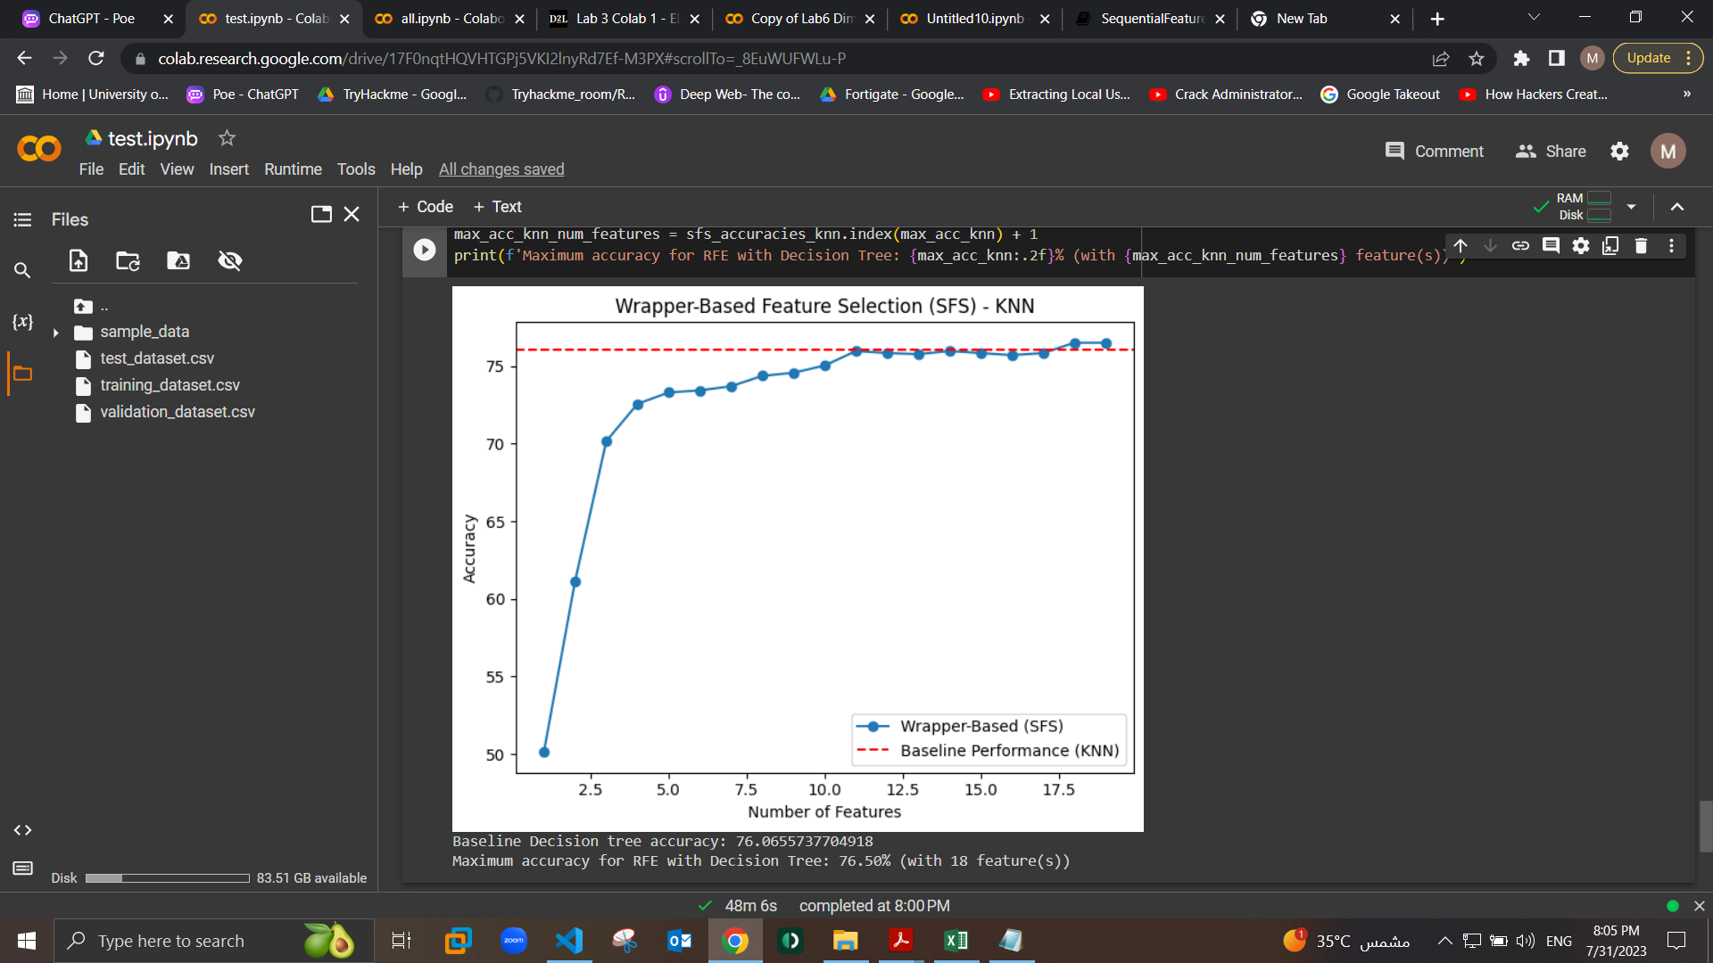
Conclusion
The wrapper based feature selection
Apply wrapper-based feature selection using RFE with the Decision tree and the SFS with the knn and we found that the accuracy increased with both of them and for the knn the number of the best features was 31 and for the Decision tree the number of the best features was 38 and the accuracy became 77.37

Slide 12
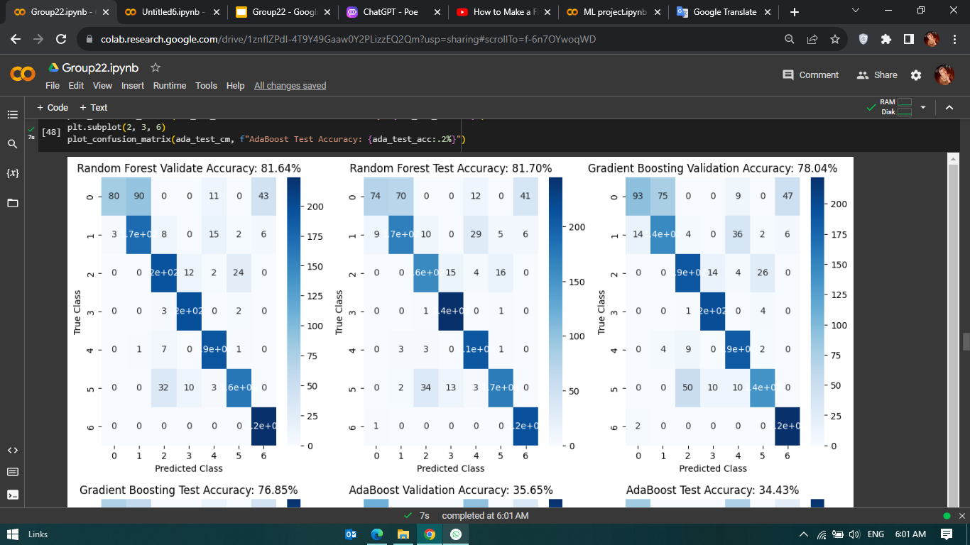
Conclusion
5. for Applying more ML models, first we applied Random Forest and 2 ensembles techniques (Gradient Boosting and AdaBoost) to get better performance.
Then we compared the performance of these models with the the best performance from the last point, which was KNN and Decision Tree, and we found that the Random Forest perform the best performance with accuracy 81.70%.

Slide 13
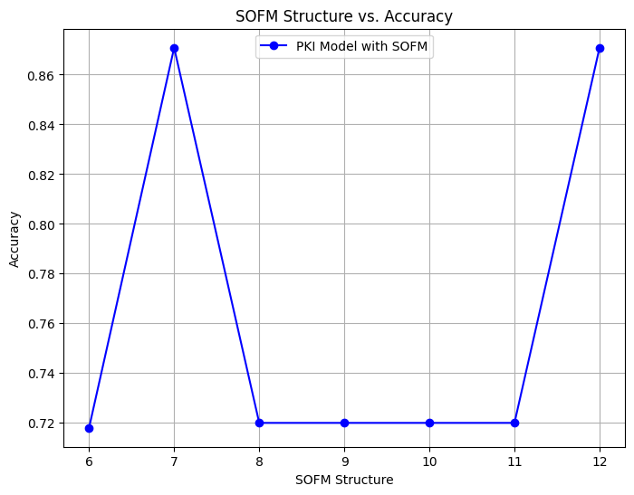
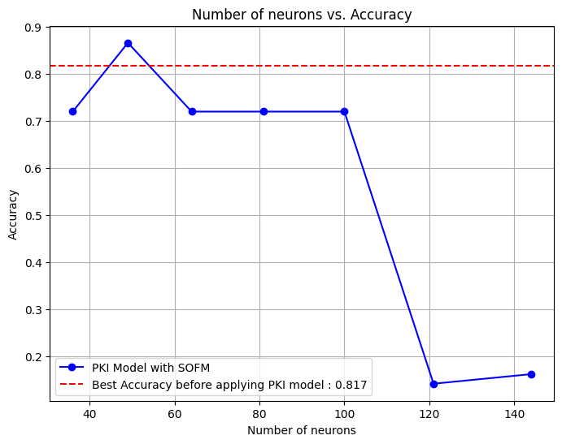
Conclusion
6. Applying the PKI model which use combination of supervised learning method ( Random Forest) and unsupervised learning method (SOFM) helps improving the accuracy by applying different structure of SOFM model we conclude that the best structure was 7x7. Then we tried different number of neurons and hidden layers to achieve the best accuracy

Slide 14
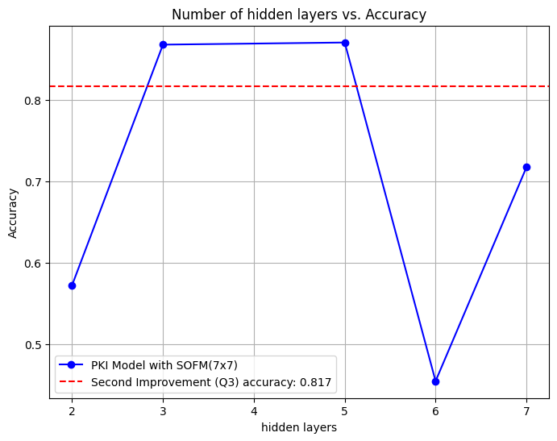
Conclusion
Changing the number of hidden layer of the PKI model increased the complexity of the model improving the accuracy at first then it goes down due to over fitting

Slide 15


