Slide 1
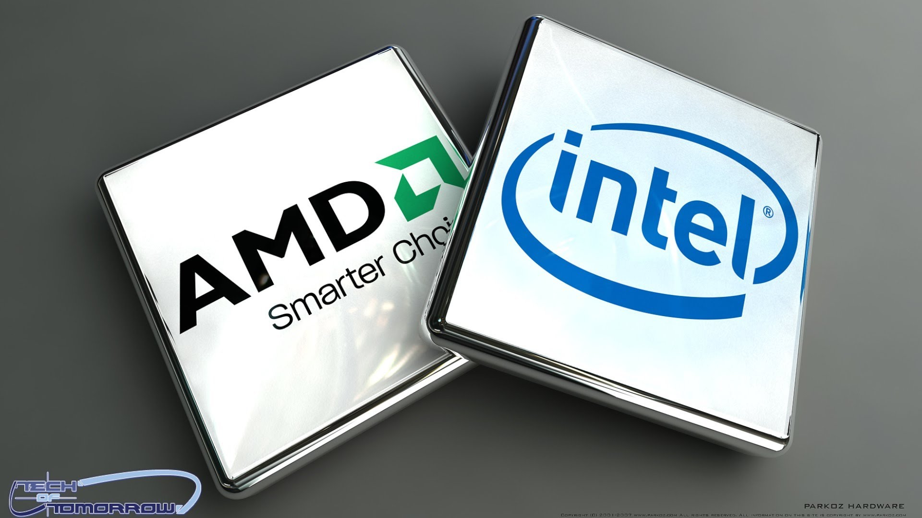
Intel VS AMD
Geraldo Braho

Slide 2
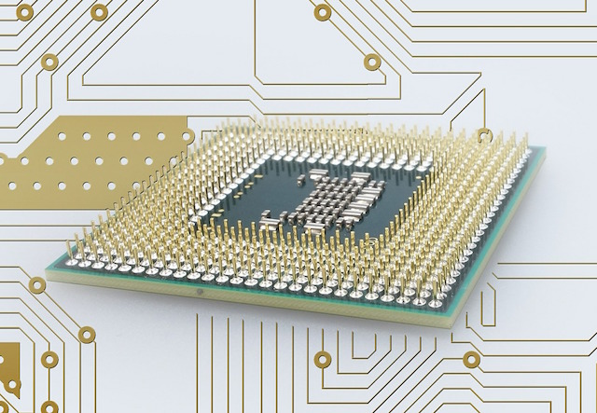
Why Does The Processor Matter

Slide 3
 | AMD FX-8150 | Intel i7 2600
Microarchitecture | Bulldozer | Sandy Bridge
Cores | 8 cores 4 modules | 4 cores
L1 cache | 256 KB(I) 128 KB(D) 64KB per module(I) 16KB per core(D) | 4*32 KB(I) 4*32 KB(D) 4-way associative for instructions 8-way associative for data
L2 cache | 4*2 MB Each 2MB is shared between 2 cores in one module | 4*256 KB Each 256KB is private to each core
L3 cache | 8 MB all core shared 64-way associative | 8MB all core shared
Replacement scheme | pseudo-LRU | L1 pseudo-LRU L2 pseudo-LRU L4 pseudo-LRU but with an ordered selection algorithm
Latency | 4 (L1 cache load) | 4 (L1 cache) 11(L2 cache)
Max memory bandwidth | 21 GB/s | 21 GB/s
Memory channel support | now known | 3 memory channels Each channel consists of a separate set of DIMMs
Virtual & physical memory addresses | 48-bit virtual and physical addresses | 48-bit virtual addresses and 36-bit physical addresses
TLB feature | 2 levels TLB | 2 levels TLB
How caches are indexed | not known | L1: virtually indexed and physically tagged L2: physically indexed

Slide 4
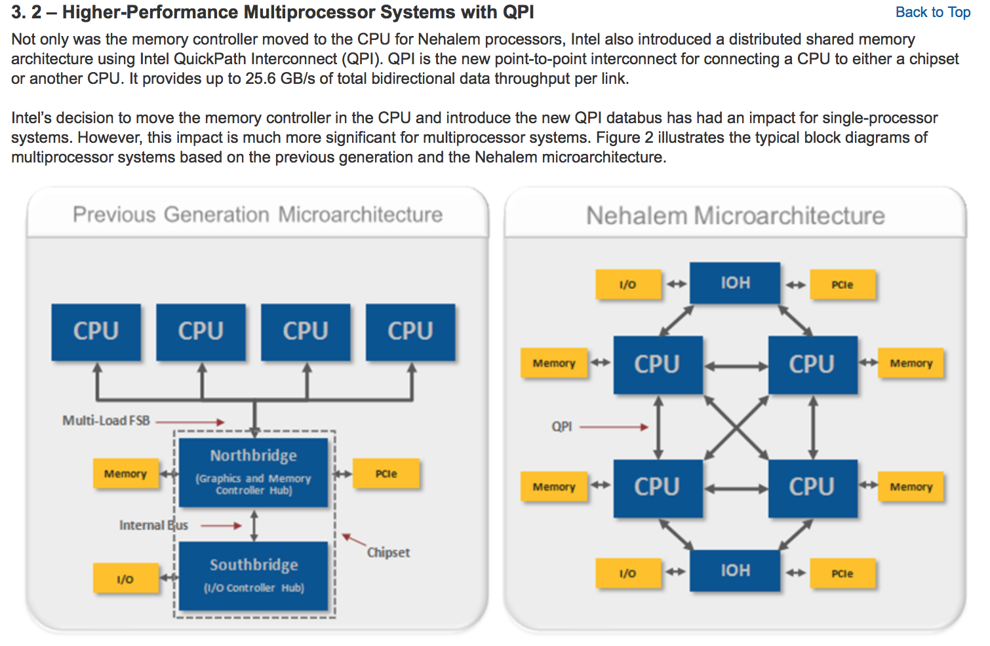

Slide 5
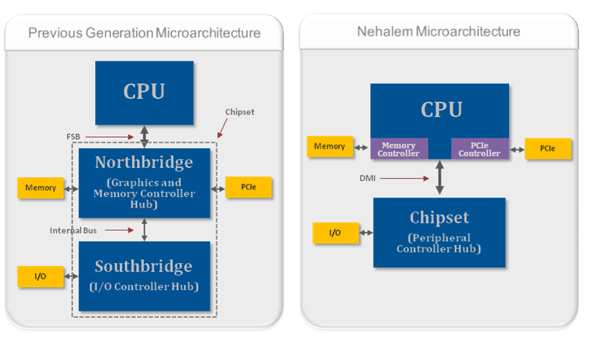

Slide 6
https://www.youtube.com/watch?v=-P28LKWTzrI

