Slide 1
Exploring Optimization Strategies for Mastermind
Gioia Dominedò • Amy Lee • Kendrick Lo • Reinier Maat AM207 Final Project (2016)

Slide 2
MASTERMIND
Hidden code:
Example guess:
Response:
1 x
2 x
Notes:
Mastermind is a game where one needs to guess a hidden code of colors. It is inspired on the ancient game of ‘Bulls and Cows’ which has been played since more than a centrury ago, where one needs to guess digits or letters.
In the original Mastermind game, the code maker creates a code consisting of 4 positions containing any of 6 colors.
The code breaker then guesses codes until they have found the hidden code. After every guess of the code breaker, the code maker responds by giving black and white pegs, indicating the number of correct colors in the right place, and the number of correct colors in the wrong place respectively. In order to win the game, the code breaker needs to find the hidden code within 10 guesses.
In this project we try to win the game as code breaker using stochastic optimization techniques. We are especially interested in performance as we expand the game to more positions than 4 and more colors than 6.

Slide 3
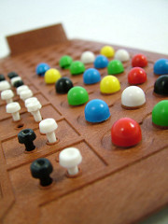
MASTERMIND
Popular Strategies
Exclude all possibilities logically (Knuth’s Algorithm)
Random Search
Problems with popular strategies
Exhaustive search
Time and space requirements increase exponentially as the number of colors and/or positions increase
Credit: Steve Berry
Notes:
Pretty self explanatory; mention some heuristics….

Slide 4
SIMULATED ANNEALING

Slide 6
permutation

Slide 7
permutation

Slide 8
permutation

Slide 9
mutation

Slide 10
mutation

Slide 11
mutation

Slide 12
SIMULATED ANNEALING

Slide 13
SIMULATED ANNEALING

Slide 14
SIMULATED ANNEALING

Slide 15
SIMULATED ANNEALING

Slide 16
SIMULATED ANNEALING

Slide 17
SIMULATED ANNEALING

Slide 18
SIMULATED ANNEALING

Slide 19
SIMULATED ANNEALING

Slide 20
SIMULATED ANNEALING

Slide 21
SIMULATED ANNEALING

Slide 22
SIMULATED ANNEALING

Slide 23
GENETIC ALGORITHMS

Slide 25
crossover

Slide 26
crossover point
crossover

Slide 27
crossover point
crossover

Slide 28
inversion

Slide 29
inversion

Slide 30
inversion

Slide 31
GENETIC ALGORITHMS

Slide 32
GENETIC ALGORITHMS

Slide 33
GENETIC ALGORITHMS

Slide 34
GENETIC ALGORITHMS
permutation + mutation
crossover
inversion

Slide 35
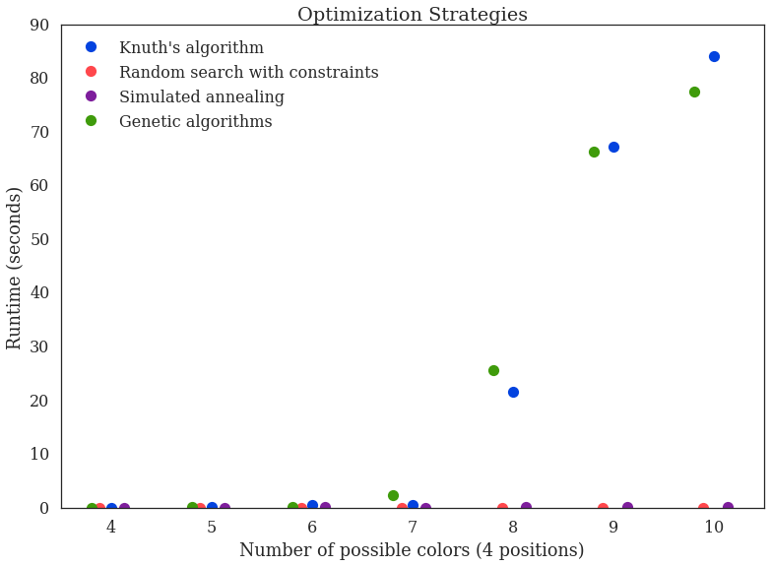
CONCLUSIONS
Exhaustive strategies: Colors↑ = Runtime↑↑
Stochastic strategies:
Lower runtimes
Similar # of guesses
Stochastic techniques make playing scaled-up Mastermind in finite time feasible

Slide 36
Exploring Optimization Strategies for Mastermind
Thanks for watching!

